Slide 1

MULTI-LINGUAL CHATBOT
J MANASA 171801120012

Slide 2

WHAT’S NEW 🤔?
VOICE INPUT AND OUTPUT
USER GET NOTIFY VIA MASSEGAES AND WHATSAPP
STUDENT CAN GET RESULTS
APPLICATION FORM
COLLECTING REVIEW
APPLYING SENTIMENTAL ANALYSIS ON FEEDBACK
DATABASE CONNECTIVITY

Slide 3

ABSTRACT
The purpose of this project is to develop an automated system which gives a reply to a user query on behalf of a human for the education system.
It can give an answer to each and every query asked by the end user. Our approach is to focus on the local database as well as web database and also to make system scalable, user-friendly, and highly interactive.
Various techniques such as machine learning, NLP, pattern matching, data processing algorithms are used in this project to enhance the performance of the system.
Chat bots are usually a stateful services, remembering previous commands (and perhaps even conversation) in order to provide functionality.
When chat bot technology is integrated with popular web services it can be utilized securely by an even larger audience.

Slide 4
PROBLEM STATEMENT
In this project we present a ML based Chatbot which can be used by students, parents,
faculties to know about the institution details like academics, admissions,
department activities, placement cell etc.
This application solves the problem of manyusers by giving fast responses to the respective queries.
It is often impossible to get all the data on a single interface without the complications of going through multiple forms and windows. This problem is solved by chat bot by providing a common and user-friendly interface to solve queries of college students and faculties and parents.
The users will have to give voice input and the system will give the text output for
better conversation systems.

Slide 5
LITERATURE SURVEY:
The Project is based on the survey of various chatbot and it is shown that how the various chatbot differs from each other’s. To make chatbot the various technology has been used to make.
A chatbot can be considered as a question-answer system where experts provide knowledge for solicitation of users.
A chatbot is a software designed to simulate a conversation with human partner. This survey paper aims to present an overview of an existing approaches of implementing a chatbot system.
The college inquiry chat-bots will be built using artificial algorithms that analyze user's queries and understand user's message.
Natural language processing technologies are used for parsing, tokenizing, stemming and filtering the content of the complaint. This chatbot can be used by any user like students faculties parents to fetch the information from the institution website.
AIML and NLP is used for creating chatbots. AIML is Artificial Intelligence Mark-up Language (AIML) by using NLP can answer to user questions. Predefined knowledge base helps develop a response to the query. Chatbot for educational sector, where user (a student or parents) can ask query regarding college admission, about college information and other things related to academics.
Chatbot is implemented to meet the academic needs of the visitors. The Chatbot is based on AIML language for Centurion University.

Slide 6





The Problems solved by bot 🤗
To get a more detailed answer to a query
Save Time & Money
Guide Users to Better Outcomes
Easy accessibility to institutional information
Sentiment analysis
By asking a series of qualifying questions, you route users to the best place for them to find the information they want.
By automating conversations that would otherwise require an employee to answer, organizations save time and money that can then be allocated to other work.
Customers don’t always know where to go to find the information they’re interested in. In fact, your customers may not even know what it is they’re interested in. Maybe they just heard your brand name in passing and decided to explore.
Chatbots are a great way of sharing information and building a strong online presence. Students can directly come visit your website and ask the bot any query related to your institution, be it values, current affairs, competitions or any college/school-related activity. It’s faster and more effective than people reaching out to the administrator for updates.
Identify the opinion or emotional tone of a given text as negative, neutral or positive as a means to extract brand perception, classify claims urgency or differentiate intent towards a product or service.

Slide 7




Required technologies
Natural Language processing
Machine Learning
Algorithms
Web Technology

Slide 8
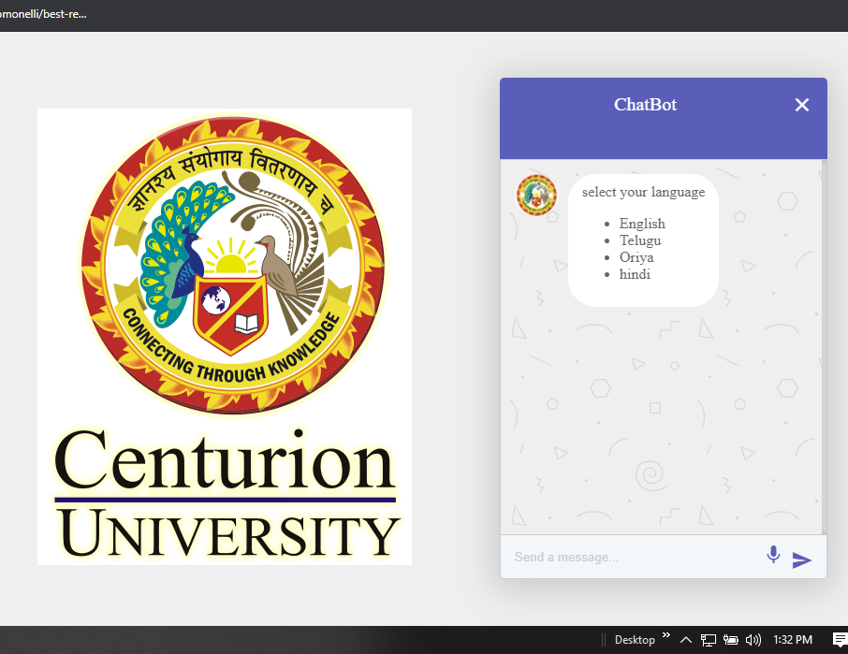
RESULTS
Front view of chat bot here you can select comfortable language and continue with their queries.

Slide 9
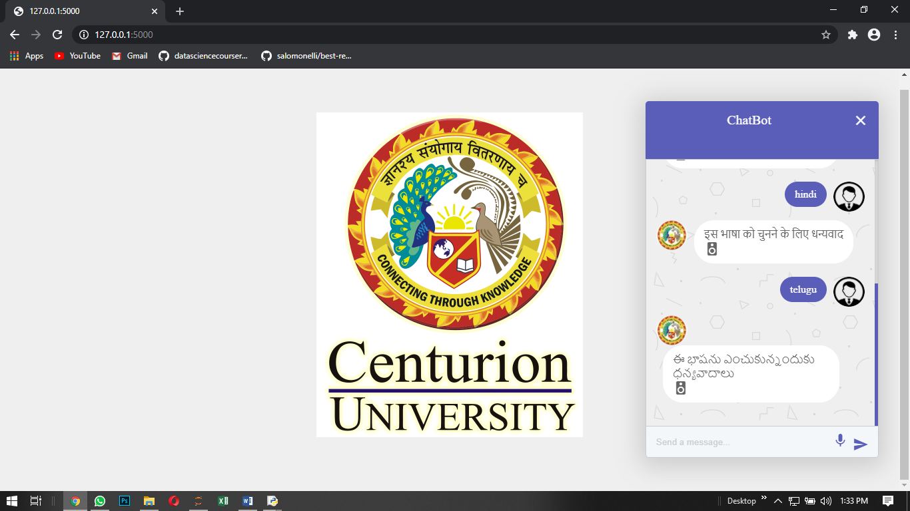
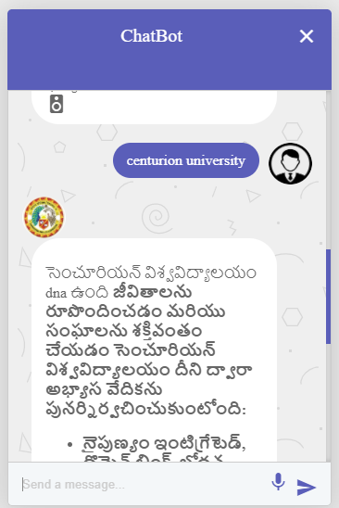
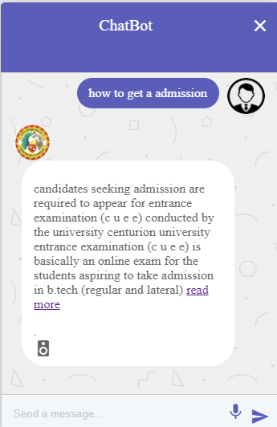
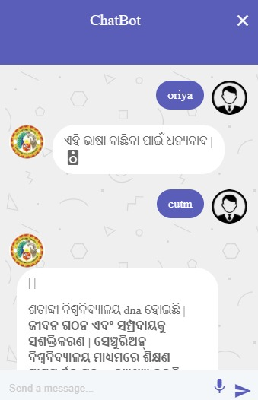
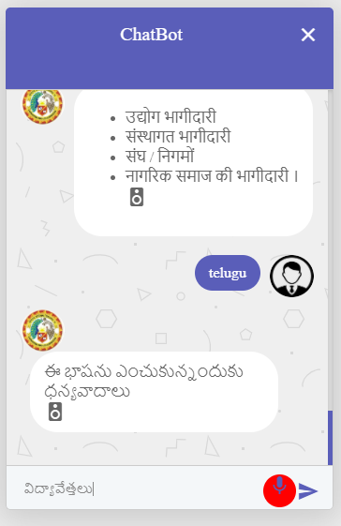
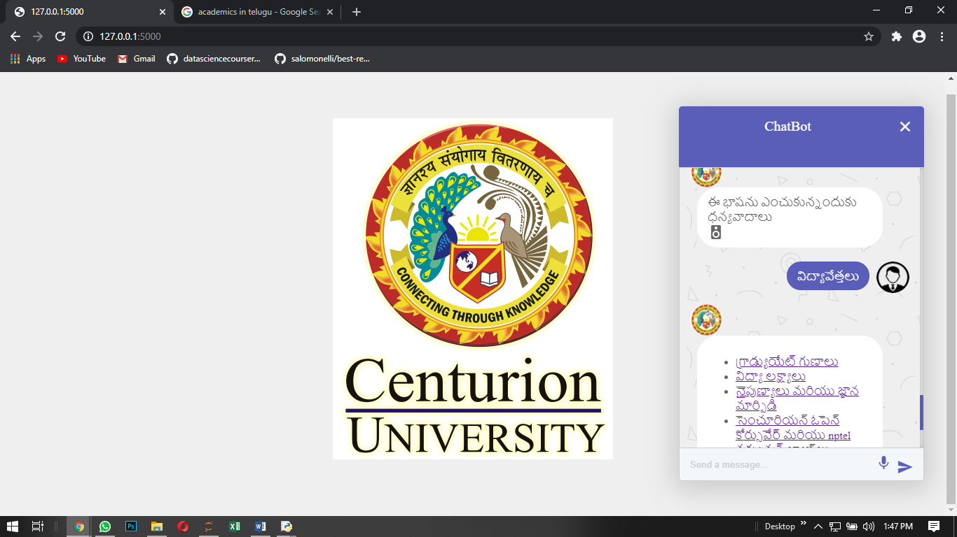
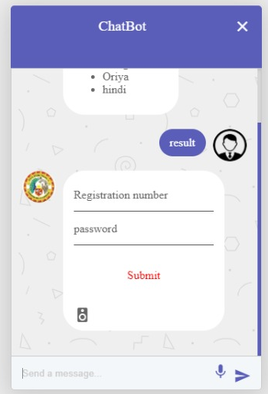
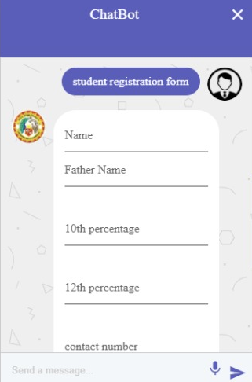

Slide 10
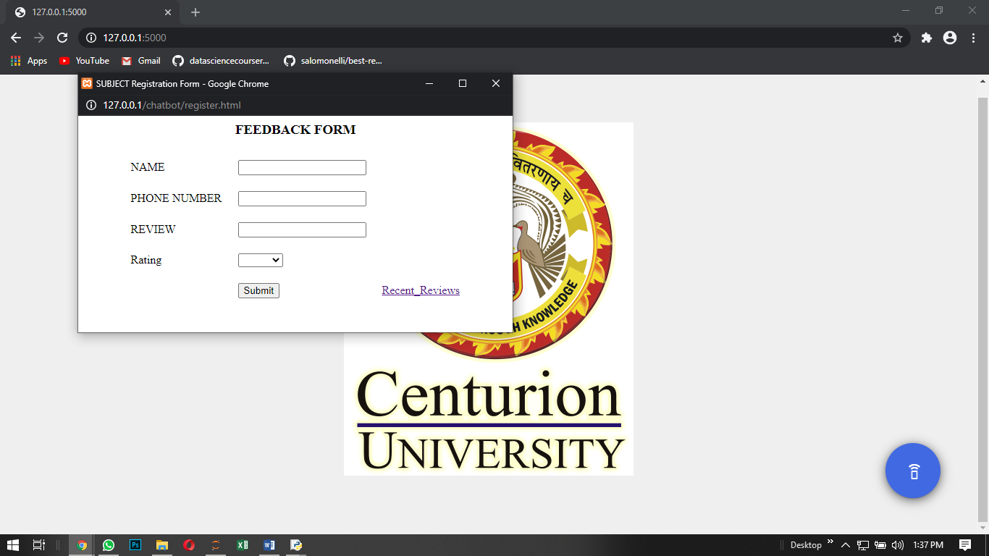
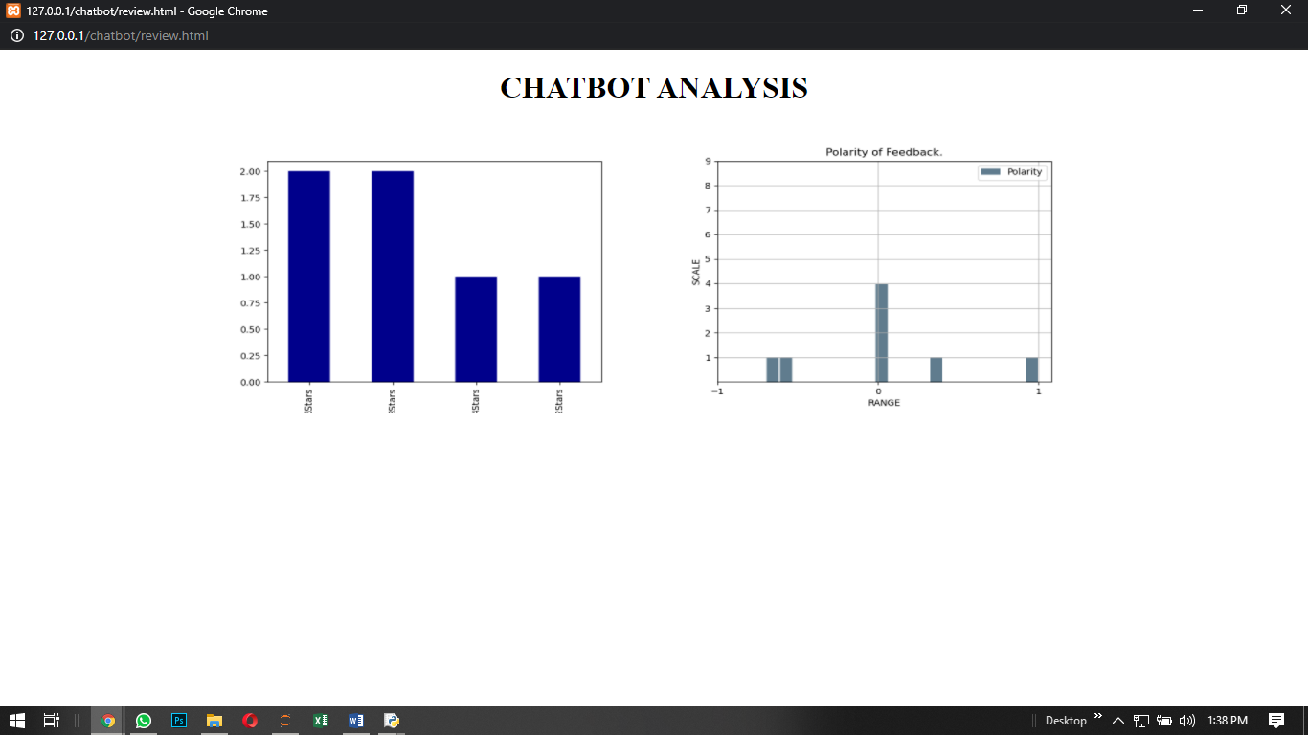

Slide 11

CONCLUSION
In this project we present a ML based Chatbot which can be used by students, parents, faculties to know about the institution details like academics, admissions, department activities, placement cell etc.
This application solves the problem of many users by giving fast responses to the respective queries. It is often impossible to get all the data on a single interface without the complications of going through multiple forms and windows.
This problem is solved by chat bot by providing a common and user-friendly interface to solve queries of college students and faculties and parents. In future we can include both text and voice-based queries.
The users will have to give voice input and the system will give the text output for better conversation systems.

Slide 12
THANK YOU😄

