Slide 1
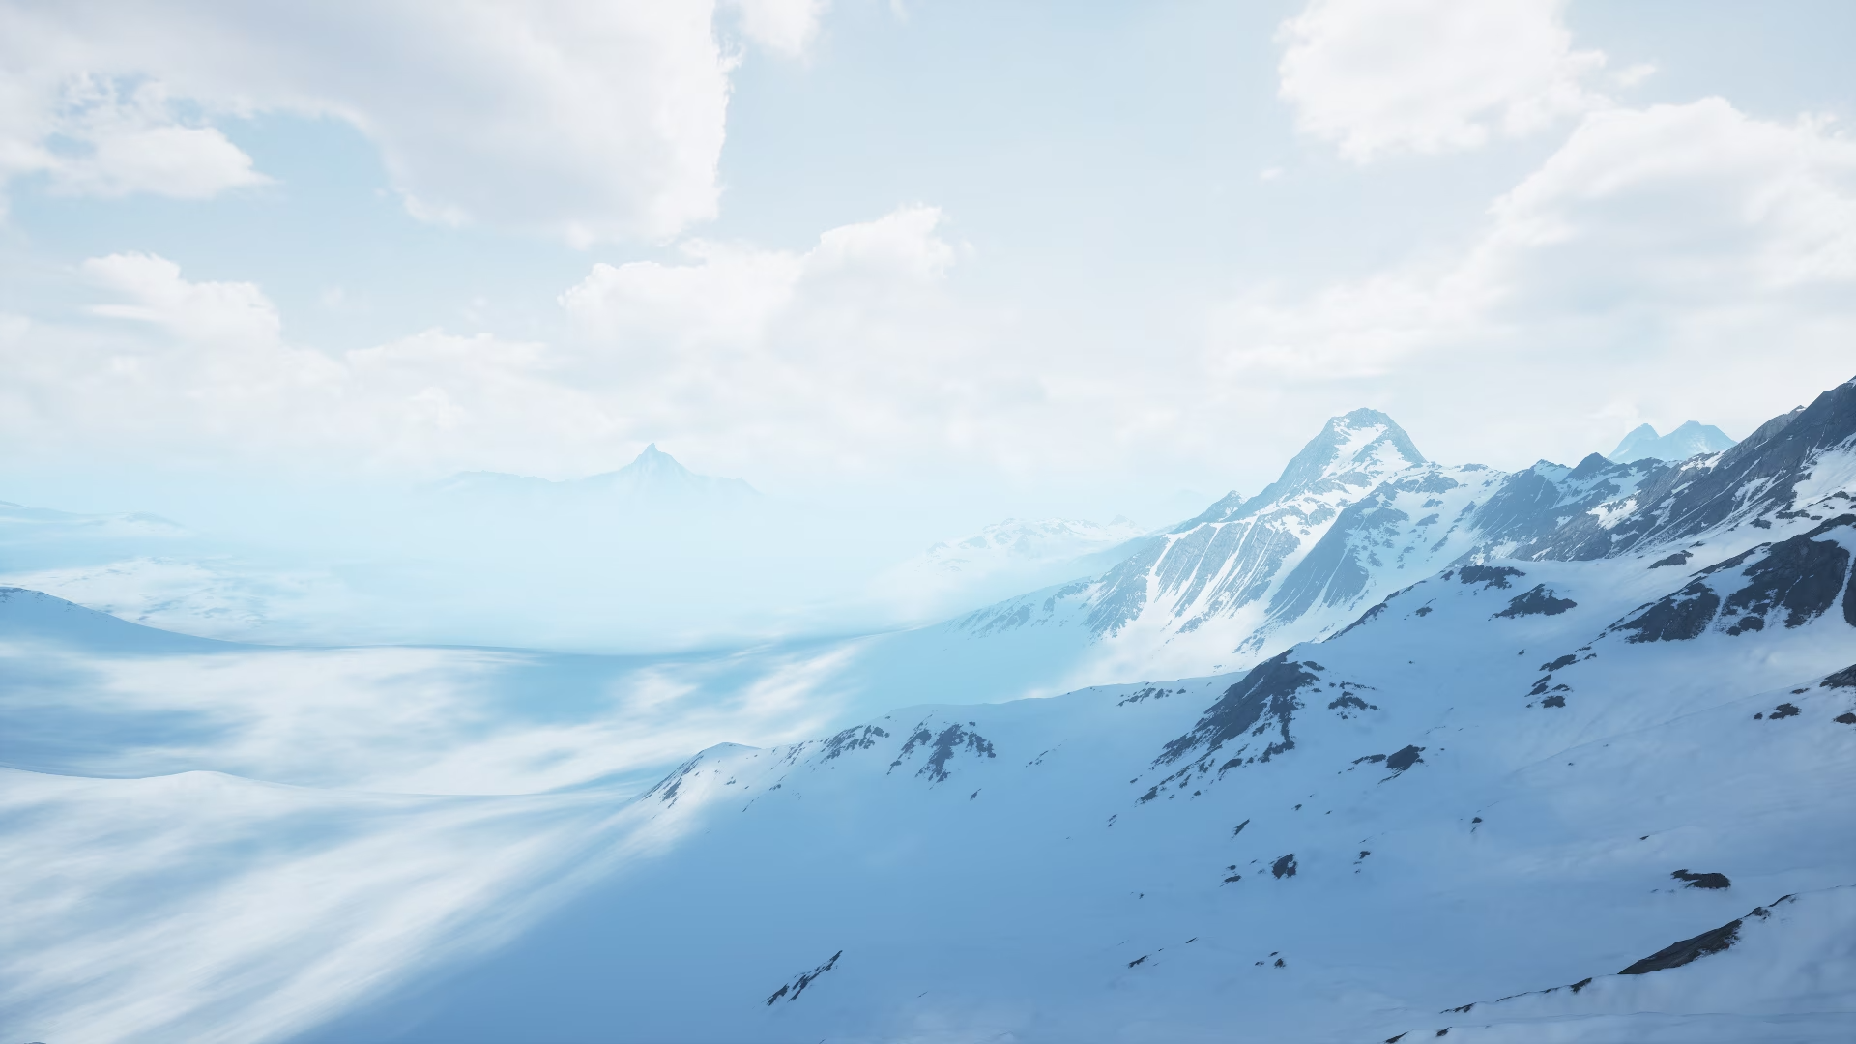
Big Mountain Resort ticket price modeling
Dec 2023
Big Mountain Resort Confidential

Slide 2
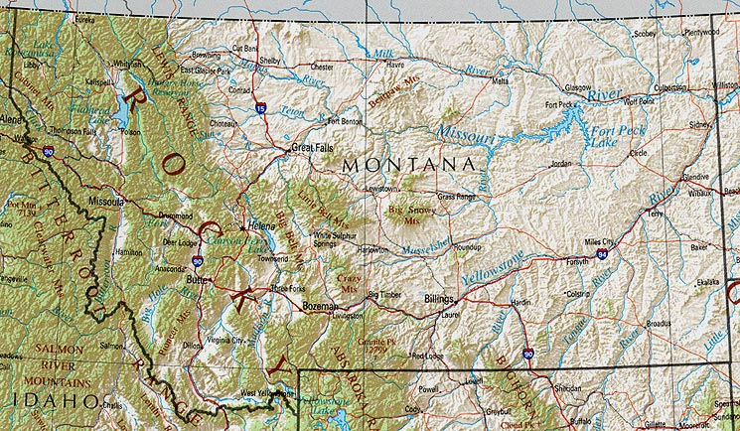
Background
BMR
BMR is 2h from Missoula, Helena, & Bozeman and serves 350k customers/year (5 tickets/person)
Ticket prices have previously been determined by comparing to total market average
BMR has premium features including a longest run of 3.3 mi, vertical drop of 2,353 feet, and 11 lifts
These features could be leveraged to facilitate data driven ticket pricing
Big Mountain Resort Confidential

Slide 3
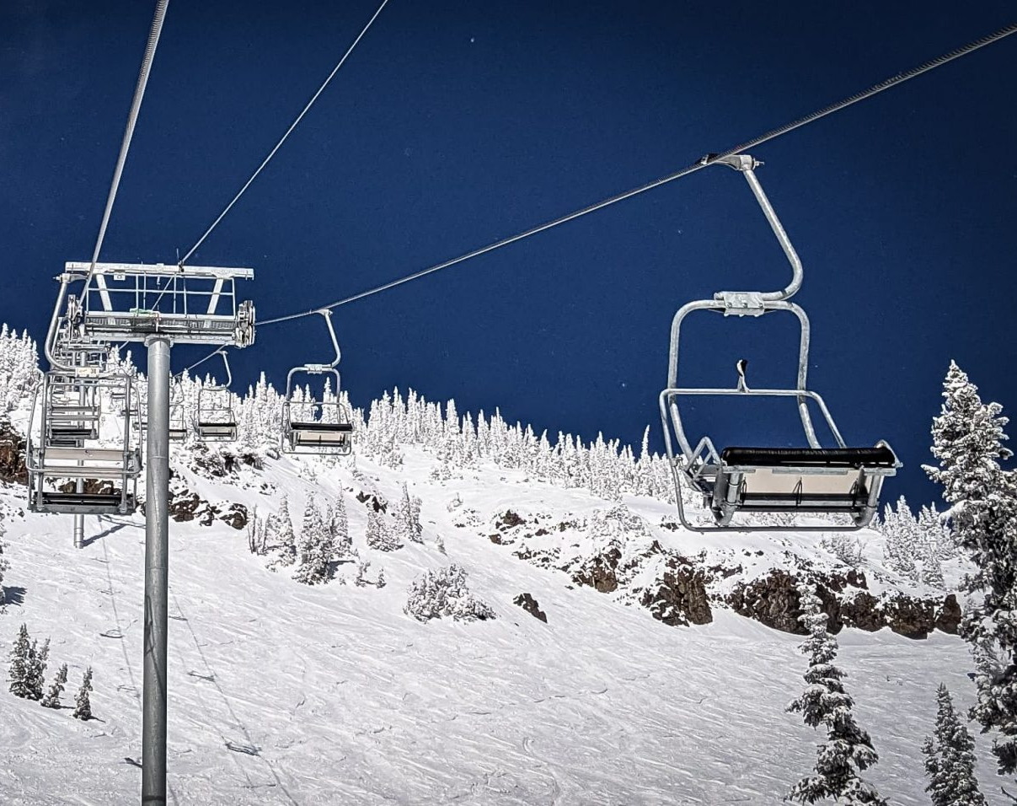
Background
In Q2 of 2023 BMR installed a new chair lift
Operating cost = $1.54M/year
Objective: model features and ticket prices of American ski resorts to determine whether BMR can recoup this cost by raising ticket prices
Big Mountain Resort Confidential

Slide 4
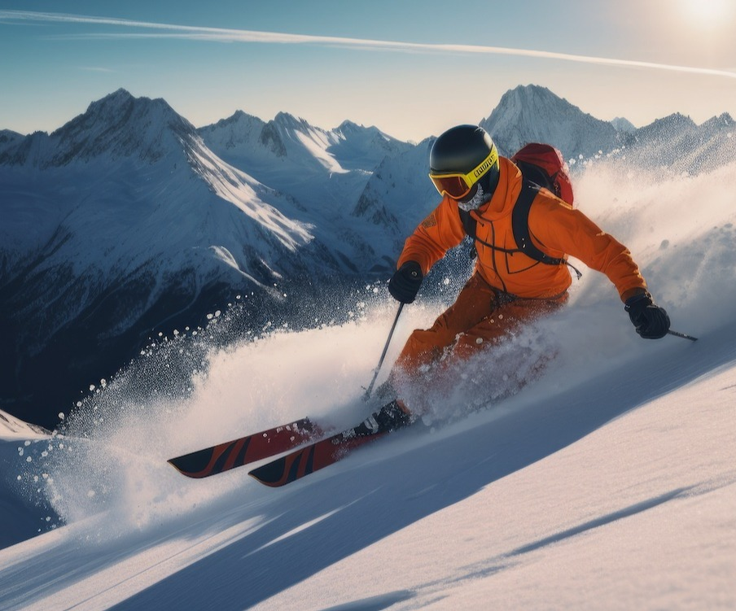
Key findings
Based on existing amenities, BMR can likely initially raise prices by $5/ticket, generating $8.75M (exceeding goal by $7.2M)
BMR could close 3 low use runs without impacting price
Could raise ticket prices another $2 by:
Increasing vertical drop 150 ft
Add a run
Add a chair lift
Big Mountain Resort Confidential

Slide 5
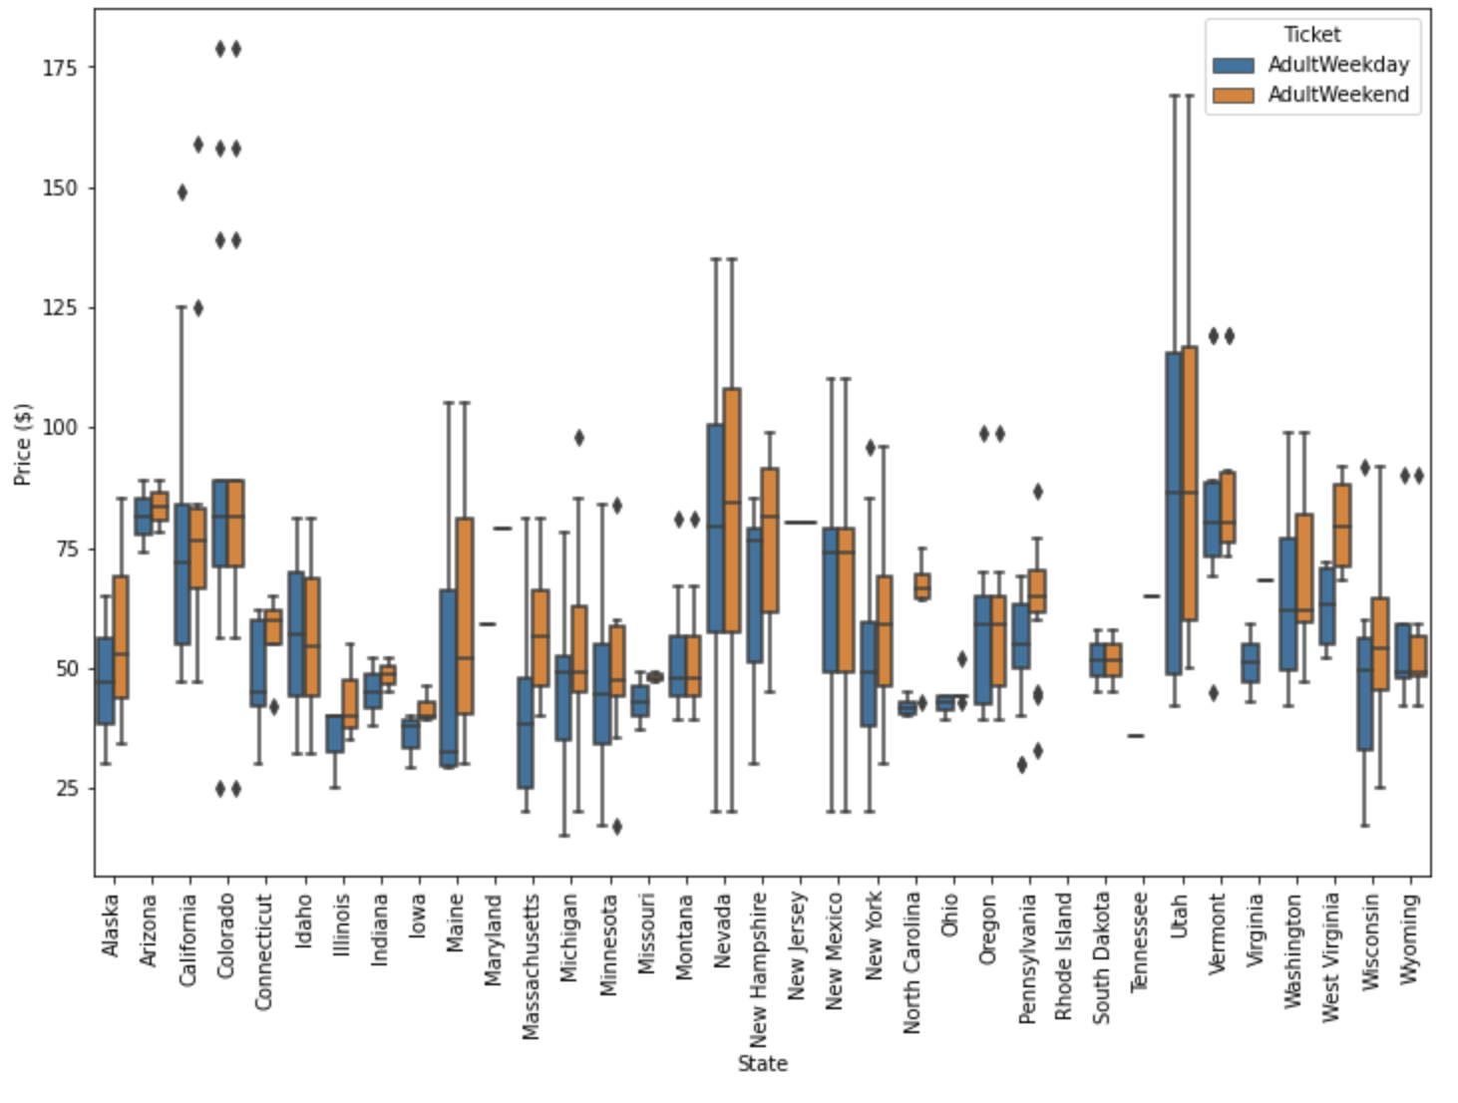
Dataset overview & summary statistics
After cleaning, the dataset used included information from 277 American ski resorts
Created state-level metrics to facilitate within-state comparison
Generated summary statistics to understand the dataset
Big Mountain Resort Confidential

Slide 6
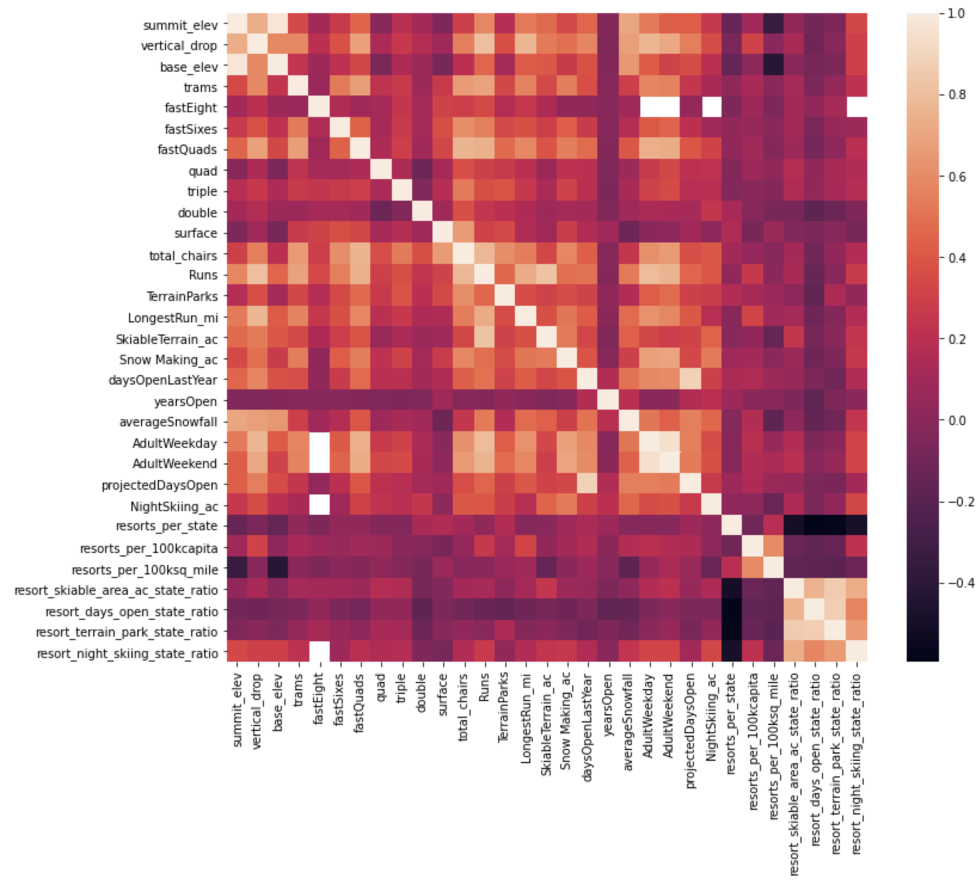
Exploratory analysis
Exploratory analysis revealed that certain features correlated with higher ticket prices
Resorts providing a greater share of each state’s night skiing can charge more for tickets
Fastquads, total chairs, runs, and snow making acreage all correlated positively with ticket price
Big Mountain Resort Confidential

Slide 7
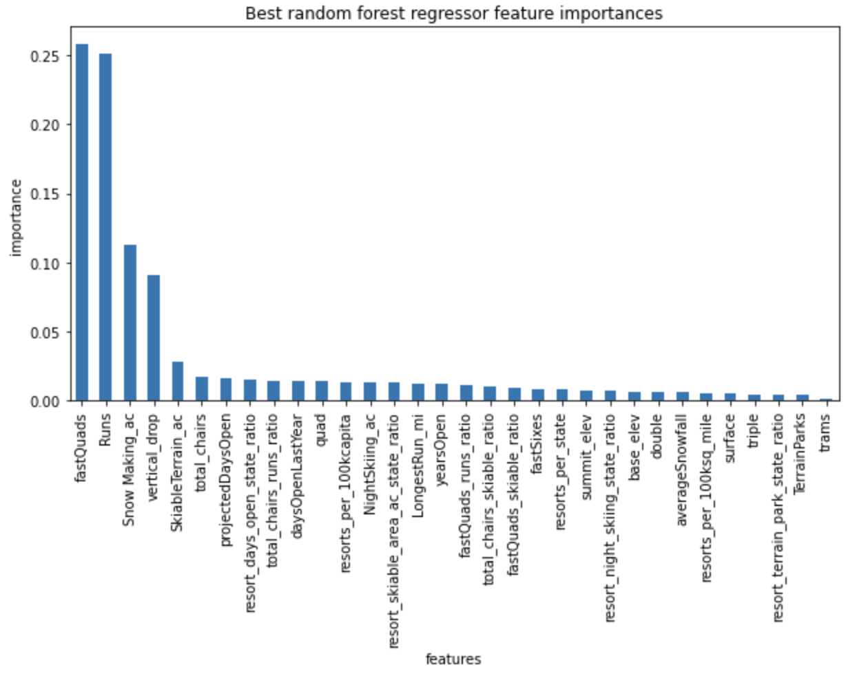
Modeling
70/30 train/test split of the data
Imputed missing values using mean and median: median performed better.
Created both linear regression and random forest regression models: random forest model performed slightly better.
The most important features for price in this model were vertical drop, snow making_ac, total_chairs, fastQuads, and Runs
Big Mountain Resort Confidential

Slide 8
Summary & conclusions
Modeling predicted BMR’s ticket price to be $96
Even with an error of $10, BMR can raise prices by $5 from $81
If the average visitor purchases 5 tickets at the higher price, this will generate an additional $8.75M, covering the cost of the new lift
If ticket sales continue as expected at the higher price, BMR can experiment with raising the price beyond $5
BMR has the option to close a few low-use runs without compromising ticket price
BMR could charge $2 more per ticket (= $3.5M in revenue) by adding a run, increasing vertical drop 150 ft, and installing a new chair lift.
Big Mountain Resort Confidential

