Slide 1
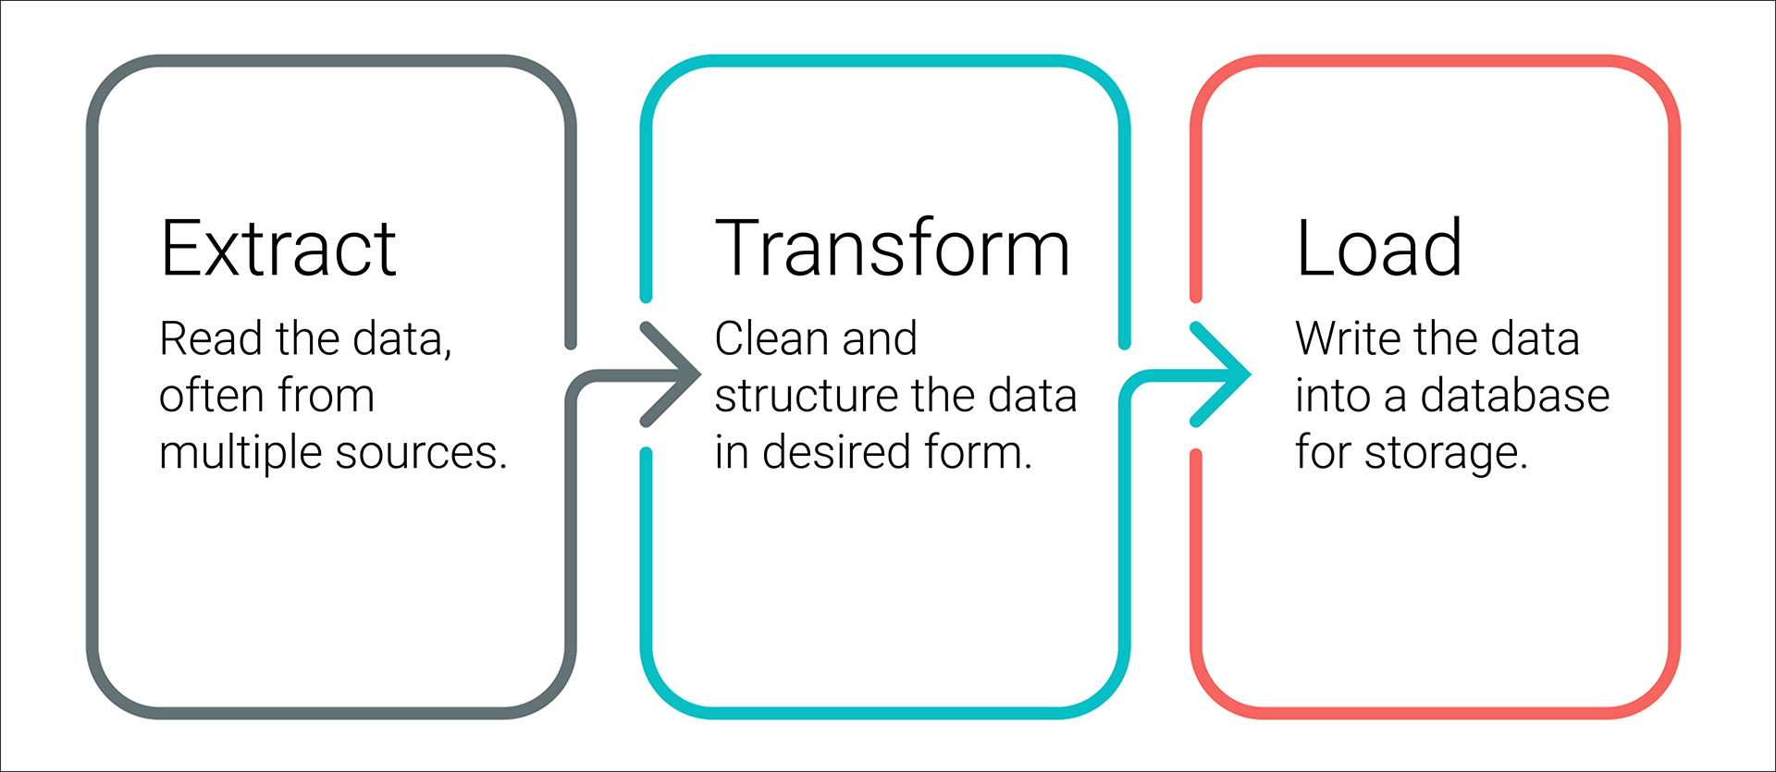






D2: Extract and Transform the Wikipedia Data
D3: Extract and Transform the Kaggle data
filter
Overview
Detailed View
Inspect:
observe patterns
Plan:
create regex strings (forms)
use str.contains() to locate forms
drop duplicates and id nulls
Execute:
create function to parse data
use str.extract() to locate forms and apply function created to parse data
drop no longer needed column
convert dtypes as needed
merge Wiki and Kaggle DataFrames into movie_df
transform and merge movie_df with ratings_df into movies_with_ratings_df
Filter out tv shows
Combine keys with same data
Extract imdb_id from IMDb link
Merge Wiki and Kaggle DataFrames
combine
Regular Expressions
D1:Extract - Read in 3 data files
wiki_movie_df
extract
Apply
Create
Function Parts:
Name
Parameters
Code block
Return value
Functions
Resources
wiki_file
kaggle_file
Ratings_file
Kaggle_metadata_df
Functions created:
clean_movie()
Extract_transform_load()
Parse_dollars()
Fill_missing_Kaggle_data
merge
box office
budget
release date
running time
ratings_df
output
movie_df
movies_with_ratings_df
D4: Create Database
PostgreSQL DB
Create PostgreSQL DB called movies using pgAdmin
Establish connection with pgAdmin’s local server using Sqlalchemy’s create_engine() method and psycopg2
Load movies and ratings tables into pgAdmin by calling the extract_transform_load() function which uses the to_sql() method
movies
ratings

