Slide 1
EXTRACT – TRANSFORM – LOAD METHODOLOGY
EXTRACT
TRANSFORM
LOAD
Transform Challenge:
- Reduce the number of fields
- Create a common field to join the data
with common date timeframe and format
Database (Db)Type: SQL
Reason: Structured Data
Db Language: Postgres
Db tool: PgAdmin4
Chicago Crime - CSV file:
Date time frame - Daily
Date format Day-Mon-Year
Unnecessary Columns
Transform Solution: Pandas
- to read the csv to a DataFrame
- to split date fields out to day month year
- to aggregate by week for a common timeframe
grouped by crime categories for summary level
statistics
- to join into a single DataFrame
- to transform to a csv file ready to load into a
database
Data Source: Kaggle
Engineer the Database
Import the Data
Chicago Weather CSV file:
Date time frame - Weekly
Date format Week-Mon-Year
Unnecessary Columns
Data Source: Visual Crossing
Follow-on Analysis
Model the Database (ERD)

Slide 2
Data Sources
Heroku Deployment
CitiBike
Trip Data CSV
Browser
(HTML, JS, CSS)
Station Analysis
Rider Analysis
Weather Impacts
RESTful API
CitiBike
Rider Data CSV
APP Server
(Flask)
Database
(PostgresSQL)
ETL
Open Weather Map API
Serve index.html
U.S Census Bureau API
NYC Open Data

Slide 4
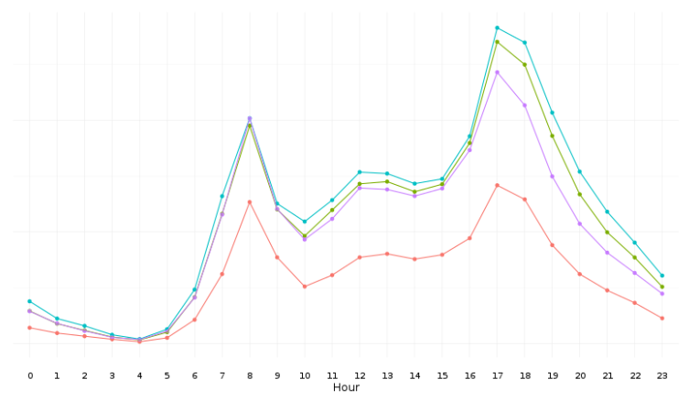

Slide 5
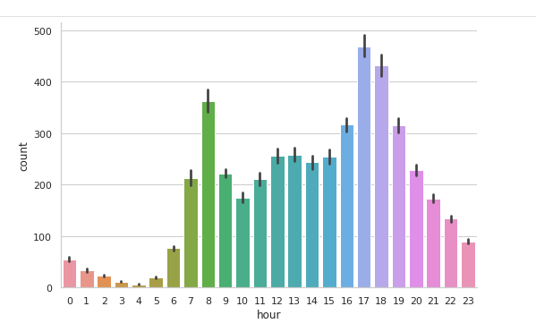

Slide 6
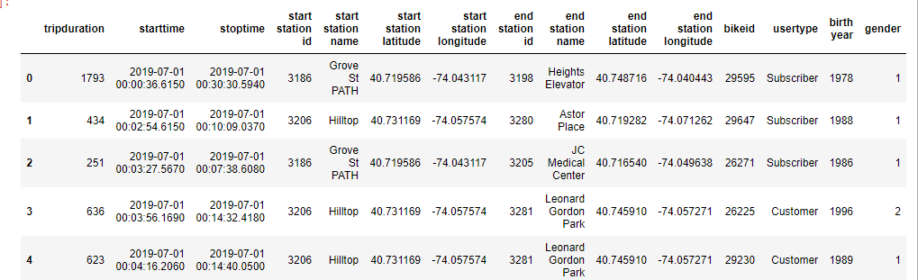

Slide 7
