Slide 1







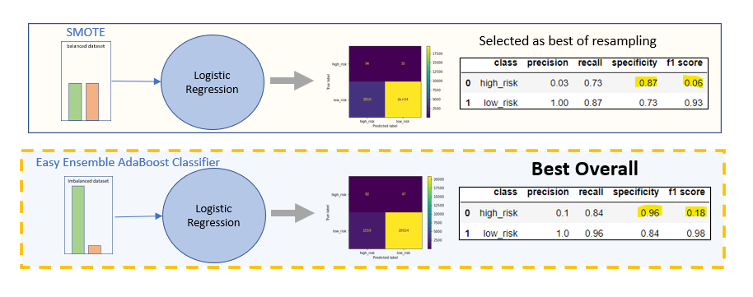

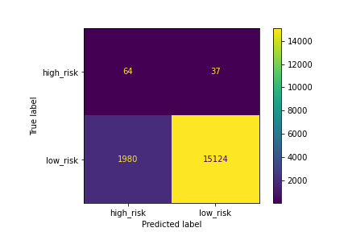
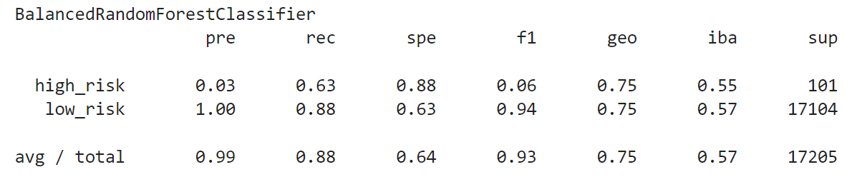
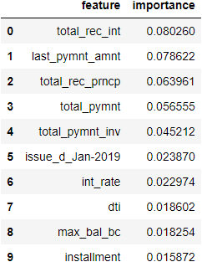

Exploratory Data Analysis (EDA)
Pre-Processing
Frame the ML problem:
Imbalanced Supervised / Classification
Get the data
Data Cleaning using pandas methods dropna, value_counts, replace…
Feature Selection using drop columns
Save the data in a format to share using to_csv
Explore the data to gain insights
Split data into X and y (feature matrix, target)
Transform object dtypes to numeric using get_dummies (increase in number of columns)
Split data into train and test sets using train_test_split. Use X & y train to train/fit model(s) and use X & y test to assess model performance
Scale X to account for different scales among features using StandardScaler
Resample to account for imbalance in y values by oversampling or under sampling
  RandomOverSampler
  SMOTE
  ClusterCentroids
  SMOTTEEN
Model using LogisticRegression as a baseline (without resampling) and with resampleing for comparison of resampling methods
LoanStats_2019Q1.csv
Shape: 115,675, 144
Pre-processing with get_dummies will increase the number of columns
EDA reduces rows & columns available for modeling
clean_cloans.csv
X_encoded_dummies
Shape: 90,445, 74
Shape: 90,445, 85
EDA
Credit_risk_1_cleaning1.ipynb
Pre-Processing
Credit_risk_2_scaling.ipynb
Communicate Findings
Github
Imbalanced Accuracy Score
Confusion Matrix
    True Positives
    True Negatives
    False Positives
    False Negatives
Imbalanced Classification Report
  Precision
  Recall
  Specificity
  f1 score
  Feature Importance*
Communicate findings
README.md
Explore many models
Credit_risk_3_ensemble.ipynb
Model - Fit - Predict
  LogisticRegression
  BalancedRandomForestClassifier
  EasyEnsembleClassifier(AdaBoost)
  Assess:
      Imbalanced Accuracy Score
      Confusion Matrix
      Imbalanced Classification Report
Explore many models
* BalancedRandomForestClassifier

Slide 2
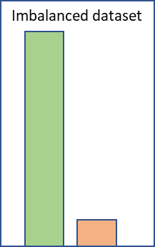
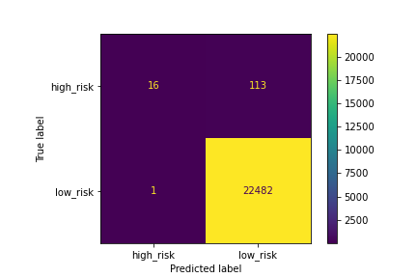

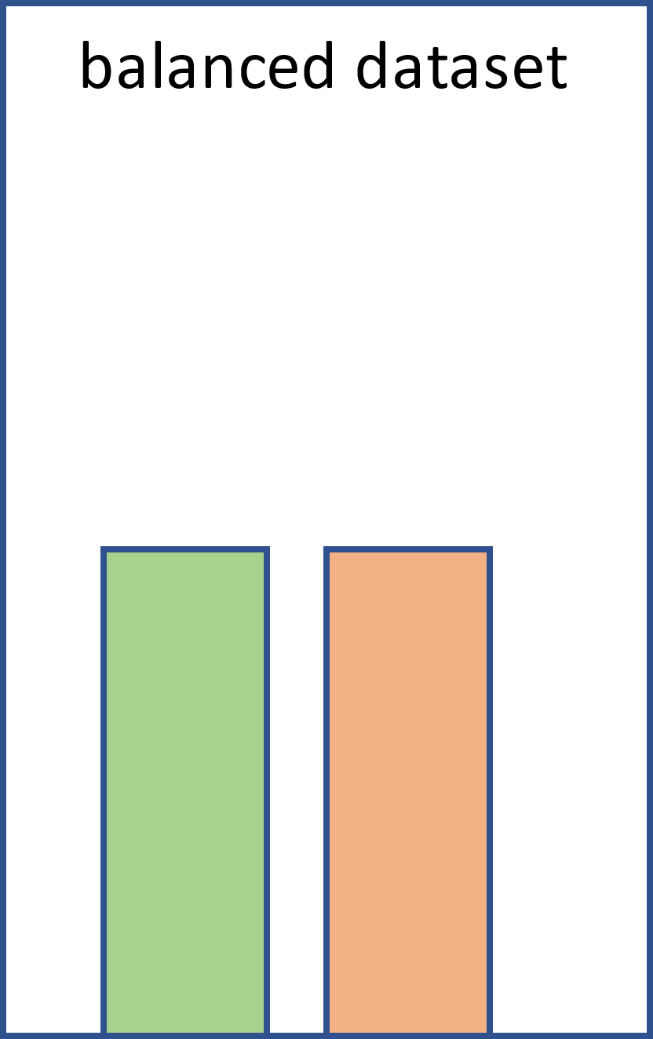
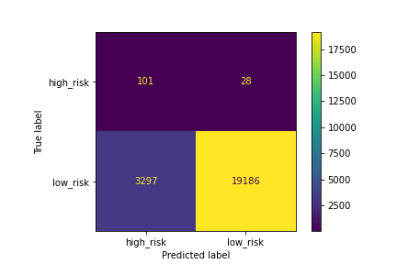



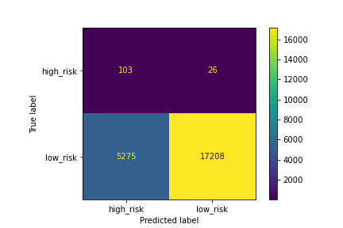


Resampling
Logistic Regression
Train
Test
Benchmark
LoanStats_2019Q1
(Confusion Matrix)
(Imbalanced Classification Report)
  RandomOverSampler
Logistic Regression
The scaled training set is resampled to produce a balanced dataset & used to train the model
Data cleaning reduces row & col
train
  SMOTE
Selected as best of those considered
Logistic Regression
StandardScaler used to scale the training data
The clean imbalanced dataset is split into train & test sets
  ClusterCentroids
Logistic Regression
clean_loans
test
  SMOTTENN
Logistic Regression
The test set is set aside and used to evaluate the model’s performance
Train: The Logistic Regression Model produces a predicted classification
Test: The model’s predicted classification is compared to the actual classification

Slide 3
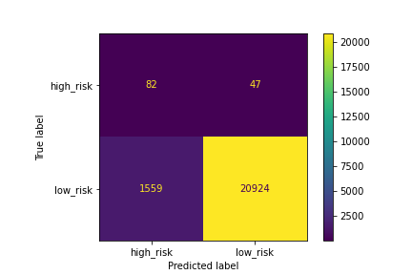
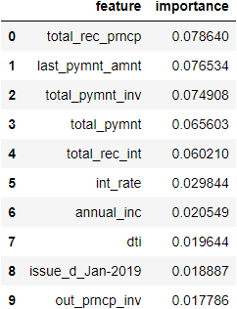


Ensemble
Logistic Regression
Train
Test
Benchmark
StandardScaler used to scale the training data for benchmark and resampling
LoanStats_2019Q1
(Confusion Matrix)
(Imbalanced Classification Report)
The scaled training set is resampled to produce a balanced dataset & used to train the model
  SMOTE
Selected as best of resampling
Logistic Regression
Data cleaning reduces row & col
  BalancedRandomForestClassifier
train
Logistic Regression
The clean imbalanced dataset is split into train & test sets
clean_loans
test
  Easy Ensemble AdaBoost Classifier
Selected as best overall
Logistic Regression
The test set is set aside and used to evaluate the model’s performance
Train: The Logistic Regression Model produces a predicted classification
Test: The model’s predicted classification is compared to the actual classification

Slide 4
Findings
LoanStats_2019Q1
Logistic Regression
Train
Test
Benchmark
(Confusion Matrix)
(Imbalanced Classification Report)
  SMOTE
Selected as best of resampling
Logistic Regression
  BalancedRandomForestClassifier
Logistic Regression
  Easy Ensemble AdaBoost Classifier
Selected as best overall
Logistic Regression
Best Overall

Slide 5
Summary
LoanStats_2019Q1
  SMOTE
Selected as best of resampling
Logistic Regression
  Easy Ensemble AdaBoost Classifier
Best Overall
Logistic Regression

