Slide 1


DDAnalytics: Attrition
By Jamie Vo

Slide 2

Key Points
Data
Attrition
Monthly Income
Job Roles

Slide 3
Attrition

Slide 4
Factors
Monthly Income
Over Time
Job Roles

Slide 5
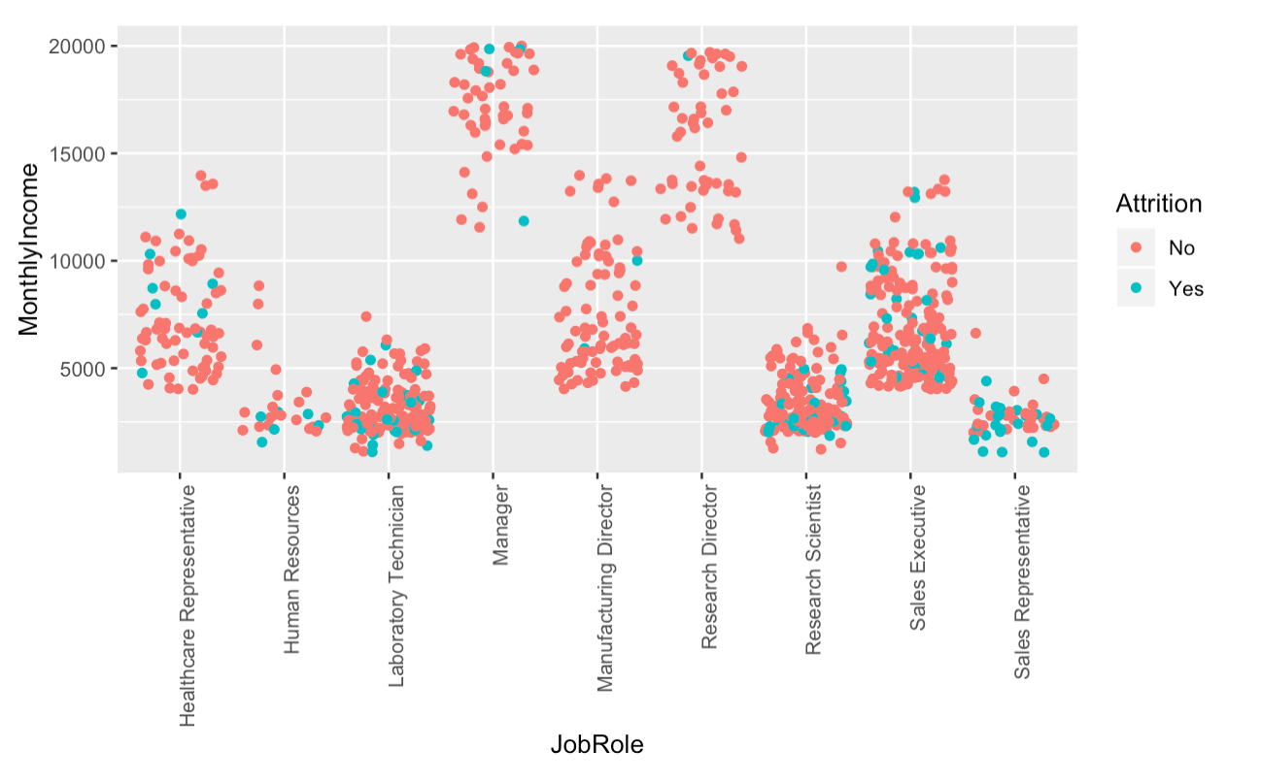
Factors
Monthly Income
Over Time
Job Roles

Slide 6
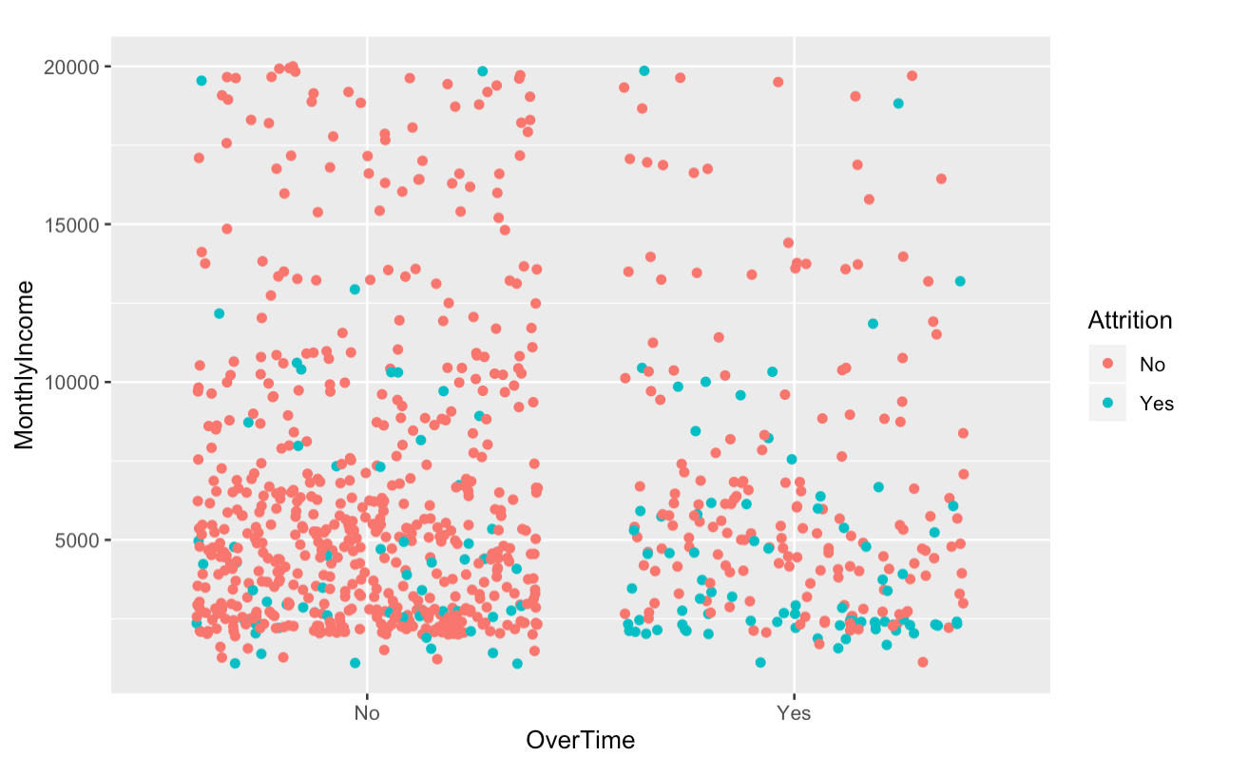
Factors
Monthly Income
Over Time
Job Roles

Slide 7
Model
KNN
K-7
Specificity : 61%
Sensitivity: 88%

Slide 8
Monthly Income

Slide 9
Factors
Total Years Working
Job Level
Non-Travel

Slide 10
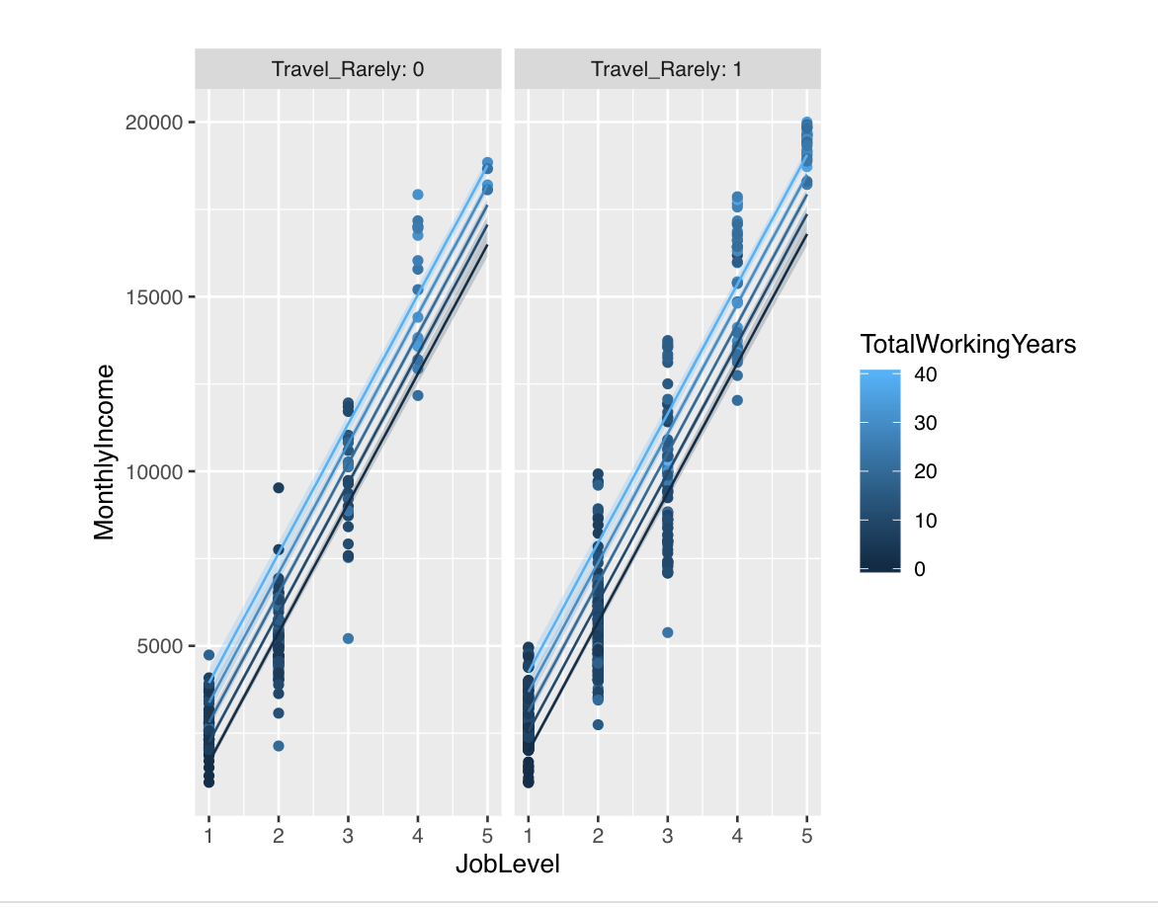
Model
Multiple Linear Regression
R²: 0.91
RMSE: 1334

Slide 11
Job Roles

Slide 12
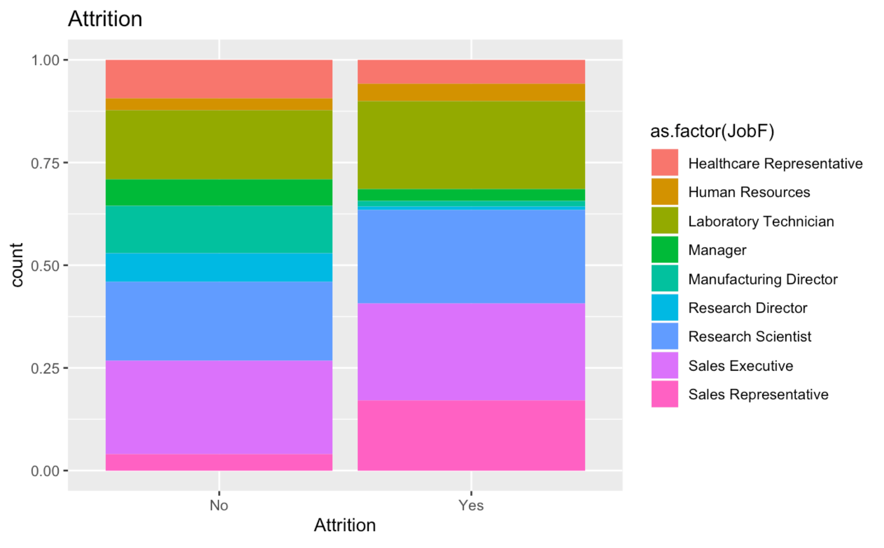
Attrition

Slide 13
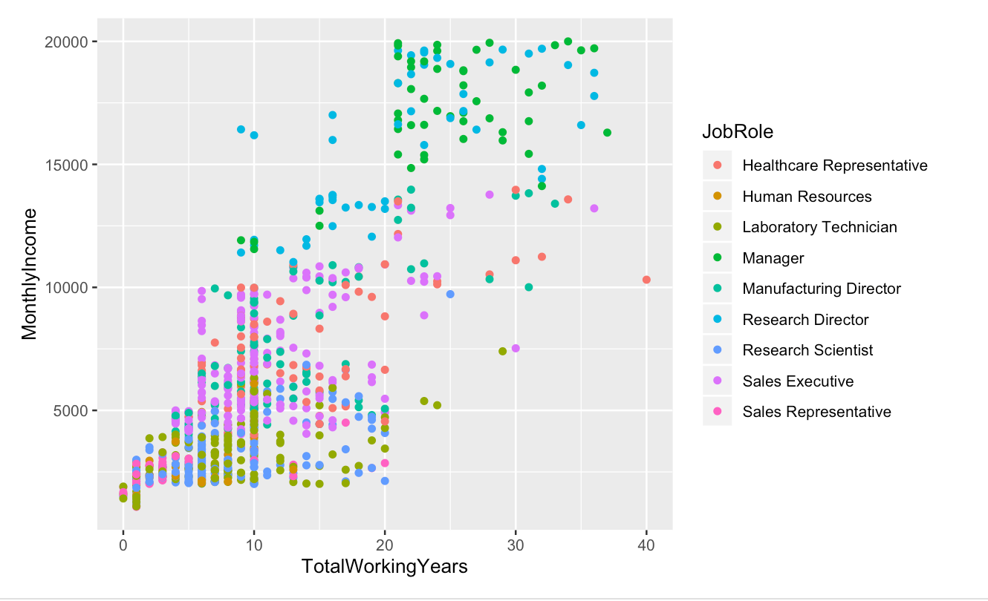
Monthly Income

Slide 14
Review
Attrition
Job Roles
Monthly Income
Over Time
Non-Travel
Total Working Years
Job Level

Slide 15

Thank you for your time! Please let me know if you have any questions.

