Slide 1
The Academy
Who is the Academy?
What do they do?
How does one become a member?

Slide 2
Oscar Voting
Films are submitted for nominations.
The nomination shortlist is announced to the Academy.
The Academy votes for the nominees.
The nominations are announced.
The Academy votes for the winners.
Oscar Day.

Slide 3
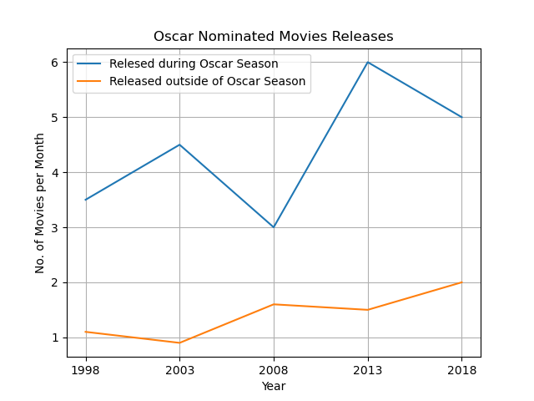
Multi Year Line Plot
More nominated movies are released during “Oscar Season”
Strategic releases
Fresher in the minds of voters
Effect of streaming services?

Slide 4
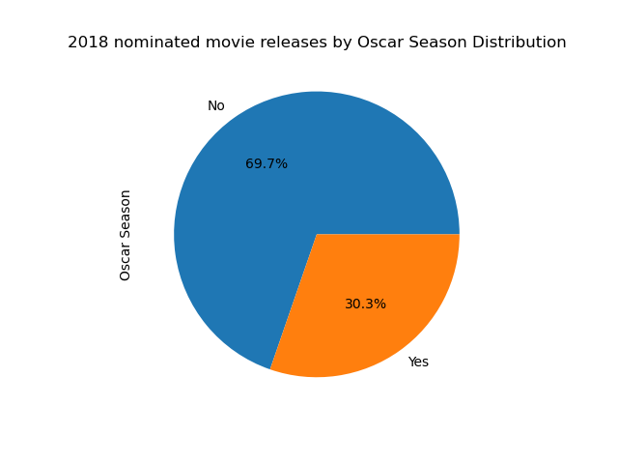
Pie Chart – Oscar Season stats
Oscar Season months are November and December. This is right before the voting window closes.
Lengthwise, these 2 months take up 16.7% of the year.
((30.30 / 16.7) – 1 ) * 100

Slide 5
Limitation, other factors, and considerations
Content of the film?
American?
Language?

