Slide 1
Intro to Python with Raspberry Pi Hardware Examples
Jamie Boyd (Tim Murphy’s lab)

Slide 2
Preamble - The Data Pipeline
Programming Skills - Essential for All Stages of the Data Pipeline
Data Base
Acquire → “Massage” → Stats → Figures → Paper!

Slide 3
Preamble - Agenda
Introduce Python
  Python Interpreter
  IDLE environment
Data Types
  Numeric
  Strings & Booleans
Flow Control
  Loops (for, while)
  Conditionals (if, else)
Collections
  Lists & Tuples
  Dictionaries
Libraries (modules)
  array / numpy
  Rpi.GPIO
Introduce Raspberry Pi
  GPIO Hardware Control

Slide 4
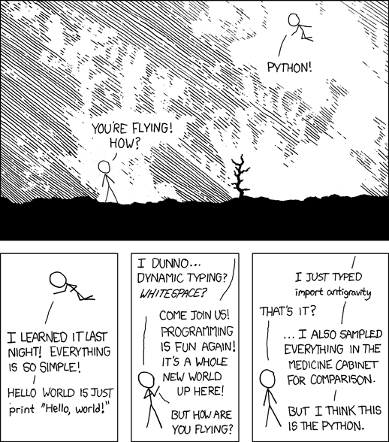
Python Programming Language
Python (both 3.x and legacy 2.7x) is installed in Raspbian by default
  Always use Python 3
Python is an interpreted language
  each line of a program executed in turn by Python interpreter (slower than C)
  Can be used interactively, running code as you type it
Python has great library support
  import RPi.GPIO
https://xkcd.com/353/

Slide 5
Booting Up
Connect micro-USB power to boot up
  Watch text scroll by until log-in prompt is presented
  Login: pi
  Password: raspberry
Launch GUI from the command line
  $startx ($ is the command prompt, don’t type $)
Open a terminal window to get a command line back
  Raspberry menu->accessories->terminal
  or select the picture of a computer monitor on task bar at top of screen. Also open a directory window from a task bar icon

Slide 6
Running Python in a Terminal Window
Run a python file with python interpreter, specifying python version 3
  $python3 hello_world.py
  Hello World!
  print ('Hello World !')
Run python interpreter interactively in a terminal
  $python3
  Python 3.53 (default, Jan 19 2017, 14:11:04)
  [GCC 6.3.0 20170124] on Linux
  Type “help”, “copyright”, “credits” or “license” for more information
  >>> (>>> is the python interpreter prompt, don’t type >>>)
  >>> quit() (quits the python interpreter)

Slide 7
Python Integrated DeveLopment Environment
IDLE is a Simple Python Integrated Development Environment (IDE)
  Python shell – behaves like Python used interactively in a terminal window
  Multi-window text editor with
    syntax highlighting
    Autocompletion
    smart indent.
Launch IDLE from raspberry menu->programming or from the command line:
$gksudo idle3 &
  Use gksudo to launch with elevated permissions to access /dev/mem to use GPIO
  Use & so terminal window can be used while IDLE runs

Slide 8
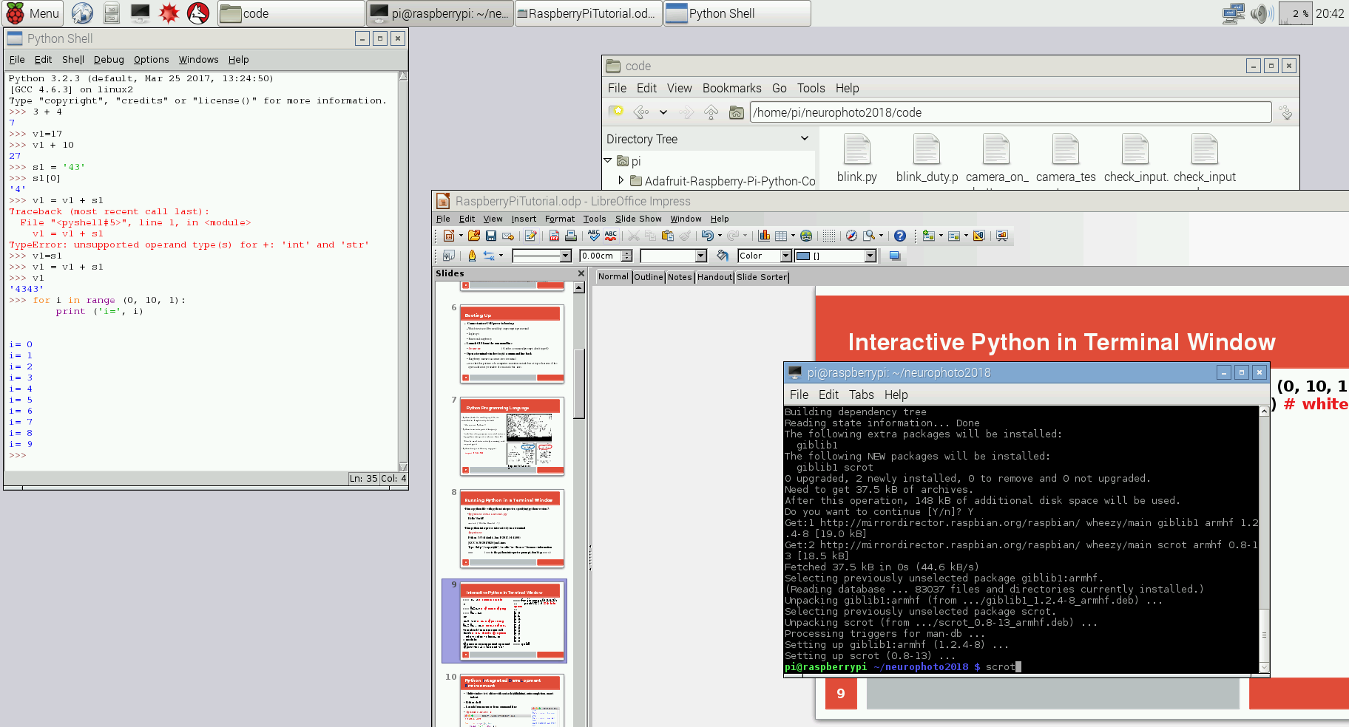
Interactive Python in IDLE Shell
Math expressions return result
Dynamic typing (v1 is an integer)
s1 is a string (array of characters)
Auto-convert int and str?
  NO ! Throws TypeError exception
Dynamic type change of v1 to string
  For strings, + means concatenation

Slide 9
Basic Operators
Addition +
Subtraction -
Multiplication *
Division /
Raise to power ** 2**4 returns 16
Set a value =
Test equality ==
Shorthands for setting a variable:
t1 += 5 is equivalent to t1 = t1 + 5

Slide 10
Python Data Types: Numbers
Type | Size | Min | Max
char | 1 byte | -128 (0 unsigned) | 127 (256 unsigned)
short | 2 bytes | -32,768 (0 unsigned) | 32,767 (65,536 unsigned)
int | 4 bytes | -2,147,483,648 (0 unsigned) | 2,147,483,647 (4294967296 unsigned)
float | 4 bytes | approx -3.4E38 | approx 3.4E38 (prec 7 dec digits)
double | 8 bytes | approx -1.7E308 | approx 1.7E308 (15 dec digits)
Python’s usual numbers are 4 byte signed int and 8 byte double
Other data types can be specified for numeric arrays
An array is a collection of elements of a single data type, addressable by index a[0]

Slide 11
Representations of Integers
• Decimal: one’s place, 10’s place, 100’s place based on powers of 10
  10⁰ =1, 10¹ = 10, 10² =100
  Each digit can contain any number from 0 to (10-1) = 9) :
  7843 = 7 thousands + 8 hundreds + 4 tens + 3 ones
• Binary: one’s place, two’s place, and four’s place based on powers of 2
  2⁰=1, 2¹=2, 2² =4, 2³ =8, 2⁴ =16
  Each binary digit (bit) can contain any number from 0 to (2-1) =1):
  10011011 = 1 + 2 + 8 + 16 + 128 = 155
  8 bits = 1 byte : 1 byte can represent 256 different values
  2 bytes can represent 256 * 256 = 65536 different values

Slide 12
Integer Overflow and Underflow
0
15
0000
1
n bit Un-Signed
0 to 2^{n} -1
n bit Signed: most significant bit is negative (two’s complement)
- 2^{(n-1)} to 2^{(n-1)} -1
n=4:
Un-Signed: 0 to 15
Signed: -8 to 7
1111
0
0001
-1
2
14
1
0010
1110
-2
2
+1
3
13
-1
3
0011
1101
-3
12
1100
-4
4
0100
4
1011
-5
11
5
0101
5
-6
1010
6
10
-7
7
0110
6
-8
1001
0111
9
1000
7
8

Slide 13
Representations of Integers and Fractions
• Decimal: one’s place, 10’s place, 100’s place based on powers of 10 :
    10⁰ =1, 10¹ = 10, 10² =100
• After the radix (decimal) point : 10ths, 100ths, 1000ths
• Binary: one’s, two’s, and four’s places based on powers of 2 :
  2⁰=1, 2¹=2, 2² =4 10011011 = 1 + 2 + 8 + 16 + 128 = 155
• After the radix point : halves, quarters, eighths, sixteenths
  0.1011001 = 1/2 + 1/8 + 1/16 + 1/128 = 0.6953125

Slide 14
Floating Point Round-off Errors
“A rational number has a terminating sequence after the radix point if all the prime factors of the denominator of the fully reduced fractional form are also factors of the base.” https://en.wikipedia.org/wiki/Repeating_decimal
Prime factors of 10 are 2 and 5
  Thirds, sevenths, ninths, e.g., have repeating expansions
  1/3 = 0.3, 1/7 =0.142857, 1/9 = 0.1
In base 2, only a fraction whose denominator is a power of 2 (i.e., its prime factorization is 2 x 2 x 2 .....) can be represented exactly .
>>> 3*0.1 == 0.3
False

Slide 15
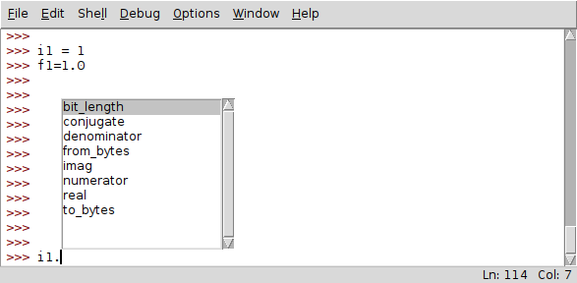
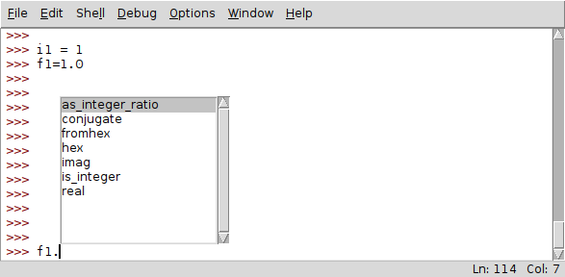
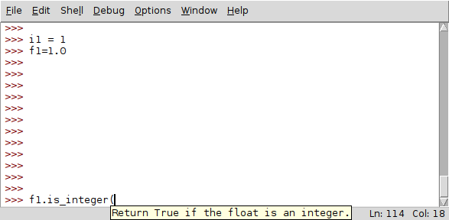
Python Numbers Are Ints or floats

Slide 16
In Python, Everything is an Object
Object Oriented Paradigm : Class -> object -> reference
• class – defines both data structures (fields) and functions (methods) that operate on that data (like a blueprint)
• object – instance of a class, with memory allocated and possibly initialized
• reference – a variable that points to an object
• C++, Java, e.g. are OOP but have variables of primitive types (ints and floats)
• In Python, even an integer is an object with class methods
The dot operator . calls an object’s methods () or returns the values of its fields
>>> i1 = 1
>>> i1.real # real is a field (real and imag for complex number)
1
>>> i1.bit_length() # bit length is a function that returns a value
1

Slide 17
A Python Class
# Class to read values from an RDM or ID-Innovations RFID tag reader
import serial
class RFIDTagReader:
  def __init__(self, serialPort, doChecksum = False, timeOutSecs = None, kind='ID'):
  # set field for time out seconds for reading serial port
self.timeOutSecs = timeOutSecs
  # set boolean for doing checksum on each read
self.doCheckSum = bool(doChecksum)
  # initialize serial port
self.serialPort = serial.Serial(str (serialPort), baudrate=9600, timeout=timeOutSecs)
  def readTag (self)
    tag=self.serialPort.read()
    return tag
    In a Python script or from shell:
    tagReader = RFIDTagReader (‘/dev/Serial0’)
    tag = tagReader.readTag()

Slide 18
Type Conversion (Python 3 vs Python 2)
Python 3.5
Python 2.7
>>> i1 = 1
>>> i1 /= 2
>>> i1
0.5 (converted int to float)
>>> i1.as_integer_ratio()
(1, 2)
>>> i1=1
>>> i1 /= 2
>>> i1
0 (integer division truncated to 0)
>>> i1.as_integer_ratio()
Traceback (most recent call last):
File "<stdin>", line 1, in <module>
AttributeError: 'int' object has no attribute 'as_integer_ratio'

Slide 19
Floating Point Rounding
>>> f1 = 13/16
>>> f1.as_integer_ratio()
(13, 16)
>>> f1 = 1/9
>>> f1.as_integer_ratio()
(2001599834386887, 18014398509481984)
>>> 2001599834386887/18014398509481984
0.1111111111111111

Slide 20
Python Data Types: Non-numeric
str type
  A String is an array of characters, “Hello World!”
  Python 3 uses the Unicode character set so each character occupies 2 bytes of memory.
bool type
  Variables of type bool have only two valid values
    True and False
  Often represents whether particular condition is true
  More generally represents any data that has two states
    yes/no, on/off

Slide 21
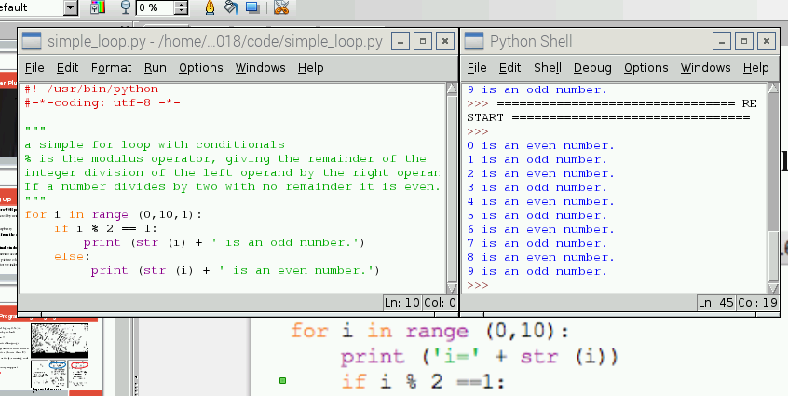
Loops and Conditionals in a Python Program
From File Menu -> Open -> simple_loop.py •From Run Menu -> Run Module
White space is syntax: loop body, and if blocks are indented using tab key

Slide 22
Lists are collections of any object
>>> l1 = list ()
>>> l1.append(1)
>>> l1.append('test')
>>> l1
[1, 'test']
>>> l1 [0]
1
>>> l1 [1]
'test'
>>> l1 [1] += 15
>>> l1.append(l1[1].capitalize())
>>> l1
[16, 'test', 'Test']

Slide 23
Tuples are Immutable Collections
Once created, they can not be modified
t1 = tuple (l1)
>>> t1
(16, 'test', 'Test')
>>> t1 [0]
16
>>> t1 [0] += 1
Traceback (most recent call last):
File "<pyshell#31>", line 1, in <module>
t1 [0] += 1
TypeError: 'tuple' object does not support item assignment

Slide 24
Dictionaries Map Keys to Values
>>> d1 = dict()
>>> d1.update({'lecture': 'Welcome to Python'})
>>> d1
{'lecture': 'Welcome to Python'}
>>> d1.get ('lecture')
'Welcome to Python'
>>> d2 = {'lecture' : 'Welcome to Python', 'course' : 501}
>>> d2.get('course')
501

Slide 25
Arrays for Numeric Data
>>> from array import array #array class in array module
>>> a1 = array ('i', [0,1,2,3,4,5,6,7,8,9])
>>> a1
array('i', [0, 1, 2, 3, 4, 5, 6, 7, 8, 9])
>>> a2 = array ('d', ((i/10) for i in range (0,10)))
>>> a2
array('d', [0.0, 0.1, 0.2, 0.3, 0.4, 0.5, 0.6, 0.7, 0.8, 0.9])
>>> a3 = array ('i', [0] * 10)
>>> a3
array('i', [0, 0, 0, 0, 0, 0, 0, 0, 0, 0])

Slide 26
Array Format Specifiers
Type Code Description
'c' 8-bit character
'b' 8-bit integer
'B' 8-bit unsigned integer
'u' Unicode character
'h' 16-bit integer
'H' 16-bit unsigned integer
'i' Integer
'I' Unsigned integer
'l' Long integer
'L' Unsigned long integer
'f' Single-precision float
'd' Double-precision float

Slide 27
Array Assignment and Overflow
>>> a1 [0] = 2**31 – 1 # biggest signed 4 byte int
>>> a1 [0]
2147483647
>>> a1 [0] += 1
Traceback (most recent call last):
File "<pyshell#106>", line 1, in <module>
a1 [0] += 1
OverflowError: signed integer is greater than maximum

Slide 28
Array Slicing and Manipulation
# get subset of array
>>> asub = a1 [2 : 7]
# multiply array by 2
>>> asub = array ('i', (2*x for x in asub))
>>> asub
array('i', [4, 6, 8, 10, 12])
# Feature rich multidimensional arrays with numpy
>>> import numpy

Slide 29
Raspberry Pi Specs (current model is Pi 3B+)
  A low cost, credit-card sized computer designed to enable people of all ages to explore computing (raspberrypi.org)
    1.2 GHZ quad-core ARM Cortex A53 (900MHz A7 on Pi 2)
    1 GB 900 MHz SDRAM (450MHz on Pi 2)
  Runs Raspbian, a Linux-based operating System
    Most of the Linux toolset supported
    Programming in Python, C/C++, Java, ....
  Standard Connectivity
    10/100 MBPS Ethernet • 802.11n Wireless LAN (not on Pi 2)
    Bluetooth (not on Pi 2) • 4 USB Ports
    HDMI video • micro SD card (no disks)
    40 GPIO Pins for General Purpose Input/Output plus some specialized communication protocols (serial, i²c, spi)

Slide 30
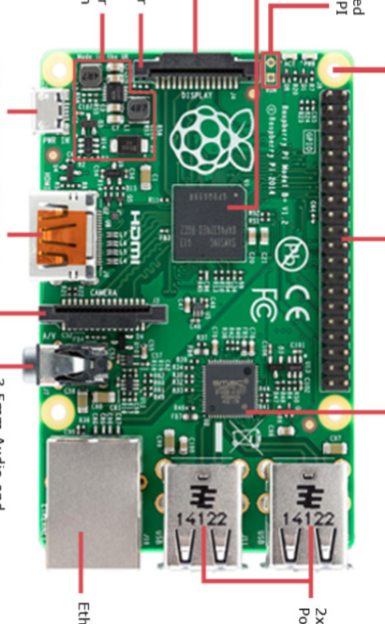
Raspberry Pi 2
Micro SD card slot (bottom)
Front
Broadcom BCM2835
DSI Display Connector
Run Header to reset Pi
Switching Power regulator
1 of 4 Squarely Placed
Mounting Holes
5V micro-USB Power
HDMI Video Output
40 pin GPIO Header
CSI Camera Connector
3.5 mm Audio and Composite Output Jack
Ethernet Controller
Ethernet Port
Rear
2 x 2 USB Ports

Slide 31
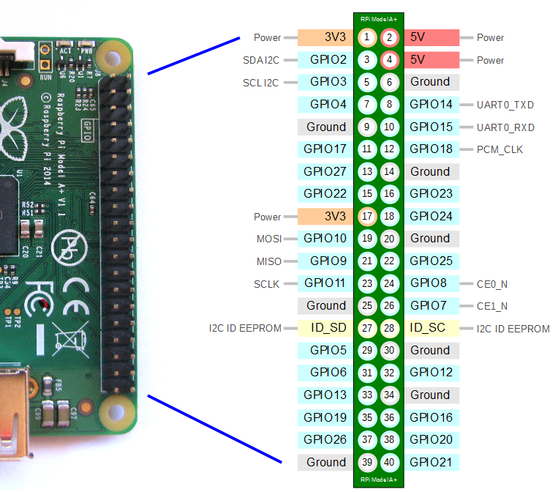
Rasberry Pi GPIO Header Pin Out
Front
Rear
https://pinout.xyz/pinout/

Slide 32
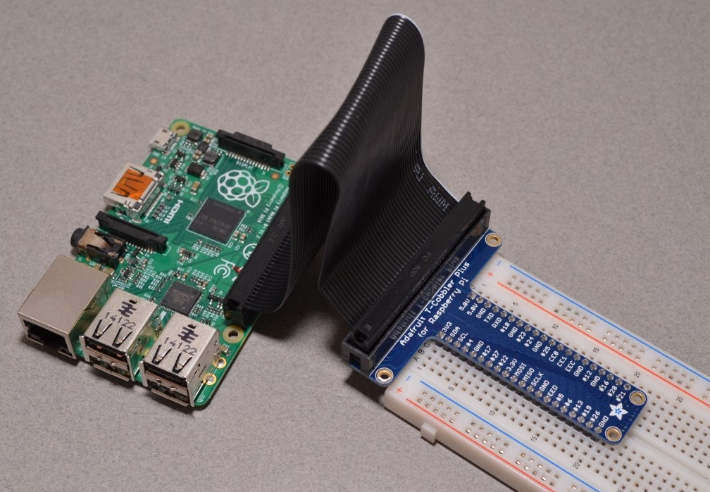
T-Cobbler Plus and Bread-board
Pin 1
Front
White line marks pin 1
Rear
Pin 40

Slide 33
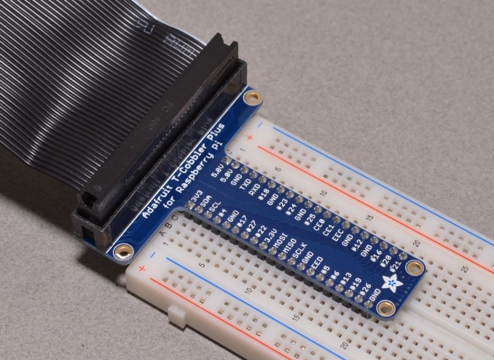
Bread-board Layout
White line marks pin 1
Outer 2 columns continuous vertically
    3.3V power, ground
Inner rows continuous horizontally, 5 pins/row
    Not connected across central gutter
Gutter

Slide 34
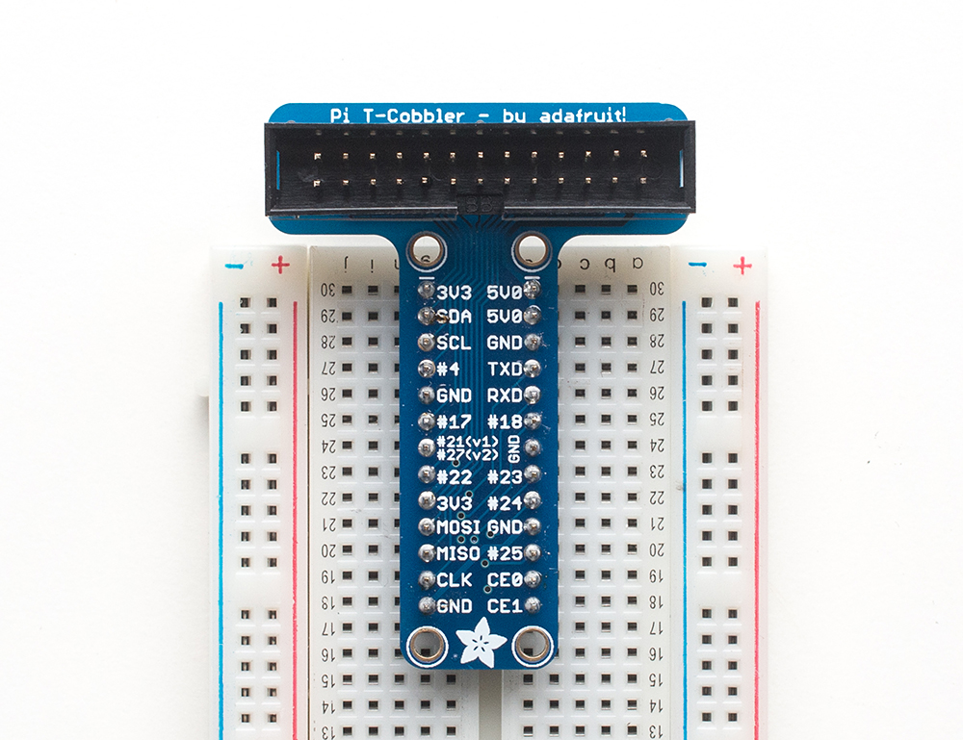
T-Cobbler Plus and Bread-board Serial Example

Slide 35
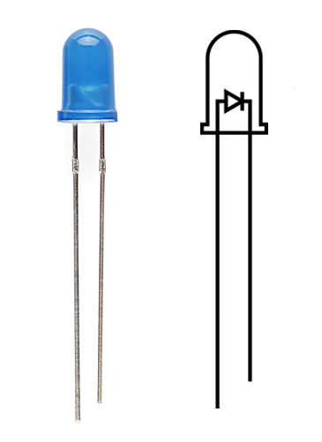
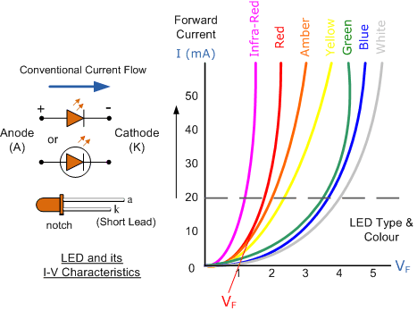
LED = Light Emiting Diode
LED has a polarity
  Current only flows one way in a diode
  Reverse breakdown voltage < -20V
Forward voltage = 1.5 to 3.5 V
  Red < Green < Blue
max current = 20 mA. Too much current/heat destroys LED
I/V curve is exponential. Hard to limit Current by controlling Voltage
  Use Ballast Resistor in series
  Current = Voltage/Resistance
    Ohm’s Law
  Assume voltage drop on LED = V_{F}
  Current =(V – LED V_{F})/ballast R

Slide 36
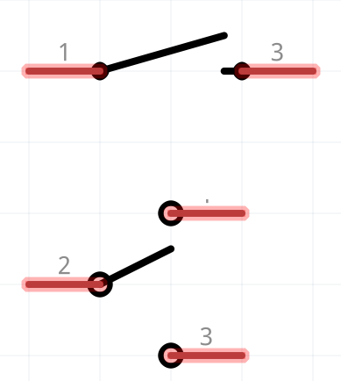
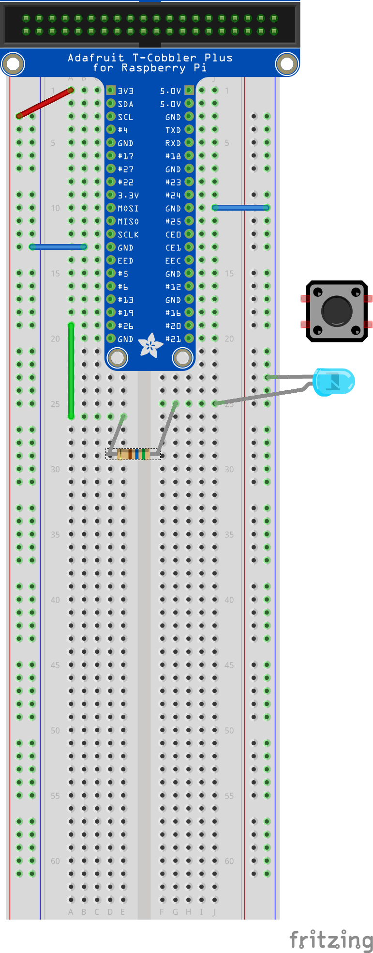
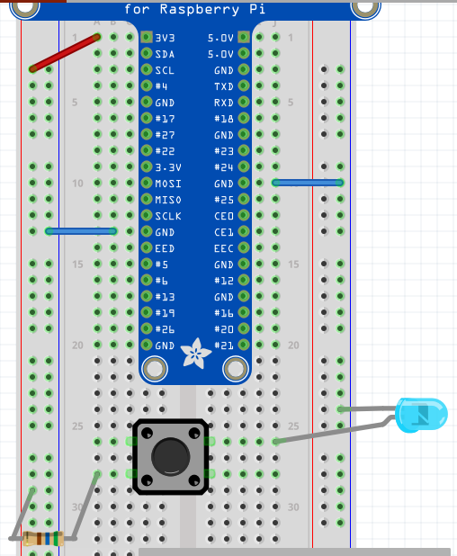
Switch an LED (Manually)
Left Power rail wired to Pi 3.3 V
Ground rails wired to Pi ground
560 Ohm resistor to limit current.
  (3.3V - 2V)/560 Ohm= 2.3 mA
Momentary switch connects when pressed.
  4 pins for mechanical stability. The 2 pins across each row are permanently connected.
  Make it span the gutter, connect diagonals
power->resistor->switch->LED->ground
  Order of resistor, switch, LED not important
LED has a polarity
  No light, flip LED
  short leg to ground

Slide 37
Raspberry Pi Digital Outputs
Digital output is High or Low (3.3V CMOS)
  Set High 3.3v -> GPIO pin -> load
  pin sources current drives voltage to >= 2.4 V
  Set Low load -> GPIO pin -> gnd
  pin sinks current pulls voltage to <= 0.5 V
How much Current can a GPIO pin sink/source and still maintain Voltage within specification?
  configurable per pin from 2 to 16 mA
  Default is 8 mA
  Exceed that current and voltage on pin sags
  The total current from all pins must not exceed 51mA or you may damage the pi
Higher resistance load = lower current draw
  Use a transistor to drive low resistance loads
GPIO 26 -> Resistor -> LED -> Ground
GPIO 26 -> Resistor -> LED -> 3.3V ?

Slide 38
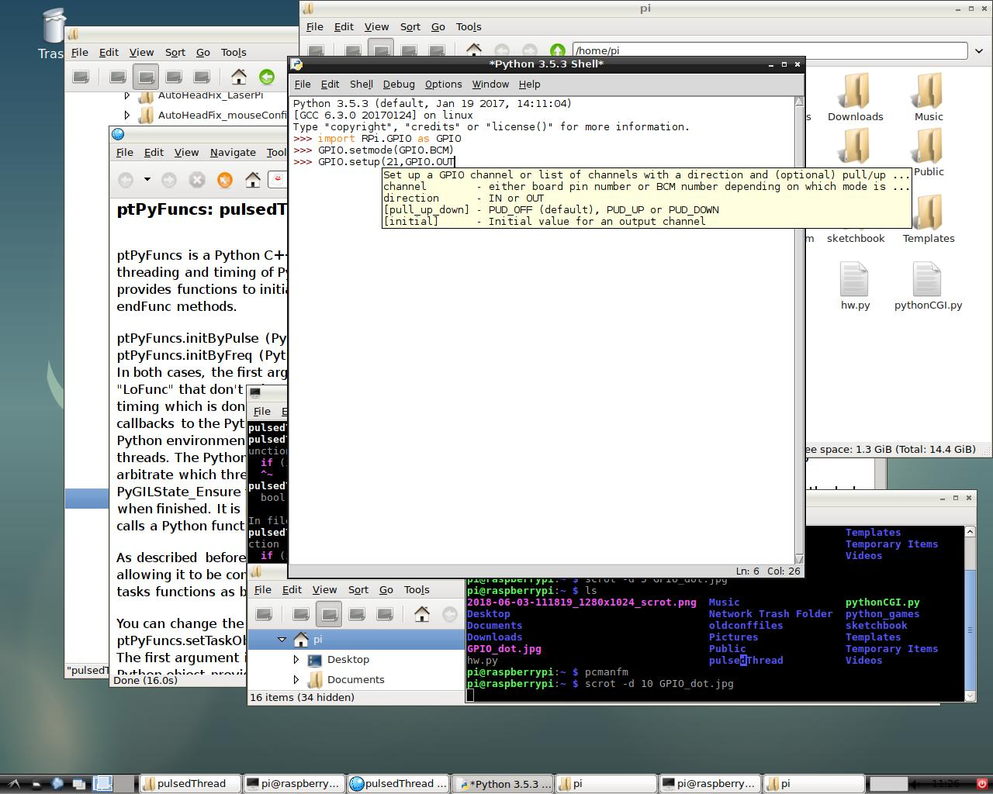
Switch LED using Python library RPi.GPIO
sourceforge.net/p/raspberry-gpio-python/wiki/
In a terminal, $gksudo idle3 & to open idle with access to /dev/mem. In Python:
>>> import RPi.GPIO as GPIO ”as” so you can refer to it as GPIO
>>> GPIO.setmode(GPIO.BCM) Broadcom numbers, not header numbers
>>> GPIO.setup(26, GPIO.OUT) set up GPIO 26 for output
>>> GPIO.output(26, GPIO.HIGH)sets GPIO 26 to 3.3 V
>>> GPIO.output (26, GPIO.LOW) sets GPIO 26 to ground
>>> GPIO.cleanup(26) when we are done with GPIO 26

Slide 39
Blink an LED using a Python Script blink.py
From File Menu -> Open -> blink.py From Run Menu -> Run Module
import RPi.GPIO as GPIO # import Rpi.GPIO library
from time import sleep # for timing LED on and off periods
the_pin = 26 # declare variables
on_time = 0.5
off_time= 0.5
blinks = 10
GPIO.setwarnings(False) #warns if GPIO pin is already in use
GPIO.setmode(GPIO.BCM) # always use Broadcom pin numbering
GPIO.setup(the_pin,GPIO.OUT) # set pin for output
for blink in range (0, blinks): # loops for blinks times
GPIO.output(the_pin,GPIO.HIGH) #LED turns on
sleep (on_time) # sleep for LED on time
GPIO.output(the_pin,GPIO.LOW) # LED turns off
sleep (off_time) # sleep for LED off time
GPIO.cleanup () # prevents warnings from pin in use

Slide 40
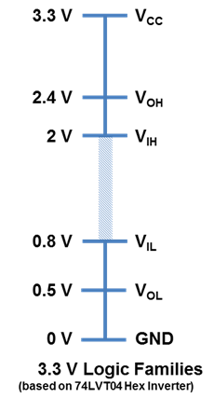
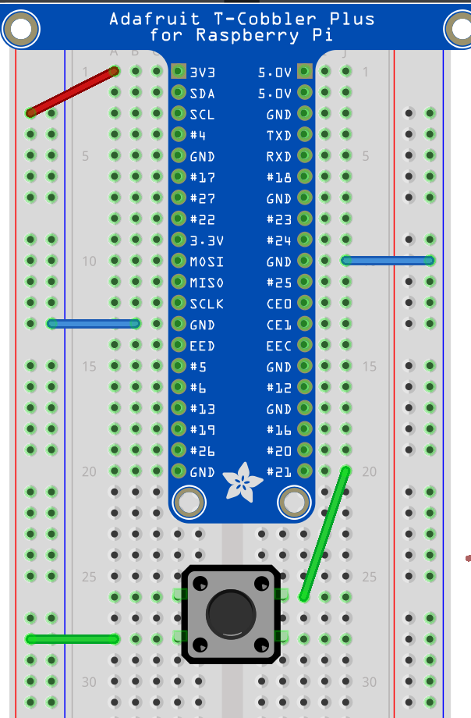
Raspberry Pi Digital Inputs
Inputs are read as high if above 2 volts
Inputs are read as low if below 0.8 volts
Inputs between those levels are undefined
Can you see a problem with this circuit ?
Keep 0 < input < 3.3 V to prevent damage to the Pi
  The Pi GPIO pins are NOT 5V tolerant

Slide 41
Raspberry Pi Digital Inputs
Your momentary switch is Single Throw (closed or open)
How can we change the circuit to get reliable inputs ?
    high when switch is pushed
    low when switch is not pushed
???
GPIO input
3.3 V
Single Pole Single Throw (SPST)
ground
GPIO input
3.3 V
Single Pole Double Throw (SPDT)

Slide 42
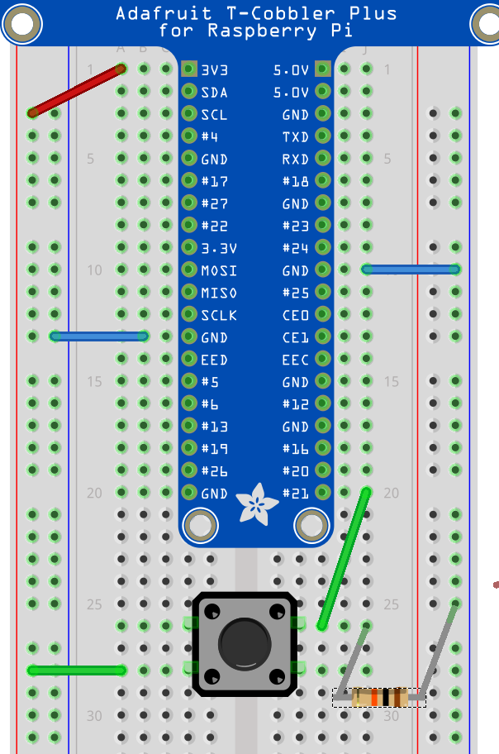
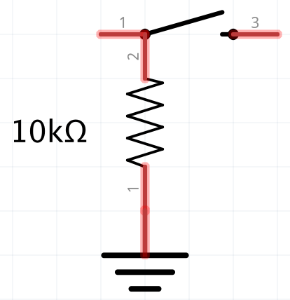
GPIO input with a pull-down Resistor
With a pull-down resistor, input is pulled down to ground through resistor when switch is open
When switch is closed, current draw from voltage source is 3.3 V/10 k = 0.33 mA
GPIO input
3.3 V
Could swap the 3.3V and ground and have a pull-up resistor to 3.3V, with switch Hi/Low logic reversed
ground

Slide 43
Read Digital Inputs using RPi.GPIO
>>> GPIO.setup(21, GPIO.IN) # set up GPIO 21 for input
>>> GPIO.input (21) # returns 1 if GPIO pin is High, 0 if pin is Low
From File Menu -> Open -> check_input.py From Run Menu -> Run Module
import RPi.GPIO as GPIO # gksudo idle3 for access to /dev/mem
from time import sleep
in_pin = 21
GPIO.setmode(GPIO.BCM)
# enable built in pull-down resistor on GPIO Pin (also PUD_UP)
GPIO.setup(in_pin,GPIO.IN, pull_up_down = GPIO.PUD_DOWN)
while True: # infinite loop
try: # exceptions try-catch
if GPIO.input(in_pin) is GPIO.HIGH:
print ('GPIO pin ' + str (in_pin) + ' is high')
else:
print ('GPIO pin ' + str (in_pin) + ' is low')
sleep (0.1) # 1/0.1 sec = 10Hz rate
except KeyboardInterrupt: # ctrl-c triggers interrupt
GPIO.cleanup()
break # breaks out of infinite loop

Slide 44
GPIO Input: Edge Detection
An edge is the change in state of an electrical signal from LOW to HIGH (rising edge) or from HIGH to LOW (falling edge).
  Edge changes are events, as opposed to states (high and low)
  We are often more interested in events than states
Checking GPIO input level repeatedly in a loop is called polling.
  Processor intensive to poll at a high frequency
  Easy to miss events polling at too low a frequency
From File Menu -> Open -> check_input_edge.py From Run Menu -> Run Module
while GPIO.input(in_pin) is GPIO.LOW:#polling for low-to-high
sleep (sleep_time) # replace with pass for performance
# pass
print ('GPIO pin ' + str (in_pin) + ' went HIGH')

Slide 45
Rpi.GPIO functions for Edge Detection
GPIO.wait_for_edge (GPIO pin, event,[bouncetime, timeout])
event can be GPIO.RISING, GPIO.FALLING or GPIO.BOTH
bouncetime in milliseconds
    transitions are ignored unless a constant state is maintained for this many milliseconds (to mitigate physical switch bounce)
    Too short a bounce time gives extra events
    Too long a bounce time may ignore real events
  Timeout in milliseconds
    Function returns after the timeout expires, even if an event has not occurred
  Returns GPIO pin number if an event has occurred before the timeout, returns None (a special Python object) if there is a timeout.
  Doesn’t miss the event, doesn’t use processor time while waiting
  Your program is blocked while waiting for event or timeout

Slide 46
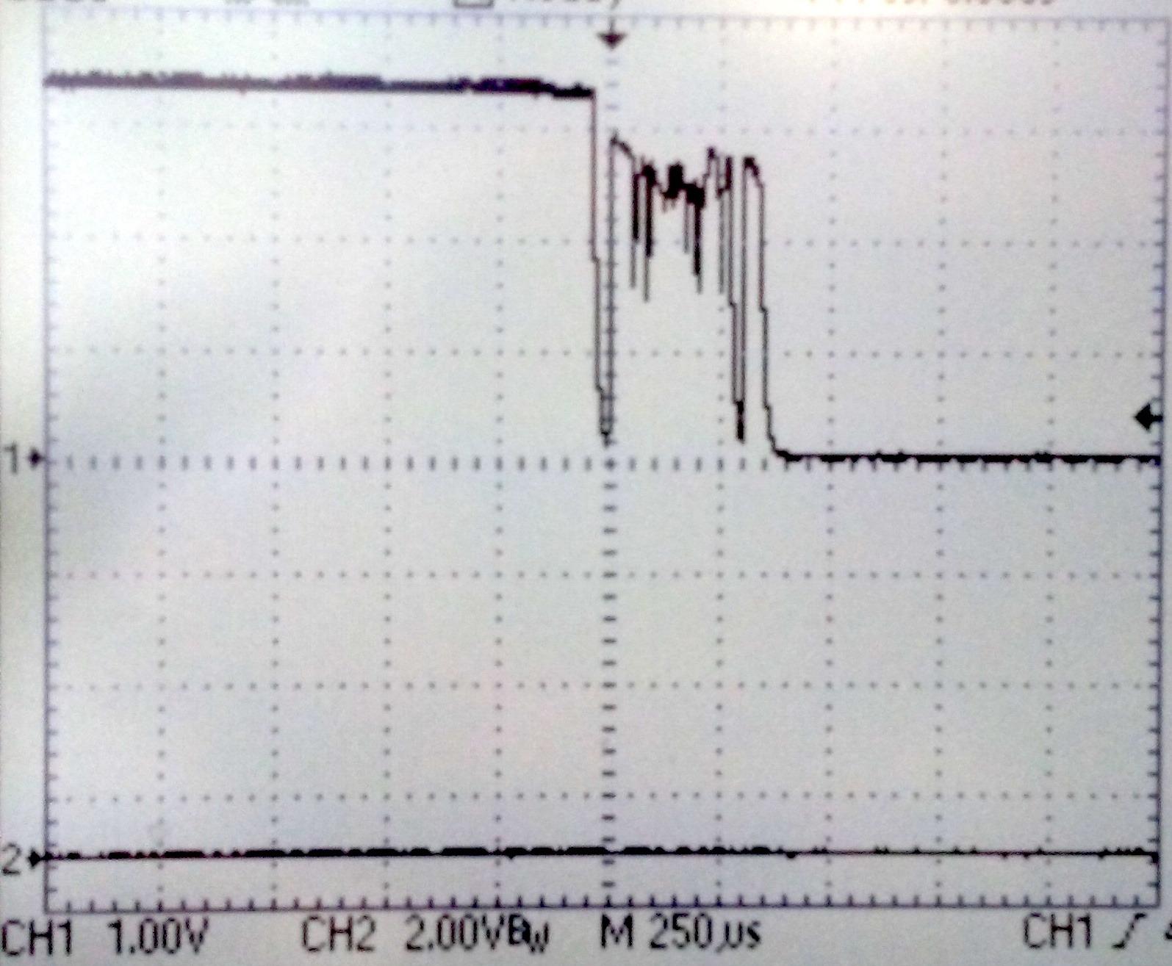
Edge Detection: Switch Debounce
Mechanical switches bounce when switched, rapidly making and breaking contact until they settle (1 ms or more depending on switch).
  Bounces give rise to phantom events
Software debounce or filter with capacitor
3 V
1 ms

Slide 47
GPIO input: wait_for_edge.py
# Set up a pin for input as usual
GPIO.setup (in_pin, GPIO.IN, pull_up_down=GPIO.PUD_DOWN)
# each time through loop, call wait for edge
result = GPIO.wait_for_edge(in_pin, GPIO.BOTH, bouncetime= bounce_time_ms, timeout=time_out_ms)
# check for timeout
if result is None:
  print ('No button press on GPIO pin ' + str (in_pin) + ' for ' + str (time_out_ms/1000) + ' seconds.')
# As we waited for both rising and falling, check level
if GPIO.input (in_pin) is GPIO.HIGH:
  print ('GPIO pin ' + str (in_pin) + ' went HIGH')
else:
  print ('GPIO pin ' + str (in_pin) + ' went LOW')

Slide 48
GPIO input: edge_detected.py
GPIO.add_event_detect(pin, edge,[callback, bouncetime])
GPIO.event_detected(pin)
Designed to be used in a loop where you want to do other things without constantly checking for an event.
  Your program is not blocked, and not constantly polling
  event_detected has a memory, but only for the most recent event
  If more than one event since last check, previous events will be lost
# Set up a pin for input as usual, then add event to detect
GPIO.setup (in_pin, GPIO.IN, pull_up_down=GPIO.PUD_DOWN)
GPIO.add_event_detect(in_pin, GPIO.BOTH, bouncetime = bounce_time_ms)
# in the loop, do some work, then check if an event happened
sleep (processing_time) # simulates doing other processing
result = GPIO.event_detected(in_pin) # if True, an event

Slide 49
GPIO input: edge_counter.py
Callback functions are threaded (threads run concurrently with data shared)
  A callback function runs at the same time as your main program, in immediate response to an edge. my_callback (pin)
  Global variables share information with callback and main program
rising_edges =0 #define globals outside of any functions
falling_edges =0
# to share a global variable between two threads, you need two functions. we define a main function
def main ():
    # body of main function goes here
# tell Python to run main() when file is opened
if __name__ == '__main__':
main()

Slide 50
GPIO input: edge_counter.py
The callback function that runs in a separate thread when an edge is detected
  It increments global variable rising_edges if a low-to-high transition, or falling_edges if a high-to-low transition
def counter_callback(channel):
global rising_edges #global, same variable in main
global falling_edges
if GPIO.input (channel) is GPIO.HIGH:
rising_edges +=1 #increment rising_edges
else:
falling_edges +=1 #increment falling_edges

Slide 51
GPIO input: edge_counter.py
In main(), we occasionally check how many events have occurred. We only read global variables in main (), never write to them as the callback runs concurrently
global rising_edges #the global tells Python these variables
global falling_edges #are declared outside of the function
sleep (processing_time) # simulates doing other processing
#rising_edges – last_rising = rising edges in processing_time
print ('GPIO pin ' + str (in_pin) + ' went HIGH ' +
str (rising_edges - last_rising) + ' times in the last ' + str (processing_time) + ' seconds')
last_rising = rising_edges # keep track of values before
last_falling = falling_edges # next period of sleeping.
print ('GPIO pin ' + str (in_pin) + ' went HIGH a total of ' + str (rising_edges) + ' times') # at ctrl-c, print totals

Slide 52
GPIO: a Challenge
Think about how you would write a program that waits for a button press and lights an LED when the button is pressed.
Combine whichever of the GPIO input and output functions that you like. There’s more than one way to do this.
Yes, you can light an LED from a switch without using a Raspberry Pi, but keep in mind that:
GPIO output to more “interesting” devices is the same as GPIO output for lighting an LED
GPIO input from a more “interesting” device is the same as processing input from a button press

Slide 53
PiCamera module v2.1
The PiCamera camera module has specs similar to a cell phone camera
  Sony IMX219 silicon CMOS back-lit sensor
  8 megapixel (3280 × 2464 pixels)
  400 to 700 nm spectral response (also a noIR version)
  ISO settings between 100 and 800 in steps of 100, or auto gain
  exposure times between 9 μs and 6 s (Rolling Shutter)
  24 bit RGB output (10-bit A/D converter on chip, resampled to 8)
  Movies:
    up to 15 frames per second (fps) full-frame imaging video
    up to 30 fps in 1080p - faster, more reliable, with reduced image size
    Frames will be dropped if Pi is taxed (pre-allocate an array ?)

Slide 54
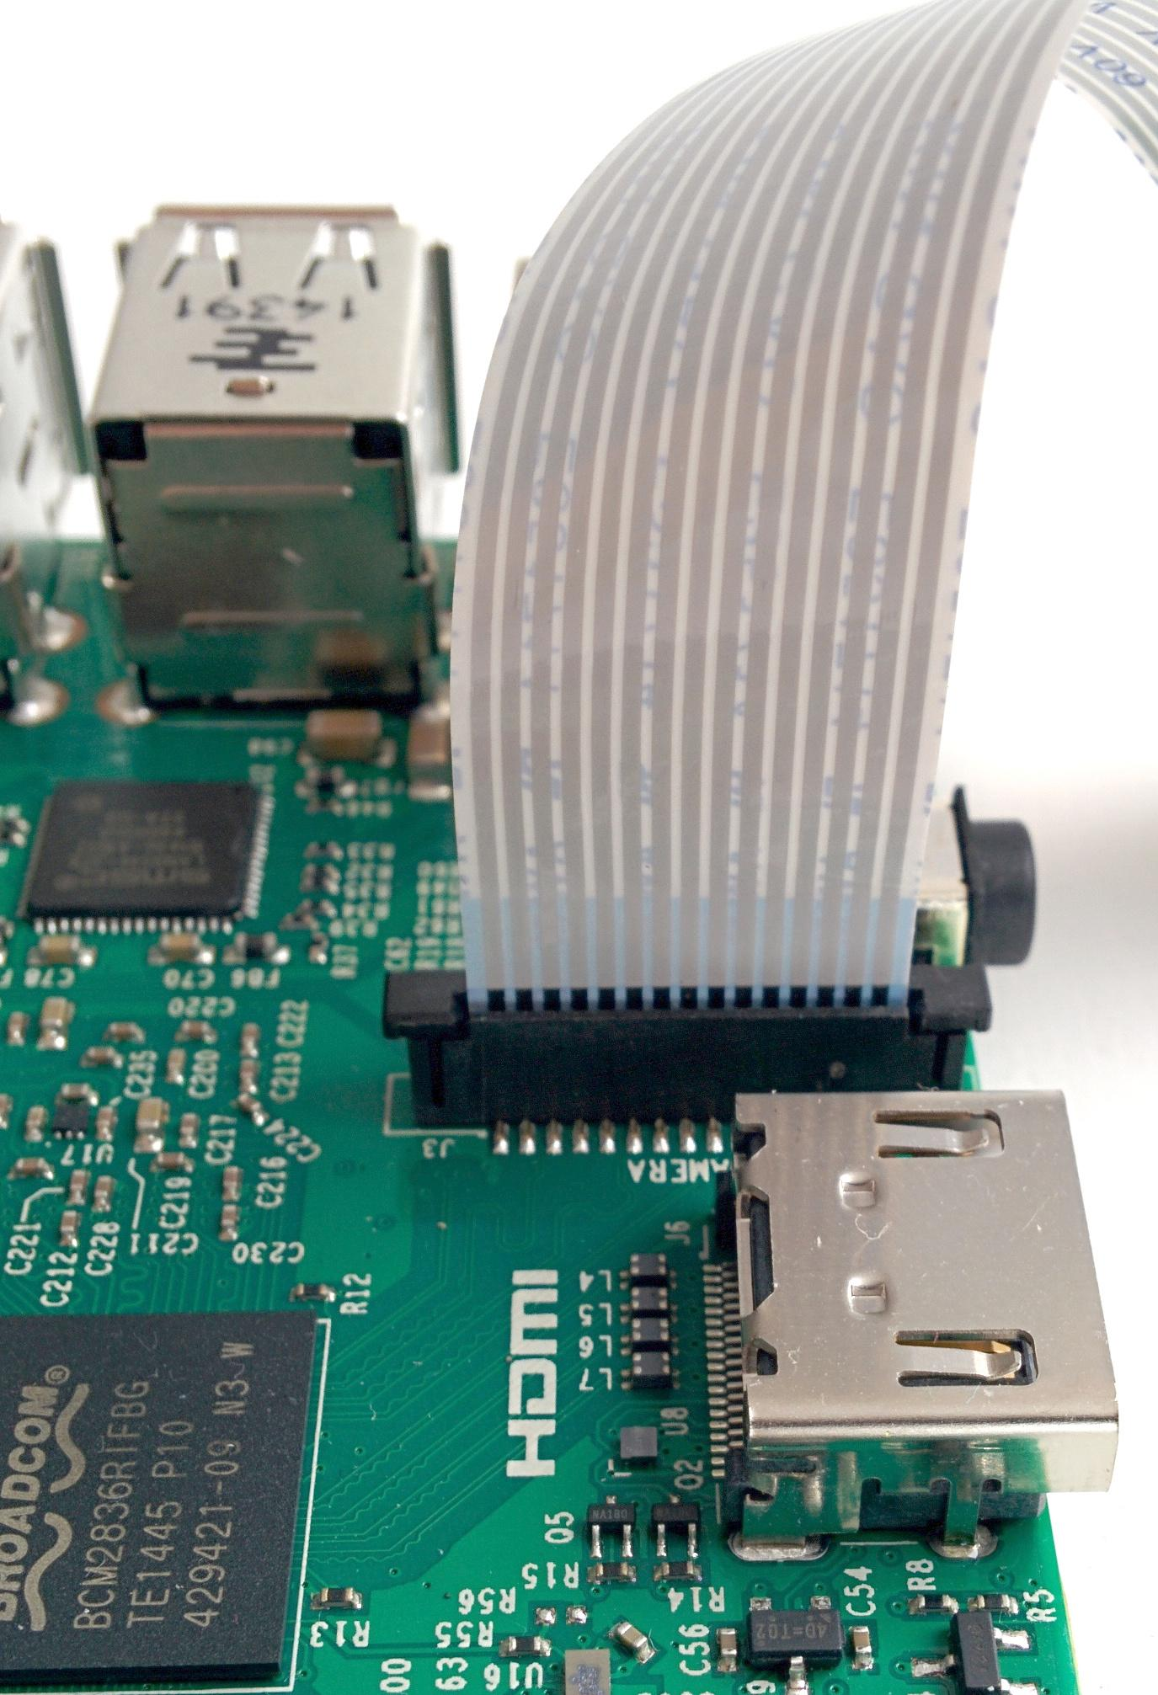
Proper PiCamera Cable Insertion
Biggest cause of problems is reversed cable insertion
On both the Pi and the camera
Avoid kinks in the cable (can connect adjacent pins)
Shutdown pi
  Select shutdown from raspberry menu, or
  $sudo shutdown -t 0 -h -P now
  Unplug power before plugging in camera
Plug ribbon cable into slot by HDMI connector
  Avoid the similar display connector at front of pi
  Ethernet and USB at rear of pi
  Silver connectors side of cable faces to front of pi
  Lift tabs, insert cable, press down tabs
Reboot pi
Login:pi
Password:raspberry
$startx
Rear
Front

Slide 55
PiCamera Python Interface
picamera.readthedocs.io/en/release-1.13/
import picamera
camera = picamera.PiCamera() # constructor for PiCamera object
camera.resolution = (640, 480) # horizontal size, vertical size
camera.framerate = 30
camera.preview_fullscreen = False
camera.preview_window = (20, 40, 680, 500) # left, top, right, bottom
camera.start_preview()#draws directly to the screen
camera.capture ('test.jpg') #takes a single image
camera.start_recording(name.h264)#extension sets filetype
many more settings than shown here (gain, white balance, ISO) but defaults are o.k.

Slide 56
camera_test.py
Preview running at this point
Sleep the cpu, wait for keyboard interrupt
while True:
  try:
time.sleep(0.1)
#Press CTRL+C to stop the preview and take picture
  except KeyboardInterrupt:
camera.capture ('test.jpg') #take single image
camera.stop_preview()
camera.close()
break
To see the picture, open a folder window from the task bar, and double-click on your picture (it’s not your father’s Linux anymore)

Slide 57
GPIO and movies: camera_on_button.py
>>> from time import time
>>> from datetime import datetime
time() returns seconds since 1970/01/01 - use this to grab time stamps
datetime is for human readable date/time formats. A datetime object has fields for year, month, day, hour, minutes, seconds, microseconds
datetime.fromtimestamp (time()).isoformat (' ')
fromtimestamp returns a datetime object from number of seconds since 1970/01/01
.isoformat (' ') returns a string with formatted date, parameter is separator character, a space in this case
>>> now = time()
>>> dt = datetime.fromtimestamp(now)
>>> dt.isoformat(‘ ‘)

Slide 58
camera_on_button.py
result = GPIO.wait_for_edge(in_pin, GPIO.FALLING, bouncetime= bounce_time_ms, timeout = 1000)
if result is None:
    continue # continues at top of loop (ctrl-c)
camera.start_recording(base_name + str(trial_num) + '.h264') # h264 is a video format, with compression
startSecs= time()
camera.start_preview()
isRecording = True
print ('Started recording ' + base_name + str(trial_num) + '.h264 at ' + datetime.fromtimestamp (int(startSecs)).isoformat (' '))

Slide 59
camera_on_button.py
timed_out = not GPIO.wait_for_edge(in_pin, GPIO.FALLING, bouncetime= bounce_time_ms, timeout=max_movie_time)
camera.stop_recording()
endSecs = time()
camera.stop_preview()
isRecording = False
if timed_out:
print ('movie ' + base_name + str(trial_num) + '.h264 stopped because of time out after ' + str( endSecs -startSecs) + ' seconds')
else:
print ('movie ' + base_name + str(trial_num) + '.h264 stopped because of button up after ' + str( endSecs -startSecs) + ' seconds')
$omxplayer trial_1.h264

Slide 60
GPIO: a Bigger Challenge
Write a program that lights an LED and then waits for a button press, timing the interval between LED and button press. Now you have a reaction time task.
Which GPIO methods would be best to use?
You can make it fancier with two buttons, making sure that the first button stays pressed until the LED is lit – so no cheating.
You can add a random element to time between trials with random.random () which returns a number between 0 and 1.

Slide 61
Care and Feeding of a Raspberry Pi
Frontiers in Neurophotonics Summer School 2018
Jamie Boyd
Dongsheng Xiao
Tim Murphy

Slide 62
Setting up an SD Card
Some cards come with Rasbian (or other) OS installed
Otherwise, you can install your own
Start at https://www.raspberrypi.org/downloads/
  Download a disk image
  Copy the disk image to the SD card
  Etcher is a graphical SD card writing tool that works on Mac OS, Linux and Windows https://etcher.io/
Raspbian versions named after Toy Story characters
  wheezy->jessie->stretch check version with $lsb_release -a
  Latest Pi needs latest OS, but latest OS will work with oldest Pi

Slide 63
sudo raspi-config
Change default user password for security
Set time zone, locale, and WiFi country code.
  All options on these menus default to British or GB until you change them.
Where did my !@#$% pound sign go?
  Change keyboard layout to US layout to change ₤ into #
Enable camera, i2c, spi, remote ssh login as needed
  To use the serial port for hardware control, you have to disable the ability to login to the pi remotely over serial.

Slide 64
apt-get is for software package management
Command
apt-get update
apt-get upgrade
apt-get dist-upgrade
apt-get install pkg
apt-get remove --purge pkg
apt-get -y autoremove
apt-get install synaptic
All if these need sudo
What it Does
updates list of packages available from repositories
Upgrades all installed packages to latest versions
Also updates dependent packages
downloads and installs a software package pkg
removes the package pkg wolfram-engine, libreoffice
removes packages that are no longer required
installs a GUI package manager front-end

Slide 65
Sudo: super user-level security privileges
sudo and gksudo allow users to run commands or launch programs with super user-level security privileges (access /dev/mem for GPIO)
gksudo also sets HOME=/root, and copies .Xauthority to a tmp directory. This prevents files in your home directory becoming owned by root. May be better when launching applications with windowed (GUI) interfaces (-H option for sudo does the same thing)
$sudo -H python3 myprogram.py
runs myprogram.py with python interpreter permissions elevated to use GPIO library for hardware access
$gksudo idle3 &
launches idle for Python 3, whatever program you run has elevated permissions. The & lets you use the terminal window while idle runs

Slide 66
Sharing Data with PCs
Why does this USB drive not work on my pi?
  Linux native file system format is ext3 or ext4
  Windows native file system is NTFS
  Macintosh native file system is APFS, which replaced HFS+
How can I make them all share a drive?
  For small thumb drives, format the drive as FAT32 (4 GiB file limit)
  Install NTFS support for Raspbian
    $sudo apt-get install ntfs-3g
  Consider exFAT, since Windows and Mac support it natively
    $sudo apt-get install fuse-exfat
    https://en.wikipedia.org/wiki/Comparison_of_file_systems

Slide 67
Controlling the Pi over a Network
Login remotely with ssh
$ssh pi@142.103.107.xxx
pi@142.103.107.xxx's password:
The programs included with the Debian GNU/Linux system are free software;
the exact distribution terms for each program are described in the
individual files in /usr/share/doc/*/copyright.
Debian GNU/Linux comes with ABSOLUTELY NO WARRANTY, to the extent
permitted by applicable law.
Last login: Sun May 6 04:17:06 2018
pi@raspberrypi:~ $

Slide 68
Copying/Sending Data over a Network
scp copies files over a secure, encrypted network connection
  From a remote computer to the local computer
  $scp pi@192.168.0.102:RemotePath/RemoteFileName LocalPath
  From the local computer to a remote computer
  $scp LocalPath/LocalFileName pi@192.168.0.102:RemotePath
  Recursively for all files in a directory (can also use wild cards *)
  $scp -r pi@192.168.0.102:RemotePath LocalPath
For GUI version for Windows or Mac:
  FileZilla, Cyberduck, WinSCP

Slide 69
The Pi and Keeping Time
Most computers have a real time clock with a battery that runs the clock when power is switched off
The Pi must reset its clock when it boots up to get correct time
  It uses a network timeserver to get correct date and time, resynching occasionally
  No network, and date/time will be same as when Pi was last shut down
You can set current date and time with date command
  $sudo date -s '2018-06-13 15:30:00'
  The Pi will then keep fairly accurate time until it is shut off again
You can add an i2c real time clock module to a raspberry pi:
https://learn.adafruit.com/adding-a-real-time-clock-to-raspberry-pi

Slide 70
Use git/github for Sharing Code
git is a version control system that tracks changes in files and allows editing by multiple users
Github hosts open source git repositories for free and provides a web interface for git. This presentation and the code referred to in it can be copied to your computer like this:
$git clone https://github.com/jamieboyd/neurophoto2018
This downloads the documents, plus some hashed git database stuff.
You can update to the latest version from github with the git pull command executed in your downloaded repository directory:
$cd neurophoto2018
$git pull
It is also easy to setup a git repository on your own servers

