Slide 1
Best US Cities to Live
Examining the Quality of Life through Visualization
Tyler Adams | Edgardo Bungay | Jamie DeGuzman | Ron Javor

Slide 2
The Story
Which US city is ideal?
Many factors determine quality of life – personal differences in parameters and priorities
We examined relative rankings and correlations with data from Wallethub:
Cost-of-Living
Weather
Happiness
Health
Parks
Community

Slide 3
Data Sources, Methodologies
Wallethub provides rankings, scorings for a number of measures. Data not natively consolidated
Data manually scraped then munged and merged in Python – latitude, longitude determined by Geocoding API
Data output in both CSV, JSON formats – stored to MongoDB in JSON form
Map visualization with Leaflet –show multiple maps in dashboard format for quick views
D3 Scatter Plot with variable axis to compare measures – colors determined as a product multiplier of each axis
Best product multiplier cities rankings are green, near plot origin. Worst are Maroon, far from origin
Tabular output of data to provide numerical reference
Flask full-stack app used for display

Slide 4
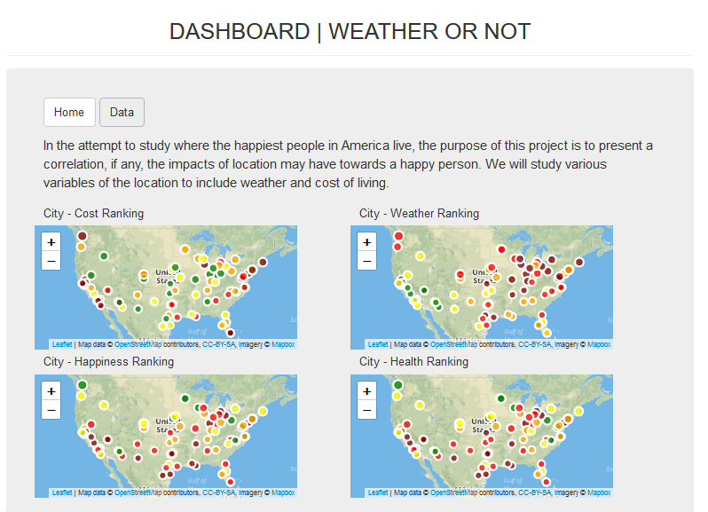
Dashboard Snapshot: Multi-Leaflet

Slide 5
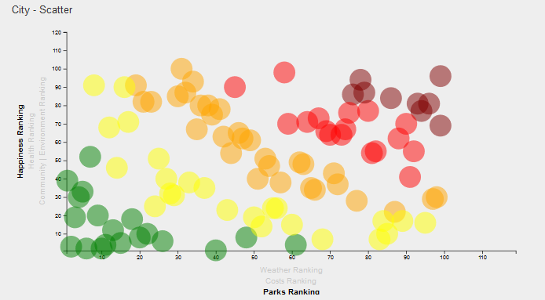
Dashboard Snapshot: D3 Variable-Axis Scatter Plot

Slide 6
Dashboard Snapshot: Tabular Output

Slide 7
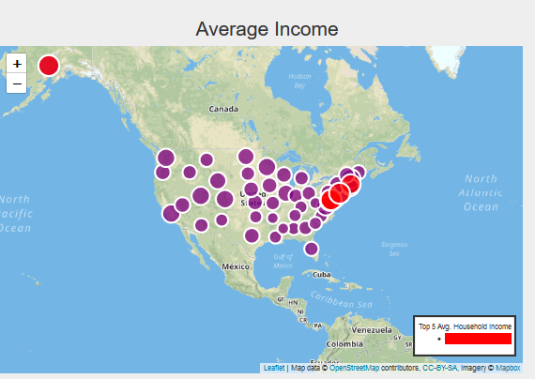
Dashboard Snapshots - Leaflet

Slide 8
Linear Regression – Top 12
Measure1 | Measure2 | Slope | P-value
hap_entertainment | health_rank | 0.692889 | 6.754246e-15
greenspace_rank | health_rank | 0.574157 | 8.273011e-10
hap_entertainment | income_employment | 0.572916 | 1.120893e-09
health_rank | income_employment | 0.571850 | 5.228215e-10
community_environment | health_rank | 0.507184 | 1.913020e-07
community_environment | hap_entertainment | 0.394299 | 6.045790e-05
costs | hap_entertainment | -0.392757 | 6.066075e-05
hap_entertainment | greenspace_rank | 0.376317 | 1.220398e-04
community_environment | income_employment | 0.364828 | 2.983343e-04
greenspace_rank | income_employment | 0.338554 | 6.899035e-04
costs | greenspace_rank | -0.251905 | 1.245095e-02
community_environment | weather | 0.215444 | 3.203444e-02

Slide 9
Summary
Not every city has it all
Happiness, Health, Income and Environment / Greenspaces show the strongest linear cross-correlation
Weather did not strongly correlate to any other measure
Costs only lightly correlated
Issues
Common denominator cities reduced the list to 100 (from ~ 300)
Rankings had to be normalized to a scale of 1-100 (ranking of 189 wouldn’t make sense)

