Slide 1
A Spoonful of Medicine for Meta-Analysis:
Introducing Meta-Sen
James G. Field
West Virginia University
Frank A. Bosco, Sven Kepes
Virginia Commonwealth University
SMA PDI | October 11, 2019
Norfolk, VA
All submission materials (e.g., original submission, PowerPoint slides, sample data sets) can be found at: https://jamiefield.github.io/research/sma2019

Slide 2
Agenda
Visit https://jamiefield.github.io/research/sma2019 for submission materials
What is meta-analysis and why is so important?
The current research environment
Threats to our cumulative scientific knowledge: outliers and publication bias
What is sensitivity analysis?
Live demonstration of Meta-Sen
Recommendations for minimizing the impact of outliers and/or PB
Discussion/questions/comments from the audience
Additional slides
  Review of two outlier assessment methods
  Review of five publication bias assessment methods
  Results that illustrate the combined effect of outliers and PB on recently published meta-analytic datasets

Slide 3
What is Meta-Analysis?
Meta-analysis is a statistical technique by which information from independent studies is assimilated
  Field, A. P. (2011)
Meta-analysis is a quantitative method used to combine the quantitative outcomes (effect sizes) of primary research studies.
  Combines the results from two or more studies
  Estimates an ‘average’ effect between two constructs
Meta-analysis is the statistical or data analytic part of a systematic review of a research topic.

Slide 4
What is Meta-Analysis?
There are two common approaches to meta-analysis
  The Hunter and Schmidt (2004; 2015) approach, which is most common in organizational research
  The Hedges and Olkin (1985) approach
For a description of both approaches, and their differences, please refer to Kepes et al. (2013)
Important note:
  We use the Hedges and Olkin (1985) approach as most sensitivity analysis techniques have not been developed for psychometrically-adjusted effect sizes

Slide 5
What is Meta-Analysis?
An example from the published literature

Slide 6
Study ID | Reference | Year | IV | DV | n | r
1 | Mitchell, Holtom, Lee, & Erez | 2001 | On-the-job embeddedness | Turnover | 177 | -0.24
2 | Crossley, Bennett, Jex, & Burnfield | 2007 | On-the-job embeddedness | Turnover | 306 | -0.08
3 | Mitchell, Holtom, Lee, & Erez | 2001 | On-the-job embeddedness | Turnover | 208 | -0.21
4 | Ramesh & Gelfand | 2010 | On-the-job embeddedness | Turnover | 474 | -0.13
5 | Giosan, Holtom, & Watson | 2005 | On-the-job embeddedness | Turnover | 122 | -0.30
6 | Mallol, Holtom, & Lee | 2007 | On-the-job embeddedness | Turnover | 164 | -0.16
7 | Lee, Mitchell, & Holtom | 2004 | On-the-job embeddedness | Turnover | 809 | -0.11
8 | Kraimer, Shaffer, Harrison, & Ren | 2012 | On-the-job embeddedness | Turnover | 112 | -0.17
9 | Ramesh & Gelfand | 2010 | On-the-job embeddedness | Turnover | 323 | -0.14
10 | Harris, Wheeler, & Kacmar | 2011 | On-the-job embeddedness | Turnover | 205 | -0.19
11 | Allen | 2006 | On-the-job embeddedness | Turnover | 222 | -0.23
12 | Wheeler, Halbesleben, & Sablynski | 2011 | On-the-job embeddedness | Turnover | 142 | -0.26
13 | Tanova & Holtom | 2008 | On-the-job embeddedness | Turnover | 9277 | -0.08
14 | Wheeler, Halbesleben, & Sablynski | 2011 | On-the-job embeddedness | Turnover | 134 | -0.19
15 | Mallol, Holtom, & Lee | 2007 | On-the-job embeddedness | Turnover | 164 | -0.13
16 | Tharenou & Caulfield | 2010 | On-the-job embeddedness | Turnover | 546 | -0.18
17 | Smith, Holtom, & Mitchell | 2011 | On-the-job embeddedness | Turnover | 750 | -0.25
18 | Smith, Holtom, & Mitchell | 2011 | On-the-job embeddedness | Turnover | 1,089 | -0.19

Slide 7
Study ID | Reference | Year | IV | DV | n | r | sei
1 | Mitchell, Holtom, Lee, & Erez | 2001 | On-the-job embeddedness | Turnover | 177 | -0.24 | 0.0758
2 | Crossley, Bennett, Jex, & Burnfield | 2007 | On-the-job embeddedness | Turnover | 306 | -0.08 | 0.0574
3 | Mitchell, Holtom, Lee, & Erez | 2001 | On-the-job embeddedness | Turnover | 208 | -0.21 | 0.0698
4 | Ramesh & Gelfand | 2010 | On-the-job embeddedness | Turnover | 474 | -0.13 | 0.0461
5 | Giosan, Holtom, & Watson | 2005 | On-the-job embeddedness | Turnover | 122 | -0.3 | 0.0917
6 | Mallol, Holtom, & Lee | 2007 | On-the-job embeddedness | Turnover | 164 | -0.16 | 0.0788
7 | Lee, Mitchell, & Holtom | 2004 | On-the-job embeddedness | Turnover | 809 | -0.11 | 0.0352
8 | Kraimer, Shaffer, Harrison, & Ren | 2012 | On-the-job embeddedness | Turnover | 112 | -0.17 | 0.0958
9 | Ramesh & Gelfand | 2010 | On-the-job embeddedness | Turnover | 323 | -0.14 | 0.0559
10 | Harris, Wheeler, & Kacmar | 2011 | On-the-job embeddedness | Turnover | 205 | -0.19 | 0.0704
11 | Allen | 2006 | On-the-job embeddedness | Turnover | 222 | -0.23 | 0.0676
12 | Wheeler, Halbesleben, & Sablynski | 2011 | On-the-job embeddedness | Turnover | 142 | -0.26 | 0.0848
13 | Tanova & Holtom | 2008 | On-the-job embeddedness | Turnover | 9277 | -0.08 | 0.0104
14 | Wheeler, Halbesleben, & Sablynski | 2011 | On-the-job embeddedness | Turnover | 134 | -0.19 | 0.0874
15 | Mallol, Holtom, & Lee | 2007 | On-the-job embeddedness | Turnover | 164 | -0.13 | 0.0788
16 | Tharenou & Caulfield | 2010 | On-the-job embeddedness | Turnover | 546 | -0.18 | 0.0429
17 | Smith, Holtom, & Mitchell | 2011 | On-the-job embeddedness | Turnover | 750 | -0.25 | 0.0366
18 | Smith, Holtom, & Mitchell | 2011 | On-the-job embeddedness | Turnover | 1,089 | -0.19 | 0.0303

Slide 8
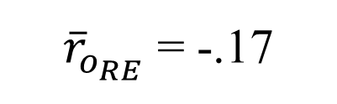
What is Meta-Analysis?
On-the-job embeddedness
Turnover
k = 18
${\overline{r}}_{o_{RE}}$ = -.17

Slide 9
Why are Meta-Analyses so Important?
Meta-analytic reviews are a primary way to summarize, integrate, and synthesize areas of research
  Schmidt & Hunter (2015)
Allows fields to build a cumulative scientific knowledge
  Kepes & McDaniel (2015)
Meta-analytic results serve as input for other analytic techniques that allow researchers to test theory
  E.g., relative importance analysis; meta-analytic structural equation modeling
Meta-analytic results often are used to inform evidence-based management
  Banks et al. (2011); Kepes et al. (2014)

Slide 10

The Current Environment

Slide 11
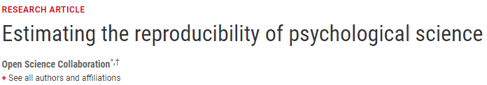
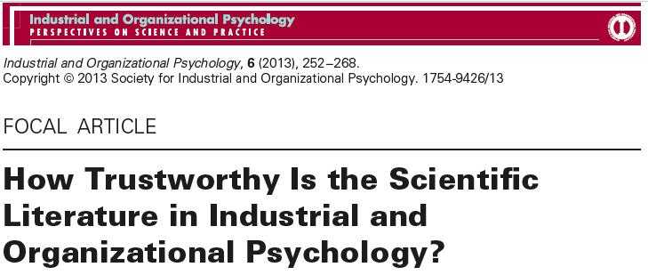

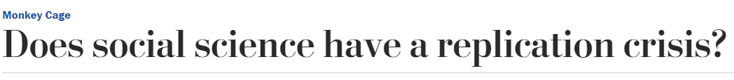
The Current Environment

Slide 12
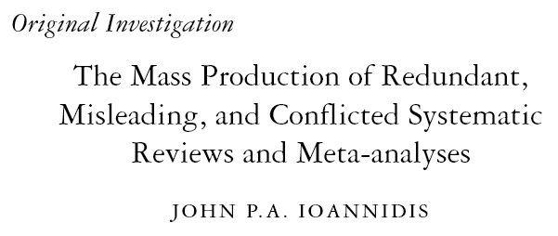
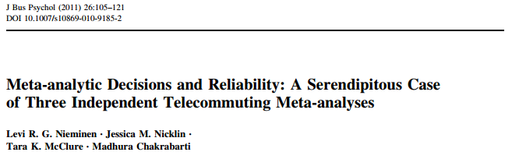
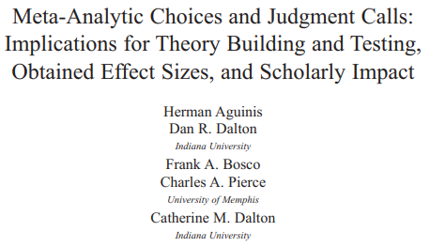

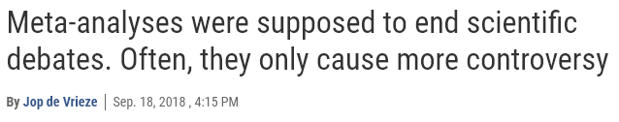
The Current Environment

Slide 13

The Current Environment
Excerpt taken from Engber, D. (March, 2016). Everything is crumbling. Slate.
Meta-analysis is not immune from scrutiny
  “All the old methods are in doubt. Even meta-analyses, which once were thought to yield a gold standard for evaluating bodies of research now seem somewhat worthless. “Meta-analyses are f*cked,” Inzlicht warned me. If you analyze 200 lousy studies, you’ll get a lousy answer in the end. It’s garbage in, garbage out.”
    From:
What could be driving opinions like these?

Slide 14
Threats to our Cumulative Knowledge
Outliers

Slide 15
Threats to our Cumulative Knowledge
Outliers
An observation that
appears “to deviate
markedly from other
members of the sample
in which it occurs”
(Grubbs, 1969, p. 1)

Slide 16
Threats to our Cumulative Knowledge
Outliers
Outcome-level causes
(e.g., effect size magnitude,
p-value)

Slide 17
Threats to our Cumulative Knowledge
Outcome-level causes of outliers: Effect size magnitude
  Samples that have an effect size that diverges from all other samples in the dataset may need to be removed before performing a meta-analysis as they could introduce residual heterogeneity that may threaten its results and conclusions.

Slide 18
Threats to our Cumulative Knowledge
Outcome-level causes of outliers: Effect size magnitude
  Each represents an effect size in the Jiang et al. (2012) dataset (our running example)
-.50
-.25
.00

Slide 19
Threats to our Cumulative Knowledge
Outcome-level causes of outliers: Effect size magnitude
  Each represents an effect size in the Jiang et al. (2012) dataset (our running example)
May be a potential outlier
-.50
-.25
.00

Slide 20
Threats to our Cumulative Knowledge
Outcome-level causes of outliers: Effect size magnitude
  Each represents an effect size in the Jiang et al. (2012) dataset (our running example)
This changes the meta-analytic mean effect size estimate from -.17 to -.22 (|Δ| = .05 or by 29%)
May be a potential outlier
-.50
-.25
.00

Slide 21
Threats to our Cumulative Knowledge
Outliers
Outcome-level causes
(e.g., effect size magnitude,
p-value)
Sample-level causes
(e.g., sample size,
sample type)

Slide 22
Threats to our Cumulative Knowledge
Sample-level causes of outliers: Sample size
  Given that both the Hedges and Olkin (1985; see also Hedges & Olkin, 2014) and Schmidt and Hunter (2015) approaches to meta-analysis estimate the meta-analytic mean by giving more precise studies more weight, relatively large samples can have an undue influence on the meta-analytic mean.

Slide 23
Threats to our Cumulative Knowledge
Sample-level causes of outliers: Sample size
  The sample sizes included in Jiang et al.’s (2012) meta-analytic dataset range from 122 → 1,089

Slide 24
Threats to our Cumulative Knowledge
Study ID | Sample size
1 | 177
2 | 306
3 | 208
4 | 474
5 | 122
6 | 164
7 | 809
8 | 112
9 | 323
10 | 205
11 | 222
12 | 142
13 | 9277
14 | 134
15 | 164
16 | 546
17 | 750
18 | 1,089
Sample-level causes of outliers: Sample size
  The sample sizes included in Jiang et al.’s (2012) meta-analytic dataset range from 122 → 1,089

Slide 25
Threats to our Cumulative Knowledge
Study ID | Sample size
1 | 177
2 | 306
3 | 208
4 | 474
5 | 122
6 | 164
7 | 809
8 | 112
9 | 323
10 | 205
11 | 222
12 | 142
13 | 9277
14 | 134
15 | 164
16 | 546
17 | 750
18 | 1,089
Sample-level causes of outliers: Sample size
  The sample sizes included in Jiang et al.’s (2012) meta-analytic dataset range from 122 → 1,089
  Imagine adding an additional effect size that had a corresponding sample size of 50,000
  Given that meta-analyses weight by precision, this addition would likely have a noticeable effect on the meta-analytic mean effect size estimate

Slide 26
Threats to our Cumulative Knowledge
Outliers
Outcome-level causes
(e.g., effect size magnitude,
p-value)
Sample-level causes
(e.g., sample size, sample
type)
Publication bias
A systematic suppression
of research findings,
which causes the
available literature to be
unrepresentative of all
completed research
on a relation of interest

Slide 27
Threats to our Cumulative Knowledge
Outliers
Outcome-level causes
(e.g., effect size magnitude,
p-value)
Sample-level causes
(e.g., sample size, sample
type)
Publication bias
Outcome-level causes
(e.g., author decisions,
editorial review process,
organizational constraints)

Slide 28
Threats to our Cumulative Knowledge
Outliers
Outcome-level causes
(e.g., effect size magnitude,
p-value)
Sample-level causes
(e.g., sample size, sample
type)
Publication bias
Outcome-level causes
(e.g., author decisions,
editorial review process,
organizational constraints)
Sample-level causes
(e.g., author decisions,
editorial review process,
organizational constraints)

Slide 29
Threats to our Cumulative Knowledge
Outliers
Outcome-level causes
(e.g., effect size magnitude,
p-value)
Sample-level causes
(e.g., sample size, sample
type)
Publication bias
Outcome-level causes
(e.g., author decisions,
editorial review process,
organizational constraints)
Sample-level causes
(e.g., author decisions,
editorial review process,
organizational constraints)

Slide 30
Threats to our Cumulative Knowledge
Outliers
Outcome-level causes
(e.g., effect size magnitude,
p-value)
Sample-level causes
(e.g., sample size, sample
type)
Publication bias
Outcome-level causes
(e.g., author decisions,
editorial review process,
organizational constraints)
Sample-level causes
(e.g., author decisions,
editorial review process,
organizational constraints)

Slide 31
Threats to our Cumulative Knowledge
Combined outlier and publication bias effect
  Rarely tested!
  However, outlier-induced heterogeneity may limit the efficacy of publication bias detection methods (Kepes & McDaniel, 2015; Peters et al., 2007; Terrin et al., 2003).
    Some scholars have started to examine the possibility of a combined effect
      (Benjamin et al.; in press; Kepes & McDaniel, 2015; Kepes et al., 2017; and Kepes & Thomas, 2018).

Slide 32
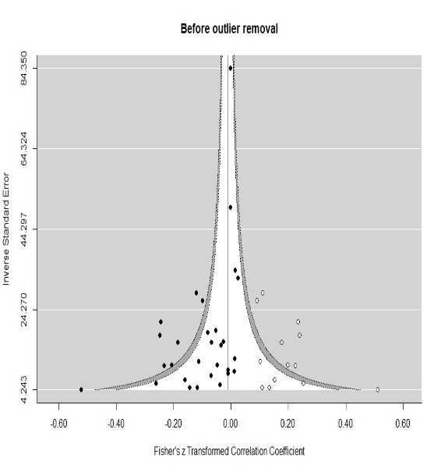


Threats to our Cumulative Knowledge
Combined outlier and publication bias effect
  k = 29
  ${\overline{r}}_{o_{RE}}$ = -.08
k = 29; ik = 13; $\text{t}\text{\&}\text{f}\text{FE} {\overline{r}}_{o}$ = -.01

Slide 33
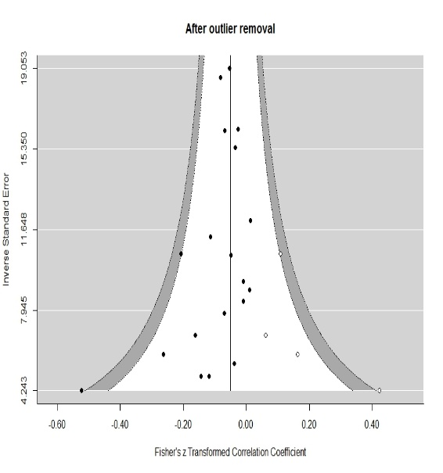
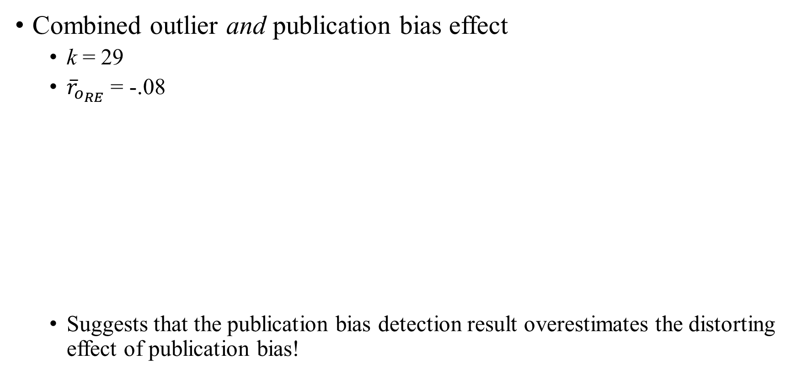

Threats to our Cumulative Knowledge
Combined outlier and publication bias effect
  k = 29
  ${\overline{r}}_{o_{RE}}$ = -.08
  Suggests that the publication bias detection result overestimates the distorting effect of publication bias!
k = 29; ik = 13; $\text{t}\text{\&}\text{f}\text{FE} {\overline{r}}_{o}$ = -.01
k = 19; ik = 4; $\text{t}\text{\&}\text{f}\text{FE} {\overline{r}}_{o}$ = -.05

Slide 34
What is Sensitivity Analysis?
A sensitivity analysis examines the extent to which results and conclusions are altered as a result of changes in the data or analysis approach
  Greenhouse & Iyengar (2009)
If the conclusions do not change as a result of the sensitivity analysis, one can state that the conclusions are robust and one can have greater confidence in the conclusions.

Slide 35
What is Sensitivity Analysis?
“Sensitivity analysis is the most powerful tool we have for assessing the influence of the specific choices made by the researchers”
  Aytug, Rothstein, Zhou, & Kern (2012, p. 118)

Slide 36
What is Sensitivity Analysis?
Sensitivity analyses are rarely conducted in meta-analyses in the organizational sciences
  Kepes, McDaniel, Brannick, & Banks (2013)
Because meta-analyses have a strong impact on our literatures, sensitivity analyses need to become much more common (and reported) in meta-analyses.

Slide 37
Live Meta-Sen Demonstration
https://metasen.shinyapps.io/gen1/
You can find some additional sample data files here: https://jamiefield.github.io/research/sma2019

Slide 38
How to minimize the impact of outliers & PB
Ultimately, it is always best to report the range of results
The effect of PB can be reduced by
  Conducting extremely thorough literature reviews
  Using research registries
  Changing the journal review process
  Altering author and organization norms
  Obsessing less about theoretical contributions
  Supporting data repositories like metaBUS

Slide 39
How to minimize the impact of outliers & PB
Step 1
Step 4
Step 5
Step 6
Step 7
Step 3
Step 2
Step 1: Conduct a meta-analysis on original dataset

Slide 40
How to minimize the impact of outliers & PB
Step 1
Step 4
Step 5
Step 6
Step 7
Step 3
Step 2
Step 1: Conduct a meta-analysis on original dataset
Step 2: Perform osr and recommended PB analyses

Slide 41
How to minimize the impact of outliers & PB
Step 1
Step 4
Step 5
Step 6
Step 7
Step 3
Step 2
Step 1: Conduct a meta-analysis on original dataset
Step 2: Perform osr and recommended PB analyses
Step 3: Perform Viechtbauer and Cheung’s (2010) influence diagnostics

Slide 42
How to minimize the impact of outliers & PB
Step 1
Step 4
Step 5
Step 6
Step 7
Step 3
Step 2
Step 1: Conduct a meta-analysis on original dataset
Step 2: Perform osr and recommended PB analyses
Step 3: Perform Viechtbauer and Cheung’s (2010) influence diagnostics
Step 4: If detected, remove outliers and repeat Steps 1 and 2. If outliers are not detected in Step 3, proceed directly to Step 5

Slide 43
How to minimize the impact of outliers & PB
Step 1
Step 4
Step 5
Step 6
Step 7
Step 3
Step 2
Step 1: Conduct a meta-analysis on original dataset
Step 2: Perform osr and recommended PB analyses
Step 3: Perform Viechtbauer and Cheung’s (2010) influence diagnostics
Step 4: If detected, remove outliers and repeat Steps 1 and 2. If outliers are not detected in Step 3, proceed directly to Step 5
Step 5: Report BRE and MRE (see Kepes et al., 2012)**

Slide 44
How to minimize the impact of outliers & PB
Step 1
Step 4
Step 5
Step 6
Step 7
Step 3
Step 2
Step 1: Conduct a meta-analysis on original dataset
Step 2: Perform osr and recommended PB analyses
Step 3: Perform Viechtbauer and Cheung’s (2010) influence diagnostics
Step 4: If detected, remove outliers and repeat Steps 1 and 2. If outliers are not detected in Step 3, proceed directly to Step 5
Step 5: Report BRE and MRE (see Kepes et al., 2012)**
Step 6: Visually inspect the range of results before and after outlier removal

Slide 45
How to minimize the impact of outliers & PB
Step 1
Step 4
Step 5
Step 6
Step 7
Step 3
Step 2
Step 1: Conduct a meta-analysis on original dataset
Step 2: Perform osr and recommended PB analyses
Step 3: Perform Viechtbauer and Cheung’s (2010) influence diagnostics
Step 4: If detected, remove outliers and repeat Steps 1 and 2. If outliers are not detected in Step 3, proceed directly to Step 5
Step 5: Report BRE and MRE (see Kepes et al., 2012)**
Step 6: Visually inspect the range of results before and after outlier removal
Step 7: Assess the robustness of recommendations for practice

Slide 46
Questions?
Thank you for attending today!
Feel free to follow up with me
james.field2@mail.wvu.edu

Slide 47
In the following slides…
I review two outlier and five publication bias assessment methods used by the Meta-Sen app
I present results that illustrate an outlier and PB effect, as well as a combined effect of these phenomena, on meta-analytic findings on employee turnover

Slide 48
Review of Two Outlier Assessment Methods
One form of sensitivity analysis is to conduct meta-analyses with and without outliers
Only 3% of meta-analyses conduct outlier analyses (Aguinis et al., 2011)
  Effect size outlier (large or small)
    Graphical methods and statistical tests for outliers (e.g., SAMD statistic; Beal, Corey, & Dunlap, 2002)
  Sample size outlier (large)
    Sample sizes influence effect size weights in meta-analyses.

Slide 49
Review of Two Outlier Assessment Methods
One sample removed analysis:
  Individual samples are removed one-by-one from the dataset and the point estimate is recalculated after each removal.
  Thus, a one-sample removed analysis, yields k-1 meta-analytic mean estimates.
  Given the Jiang, et al. (2012) dataset included 18 effect sizes, the one-sample removed analysis will produce 17 estimates of the meta-analytic mean
  Important questions to ask:
    How much does the distribution mean change when a given sample is excluded from the analysis?
    Are the results due to a small number of influential samples?

Slide 50
Review of Two Outlier Assessment Methods
Viechtbauer and Chueng’s (2010; Viechtbauer [2015]) multivariate, multidimensional influence diagnostics:
  A framework that calculates leave-one-out analyses for
    externally standardized residuals
    DFFITS value,
    Cook’s distance,
    covariance ratio,
    the leave-one-out amount of heterogeneity,
    the leave-one-out test statistic for the test of heterogeneity, and
    DFBETAS values.
  In addition, an inspection of the hat matrix is examined for highly influential observations.

Slide 51
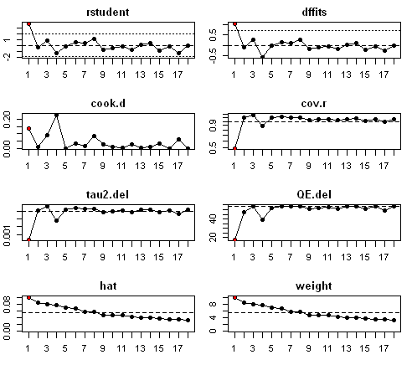
Review of Two Outlier Assessment Methods
Viechtbauer and Chueng’s (2010; Viechtbauer [2015]) multivariate, multidimensional influence diagnostics:
!!IMPORTANT!!
This is an iterative process that must be performed until all identified outliers are removed

Slide 52
Review of Five PB Assessment Methods
Symmetry-based methods
  When sampling error is the sole source of variance, and the sampling distribution is symmetrical, then a funnel plot can be examined for symmetry.
  A funnel plot is a plot of effect sizes by precision (1/standard error).
  Examples of symmetry-based methods include (1) trim and fill models and (2) contour-enhanced funnel plot

Slide 53
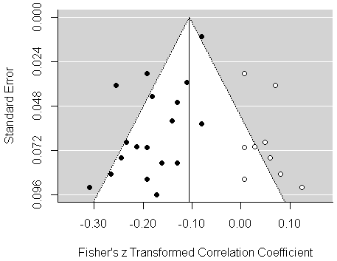
Review of Five PB Assessment Methods
Trim and fill models
  The trim and fill method is probably the most useful symmetry based method in that it estimates what the population distribution would be if the missing studies were located
  Analyses are re-conducted on the distribution containing both the observed data and the imputed data
FE trim and fill model of Jiang et al.’s meta-analytic distribution

Slide 54
Review of Five PB Assessment Methods
Trim and fill models
  It is unwise to consider this distribution of observed and imputed data as the “true” distribution
  More reasonable to compare the observed mean with the trim and fill adjusted mean
  If the mean drops from .45 to .15, one should worry about publication bias
  But, one should not assume that .15 is the best estimate of the population mean
FE trim and fill model of Jiang et al.’s meta-analytic distribution

Slide 55
Review of Five PB Assessment Methods
Some asymmetry is not due to publication bias but to “small sample effects.”
  A medicine may work best with the sickest (small N) patients and work less well with moderately sick (larger N) patients.
  Small sample studies may yield larger effects due to better measures that are more difficult to collect in larger samples.

Slide 56
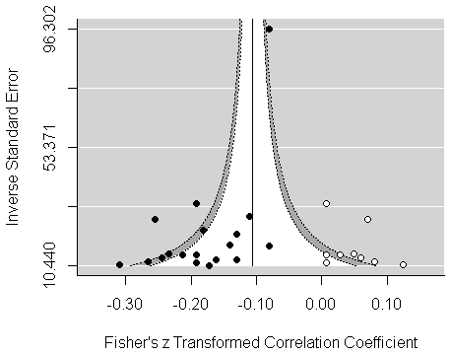
Review of Five PB Assessment Methods
Contour-enhanced funnel plots
  Related to the funnel plot and trim and fill is the contour-enhanced funnel plot, which displays graphically whether the imputed samples are a function of statistical significance (Peters et al., 2008).
    Helps separate publication bias effects from “small sample effects.”
Contour enhanced funnel plot of Jiang et al.’s meta-analytic distribution

Slide 57
Review of Five PB Assessment Methods
A priori selection models
  Selection models, also called weight-function models, originated in econometrics to estimate missing data at the item level.
  Hedges and Vevea introduced the method to the publication bias literature
    Hedges (1992)
    Vevea and Hedges (1995)
  Relatively robust to heterogeneity
    Vevea and Woods (2005)

Slide 58
Review of Five PB Assessment Methods
A priori selection models
  As with trim and fill, selection models estimate what the population distribution would be if the missing studies were located and included in the meta-analytic distribution
  When one is conducting a meta-analysis without regard to suppressed studies, one is implicitly assuming that one has 100% of the completed studies
    This assumption is unlikely to be valid
      Vevea and Woods (2005)
Selection models permit you to make other assumptions

Slide 59
Review of Five PB Assessment Methods
A priori selection models
  Selection models assume that the probability that an effect size is included in a distribution is a function of a characteristic of that effect size
    This characteristic is usually the level of statistical significance
  Consider an a priori assumed selection model

Slide 60
Review of Five PB Assessment Methods
A priori selection models
  Selection models assume that the probability that an effect size is included in a distribution is a function of a characteristic of that effect size
    This characteristic is usually the level of statistical significance
  Consider an a priori assumed selection model
Significance level | Probability of being in the distribution
p ≤ .001 | 100%
.001 < p ≤ .05 | 90%
.005 < p ≤ .10 | 70%
p > .10 | 30%

Slide 61
Review of Five PB Assessment Methods
Cumulative meta-analysis by precision
  Sort samples by sample size or precision
  Conduct a meta-analysis starting with one effect size (the most precise effect) and add an additional effect size (with increasingly less precision) with each iteration of the meta-analysis
  Inspect the meta-analytic means for drift

Slide 62
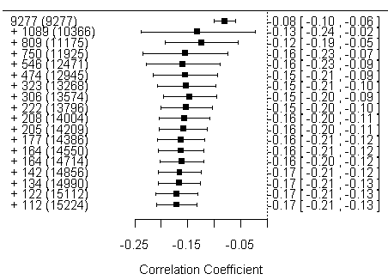
Review of Five PB Assessment Methods
Cumulative meta-analysis by precision
CMA by precision of Jiang et al.’s meta-analytic distribution
The most precise sample (N = 9,277), has an effect size of -.08.
With five studies, the cumulative sample size is 12,471 and the mean effect size is -.16
By the time one gets to 18 studies (N = 15,224), the mean effect size is -.17

Slide 63
Review of Five PB Assessment Methods
Cumulative meta-analysis by precision
  Gives similar results to that obtained in symmetry based methods
  When symmetry analyses suggest small effects are suppressed, cumulative meta-analysis will show a drift toward larger effects
  When symmetry analyses suggest larger effects are suppressed, cumulative meta-analysis will show a drift toward smaller effects.

Slide 64
Review of Five PB Assessment Methods
Precision-effect test-precision effect estimate with standard error analysis (PET-PEESE)
  A relatively new PB detection technique (Stanley and Doucouliagos, 2014)
  This method is a combination of two regression models (PET and PEESE)
    Conditional decision rule that determines which of the two models should be used
  PET → Observed effect sizes are regressed on their corresponding standard errors using meta-regression techniques
  PEESE → Observed effect sizes are regressed on their corresponding squared SE

Slide 65
Evidence of Combined Outlier and PB Effect
Comprehensive sensitivity analyses were conducted on 84 recently published meta-analytic distributions on employee turnover
  Examined the trustworthiness of these distributions
  Does a greater threat to the trustworthiness arise from outliers or publication bias?
  Assessed if meta-analytic and PB results changed after outlier removal
  Examined whether or not recommendations for practice were robust to outliers and/or PB
We assessed the generalizability of our results to other management topics by performing comprehensive sensitivity analyses on an additional 103 meta-analytic distributions
  These data were taken from the metaBUS database (see metaBUS.org)

Slide 66
Evidence of Combined Outlier and PB Effect
How trustworthy is our cumulative scientific knowledge on turnover?
  92% (77/84) of the turnover distributions were misestimated by a “noticeable” amount (i.e., > 20%; Kepes et al., 2012)
  96% (99/103) of the metaBUS distributions were misestimated by a “noticeable” amount

Slide 67
Evidence of Combined Outlier and PB Effect
Does a greater threat to the trustworthiness arise from outliers or publication bias?
  PB was the source of non-robustness in 92% (77/84) of the turnover meta-analytic mean effect size estimates
  Outliers was the source of the non-robustness in 48% (40/84) of the turnover meta-analytic mean effect size estimates
  Therefore, PB > outliers
  A combined outlier and PB effect was observed in 48% (40/84) of the turnover distributions

Slide 68
Evidence of Combined Outlier and PB Effect
Does a greater threat to the trustworthiness arise from outliers or publication bias?
  PB was the source of non-robustness in 96% (99/103) of the metaBUS meta-analytic mean effect size estimates
  Outliers was the source of the non-robustness in 74% (76/103) of the metaBUS meta-analytic mean effect size estimates
  Therefore, and similar to the turnover results, PB > outliers
  A combined outlier and PB effect was observed in 96% (99/84) distributions

Slide 69
Evidence of Combined Outlier and PB Effect
Do outliers distort meta-analytic results?
  52% (44/84) of the turnover distributions contained at least one outlier
    Nine had k < 10 and, thus, could not be reanalyzed after outlier removal
  For the 35 that could be compared, our results suggest that 86% (30/35) of the meta-analytic mean effect size estimates changed after outlier removal
    34% (12/30) were misestimated by more than 20%
  Similar results were observed for the metaBUS distributions
    81% (83/103) distributions had at least one outlier
    The meta-analytic mean effect size changed in 68% (54/79) of the cases
      11% (9/79) were misestimated by at least 20%

Slide 70
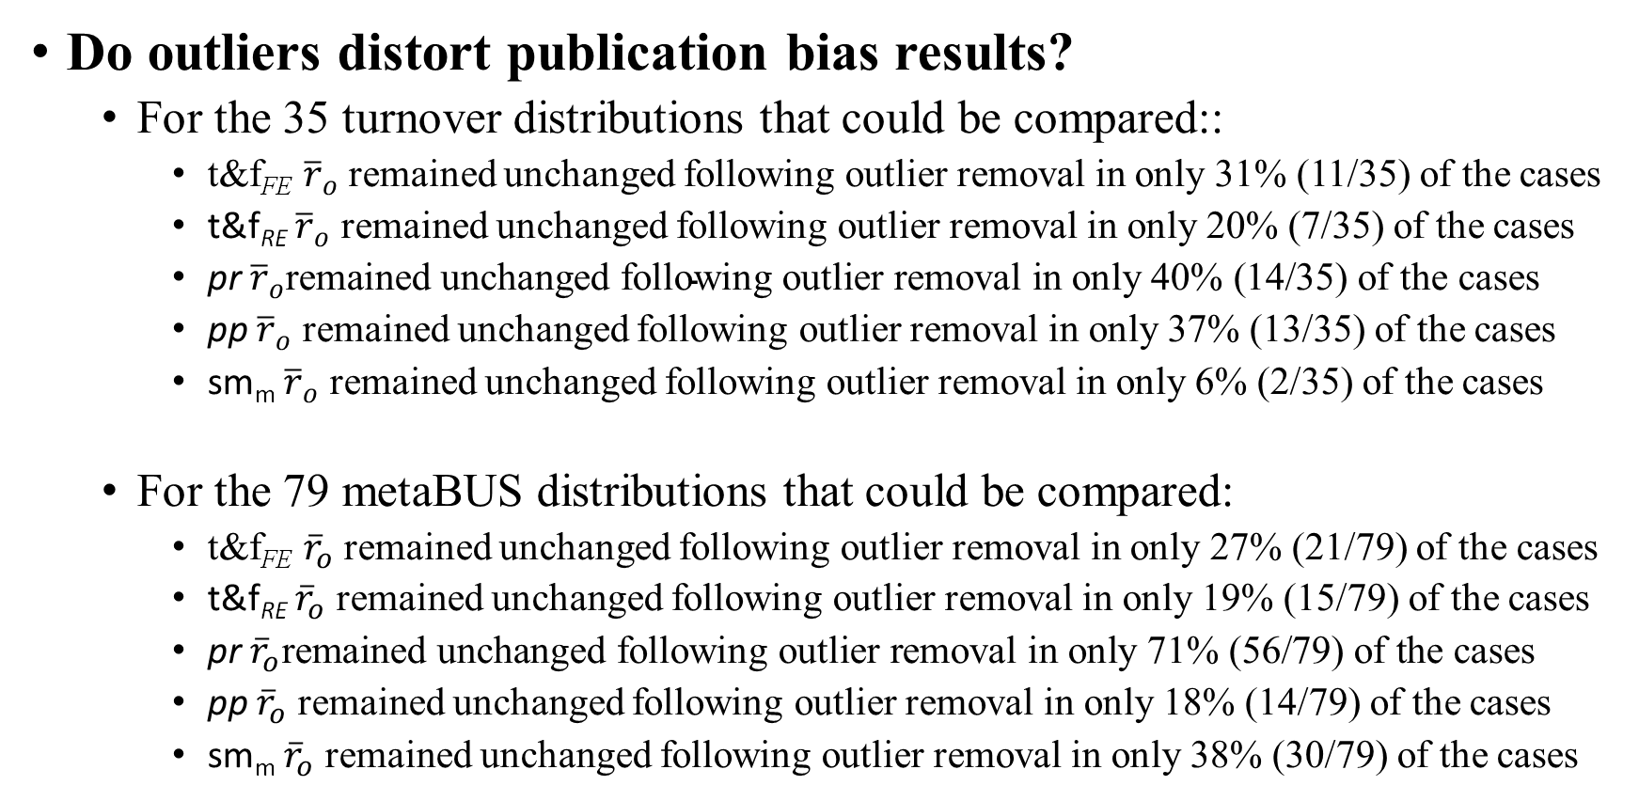
Evidence of Combined Outlier and PB Effect
Do outliers distort publication bias results?
  For the 35 turnover distributions that could be compared::
    t&f_{FE} ${\overline{r}}_{o}$ remained unchanged following outlier removal in only 31% (11/35) of the cases
    t&f_{RE} ${\overline{r}}_{o}$ remained unchanged following outlier removal in only 20% (7/35) of the cases
    pr ${\overline{r}}_{o}\text{remained} \text{unchanged} \text{following} \text{outlier} \text{removal} \text{in} \text{only}\text{ 40\% (14/35) }\text{of} \text{the} \text{cases}$
    pp ${\overline{r}}_{o}$ remained unchanged following outlier removal in only 37% (13/35) of the cases
    sm_{m} ${\overline{r}}_{o}$ remained unchanged following outlier removal in only 6% (2/35) of the cases
  For the 79 metaBUS distributions that could be compared:
    t&f_{FE} ${\overline{r}}_{o}$ remained unchanged following outlier removal in only 27% (21/79) of the cases
    t&f_{RE} ${\overline{r}}_{o}$ remained unchanged following outlier removal in only 19% (15/79) of the cases
    pr ${\overline{r}}_{o}\text{remained} \text{unchanged} \text{following} \text{outlier} \text{removal} \text{in} \text{only}\text{ 71\% (56/79) }\text{of} \text{the} \text{cases}$
    pp ${\overline{r}}_{o}$ remained unchanged following outlier removal in only 18% (14/79) of the cases
    sm_{m} ${\overline{r}}_{o}$ remained unchanged following outlier removal in only 38% (30/79) of the cases

Slide 71
Evidence of Combined Outlier and PB Effect
Do recommendations for practice change after accounting for outliers and PB?
  Hancock et al. (2013) recommended that most organizations should increase their investments in reducing turnover
  Estimated that a one SD decrease in turnover would be associated with a $352 million increase in profits for Fortune 1,000 companies
  However, out results suggest that this may be dramatically overestimated
  Our FE trim and fill mean estimate following outlier removal (k = 46, t&f_{FE} ${\overline{r}}_{o}$ = -.02 suggests that a one SD decrease in turnover would be associated with a $101 million increase in profits
    Suggests that the originally estimated financial benefit of a reduction in turnover may be overestimated by $251 million (or 249%)

Slide 72
Evidence of Combined Outlier and PB Effect
Do recommendations for practice change after accounting for outliers and PB?
  We found that 75% (12/15) of the recommendations for practice were not robust to outliers and publication bias
  Specifically, at least one of the following three occurred after taking into account the effect of outliers and/or PB
    The direction of the meta-analytic mean used to justify the recommendation changed
    The magnitude of he meta-analytic mean used to justify the recommendation changed by at least 20%
    A moderating effect used to justify the recommendation disappeared

Slide 73
Convergence of PB Detection Methods
Convergence Rates Regarding Practical Differences Before and After Outlier Removal for 35 Turnover Distributions
PB method | Before outlier removal |  |  | 1. | 2. | 3. | 4. | 5. | After outlier removal
 | Negligible | Moderate | Severe |  |  |  |  |  | Negligible | Moderate | Severe
1. t&f_{FE} ${\overline{r}}_{o}$ | 4 (11%) | 6 (17%) | 25 (71%) | - | 21 (60%) | 12 (34%) | 26 (74%) | 25 (73%) | 11 (31%) | 6 (17%) | 18 (51%)
2. t&f_{RE} ${\overline{r}}_{o}$ | 15 (43%) | 8 (23%) | 12 (34%) | 16 (46%) | - | 20 (57%) | 21 (60%) | 15 (43%) | 16 (47%) | 9 (26%) | 10 (29%)
3. sm_{m} ${\overline{r}}_{o}$ | 16 (47%) | 13 (37%) | 6 (17%) | 10 (29%) | 14 (40%) | - | 12 (34%) | 9 (26%) | 25 (71%) | 9 (26%) | 1 (3%)
4. pr ${\overline{r}}_{o}$ | 8 (23%) | 6 (17%) | 21 (60%) | 23 (66%) | 19 (54%) | 14 (40%) | - | 18 (51%) | 12 (34%) | 10 (29%) | 13 (37%)
5. pp ${\overline{r}}_{o}$ | 2 (6%) | 4 (11%) | 29 (83%) | 29 (83%) | 15 (43%) | 9 (26%) | 21 (60%) | - | 6 (17%) | 6 (17%) | 23 (66%)

Slide 74
Convergence of PB Detection Methods
Based on our turnover and metaBUS results we recommend that future meta-analysts use the following to triangulate the potentially most robust estimate of the “true” meta-analytic effect size
  FE trim and fill model
  CMA by precision
  PET-PEESE analysis
For outlier detection, we recommend Viechtbauer and Cheung’s (2010; Viechtbauer 2015) influence diagnostics procedure due to its statistical rigor

