Slide 1






Pre-Refurbishment Audit
ASSESS. PLAN. MANAGE. SUSTAIN.
A comprehensive assessment to support responsible deconstruction and resource recovery.
Date of report:
{{DATE_OF_REPORT}}
Project Address:
{{PROJECT_ADDRESS}}
Report Number:
{{REPORT_NUMBER}}
Company:
{{COMPANY_NAME}}
In partnership with
www.lawmens.co.uk

Slide 2




Report Prepared by Lawmans: Expertise and Terms of Distribution
Authorised by:
Name: Andrew Wedlake
Position: Sustainability Director
Date: {{AUTHORISED_DATE}}
Both parties who prepared the report work for the Lawmans Group of companies, and have appropriate knowledge of buildings, waste and options for reuse and recycling of different waste streams.
This report is made on behalf of Lawmans UK using the Lawmens branding and may only be distributed in its entirety, without amendment. Lawmen’s liability in respect of this report and reliance thereupon shall be as per the terms and conditions of contract with the client and Lawmens shall have no liability to third parties to the extent permitted in law.
Prepared by:
Name: {{PREPARED_BY_NAME}}
Position: {{PREPARED_BY_ROLE}}
Date: {{PREPARED_DATE}}

Slide 3




BREEAM - Competent Person
Andrew Wedlake
4. Independence and Objectivity
I confirm that this assessment has been carried out with professional objectivity and integrity. Any conclusions and recommendations presented within this report are based on the information available at the time of assessment and my professional judgement as a competent assessor.
Where assumptions have been made due to limitations in available data, these are clearly identified within the report.
1. Declaration of Competence
I, Andrew Wedlake confirm that I am the author and assessor of this Pre-Demolition Audit and that I am a suitably competent person to undertake this work in accordance with the requirements and intent of BREEAM (Building Research Establishment Environmental Assessment Methodology) and associated best practice guidance for pre-demolition resource audits.
2. Professional Competence
I confirm that I hold relevant qualifications, training, and professional experience appropriate to the preparation of pre-demolition audits and resource assessments, including:
Professional Membership(s): Licensed BREEAM Assessor
Relevant Experience: 12 years in Deconstruction auditing / Waste Management / Sustainable Construction / Circular Economy Assessments.
I have sufficient knowledge of construction materials, demolition processes, waste streams, reuse opportunities, and relevant legislation and guidance applicable to this assessment.
3. Methodology and Standards
This report has been prepared using recognised industry methodologies and guidance, including (where applicable):
BREEAM guidance for pre-demolition audits and resource efficiency
Relevant UK waste and resource management legislation
Best practice principles for circular economy and material recovery
Site-specific information provided by the client and project team
Visual inspection and available record drawings / surveys
5. Limitations
This declaration is based on:
Information provided by {{CLIENT_NAME}}
Site access conditions at the time of inspection on {{DATE_OF_REPORT}}
Available documentation, which may include drawings, surveys, and asset registers
No liability is accepted for conditions or materials not reasonably observable or disclosed at the time of assessment.
6. Declaration
I confirm that, to the best of my knowledge and professional belief, the information contained within this Pre-Demolition Audit has been prepared in accordance with good industry practice and is suitable for use in support of BREEAM assessment requirements.
Name: Andrew Wedlake
Position: Sustainability Director
Company: Lawmens
Date: {{DATE_OF_REPORT}}

Slide 4


{{PHOTO_OF_BUILDING_FRONT}}
Executive Summary
A pre-deconstruction audit was carried-out at {{PROJECT_ADDRESS}}
The audit consisted in reviewing the items within the building that could be salvaged, reused or recycled.
The audit was performed as part of the circular economy approach to the project.
The building circularity for the proposed scheme follows the following principles and approach:
Conserve resources, increase efficiency and source sustainably
Minimise the quantity of the material used such that the whole life carbon doesn’t not exceed the Greater London Authority’s WLC benchmarks.
The aim is to further reduce the embodied carbon to meet the GLA benchmarks and get close to the GLA aspirational targets.
Maximise the reuse of existing structure on site.
Promote the use of recycled content.
The material will be procured sustainably. All timber or timber-based products will be FSC or PEFC certified. The use of suppliers with ISO 14001 or equivalent environmental management system will be encouraged for material procurement.

Slide 5

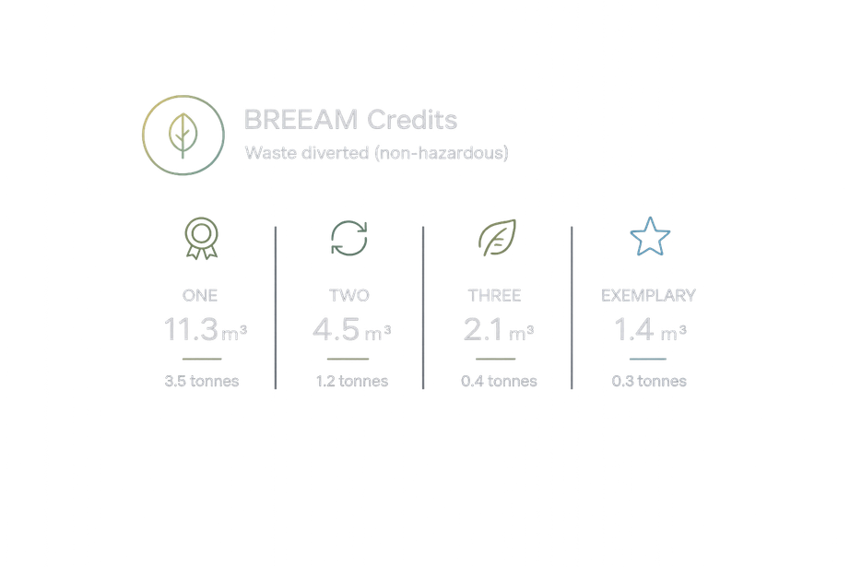
Minimising Waste Diversion
There is potential for reclamation and reuse of many of these materials such as the carpet tiles and partitions. Where this is not possible, there is potential for recycling the majority of these materials thereby diverting waste from landfill.
It is recommended that a target of 95% diversion of waste from landfill should be set.
Wherever possible on-site re-use of non-hazardous materials is also recommended.
The Key Waste Products by % of total weight (tonnes) are as follows:
Design to eliminate waste
The building layers with longer life expectancy will be designed for longevity, flexibility and adaptability and layers with shorter life expectancy for ease of maintenance, recoverability and replacement.
At least 99% of the waste can be diverted from going into landfill.
A site waste management plan will be implemented on site to minimise waste generation and then manage waste responsibly.
A operational waste strategy will be implemented to ensure municipal waste is managed sustainably.
{{KWP_OF_TOTAL_WEIGHT_TONNES}}
Manage waste sustainably

Slide 6
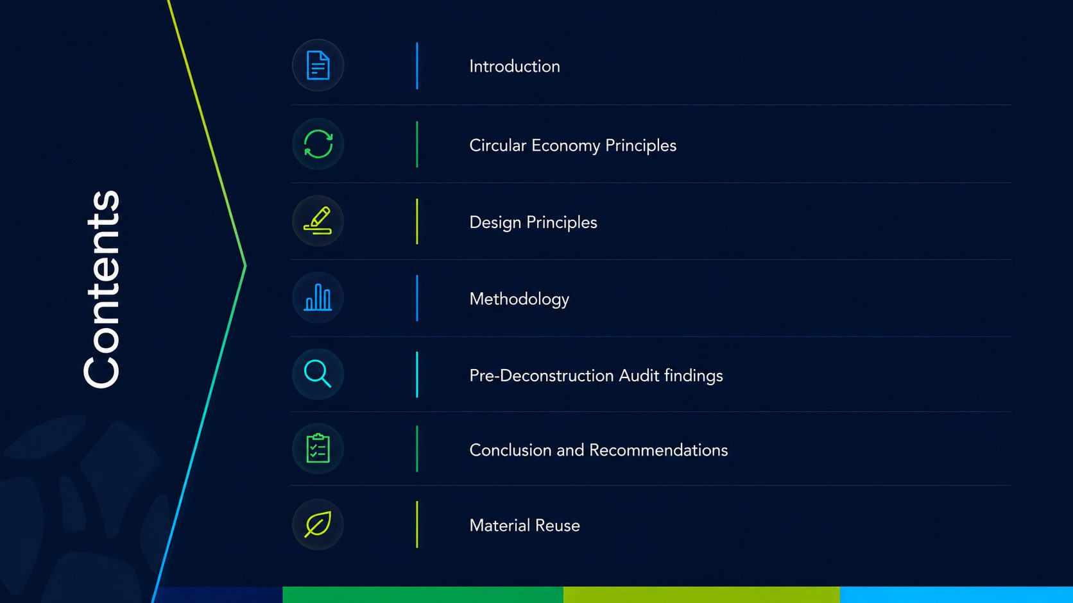
06
07
10
19
28
32
33

Slide 7


Introduction
Lawmens has conducted a pre-deconstruction waste audit of {{PROJECT_ADDRESS}}
This report provides information on the site to be assessed, the likely types and amounts
of materials arising from the refurbishment and recommendations for the management of these materials.
Details of local reuse and recycling organisations have been provided. The products, services, companies and websites listed are for informational purposes only and constitute neither an endorsement nor a recommendation. We recommend that you check if a waste management facility or a company transporting your waste has the appropriate permit in place. This can be done via the Environment Agency website.
This Pre-deconstruction audit was completed by a competent person with extensive sustainability knowledge and authorised by a competent person within the waste and demolition industry.
We can confirm both persons have extensive knowledge of the value and condition of the materials within the project, and how they should be repaired, reused or recycled dependent on the condition of the items. Both persons have appropriate knowledge of buildings, waste and options for the materials being removed from site, allowing them to analyse and create the appropriate waste streams where neccessary.
This project addresses the potential for reusing and recycling components and materials
from the building and aims to:
Provide an understanding of the waste materials likely to arise from the refurbishment of the building in order to help with the development of a waste management plan
Maximise the management of material removed from the building in line with the waste hierarchy i.e. maximise reuse and recycling and minimise waste to landfill
Provide evidence for environmental assessments such as BREEAM
Look at ways of promoting circular economy principles, including unique ways to re-purpose, re-condition and recycle materials.

Slide 8

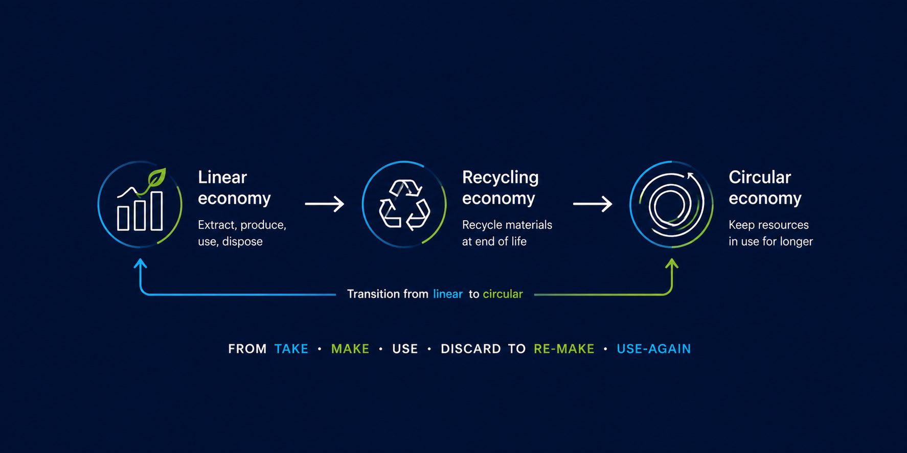
Circular Economy Principles
A key way of achieving this will be through incorporating circular economy principles into the design of developments, these principals are as follows:
Building in layers
Ensuring that different parts of the building are accessible and can be maintained and replaced where necessary.
Current and future trends point toward the need for a fundamental shift in the way
resources are consumed. A shift to a circular economy will provide considerable economic opportunities as a result.
In contrast to a linear economy (take, make, dispose), a circular economy keeps products
and materials circulating through the system at their highest value for as long as possible, through re- use, recycling, refurbishment and remanufacturing. As 60% of total UK waste is generated from construction, demolition and excavation (Defra and Government Statistical Service, 2019) this transition from linear to circular is essential.
The successful implementation of circular economy principles will help to reduce the volume of waste that London produces and has to manage.
Designing out waste
Ensuring that waste reduction is planned in from project inception to completion, including consideration of standardised components, modular build and re-use of secondary products and materials.
Designing for longevity
creating a built asset with well-defined long-term needs, while being durable, resilient or able to cope with societal and environmental change. It would require little modification / no replacement of parts, due to its ‘loose fit’, generous proportions and readiness for alternative technologies.
Designing for adaptability or flexibility
To meet the needs of the present but with consideration of how those needs might change in the future, and to enable change in the form of periodic remodelling and reconfiguration, including alterations or replacement of non-structural parts.
Design for assembly, disassembly and recoverability
Future proofing the asset by designing products and services to be assembled, deconstructed and reused or recycled on a part-by-part basis.
Selecting materials
Any new material specified in the development should aim to be low impact materials with little or no adverse effect on either the environment or on human health throughout its lifecycle. Recognise and encourage the use of recycled content and secondary aggregates, thereby reducing the demand for virgin material and optimising material efficiency in construction.

Slide 9

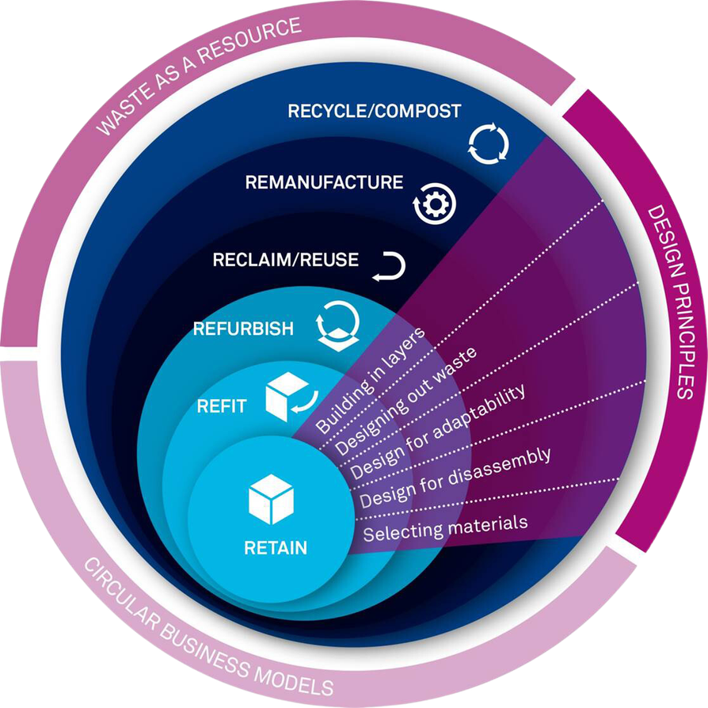
Implementing Circular Economy
Building circularity into projects is complex. There are many different approaches a project can identify and adopt solutions, with input from all design team members, including project managers and cost consultants.
Figure 4 defines a hierarchy for building approaches which maximises use of existing materials, with the ideal being to retain existing buildings.
A noted previously, the Mayor’s updated London Plan will require all new referable developments to submit a Circular Economy Statement. This policy focuses on waste reduction, increases in material re-use and recycling and aim to be net zero-waste.
For circular principles to be successful, it requires a whole building approach. Figure 5 suggests methods to incorporate circular economy principles into a development process using the RIBA stages as an indicator of when the action should be undertaken.
Figure 4: Circular Economy Principles (Source:RICS)

Slide 10

RIBA Stages
These principles need to be proactively considered throughout specification, design, procurement, construction and operation. This includes collaborating with supply chains to explore and develop solutions which implement these principles and realise the benefits.
Set broad objective for Circular Economy aspirations
Assess current site - undertake pre-demolition/ Pre-demolition audit (demolition contract)
RIBA 0/1
RIBA 1
Develop objectives with specific metrics (design team and facility management)
Identify further information required (e.g. carbon/ cost consultant, case studies)
RIBA 2/3
Hold workshop to investigate CE alternative approach (contractor, suppliers, design team, facility managers)
Agree opportunities, commitments and metrics/ targets (contractor, design team)
RIBA 4
Include metrics as clauses within procurement packages
Monitor design against metrics, continue to engage with suppliers
RIBA 5
Monitor metrics as clauses within procurement packages
Monitor design against metrics, continue to engage with suppliers
RIBA 6/7
Monitor metrics with contractor (and supply chain)
Continue to investigate alternative materials/ products

Slide 11

Design Principles
Designing Out Waste
Minimised Material Use
This section will review circular economy design principles and detail measures the proposed development could implement throughout the design, construction and operational phases in addition to those company objectives that are already in place.
Adopting a design approach that focuses on material resource efficiency so that less material is used in the design (i.e. lean design), and / or less waste is produced in the construction process, without compromising the design concept. For waste reduction, minimisation of excavation, simplification and standardisation of materials and components of choice, and dimensional coordination have been considered.
The development will aim to ‘design out’ waste through the consideration of material
specification, such as maximising use of existing materials, and construction techniques in
order to prevent and minimise waste generation.
When selecting and designing components the following will be applied where feasible:
Design out the need for the component or material.
Use reclaimed material over new and remanufactured components over new, where possible.
Use products with labels such as Cradle to Cradle (C2C) and Natureplus.
Select products that can be remanufactured or reused at end of first life.
Use materials with recycled content.
Select products that are designed for disassembly.
Select materials that can be recycled or composted at end of life; and,
Consider leasing short lived components.
When applying the above, complete transparency and visibility throughout the supply chain will be encouraged. Early engagement with the contractor and partnering within the supply chain will be required

Slide 12
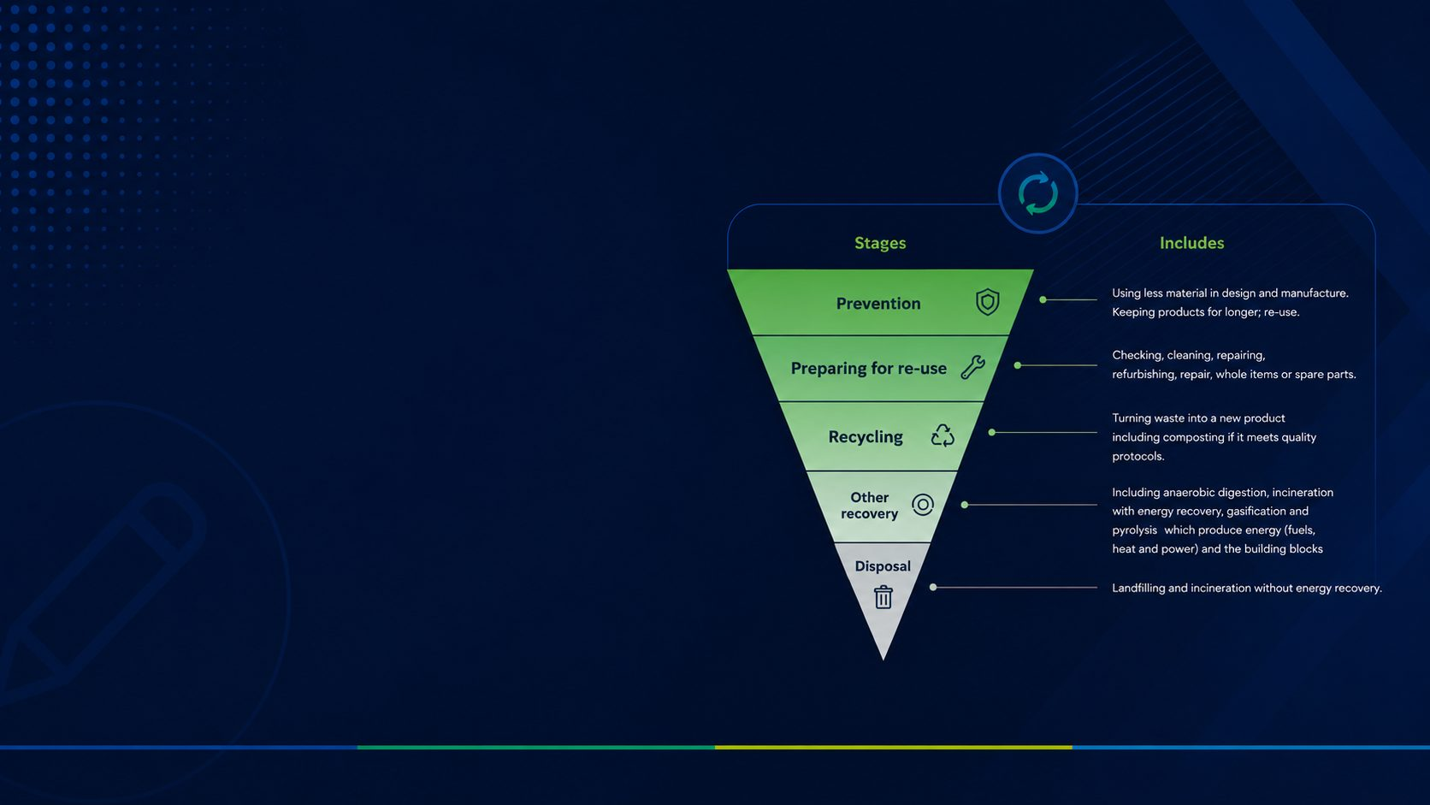
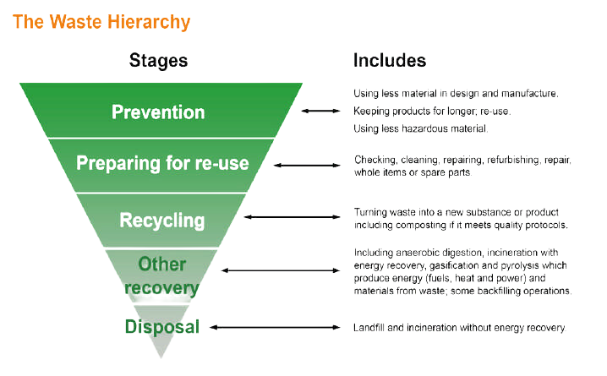
Waste Hierarchy
The design team will consider the Waste Hierarchy (Figure 7), to optimise reuse, recycling and recovery opportunities for the purpose of minimising waste as far as possible. The principal contractor, once appointed, will be responsible for implementing the principles within the Waste Management Strategy and the Site Waste Management Plan (SWMP) during the construction phase of the proposed development.
Estimated Waste from Construction
At this stage, no detailed bill of quantities for building material has been drawn up for the
proposed development. Assumptions on the likely quantity of waste to arise have been made
based on the building use schedule, and using typical construction waste composition data
(DEFRA, 2009). Therefore, estimations at present, do not account for measures that should
be incorporated to reduce waste produced during construction, for example through design
and procurement.
Reuse and Recovery
Site Analysis and Potential for Reuse
A site analysis including this pre-deconstruction audit will be carried out to determine opportunities for reusing existing materials and / or components. The existing materials on site will be reviewed to determine if they meet the required functionality of the new building design. Where no such opportunities exist, good practice measures will be taken in the strip-out to ensure maximum recovery of materials through recycling. All elements from the strip-out phase that cannot be reused on site will be sent to organisations for onward use where feasible.

Slide 13
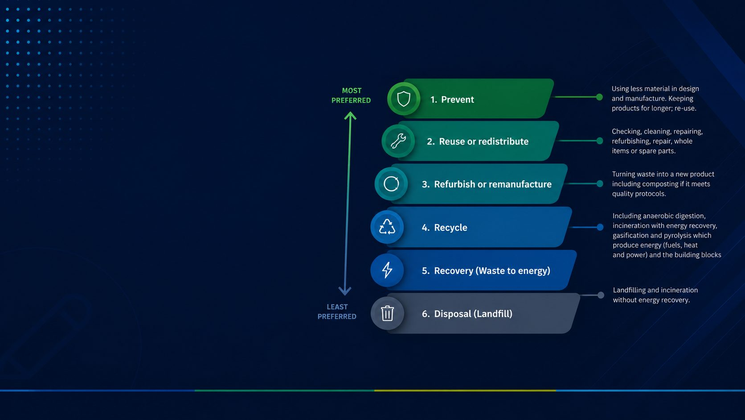
Early Investigations for Sustainable Material Recovery
Investigations will be carried out to establish where possible the extent of reuse, including
reuse of materials and components from other projects (whether of major assemblies – e.g.
structural steel frame – components, materials, etc.), and its practicality as early as possible.
Throughout this process, carbon impacts will also be considered to ensure they are not
compromised in material selection.
Site Waste Management
Reuse and recycling general requirements and targets
The principal contractor will divert >99% of (non- hazardous) strip-out waste from landfill. i.e. to be reused or recycled
The principal contractor will find reuse pathways for as much material as possible. Each project should achieve or exceed 20% by volume, or 30% by weight of stripped out material to be reused on-site or elsewhere.
Waste not sent to reuse pathways will be separated and sorted into key waste groups as per either on-site or through a licensed contractor for recycling or recovery.
The principal contractor will send stripped out materials to pathways prioritised by the waste preference hierarchy

Slide 14

Pathways to Divert Waste from Landfill - Reuse
Examples of reuse include the following:
reusing timber for concrete shuttering or other temporary works
refurbishing M&E items such as light fittings or AC units for future use
re-purposing metal electrical trunking as a raw material to make furniture or other items
reusing cut reinforced concrete pieces for other purposes such as within gabions or for external paving
Note that selling or donating materials and products to buyers/beneficiaries who have the
intention of putting the items to re-use would be classed as re-use, so long as the buyer/
beneficiary can provide some credible evidence that re-use is their primary aim (for example an established business website or a letter of intent).
For example, selling or donating items to an established architectural salvage company
who has a track record of stocking items for reuse would qualify as reuse, whereas selling/
donating items to a scrap metal dealer whose primary activity is to serve the recycling
industry would not. Selling or donating items to organisations or individuals (such as charities or businesses) would qualify if they provide written confirmation that they intend to reuse/repurpose (and not recycle or otherwise dispose of) the items.
What counts as reuse?
It’s important to understand that recycling is not reuse. Reuse of materials keeps the material in high grade form. Any processing required doesn’t reduce the material to a significantly lower grade of material.
Reuse or redistribute: Products that are in technically good condition, that can be removed and reused multiple times, either on site or redistributed to new users in their original form with little enhancement or change.
Refurbish or remanufacture: This is when a product is refurbished, its condition is improved – potentially to as-new e.g. Lighting. This can include disassembly and rebuild, replacing components where necessary, updating specifications, and improving cosmetic appearance. When a component is remanufactured, it is reengineered to as-new condition with the same warranty as a new component.

Slide 15

Pathways to Divert Waste from Landfill - Recycling
Pre-deconstruction audit
A pre-deconstruction audit will be carried-out by Principal Contractor’s waste contractor
Lawmens in conjunction with the contractor prior to the works commencing. The audit will
be used to consider the materials that the client considers suitable for reuse and maximise
the high-grade reuse and recycling opportunities. The decisions arising from audit must be integrated into the Resource Management Plan which Principal Contractor will provide.
During the construction, the actual waste produced, and waste management routes used
should be compared with those forecast from the audit and barriers to achieving targets
should be investigated.
What counts as recycling?
Recycling reduces a product or a material to its granular level to be reprocessed and made into new products, components or materials.
Examples of recycling, that don’t qualify as reuse (because the materials are too degraded
prior to new use/formation) include the following:
crushing concrete and using it as Recycled Aggregate (RA) in new concrete or Recycled Concrete Aggregate (RCA) or road base
melting metals for forming into new metals
vinyl take-back schemes by manufacturers.
Waste to energy (e.g. incarnation CHP) is classed as recycling, however it is the least
desirable form of recycling as energy is considered a lower grade product than an object or material that can be put to use. Where possible Principal Contractor’s prioritises material recycling in preference to waste to energy recycling pathways.
Principal Contractor will ensure that waste is transferred to authorised organisation/persons for recycling and waste transfer notes are evidenced containing:
Description of the waste including European Waste Catalogue (EWC) codes
Contractor information (including the address of the final destination of the waste);
Consignee information;
Date and signature of both parties.
Our audits cover:
Identification and quantification of the key materials where present on the project
Potential applications and any related issues for the reuse and recycling of the key materials in accordance with the waste hierarchy.
Identification of local re-processors or recyclers for recycling of materials
Identification of overall recycling rate for all key materials
Identification of reuse targets where appropriate.
Identification of overall landfill diversion rate for all key materials.

Slide 16
Typical checklist
Materials | Options for reuse or direct recycling | Priority
Timber products (All sawn soft/hard wood only – no board products e.g. MDF/ chipboard etc) | On-site reuse of timber on the project | 1
Timber products (All sawn soft/hard wood only – no board products e.g. MDF/ chipboard etc) | Off-site reuse via another project, national/ local community wood reuse scheme | 2
New and unused insulation board (foam board only e.g. EPS, XPS, ISO, COMP. not mineral fibre) | Off-site reuse of a new and unused insulation board on other construction/ refurbishment projects, local community schemes, charities | 1
New and unused insulation board (foam board only e.g. EPS, XPS, ISO, COMP. not mineral fibre) | Resale of insulation board via surplus construction material trading companies | 2
New and unused insulation board (foam board only e.g. EPS, XPS, ISO, COMP. not mineral fibre) | Collection by manufacturer for closed loop recycling | 3
Fixtures and fittings | On-site reuse in original form e.g sinks, doors, gates | 1
Fixtures and fittings | Off-site reuse in original form, e.g. sinks, doors, gates | 2
Materials | Options for reuse or direct recycling | Priority
New and used mineral fibre ceiling panels and tiles | Off-site reuse in other construction/ refurbishment projects, local community schemes, charities | 1
New and used mineral fibre ceiling panels and tiles | Off-site recycling via manufacturer for closed loop recycling (see relevant definitions) | 2
Vinyl floor coverings (uplifted vinyl floor coverings and post installation offcuts) | Off-site direct recycling via manufacturer for closed loop recycling | 1
Used carpet tiles (good reusable condition) | On-site reuse of carpet tiles in their original form | 1
Used carpet tiles (good reusable condition) | Off-site direct reuse on other construction/ refurbishment projects, local community schemes, charities | 2
Used carpet tiles (good reusable condition) | Direct recycling via a manufacturer for closed loop recycling | 3
Packaging materials (all timber, cardboard & plastic) | Repatriation of wooden pallets from product suppliers for direct reuse | 1
Materials | Options for reuse or direct recycling | Priority
Inert materials | On-site reuse in original form e.g. bricks, roof tiles, paving slabs, kerbs, cills | 1
Inert materials | Off-site reuse in original form e.g. bricks, roof tiles, paving slabs, kerbs, cills | 2
New and used metal materials | On-site reuse of metal material in original form | 1
New and used metal materials | Off-site reuse of metal material in original form | 2
Composite materials (materials which include more than one material type often bonded together) | On-site reuse in original form | 1
Composite materials (materials which include more than one material type often bonded together) | Off-site reuse in original form | 2
New and used plasterboard (offcuts/ unused/ undamaged boards) | On-site reuse in original form | 1
New and used plasterboard (offcuts/ unused/ undamaged boards) | Off-site reuse of unused/ undamaged plasterboard on other construction or refurbishment projects | 2
New and used plasterboard (offcuts/ unused/ undamaged boards) | Off-site reuse options for unused or undamaged plasterboard - e.g. local community scheme, surplus construction material trading, charities | 3
New and used plasterboard (offcuts/ unused/ undamaged boards) | Plasterboard manufacturer take-back schemes e.g. collection of bagged offcuts or unused boards | 4
Furniture | On-site reused in original form | 1
Furniture | Off-site reuse options - e.g. local community schemes, local charities, schools, etc | 2
A list of categories can be found here:
https://www.gov.uk/how-to-classify-different-types-of-waste/construction-and-demolitionwaste

Slide 17
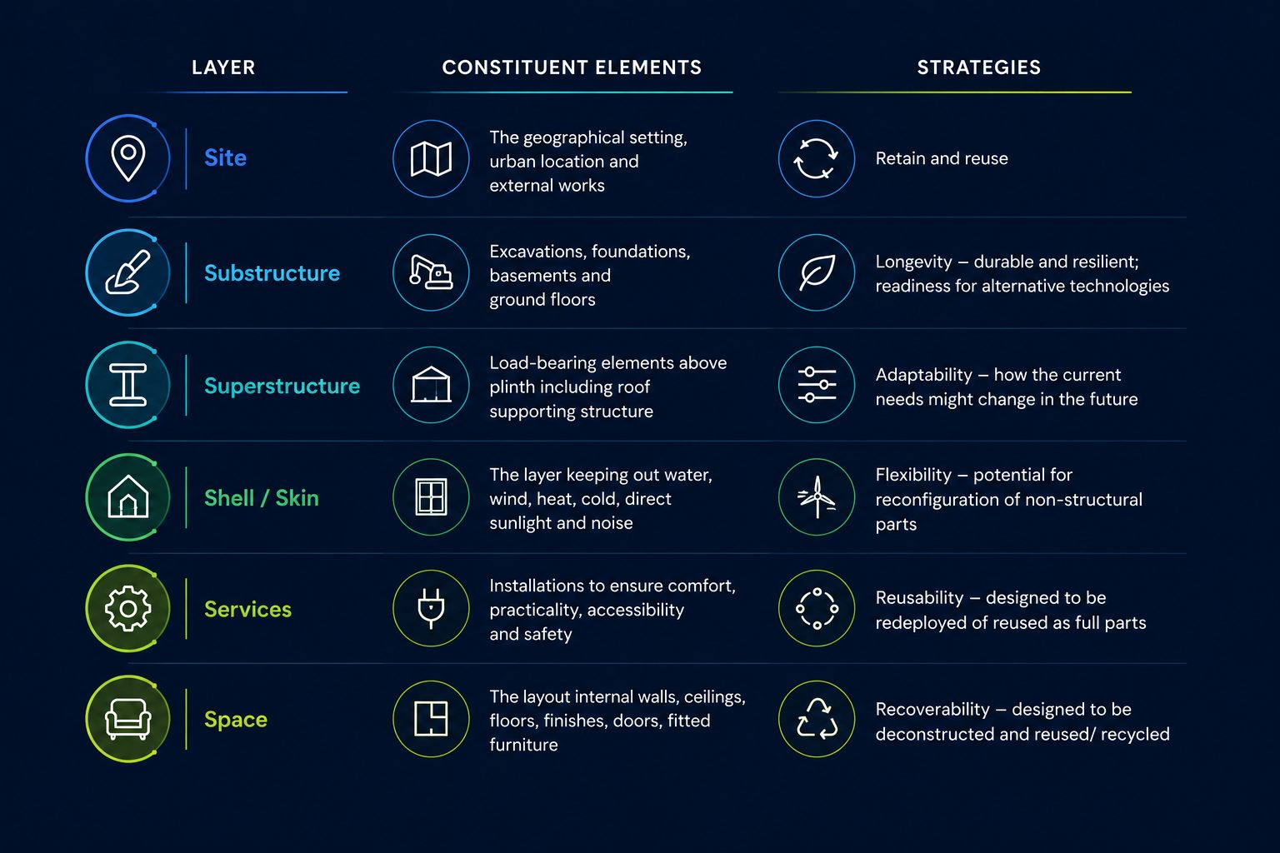
Strategic Approach - Proposed Design
Proposed Design
The proposed scheme design should be broken down into building layers to design out waste, optimise material use and keeping building elements/materials in use after the end of their life cycle. Please refer to the summary of strategies in the table below.
The design objective for the elements with longer life cycle (more than 25 years) is to design for longevity, adaptability and flexibility. Concrete provides longevity and high thermal mass whilst steel is highly recyclable.
Building layers with shorter life expectancy (less than 25 years) will be designed for ease of
maintenance, reuse and recoverability. The plant will be made accessible for replaceability
and maintenance. In terms of building services, a water based wet system is proposed for the communal network thus reducing the use of refrigerant in the building. The proposed mixed mechanical ventilation system with heat recovery reduces the heating demand, thus reducing the plant requirement.
Opportunities will be explored for reusing hoardings and scaffoldings. Discussions with
suppliers with regards to the possibility of sending back the packaging for reuse will be
explored. Offsite and modern methods of construction may be considered to further optimise material use and waste minimisation.

Slide 18
Specifying & sourcing materials
This involves designers and contractors collaborating for optimum results and includes
reference to a bespoke Sustainable Procurement Plan. A high priority will be given to locally
sourced, high recycled content materials and products with EPDs.
Design for longevity, adaptability/flexibility and reusability/recoverability
Materials will be specified for durability and longevity. Waterproofing detailing, profiling,
drainage details, fixings and general geometry will be thoroughly assessed.
The strategic approach GLA decision tree directed attention towards designing for
adaptability and longevity for the development. Non-load bearing internal partitions may
be dismantled to accommodate the needs of the future tenants and adaptability without
damaging the building structure (building in layers)
Design out waste
Design out Waste
Apply the building in layers approach, the design objective for the elements with longer
life cycles (more than 25 years) is to design for longevity, adaptability and flexibility.
Building layers with shorter life expectancy (less than 25 years) will be designed for ease of
maintenance, reuse and recoverability. The plant will be made accessible for replaceability
and maintenance.
{{BENCHMARK_FOR_RESOURCE_EFFICIENCY}}
Manage waste sustainably and at the highest value
A site waste management plan and an operational waste management plan will ensure
optimum management and auditing of demolition, construction and municipal waste.
The team aims to divert 99% of construction waste and 99% of the demolition/excavation
waste from going into the landfill.
Circular Economy Commitments
1. Circular Economy Commitments
The project is adopting exemplary circular economy commitments that go beyond standard practice construction, including:
{{CIRCULAR_ECONOMY_COMMITMENTS}}
1.1 Key Circular Economy Commitments Narrative
Minimise material quantities
The major part of the development will take place using an existing structure and
foundations, retaining the slabs of the existing building. The rest of the development will use an optimised structure in order to reduce material usage.
Minimise fuels, land & water
The development is on a brownfield site, will be designed for energy and water efficiency in operation. Construction processes will prioritise fuel and water conservation, including delivery and storage logistics for example.

Slide 19
Implementation Strategy
The plan should be in line with guidance provided by DEFRA, Building Research
Establishment (BRE) and Waste & Resources Action Programme (WRAP). Where materials
cannot be reused or recycled on-site, the contractor will identify opportunities for potential
reuse off-site. Material and waste generated through construction will be stored safely and
efficiently, prior either for reuse on site or removal. Any materials to be reclaimed / reused
will be done so in accordance with the WRAP protocol.
The waste reports and records will be reviewed and audited periodically. They will be discussed with the Sustainability champion on site and the BREEAM assessor from time to time. At least 99% of excavation, demolition and construction waste will be diverted from landfill.
Contractor will take appropriate measures on site to further reduce the environmental impact of the construction. They will adopt the following:
The contractor will register with the Considerate Constructor’s Scheme and aim to attain a high score in all categories
Energy efficient equipment, services and construction methods will be adopted to reduce energy consumption.
Water use will be minimised during operation, installation and construction processes
Energy including fuel and water use will be recorded on site during the construction process.
This audit will be referenced in the Contractors Resource Management Plan / SWMP
A Site Waste and Resource Management Plan (SWMP) will be created by the contractor to outline strategies for diverting waste from landfills through methods such as:
Reusing materials on-site
Repurposing for other sites
Salvaging materials
Implementing a ‘take-back’ scheme
Employing an approved waste contractor for recycling or energy recovery
Waste will be categorised into groups like bricks, concrete, insulation, and plastics based on project waste streams. The SWMP aims for resource efficiency, targeting {{AIMS_RESOURCE_EFFICIENCY}}. It will also include:
Procedures to minimise non-hazardous waste
Strategies for reducing hazardous waste
Monitoring methods for waste reporting
Guidelines for sorting and recycling construction waste
The plan will identify the individual responsible for implementing these procedures.

Slide 20

Methodology
Prior to demolition, it is useful to survey the site so that the volume, type and condition of the structure and internal fixtures and fittings can be determined. A pre-strip out audit provides a list of Key Waste Products (KWPs) that will be removed during the strip-out/ demolition phase of the refurbishment that are suitable for reuse and recycling.
A review of the site was initially carried-out based on information provided:
{{INITIAL_INFORMATION_PROVIDED}}
This was followed-up by a site visit. The site visit involved measurement of materials to be removed and also allowed a detailed investigation of the quality and condition of components to assess their potential for reuse and recycling. The findings of the audit are based on measurements of different materials as well as estimates from visual assessment and drawings. Therefore, the results do include some margin of error when direct measurement has not been possible.
Based on measurements, or estimates from drawings, the volume of different materials insitu has been estimated. The weight of the different materials has then been estimated using densities from the BRE’s Green Guide or from material suppliers.

Slide 21
{{SPEC_1}}

Slide 22
{{SPEC_2}}

Slide 23
{{SPEC_3}}

Slide 24
{{SPEC_4}}

Slide 25
{{SPEC_5}}

Slide 26
{{SPEC_6}}

Slide 27
{{SPEC_7}}

Slide 28
{{SPEC_8}}

Slide 29
{{SPEC_9}}

Slide 30
{{SPEC_10}}

Slide 31
{{SPEC_11}}

Slide 32
{{SPEC_12}}

Slide 33
Pre-deconstruction audit findings
Material | EWC Codes | Volume (m3) | Weight (KGs) | % by weight | Embodied carbon factor A1-A3 (kgCO2e/kg) | Source | A1-A3 Embodied carbon (kgCO2e) | Circularity Scenario % | Circularity Score | Diversion From Landfill %
{{MATERIAL_1}} | {{MATERIAL_EWC_1}} | {{MAT_1_VOL}} | {{MAT_1_WEIGH}} | {{MAT_1_WEIGHP}} | {{MAT_1_ECF}} | ICE | {{MAT_1_CARB}} | {{MAT_1_CS%}} | {{MAT_1_CS}} | {{MAT_1_LANDFILL%}}
{{MATERIAL_2}} | {{MATERIAL_EWC_2}} | {{MAT_2_VOL}} | {{MAT_2_WEIGH}} | {{MAT_2_WEIGHP}} | {{MAT_2_ECF}} | ICE | {{MAT_2_CARB}} | {{MAT_2_CS%}} | {{MAT_2_CS}} | {{MAT_2_LANDFILL%}}
{{MATERIAL_3}} | {{MATERIAL_EWC_3}} | {{MAT_3_VOL}} | {{MAT_3_WEIGH}} | {{MAT_3_WEIGHP}} | {{MAT_3_ECF}} | ICE | {{MAT_3_CARB}} | {{MAT_3_CS%}} | {{MAT_3_CS}} | {{MAT_3_LANDFILL%}}
{{MATERIAL_4}} | {{MATERIAL_EWC_4}} | {{MAT_4_VOL}} | {{MAT_4_WEIGH}} | {{MAT_4_WEIGHP}} | {{MAT_4_ECF}} | ICE | {{MAT_4_CARB}} | {{MAT_4_CS%}} | {{MAT_4_CS}} | {{MAT_4_LANDFILL%}}
{{MATERIAL_5}} | {{MATERIAL_EWC_5}} | {{MAT_5_VOL}} | {{MAT_5_WEIGH}} | {{MAT_5_WEIGHP}} | {{MAT_5_ECF}} | ICE | {{MAT_5_CARB}} | {{MAT_5_CS%}} | {{MAT_5_CS}} | {{MAT_5_LANDFILL%}}
{{MATERIAL_6}} | {{MATERIAL_EWC_6}} | {{MAT_6_VOL}} | {{MAT_6_WEIGH}} | {{MAT_6_WEIGHP}} | {{MAT_6_ECF}} | ICE | {{MAT_6_CARB}} | {{MAT_6_CS%}} | {{MAT_6_CS}} | {{MAT_6_LANDFILL%}}
{{MATERIAL_7}} | {{MATERIAL_EWC_7}} | {{MAT_7_VOL}} | {{MAT_7_WEIGH}} | {{MAT_7_WEIGHP}} | {{MAT_7_ECF}} | ICE | {{MAT_7_CARB}} | {{MAT_7_CS%}} | {{MAT_7_CS}} | {{MAT_7_LANDFILL%}}
{{MATERIAL_8}} | {{MATERIAL_EWC_8}} | {{MAT_8_VOL}} | {{MAT_8_WEIGH}} | {{MAT_8_WEIGHP}} | {{MAT_8_ECF}} | ICE | {{MAT_8_CARB}} | {{MAT_8_CS%}} | {{MAT_8_CS}} | {{MAT_8_LANDFILL%}}
{{MATERIAL_9}} | {{MATERIAL_EWC_9}} | {{MAT_9_VOL}} | {{MAT_9_WEIGH}} | {{MAT_9_WEIGHP}} | {{MAT_9_ECF}} | ICE | {{MAT_9_CARB}} | {{MAT_9_CS%}} | {{MAT_9_CS}} | {{MAT_9_LANDFILL%}}
{{MATERIAL 10}} | {{MATERIAL_EWC_10}} | {{MAT_10_VOL}} | {{MAT_10_WEIGH}} | {{MAT_10_WEIGHP}} | {{MAT_10_ECF}} | ICE | {{MAT_10_CARB}} | {{MAT_10_CS%}} | {{MAT_10_CS}} | {{MAT_10_LANDFILL%}}
 |  |  |  |  |  |  |  |  | {{OVERALL_CIRCULARITY_SCORE}}

Slide 34
Pre-deconstruction audit findings
Material | EWC Codes | Volume (m3) | Weight (KGs) | % by weight | Embodied carbon factor A1-A3 (kgCO2e/kg) | Source | A1-A3 Embodied carbon (kgCO2e) | Circularity Scenario % | Circularity Score | Diversion From Landfill %
{{MATERIAL_11}} | {{MATERIAL_11_EWC}} | {{MAT_11_VOL}} | {{MAT_11_WEIGH}} | {{MAT_11_WEIGHP}} | {{MAT_11_ECF}} | ICE | {{MAT_11_CARB}} | {{MAT_11_CS%}} | {{MAT_11_CS}} | {{MAT_11_LANDFILL%}}
{{MATERIAL_12}} | {{MATERIAL_12_EWC}} | {{MAT_12_VOL}} | {{MAT_12_WEIGH}} | {{MAT_12_WEIGHP}} | {{MAT_12_ECF}} | ICE | {{MAT_12_CARB}} | {{MAT_12_CS%}} | {{MAT_12_CS}} | {{MAT_12_LANDFILL%}}
{{MATERIAL_13}} | {{MATERIAL_13_EWC}} | {{MAT_13_VOL}} | {{MAT_13_WEIGH}} | {{MAT_13_WEIGHP}} | {{MAT_13_ECF}} | ICE | {{MAT_13_CARB}} | {{MAT_13_CS%}} | {{MAT_13_CS}} | {{MAT_13_LANDFILL%}}
{{MATERIAL_14}} | {{MATERIAL_14_EWC}} | {{MAT_14_VOL}} | {{MAT_14_WEIGH}} | {{MAT_14_WEIGHP}} | {{MAT_14_ECF}} | ICE | {{MAT_14_CARB}} | {{MAT_14_CS%}} | {{MAT_14_CS}} | {{MAT_14_LANDFILL%}}
{{MATERIAL_15}} | {{MATERIAL_15_EWC}} | {{MAT_15_VOL}} | {{MAT_15_WEIGH}} | {{MAT_15_WEIGHP}} | {{MAT_15_ECF}} | ICE | {{MAT_15_CARB}} | {{MAT_15_CS%}} | {{MAT_15_CS}} | {{MAT_15_LANDFILL%}}
{[MATERIAL_16}} | {{MATERIAL_16_EWC}} | {{MAT_16_VOL}} | {{MAT_16_WEIGH}} | {{MAT_16_WEIGHP}} | {{MAT_16_ECF}} | ICE | {{MAT_16_CARB}} | {{MAT_16_CS%}} | {{MAT_16_CS}} | {{MAT_16_LANDFILL%}}
{{MATERIAL_17}} | {{MATERIAL_17_EWC}} | {{MAT_17_VOL}} | {{MAT_17_WEIGH}} | {{MAT_17_WEIGHP}} | {{MAT_17_ECF}} | ICE | {{MAT_17_CARB}} | {{MAT_17_CS%}} | {{MAT_17_CS}} | {{MAT_17_LANDFILL%}}
{{MATERIAL_18}} | {{MATERIAL_18_EWC}} | {{MAT_18_VOL}} | {{MAT_18_WEIGH}} | {{MAT_18_WEIGHP}} | {{MAT_18_ECF}} | ICE | {{MAT_18_CARB}} | {{MAT_18_CS%}} | {{MAT_18_CS}} | {{MAT_18_LANDFILL%}}
{{MATERIAL_19}} | {{MATERIAL_19_EWC}} | {{MAT_19_VOL}} | {{MAT_19_WEIGH}} | {{MAT_19_WEIGHP}} | {{MAT_19_ECF}} | ICE | {{MAT_19_CARB}} | {{MAT_19_CS%}} | {{MAT_19_CS}} | {{MAT_19_LANDFILL%}}
{{MATERIAL_20}} | {{MATERIAL_20_EWC}} | {{MAT_20_VOL}} | {{MAT_20_WEIGH}} | {{MAT_20_WEIGHP}} | {{MAT_20_ECF}} | ICE | {{MAT_20_CARB}} | {{MAT_20_CS%}} | {{MAT_20_CS}} | {{MAT_20_LANDFILL%}}
 |  |  |  |  |  |  |  |  | {{OVERALL_CIRCULARITY_SCORE}}

Slide 35
Pre-deconstruction audit findings
Material | EWC Codes | Volume (m3) | Weight (KGs) | % by weight | Embodied carbon factor A1-A3 (kgCO2e/kg) | Source | A1-A3 Embodied carbon (kgCO2e) | Circularity Scenario % | Circularity Score | Diversion From Landfill %
{{MATERIAL_21}} | {{MATERIAL_21_EWC}} | {{MAT_21_VOL}} | {{MAT_21_WEIGH}} | {{MAT_21_WEIGHP}} | {{MAT_21_ECF}} | ICE | {{MAT_21_CARB}} | {{MAT_21_CS%}} | {{MAT_21_CS}} | {{MAT_21_LANDFILL%}}
{{MATERIAL_22}} | {{MATERIAL_22_EWC}} | {{MAT_22_VOL}} | {{MAT_22_WEIGH}} | {{MAT_22_WEIGHP}} | {{MAT_22_ECF}} | ICE | {{MAT_22_CARB}} | {{MAT_22_CS%}} | {{MAT_22_CS}} | {{MAT_22_LANDFILL%}}
{{MATERIAL_23}} | {{MATERIAL_23_EWC}} | {{MAT_23_VOL}} | {{MAT_23_WEIGH}} | {{MAT_23_WEIGHP}} | {{MAT_23_ECF}} | ICE | {{MAT_23_CARB}} | {{MAT_23_CS%}} | {{MAT_23_CS}} | {{MAT_23_LANDFILL%}}
{{MATERIAL_24}} | {{MATERIAL_24_EWC}} | {{MAT_24_VOL}} | {{MAT_24_WEIGH}} | {{MAT_24_WEIGHP}} | {{MAT_24_ECF}} | ICE | {{MAT_24_CARB}} | {{MAT_24_CS%}} | {{MAT_24_CS}} | {{MAT_24_LANDFILL%}}
{{MATERIAL_25}} | {{MATERIAL_25_EWC}} | {{MAT_25_VOL}} | {{MAT_25_WEIGH}} | {{MAT_25_WEIGHP}} | {{MAT_25_ECF}} | ICE | {{MAT_25_CARB}} | {{MAT_25_CS%}} | {{MAT_25_CS}} | {{MAT_25_LANDFILL%}}
{[MATERIAL_26}} | {{MATERIAL_26_EWC}} | {{MAT_26_VOL}} | {{MAT_26_WEIGH}} | {{MAT_26_WEIGHP}} | {{MAT_26_ECF}} | ICE | {{MAT_26_CARB}} | {{MAT_26_CS%}} | {{MAT_26_CS}} | {{MAT_26_LANDFILL%}}
{{MATERIAL_27}} | {{MATERIAL_27_EWC}} | {{MAT_27_VOL}} | {{MAT_27_WEIGH}} | {{MAT_27_WEIGHP}} | {{MAT_27_ECF}} | ICE | {{MAT_27_CARB}} | {{MAT_27_CS%}} | {{MAT_27_CS}} | {{MAT_27_LANDFILL%}}
{{MATERIAL_28}} | {{MATERIAL_28_EWC}} | {{MAT_28_VOL}} | {{MAT_28_WEIGH}} | {{MAT_28_WEIGHP}} | {{MAT_28_ECF}} | ICE | {{MAT_28_CARB}} | {{MAT_28_CS%}} | {{MAT_28_CS}} | {{MAT_28_LANDFILL%}}
{{MATERIAL_29}} | {{MATERIAL_29_EWC}} | {{MAT_29_VOL}} | {{MAT_29_WEIGH}} | {{MAT_29_WEIGHP}} | {{MAT_29_ECF}} | ICE | {{MAT_29_CARB}} | {{MAT_29_CS%}} | {{MAT_29_CS}} | {{MAT_29_LANDFILL%}}
{{MATERIAL_30}} | {{MATERIAL_30_EWC}} | {{MAT_30_VOL}} | {{MAT_30_WEIGH}} | {{MAT_30_WEIGHP}} | {{MAT_30_ECF}} | ICE | {{MAT_30_CARB}} | {{MAT_30_CS%}} | {{MAT_30_CS}} | {{MAT_30_LANDFILL%}}
 |  |  |  |  |  |  |  |  | {{OVERALL_CIRCULARITY_SCORE}}

Slide 36
Pre-deconstruction audit findings
The types and amounts of different materials likely to be removed during the strip-out/ deconstruction phase of the redevelopment have been estimated based on estimates taken during the site visit and information from the plans supplied.
A number of Key Waste Products (KWP) that presented potential for recycling were identified. An estimate of the overall volume and tonnage of materials likely to be generated during the strip- out/demolition phase of the redevelopment are shown in Table 1 and in Chart 1. (A detailed element listing of all the potential materials arising is given in Appendix D.)
Each KWP is described in more detail in the following pages, including:
Product description
Product volumes/tonnages where these could be quantified
Recommendation/s on opportunities to divert waste from landfill for reuse and/or recycling.
Examples of local companies who may be able to provide services are given for information but do not constitute an endorsement or recommendation.
Figure 2: Breakdown of KWP by Volume (m3)
Figure 3: Breakdown of KWP by tonnes
{{KWP_BY_VOL}}
{{KWP_BY_TON}}

Slide 37

Items for Re-Use & Recycling
Reclamation - General Advice
The strip-out works at {{PROJECT_ADDRESS}} present a valuable opportunity for material reuse, reducing waste and supporting sustainable construction practices. Many elements such as timber, metal framing, doors, lighting fixtures, and mechanical components can often be salvaged, refurbished, and reintegrated either within the project or through approved recycling and reuse partners. By carefully identifying and recovering reusable materials during the strip-out, the project can lower disposal costs, minimise environmental impact, and contribute to a more circular approach to building refurbishment.
The reclamation values for any key waste products detailed in this report are entirely dependent upon finding a market for the right items at the right time. Lawmens advise that a long lead-in time and maximum exposure are required. The best chances for reuse, with the best environmental and economic benefits, are as near to site as possible, usually be being sold, or given away locally.
The following recommendations may assist in maximising the reclamation potential of KWPs identified:
Consider setting aside storage on site for segregation of salvage items.
Advertise specific salvage items for free on www.salvo.co.uk or low value materials on www.salvomie.co.uk
Contact local architectural salvage merchants about specific items. Salvo publish a directory on their website.
Ensure that salvaged items are removed and stored in such a way that all components remain together, e.g. doors in their frames.
Salvo also operate a demolition alert service on their website which serves to bring forthcoming products to the attention of potential buyers or users.

Slide 38

Conclusion and Recommendations
Recycling/Re-Use Targets
The strategy for recycling and reuse will be as follows:
Reusing the material on site (in-situ or for new applications)
Reusing the material on other sites
Salvaging or reclaiming the material for reuse
Returning material to the supplier via a ‘take-back’ scheme
Recovery of the material from site by an approved waste management contractor and recycled or sent for energy recovery.
It is recommended that an overall recycling target is set prior to the strip-out phase commencing based on the recommendations of this report. The targets should be communicated to all contractors to ensure that maximum reuse and recycling is achieved. An estimate of the total percentage of waste materials that can be recycled/reused on this project is {{LANDFILL_TARGET_PERCENT}} based on diversion from landfill & {{RECYCLE_TARGET_PERCENT}} based on re-use and recycling targets.
This will be further refined once we have fully understood the scope of works.
Target = {{OVERALL_REUSE_PERCENT}}
Comparison of actual material arisings with forecast
During the strip-out phase, details of the actual materials arising and the waste management methods used should be recorded to compare actual with forecast and to assess performance against the targets set.
Following completion of the project, any barriers to achieving the targets should be reviewed to ensure that in future projects these barriers can be overcome.
The results of the audit show that the potential material arising from the strip-out phase of the project is {{PROJECT_WEIGHT}}, and the key waste products are {{KEY_WASTE_PRODUCTS}}
Lawmens believe that by putting in procedures to manage each waste stream, we will be able to provide Principal Contractor with options for:
1. Trade-in of items that can be re-conditioned/re-purposed.
2. Re-use of many of the items e.g. kitchens
3. Recycling of more >85% of materials
4. Diversion to landfill of >99% of materials
There is potential for the re-use or recycling of the majority of the materials thereby diverting waste from landfill.

Slide 39

Material Reuse
{{MAT_1_PHOTOS}}
{{MATERIAL_1}}
Reuse Potential: {{MATERIAL_1_POTENTIAL}}
{{MATERIAL_1_DESCRIPTION}}
Risk Factors:
{{MATERIAL_1_RISKS}}
{{MAT_2_PHOTOS}}
{{MATERIAL_2}}
Reuse Potential: {{MATERIAL_2_POTENTIAL}}
{{MATERIAL_2_DESCRIPTION}}
Risk Factors:
{{MATERIAL_2_RISKS}}
{{MAT_1_PHOTOS}}
{{MAT_2_PHOTOS}}

Slide 40
Material Reuse
{{MAT_3_PHOTOS}}
{{MATERIAL_3}}
Reuse Potential: {{MATERIAL_3_POTENTIAL}}
{{MATERIAL_3_DESCRIPTION}}
Risk Factors:
{{MATERIAL_3_RISKS}}
{{MAT_4_PHOTOS}}
{{MATERIAL_4}}
Reuse Potential: {{MATERIAL_4_POTENTIAL}}
{{MATERIAL_4_DESCRIPTION}}
Risk Factors:
{{MATERIAL_4_RISKS}}
{{MAT_3_PHOTOS}}
{{MAT_4_PHOTOS}}

Slide 41
Material Reuse
{{MAT_5_PHOTOS}}
{{MATERIAL_5}}
Reuse Potential: {{MATERIAL_5_POTENTIAL}}
{{MATERIAL_5_DESCRIPTION}}
Risk Factors:
{{MATERIAL_5_RISKS}}
{{MAT_6_PHOTOS}}
{{MATERIAL_6}}
Reuse Potential: {{MATERIAL_6_POTENTIAL}}
{{MATERIAL_6_DESCRIPTION}}
Risk Factors:
{{MATERIAL_6_RISKS}}
{{MAT_5_PHOTOS}}
{{MAT_6_PHOTOS}}

Slide 42
Material Reuse
{{MAT_7_PHOTOS}}
{{MATERIAL_7}}
Reuse Potential: {{MATERIAL_7_POTENTIAL}}
{{MATERIAL_7_DESCRIPTION}}
Risk Factors:
{{MATERIAL_7_RISKS}}
{{MAT_8_PHOTOS}}
{{MATERIAL_8}}
Reuse Potential: {{MATERIAL_8_POTENTIAL}}
{{MATERIAL_8_DESCRIPTION}}
Risk Factors:
{{MATERIAL_8_RISKS}}
{{MAT_7_PHOTOS}}
{{MAT_8_PHOTOS}}

Slide 43
Material Reuse
{{MAT_9_PHOTOS}}
{{MATERIAL_9}}
Reuse Potential: {{MATERIAL_9_POTENTIAL}}
{{MATERIAL_9_DESCRIPTION}}
Risk Factors:
{{MATERIAL_9_RISKS}}
{{MAT_10_PHOTOS}}
{{MATERIAL_10}}
Reuse Potential: {{MATERIAL_10_POTENTIAL}}
{{MATERIAL_10_DESCRIPTION}}
Risk Factors:
{{MATERIAL_10_RISKS}}
{{MAT_9_PHOTOS}}
{{MAT_10_PHOTOS}}

Slide 44
Material Reuse
{{MAT_11_PHOTOS}}
{{MATERIAL_11}}
Reuse Potential: {{MATERIAL_11_POTENTIAL}}
{{MATERIAL_11_DESCRIPTION}}
Risk Factors:
{{MATERIAL_11_RISKS}}
{{MAT_12_PHOTOS}}
{{MATERIAL_12}}
Reuse Potential: {{MATERIAL_12_POTENTIAL}}
{{MATERIAL_12_DESCRIPTION}}
Risk Factors:
{{MATERIAL_12_RISKS}}
{{MAT_11_PHOTOS}}
{{MAT_12_PHOTOS}}

Slide 45
Material Reuse
{{MAT_13_PHOTOS}}
{{MATERIAL_13}}
Reuse Potential: {{MATERIAL_13_POTENTIAL}}
{{MATERIAL_13_DESCRIPTION}}
Risk Factors:
{{MATERIAL_13_RISKS}}
{{MAT_14_PHOTOS}}
{{MATERIAL_14}}
Reuse Potential: {{MATERIAL_14_POTENTIAL}}
{{MATERIAL_14_DESCRIPTION}}
Risk Factors:
{{MATERIAL_14_RISKS}}
{{MAT_13_PHOTOS}}
{{MAT_14_PHOTOS}}

Slide 46
Material Reuse
{{MAT_15_PHOTOS}}
{{MATERIAL_15}}
Reuse Potential: {{MATERIAL_15_POTENTIAL}}
{{MATERIAL_15_DESCRIPTION}}
Risk Factors:
{{MATERIAL_15_RISKS}}
{{MAT_16_PHOTOS}}
{{MATERIAL_16}}
Reuse Potential: {{MATERIAL_16_POTENTIAL}}
{{MATERIAL_16_DESCRIPTION}}
Risk Factors:
{{MATERIAL_16_RISKS}}
{{MAT_15_PHOTOS}}
{{MAT_16_PHOTOS}}

Slide 47
Material Reuse
{{MAT_17_PHOTOS}}
{{MATERIAL_17}}
Reuse Potential: {{MATERIAL_17_POTENTIAL}}
{{MATERIAL_17_DESCRIPTION}}
Risk Factors:
{{MATERIAL_17_RISKS}}
{{MAT_18_PHOTOS}}
{{MATERIAL_18}}
Reuse Potential: {{MATERIAL_18_POTENTIAL}}
{{MATERIAL_18_DESCRIPTION}}
Risk Factors:
{{MATERIAL_18_RISKS}}
{{MAT_17_PHOTOS}}
{{MAT_18_PHOTOS}}

Slide 48
Material Reuse
{{MAT_19_PHOTOS}}
{{MATERIAL_19}}
Reuse Potential: {{MATERIAL_19_POTENTIAL}}
{{MATERIAL_19_DESCRIPTION}}
Risk Factors:
{{MATERIAL_19_RISKS}}
{{MAT_20_PHOTOS}}
{{MATERIAL_20}}
Reuse Potential: {{MATERIAL_20_POTENTIAL}}
{{MATERIAL_20_DESCRIPTION}}
Risk Factors:
{{MATERIAL_20_RISKS}}
{{MAT_19_PHOTOS}}
{{MAT_20_PHOTOS}}

Slide 49
Material Reuse
{{MAT_21_PHOTOS}}
{{MATERIAL_21}}
Reuse Potential: {{MATERIAL_21_POTENTIAL}}
{{MATERIAL_21_DESCRIPTION}}
Risk Factors:
{{MATERIAL_21_RISKS}}
{{MAT_22_PHOTOS}}
{{MATERIAL_22}}
Reuse Potential: {{MATERIAL_22_POTENTIAL}}
{{MATERIAL_22_DESCRIPTION}}
Risk Factors:
{{MATERIAL_22_RISKS}}
{{MAT_21_PHOTOS}}
{{MAT_22_PHOTOS}}

Slide 50
Material Reuse
{{MAT_23_PHOTOS}}
{{MATERIAL_23}}
Reuse Potential: {{MATERIAL_23_POTENTIAL}}
{{MATERIAL_23_DESCRIPTION}}
Risk Factors:
{{MATERIAL_23_RISKS}}
{{MAT_24_PHOTOS}}
{{MATERIAL_24}}
Reuse Potential: {{MATERIAL_24_POTENTIAL}}
{{MATERIAL_24_DESCRIPTION}}
Risk Factors:
{{MATERIAL_24_RISKS}}
{{MAT_23_PHOTOS}}
{{MAT_24_PHOTOS}}

Slide 51
Material Reuse
{{MAT_25_PHOTOS}}
{{MATERIAL_25}}
Reuse Potential: {{MATERIAL_25_POTENTIAL}}
{{MATERIAL_25_DESCRIPTION}}
Risk Factors:
{{MATERIAL_25_RISKS}}
{{MAT_26_PHOTOS}}
{{MATERIAL_26}}
Reuse Potential: {{MATERIAL_26_POTENTIAL}}
{{MATERIAL_26_DESCRIPTION}}
Risk Factors:
{{MATERIAL_26_RISKS}}
{{MAT_25_PHOTOS}}
{{MAT_26_PHOTOS}}

Slide 52
Material Reuse
{{MAT_27_PHOTOS}}
{{MATERIAL_27}}
Reuse Potential: {{MATERIAL_27_POTENTIAL}}
{{MATERIAL_27_DESCRIPTION}}
Risk Factors:
{{MATERIAL_27_RISKS}}
{{MAT_28_PHOTOS}}
{{MATERIAL_28}}
Reuse Potential: {{MATERIAL_28_POTENTIAL}}
{{MATERIAL_28_DESCRIPTION}}
Risk Factors:
{{MATERIAL_28_RISKS}}
{{MAT_27_PHOTOS}}
{{MAT_28_PHOTOS}}

Slide 53
Material Reuse
{{MAT_29_PHOTOS}}
{{MATERIAL_29}}
Reuse Potential: {{MATERIAL_29_POTENTIAL}}
{{MATERIAL_29_DESCRIPTION}}
Risk Factors:
{{MATERIAL_29_RISKS}}
{{MAT_30_PHOTOS}}
{{MATERIAL_30}}
Reuse Potential: {{MATERIAL_30_POTENTIAL}}
{{MATERIAL_30_DESCRIPTION}}
Risk Factors:
{{MATERIAL_30_RISKS}}
{{MAT_29_PHOTOS}}
{{MAT_30_PHOTOS}}

Slide 54









Material Reuse
Material Reuse is at the forefront of sustainable construction practices, committed to maximising resource efficiency and minimising environmental impact.
Our core mission revolves around the meticulous reuse of materials on projects undertaken by our approved contractor, ensuring that the maximum carbon emissions are saved in the process. With a wide network of charities, organisations, and companies in need of materials, we facilitate the repurposing of construction materials, diverting them from landfills and extending their lifespan.
Our dedicated on-site team is highly skilled in the careful dismantling and packaging of materials, ensuring that they remain reusable and suitable for secondary applications. Furthermore, our logistics team coordinates the transportation of these materials to sustainable destinations, further enhancing their environmental credentials.
Summary of Material Reuse Potential
After assessing the materials within {{PROJECT_ADDRESS}}, we have identified various materials with potential for reuse. In the following pages, you will find detailed information on the specific materials from this project that we aim to reuse, along with descriptions of their reuse potential and any associated risk factors.
Carbon Life Cycle - Reuse
65%-85% of total embodied carbon emissions
6%-10% of total embodied carbon emissions
8%-15% of total embodied carbon emissions
3%-15% of total embodied carbon emissions
*Saved when executing effective reuse strategy*
8.86kg CO2/m2
Construction
1.02kg CO2/m2
Use
3.56kg CO2/m2
End
-7.70kg CO2/m2
A2
A3
A4
A5
B1-7
D
Raw material extraction
Transport to manufacturer
Manufacturing
Transport to site
Installation
Maintanance
Material Reuse
“Cradle to Gate”

