Slide 1
Docker

Slide 2
Build Arguments
Arguments that can be consumed in the context of the Dockerfile
Available during build-time
Not persisted in the built image unlike ENV vars
Goes out of scope at the end of the build stage

Slide 3
.dockerignore file
Blah

Slide 4
Build cache & layering
Blah

Slide 5
Environment Variables
Available in running containers
Values can be viewed using docker inspect
ENV DB_SCHEMA=mytestdb
blah

Slide 6

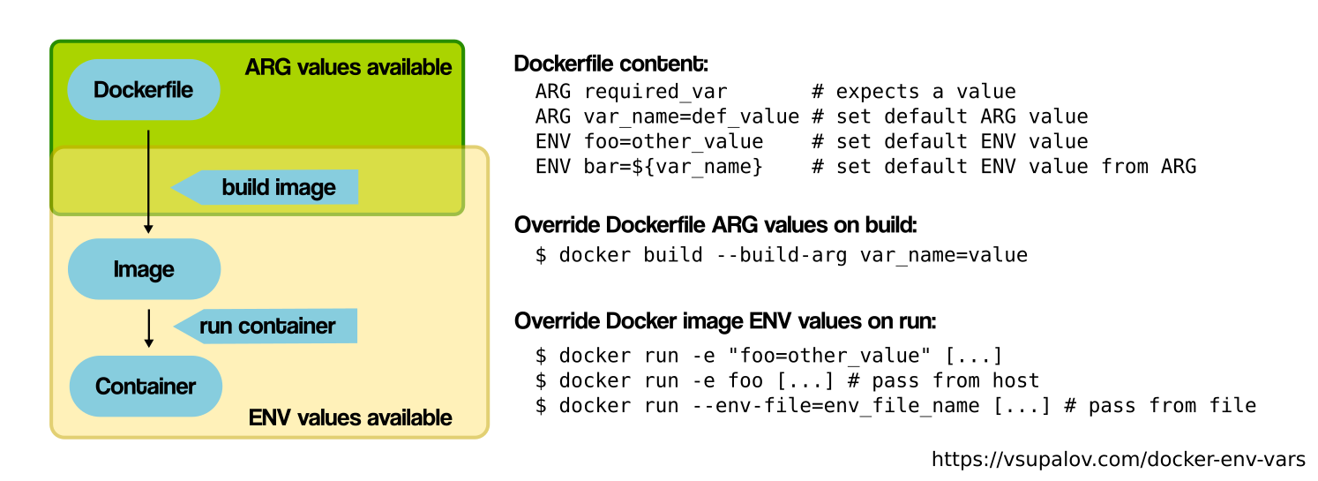



ARG vs ENV

Slide 7
Docker Compose
Configure multiple containers and dependencies together as a single service. Use a single command to start them up
Use cases:
Isolated development environment
Automated testing environments

