Slide 1

APAC Tech Summit MXNet Gluon Workshop Machine Learning on Edge
Amazon Web Services Japan

Slide 2
Agenda
About Edge + ML
Architecture design considerations
Bring Your Own Script Overview
Efficient DL models for edge
Demo
Summary

Slide 3
About Edge + ML
Notes:
Go through quickly

Slide 4

What is Edge + ML ?
Inference on Edge
Training on Cloud
Training data
Smarter models
Local actions
Edge
Inference
Training
Cloud

Slide 5
Benefits of Edge + ML
Latency
Bandwidth
Availability
Privacy

Slide 6
Edge + ML Developing Cycle
Device Setup
Collect data to the cloud
Process data, build and train your model
Develop inference app
Deploy app and model to the edge devices
Continuous Improvement
Notes:
Device setup: Build ML framework and dependencies for different devices

Slide 7
Related Services
Greengrass ML Inference
AWS IoT, Kinesis
=> S3
SageMaker,
DL AMI
Greengrass ML Inference
Device Setup
Collect data to the cloud
Process data, build and train your model
Develop inference app
Deploy app and model to the edge devices
Continuous Improvement
Notes:
Device setup: Build ML framework and dependencies for different devices

Slide 8



Greengrass ML Inferences
Trained models and Lambda functions
Train in the cloud
Massive computing power
Large repository of data
AWS Cloud for training
Inference at the edge
Low latency
bandwidth saving
regulation/privacy
reliability
Extracted Intelligence
Inferences and take actions locally on device

Slide 9



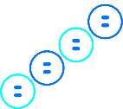


Amazon SageMaker
One-click
training
Hyperparameter optimization
One-click
deployment
Fully managed hosting with auto-scaling
Pre-built notebooks for common problems
Built-in, high performance algorithms
BUILD
TRAIN
DEPLOY
Edge + ML Use Cases

Slide 10
Architecture Design Considerations

Slide 11
Basic Edge + ML Architecture
Inference on Edge
Training on Cloud
Training data
Smarter models
Local actions
Edge
Inference
Training
Cloud

Slide 12
Edge Considerations
Device lifecycle
The lifecycle of device tends to be long.(e.g. 5 years) The latest technology may not be available.(e.g. OS/SW) ⇒Enable feature enhancement on Cloud
Inference on Edge
Training on Cloud
Training data
Smarter models
Local actions
Edge
(Old HW/SW)
Inference
Training
Cloud
(Latest HW/SW)
New generation ML model may not be executable on Edge

Slide 13
Edge Considerations
HW Spec
High spec HW may not be available. Because of the HW cost/may need to use existing HW ⇒ Enable feature enhancement on Cloud Consider using lightweight ML model
PoC Environment
Production Environment
(limited number of devices)
(e.g. 10,000 devices)
Poor inference performance
(e.g. below required throughput)
Local actions
Local actions
Edge
(Low Spec HW)
Inference
Edge
(High Spec HW)
Inference

Slide 14
Model Lifecycle Considerations
ML model performance monitoring
Inference on Edge is not always correct. ML model performance monitoring is necessary. ⇒ Collect data and inference result on Cloud to monitor model performance
Factory
Training data
(e.g. visual inspection)
Smarter models
camera
Training
Cloud
Inference
Collect data on Cloud
Evaluate ML model performance regularly

Slide 15
Model Lifecycle Considerations
ML model deployment on Edge
ML model updates needed. e.g. additional classification class, performance improvement ⇒ Need Cloud -> Edge model deployment mechanism.
Factory
Training data
(e.g. visual inspection)
Smarter models
camera
Training
Cloud
(Latest HW/SW)
Inference
Deploy new ML model from Cloud to Edge

Slide 16
Architecture Design Considerations Summary
Edge
Consider HW lifecycle and production HW spec to design the architecture. Enable feature enhancement on Cloud. Consider using lightweight ML model.
Model lifecycle
ML model performance monitoring is always needed even when inference task is executed on Edge.
ML model updates mechanism needed

Slide 17









Architecture Example
e.g. Factory visual inspection
Local Area Network
Read training data
Deploy trained model
Greengrass Core
Device
Greengrass Service
SageMaker
S3 (Data Lake)
Upload results
AWS IoT
Kinesis Firehose
Results
Camera
Upload images
Images
Production Line

Slide 18
SageMaker Bring Your Own Script Overview
MXNet

Slide 19

MXNet – Functions in Your Script
train()
ML Training Code
Train
save()
Model Saving Code

Slide 20
MXNet – Functions in Your Script
train()
ML Training Code
Train
save()
Model Saving Code
model_fn()
Model Loading Code
transform_fn()
Transform input data into prediction result
Inference

Slide 21
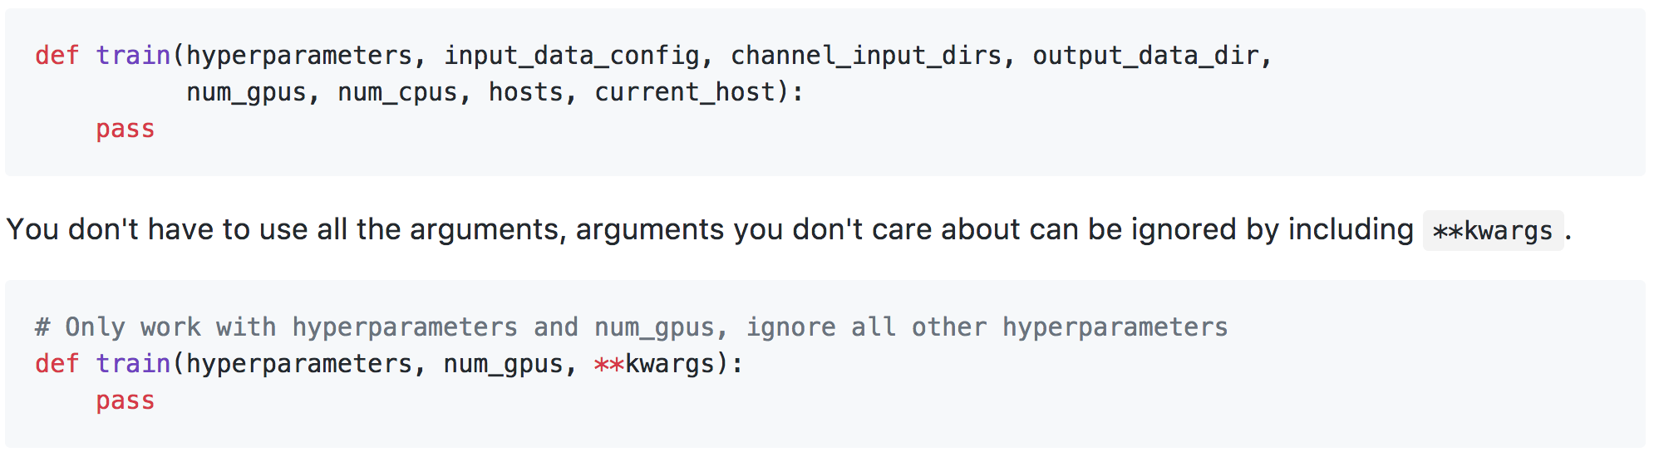
MXNet – train function
Put your code for ML training into train() function
SageMaker provides information about training environment
Returns trained MXNet Module API module object or Gluon API net object

Slide 22
MXNet – train function Parameters
hyperparameters (dict[string,string]): Hyperparameter for ML Training
input_data_config (dict[string,dict]): SageMaker TrainingJob InputDataConfig object
channel_input_dirs (dict[string,string]): Directories of training data
output_data_dir (str): Directory to put checkpoint files
num_gpus (int): # of GPUs
num_cpus (int): # of CPUs
hosts (list[str]): List of host names for distributed training
current_host (str): Name of the training instance

Slide 23
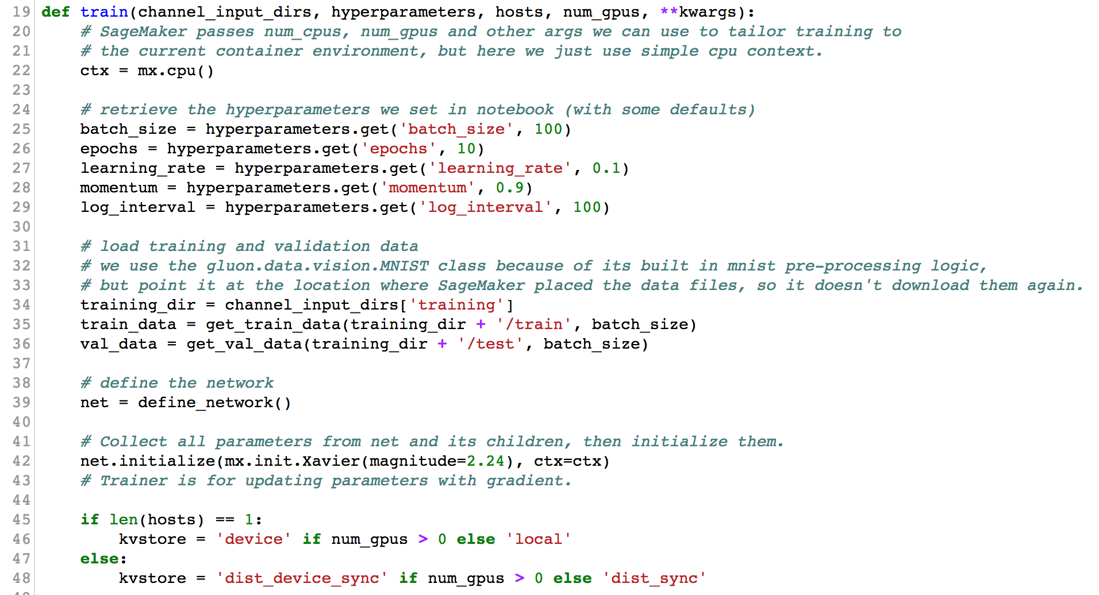
MXNet – train function Example

Slide 24
MXNet – save function for Module API
SageMaker will invoke save function with return-value of train
Default implementation works with MXNet Module API Module object
You should define model serialization logic if
train function returns Gluon API net object or
special processing is needed
Parameters
model : return-value from train function
model_dir : directory to save model

Slide 25
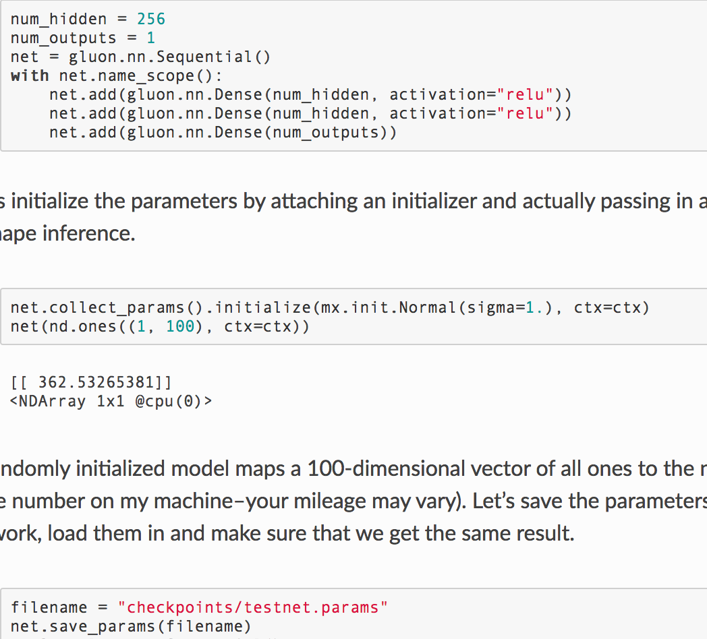
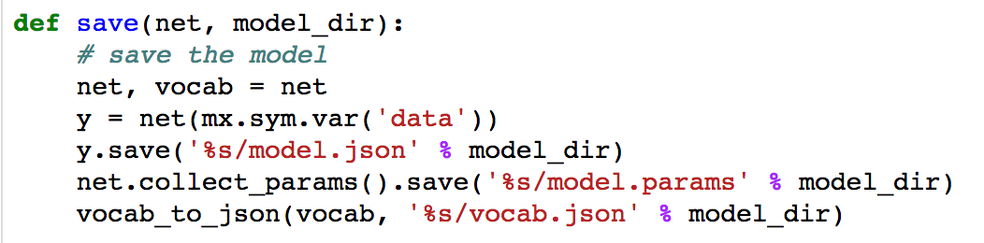
MXNet – save function for Gluon API
Default save function is NOT compatible with Gluon API net object
net object’s save_params() method does serialization of parameters
net.collect_params().save() also works

Slide 26
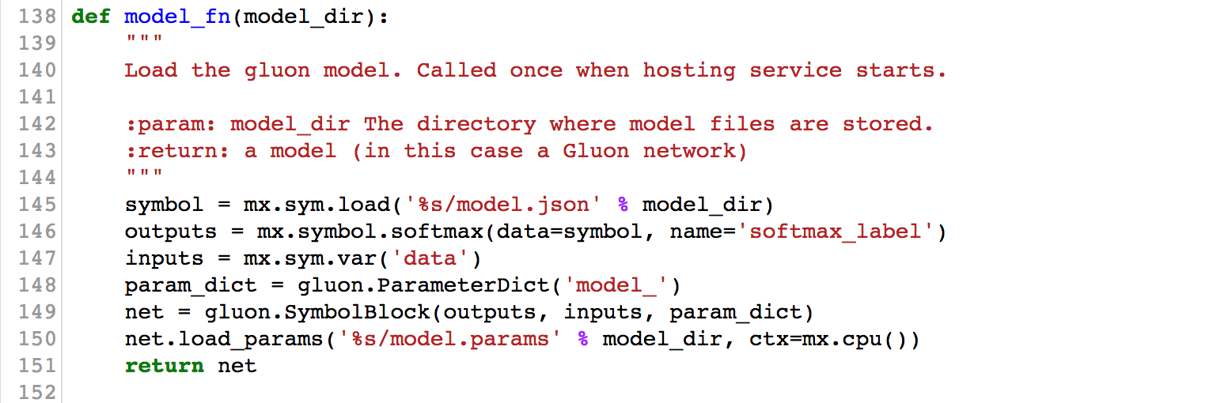
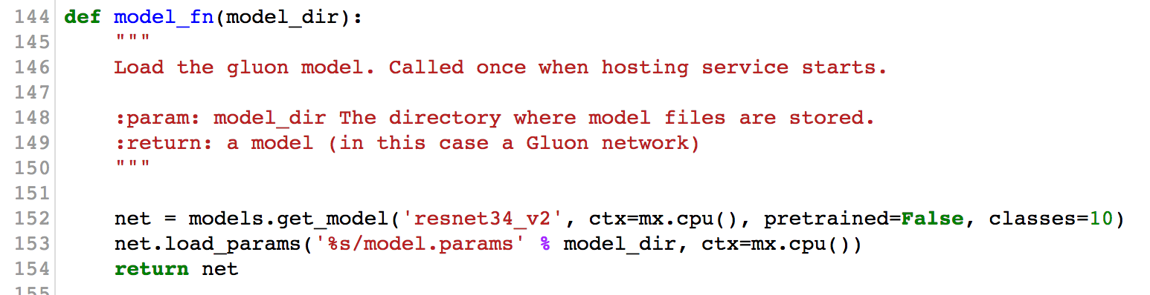
MXNet – model_fn function
Loading trained model
Default model_fn function provided for MXNet Module API model
You should write your model_fn for Gluon API model
model_dir : directory where your model files and sub-directories, saved by save, have been mounted
Loading Custom Model
Loading pre-defined Model

Slide 27
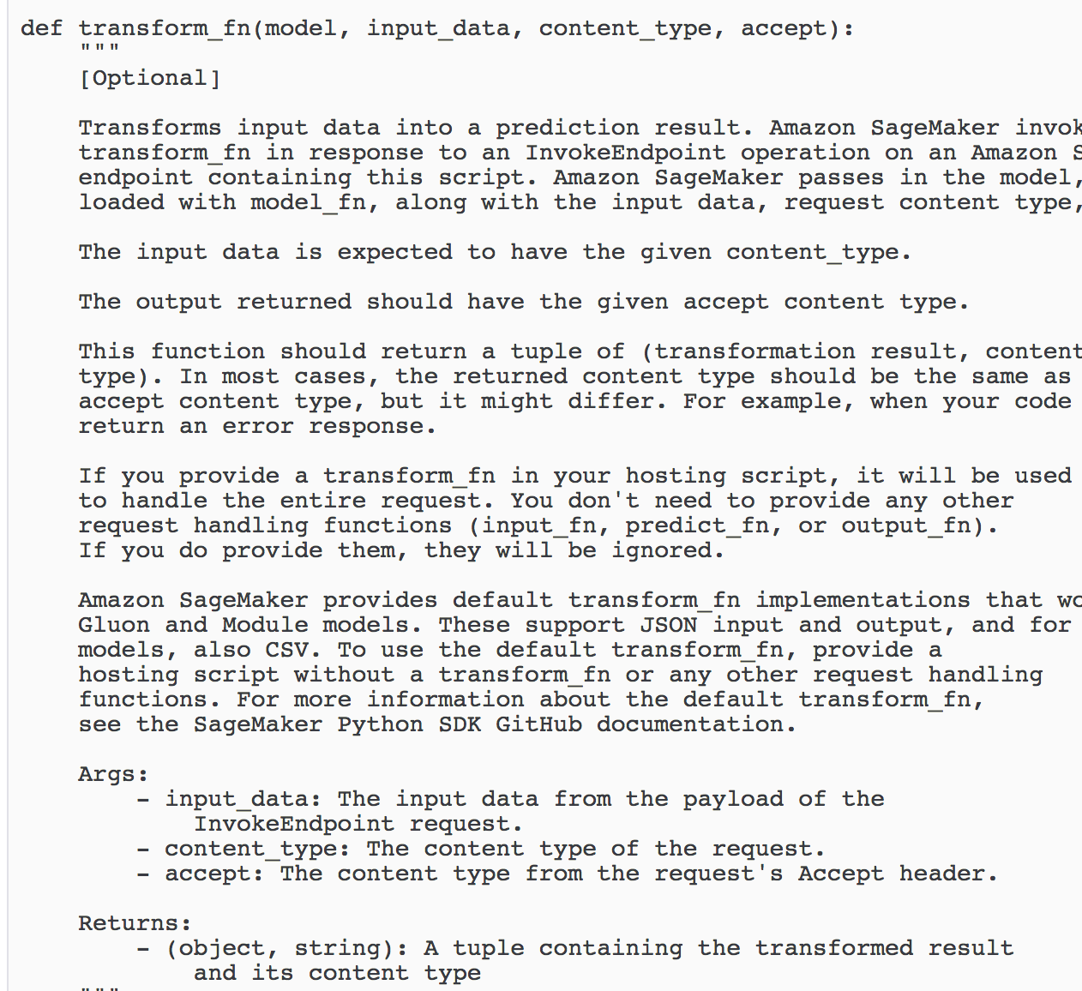
MXNet – transform_fn
Transforming input data into a prediction result
Default transform_fn implementations that work withGluon and Module models
If you provide transform_fn in your hosting script, it will be used to handle the entire request. You don't need to provide any other request handling functions (input_fn, predict_fn, or output_fn). If you do provide them, they will be ignored.
https://docs.aws.amazon.com/sagemaker/latest/dg/mxnet-training-inference-code-template.html

Slide 28
Efficient deep learning model for edge

Slide 29
Motivation of efficient DL models
While modern huge DL models cannot work at an edge, state-of-the-art efficient DL models enable to run at edge with high accuracy.
Inference on Edge
Training on Cloud
Training data
Smarter efficient models
Local actions
Edge
(Old HW/SW)
Inference
Training
Cloud
(Latest HW/SW)

Slide 30







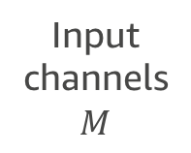

Trend of efficient DL models
Factorization of convolution layers that are computationally demanding [SqueezeNet, 16’], [MobileNets, 17’], [ShuffleNet, 17’].
Convolution layer
Replaced by small layers [MobileNets]
Input
channels
$$M$$
Factorization
1
$$M$$
…
…
+
…
$$D_{k}$$
$$D_{k}$$
$$D_{k}$$
1
$$D_{k}$$
1
Output channels: $N$
$$M$$
$$N$$

Slide 31


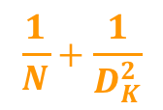
Computational cost for $D_{F}×D_{F}$ image
$$\frac{1}{N}+\frac{1}{D_{K}^{2}}$$
$$D_{k}D_{k}MND_{F}D_{F}$$
$D_{k}D_{k}MD_{F}D_{F}+$ $MND_{F}D_{F}$
Convolution layer
Replaced by small layers [MobileNets]
Input
channels
$$M$$
Factorization
1
$$M$$
…
…
+
…
$$D_{k}$$
$$D_{k}$$
$$D_{k}$$
1
$$D_{k}$$
1
Output channels: $N$
$$M$$
$$N$$

Slide 32
Framework supporting MobileNets
Models with and without pretraining are available.
MXNet example is provided on github official repository.
Gluon/GluonCV supports in model_zoo.
Tensorflow supports in TF-slim library.
Keras supports in keras.applications.mobilenet.MobileNet
(We can find source codes for Pytorch and Chainer on github.)

Slide 33
Demo (10 min.)

Slide 34
Summary
For machine learning at edge, we need to care device lifecycle, HW performance, and model monitoring/updating.
MobileNets is efficient and supported by DL frameworks, which is of use for machine learning at edge.

Slide 35

Thank you!

