Slide 1

End-to-End Application Design
Featuring ColdSpring/AOP, FW/1,
MXUnit, ORM and ValidateThis
Jamie Krug
jamiekrug.com/blog
identi.ca/jamiekrug
twitter.com/jamiekrug
github.com/jamiekrug
cf.Objective() 2011

Slide 2
Goals
  Good application design
  Progressive development, refactoring
  Frameworks, patterns, tools
  Code with confidence (down with design paralysis!)
Notes:
Tenets of good application design in CFML context.
Knowing how to "plan" for refactoring.
Frameworks/patterns as *tools* _not_ *obstacles*.
Learning to be "okay" with moving on w/development.
Learning new stuff can be difficult--this session strives to cover things that can provide a big ROI of learning time.

Slide 3
Application Design: "10,000-foot view"
  Model-View-Controller (MVC)
  Dependency Injection (DI)
  Object-Relational Mapping (ORM)
  Aspect-Oriented Programming (AOP)
  Unit Testing, Test-Driven Development (TDD)
Notes:
MVC:
architectural pattern to isolate business logic from user interface
DI:
allows a software component to list dependencies, and a DI framework handles the dependency resolution (DI is a specific form of the IoC principle)
ORM:
abstracts persistence of objects (CFC instance data) to relational database
AOP:
increase modularity and decrease coupling by allowing for separation of cross-cutting concerns

Slide 4
Sample Application Overview
  MVC with Framework One (FW/1)
  Data Access Layer of Model
  Service Layer of Model
  Persistence with CFML/Hibernate ORM
  ValidateThis for CFC Validation
  ColdSpring Dependency Injection (DI)
  Abstract Gateway/Service for ORM Entities
  ColdSpring AOP for Transaction Advice
  Abstract Persistent Entity CFC
  Unit Testing with MXUnit
Notes:
**Expectations/Disclaimers:**
* Variety of topics: wide, yet related
* Depth of topics: shallow individually, yet rich and powerful collectively
* Tools: excellent choices, but not the only choices
* Examples: directly useful, but not the only way
* At end we'll review how/when to "break the rules" and refactor later

Slide 5
DEMO
Sample Application...
Notes:
Browser preview of branch:
presentation_cfObjective-2011

Slide 6
Model-View-Controller (MVC)
A pattern to isolate business/domain logic from the user interface.
Model: domain objects, business logic, data access
View: user interface (input and presentation)
Controller: coordination between model and view
Notes:
MVC separation of concerns permitting independent development, testing and maintenance of each (Model/View).

Slide 7
MVC with Framework One (FW/1)
  Simple, lightweight, flexible, powerful MVC
  Convention over configuration (no XML, no "boilerplate")
  The "invisible" framework (no API restrictions/requirements)
  Single framework.cfc (extended by Application.cfc)
  Supports any bean factory (ColdSpring, Lightwire, etc.)
  Auto-wiring of controllers with service dependencies
  Flexible options for wrapping views and layouts
  Custom "skinning" (dynamic view/layout selection)
  Subsystems (stand-alone or integrated sub-apps)
  "Search engine safe" (SES) URLs
Notes:
Heavy list for one slide, but good highlights to intro FW/1.
**Briefly** explain each point.

Slide 8
FW/1 Convention: Request Action
/index.cfm?action=section.item
Configurable default section ("main") and item ("default"):
/index.cfm?action=main.default
/index.cfm?action=main
/index.cfm
Examples (basic and SES style):
/index.cfm?action=user.list
/index.cfm/user/list
/index.cfm?action=user.edit&id=123
/index.cfm/user/edit/id/123
/index.cfm?action=security.logout
/index.cfm/security/logout
Notes:
How to make a request of the framework--note nomenclature for later discussion:
action --> section and item

Slide 9
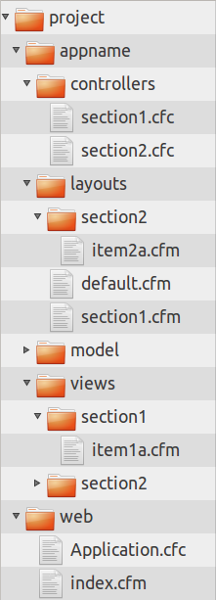
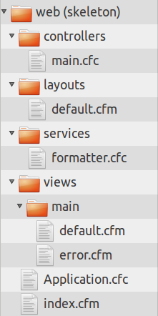
FW/1 Convention: File Organization
Default base
(under Web root)
Custom base
(outside Web root)
base = '/appname'
Notes:
layouts == main display layout template(s)
views == body markup and other "pods" of display output
controllers == framework/request-"aware" CFCs
Review example screen shot directory structures, referencing action=section.item from prior slide.

Slide 10
FW/1 Convention: Request Context
request.context struct contains merged URL/form values
rc is shorthand for the request context, available to:
  controllers (rc is sole argument to controller methods)
  views
  layouts
Controller methods can set data in rc, for views/layouts
Notes:
RC is basically data *from* user/request and data *to* views/layouts/response.

Slide 11
FW/1 Convention: Request Flow-1/2
  /controllers/section.cfc:item( rc )
  /views/section/item.cfm -- required
  /layouts/section/item.cfm
  /layouts/section.cfm
  /layouts/default.cfm

Slide 12
FW/1 Convention: Request Flow-2/2
  /controllers/section.cfc:before( rc )
  /services/section.cfc:item( argumentcollection = rc )
  /controllers/section.cfc:after( rc )
  /views/section/item.cfm -- required
  /layouts/section/item.cfm
  /layouts/section.cfm
  /layouts/default.cfm
Notes:
Discuss implicit service calls by FW/1, and setting to turn off.

Slide 13
FW/1 Configuration, Application.cfc
variables.framework = {
action = 'action',
defaultSection = 'main',
defaultItem = 'default',
error = 'main.error',
reload = 'reload',
password = 'true',
reloadApplicationOnEveryRequest = false,
generateSES = false,
SESOmitIndex = false,
base = '/',
baseURL = 'useCgiScriptName',
suppressImplicitService = false,
unhandledExtensions = 'cfc',
unhandledPaths = '/flex2gateway',
preserveKeyURLKey = 'fw1pk',
maxNumContextsPreserved = 10,
cacheFileExists = false,
applicationKey = 'org.corfield.framework'
};

Slide 14
DEMO
FW/1 basics...
Notes:
**demo_01_FW1-basics**
**Walk through action=main.default:**
* Application.cfc
* Browser: home page
* layouts/default.cfm
* views/main/default.cfm
* controllers/main.cfc

Slide 15
Model
  Domain objects
    Most business logic and data
  Data access layer
    All database/persistence operations
  Service layer
    Main API or "gate keeper" to the model
Notes:
Your focus should be on domain objects as most important part of OOP design.
Data access is just that.
Service layer basics--more covered later.

Slide 16
Model: Domain/Business Objects
  Core business logic and data
  "Smart" objects, well-encapsulated
  Related objects, still loosely coupled
  Most important part of application model?

Slide 17
Model: Data Access Layer
  Database operations, no business logic
  Easily mocked for testing/prototyping
  Data operations involving related domain objects
  Avoid DAO/Gateway-per-domain-object pattern

Slide 18
Model: Service Layer
  Keep service objects "thin"
  (and domain objects "smart")
  Operations involving multiple domain objects
  Data access layer interactions
  Avoid service-per-domain-object pattern

Slide 19
Persistence: CFML/Hibernate ORM
  Object-relational mapping
  Design for model, not data schema
  Saves time and lines of code
  Flexible, powerful
Notes:
ORM can be overwhelming to the uninitiated, but it has big ROI potential!
Think about domain model objects and good OOP principles--not database.

Slide 20
ORM Configuration
Configure ORM in Application.cfc:
this.name = 'orm_app';
this.datasource = 'mydsn';
this.ormEnabled = true;
this.ormSettings = {
cfclocation = '/appname',
dbcreate = 'update',
flushatrequestend = false
};

Slide 21
ORM Entities
component persistent='true' hint='User.cfc'
{
property name='id' fieldtype='id' generator='native';
property name='dateCreated' ormtype='timestamp';
property name='firstName';
property name='lastName';
}

Slide 22
ORM CRUD
transaction {
user = entityNew( 'User', { 'name' = 'Jamie' } );
entitySave( user ); // Create
}
id = user.getID();
transaction {
user = entityLoadByPK( id ); // Read
user.setName( 'Jamie Krug' );
entitySave( user ); // Update
}
transaction {
user = entityLoadByPK( id );
entityDelete( user ); // Delete
}

Slide 23
Importance of ORM Transactions
  Encapsulate units of work
  Demarcation controlled by business logic
  Explicit control of when database operations occur
  Avoid accidental database changes

Slide 24
DEMO
ORM, Service/Data Layers...
Notes:
**demo_02_orm-service-data-basics**
* Application.cfc
* Abbreviation.cfc
* Definition.cfc
* AbbreviationService.cfc
* AbbreviationGateway.cfc
* Browser: home page
* action=main.default: layout, view, controller, service, gateway
* action=abbreviation.define: view, controller, service, gateway
* action=abbreviation.submit: controller, service, gateway

Slide 25
Questions?
Part 2, after a short break...
Notes:
**Covered So Far:**
* MVC
* Model: domain objects, data access, services
* FW/1
* ORM

Slide 26
ValidateThis for CFC Validation
  Why a validation framework? DRY
  Encapsulate validation rules in one place
  Client and server side validation
  Single object, multiple contexts
  Built-in or custom validation types
  Failure messages, default or custom

Slide 27
ValidateThis, Quick Start
Validation service (singleton):
import ValidateThis.ValidateThis;
validateThisConfig = { jsRoot = '/js/', definitionPath = '/model/' };
application.validationService = new ValidateThis( validateThisConfig );
Server-side validation of an object:
user = new User( 'Jamie' );
result = application.validationService.validate( user );
if ( !result.getIsSuccess() )
// handle validation failures
Generate client-side validations:
<!--- output between <head></head> tags --->
#application.validationService.getValidationScript( objectType = 'User' )#
Built-in validation types Javascript initialization (if needed):
<!--- output between <head></head> tags --->
#application.validationService.getInitializationScript()#

Slide 28
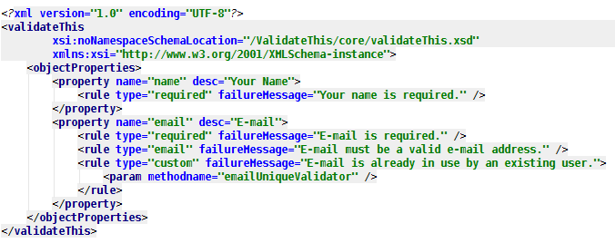
ValidateThis Rules Definition

Slide 29
DEMO
ValidateThis...
Notes:
**demo_03_ValidateThis**
* Browser: demo validation failures
* Application.cfc
* Abbreviation.xml
* Definition.xml
* AbbreviationService.cfc: saveAbbreviation()/saveDefinition()

Slide 30
ColdSpring Framework
  Power of Java Spring framework, for CFML
  Dependency Injection (DI) framework
  Aspect-Oriented Programming (AOP) framework
  Ease configuration and dependencies of CFCs
  Remote proxies, automatically generated
  (Much more)

Slide 31
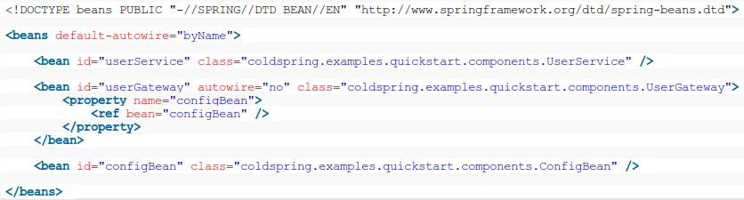
ColdSpring: Beans Definition

Slide 32
ColdSpring: Bean Factory
import coldspring.beans.DefaultXmlBeanFactory;
coldspringConfig = '/appname/config/coldspring.xml';
beanFactory = new DefaultXmlBeanFactory();
beanFactory.loadBeans( coldspringConfig );
userService = getBean( 'userService' );
users = userService.listUserByFirstName( 'Jamie' );

Slide 33
DEMO
ColdSpring DI...
Notes:
**demo_04_ColdSpringDI**
* beans.xml
* AbbreviationService.cfc properties: abbreviationGateway, validationService

Slide 34
Abstract Gateway/Service for ORM
  Encapsulate generic ORM CRUD
  Dynamic and flexible with onMissingMethod():
    getXXX( id )
    getXXXByYYY( yyyValue )
    listXXX[FilterByYYY][OrderByZZZ]( [yyyValue] )
    newXXX()
    saveXXX(object)
    deleteXXX(object)
  Extend as needed

Slide 35
DEMO
Abstract Gateway/Service...
Notes:
**demo_05_AbstractGateway**
* AbstractGateway.cfc
* oMM tricks/"API"
* AbbreviationService.cfc
**demo_06_AbstractService**
* AbstractService.cfc: get/list methods all removed
* onMM "API"/passthrough
* Controllers -- calling missing service methods ;-)

Slide 36
ColdSpring AOP for Transaction Advice
  Transactions transparent to business logic
  DRY (cross-cutting concerns)
  Simplify service methods
  Wrap multiple service methods

Slide 37
DEMO
AOP Transaction Advice...
Notes:
**demo_07_AOPTransactionAdvice**
* beans.xml
* TransactionAdvice.cfc
* AbbreviationService.cfc: transactions removed

Slide 38
Abstract Base CFCs
  DRY, e.g.,
    Entity properties (id, created, lastModified...)
    Common service dependencies (DI)
    Common/generic behavior
  Rich, shared behavior and data
  Free to override methods, if needed
  E.g., AbstractPersistentEntity.cfc as mappedsuperclass

Slide 39
DEMO
Abstract Persistent Entity...
Notes:
**demo_08_AbstractPersistentEntity**
* AbstractPersistentEntity and slimmed down beans

Slide 40
Unit Testing with MXUnit
  What is unit testing?
  When do I perform unit testing?
  Where do I perform unit testing?
  How do I perform unit testing?

Slide 41
DEMO
MXUnit unit testing...
Notes:
**demo_09_MXUnitTesting**
* Review /tests directory structure
* Browser: /tests/unit/index.cfm -- show test suite run
* AbstractTestCase.cfc
* Review each test case CFC--*briefly*

Slide 42
Review: Big Picture
  Controllers -- KISS
    Framework/HTTP coordination
    A good service layer API helps!
  Service layer -- KISS
    How you expose your model API
    API useful to controllers, remote/Web Service
  Domain objects
    "Smart" objects encapsulating domain logic
    Keep OOP best practices in mind when designing
  Abstract CFCs
    DRY--but don't stress either--refactoring later is OK
  Unit testing
    Use it and enjoy the safety net!

Slide 43
Review: Down w/Design Paralysis!
There are good ways to "hack something together quickly."
The key is to know how/where to allow for refactoring.
  "Heavy" controllers and/or services
  Data access in controllers and/or services
  Mocked data access layer
  Avoid premature performance tuning

Slide 44
Questions?
Thank you!
Jamie Krug
jamiekrug.com/blog
identi.ca/jamiekrug
twitter.com/jamiekrug
github.com/jamiekrug
Notes:
* Code on GitHub: https://github.com/jamiekrug/notintothewholebrevitything/tree/presentation_cfObjective-2011
* Hallway/lunch questions or discussion
* Feedback survey (4 questions) on cfObjective.com session page

