Slide 1
Archiver Overview
Version 1
Jamie Cho

Slide 2
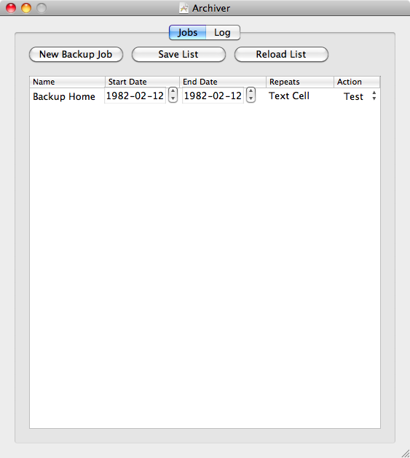


Slide 3
Backend
UI (Swing)
Archiver Functionality
RMI
Uses
Uses
Archiver Library
Uses
Jobs Library
Scheduler Functionality
Utility Library
Generic Functionality

Slide 4
log
Archiver is a SchedulerSystem
SchedulerSystem
Jobs.yml
SchedulerSystemService
RMI
JobsStats.yml

Slide 5
log
SchedulerSystem
Logger
Scheduler
Jobs.yml
JobsListSerializer
JobsStatusSerializer
JobsStats.yml

Slide 6
Scheduler
JobList
ScheduledExecutorService
JobStatusList

Slide 7
External Libraries
JSE 6
YamlBeans (http://yamlbeans.sourceforge.net/)
Apache Commons Net (http://commons.apache.org/net/)
Mockito – for testing (http://mockito.googlecode.com/svn/tags/1.8.0/javadoc/org/mockito/Mockito.html)
QF-Test – for testing UI (http://www.qfs.de)

