Slide 1
How we got here
A small team, a vibe coding mentality and an investment portal that makes money less daunting
The NTT Team, with Claude Code
Notes:
An account of how the NTT Team approached Aurelius: the idea behind it, the way the team worked, and how a prototype theme became an application built in OutSystems ODC. It is written to be read on its own and can also be presented. Slide 21 sets out what the account rests on.

Slide 2

Vibe coding gave us speed. Principles made it shippable
THE SHORT VERSION
The NTT Team set out to show that a vibe coding mentality, teamed with a small group of OutSystems developers, could rapidly craft a rounded investment portal.
The front end steered the design and architecture of the theme with Claude Code. A skilled OutSystems team took it and built the app in ODC.
PULL REQUESTS
STYLE GUIDE
186
38
merged into the theme
pages of documentation
CSS MODULES
OSUI VARIABLES
36
63
one job per file
bridged to our tokens
Notes:
The argument of the whole deck. Speed alone would not have produced something an OutSystems team could build on. What made the difference was a clear standard for the front end and a skilled team of OutSystems developers to take the work the rest of the way.
Evidence: Repository history and GitHub. Counts are from the theme repository; the ODC application is not in it.

Slide 3



Take what was out there, and improve it
THE IDEA
THE QUESTION
Could a small team, with a vibe coding mentality, build something better than what is out there?
Why finance
Why vibe coding
Why OutSystems
FinTech experience in the team and NTT’s banking division made investment portals familiar ground.
To craft a product rapidly, without giving up the quality a wealth client expects.
To show the approach could reach a real application in the hands of skilled developers, not stop at a demo.
Notes:
Aurelius was born from an idea, not from an existing product. The team looked at what investment portals offered and asked whether it could be improved, and whether a vibe coding mentality teamed with a small team of OutSystems developers could do it. FinTech experience in the team and NTT’s banking division made financial services the natural place to prove it.
Evidence: The NTT Team’s own account.

Slide 4
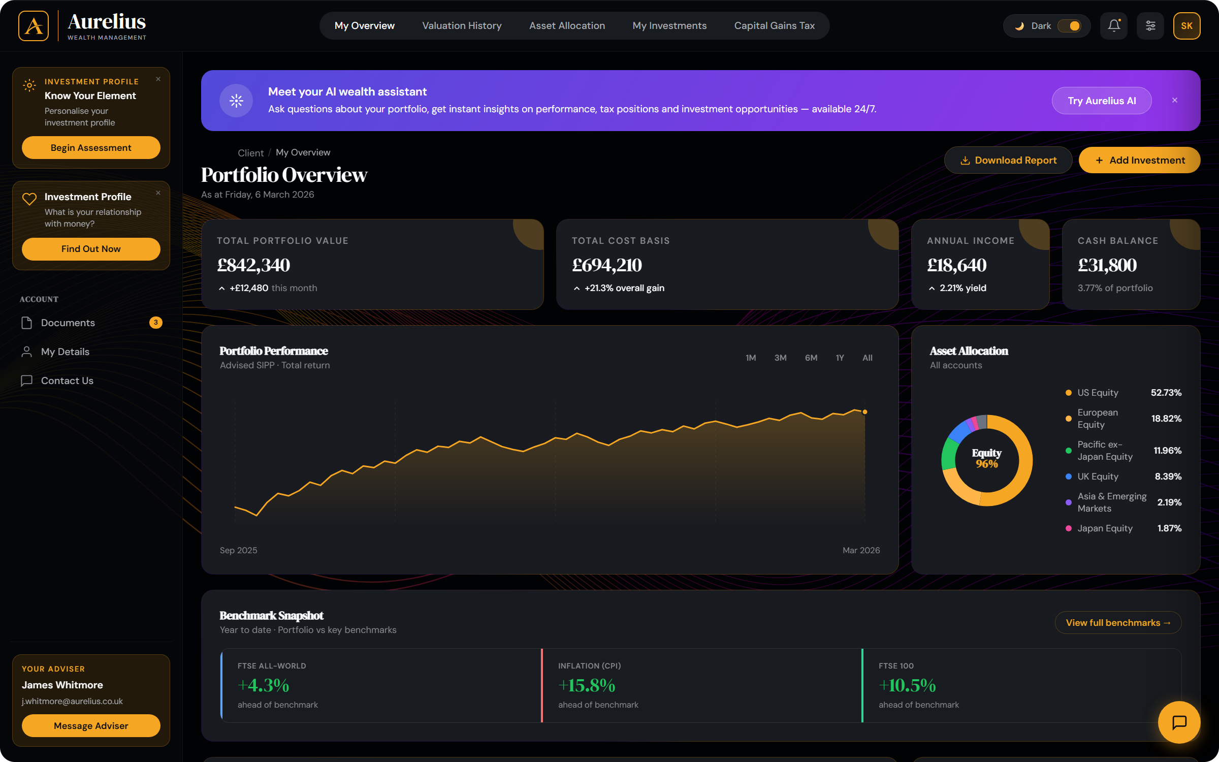




Nobody likes talking about money
THE AMBITION
“it needs to feel ultra modern and simple, not intimidating”
Jamie Scott, front end
Engage, don’t intimidate
A rounded investment portal that draws people in, rather than scaring them away from the subject.
Room to breathe
Clear the clutter and let the content breathe, so nobody feels overloaded.
Considerate by design
Real care around sensitive questions, such as family or bereavement.
Platinum for everyone
The visual language: calm, dark and spacious
A premium experience that never feels like a tool for the elite.
Notes:
This is the heart of the idea. Money is a topic people would rather avoid, and investment portals can make that worse. The ambition was a rounded investment portal that wants to engage people rather than scare them away. The quotes are from the front-end design direction: "it needs to feel ultra modern and simple, not intimidating", and "clear the clutter, let the content breathe". The screenshot is there to show the visual language, with the client name masked and demo figures.
Evidence: The NTT Team’s own account; session transcripts for the quoted design direction.

Slide 5

We studied what was out there, then asked for better
THE RESEARCH
What the NTT Team brought
What Claude Code brought
The bar to beat
Gap analysis
Bootstrap, Tailwind and Material as examples of great style guides. “we need better than that”.
A ranked list of what an investment portal should offer and what was still missing.
Design direction
Root causes
Award-winning sites and studios, and leading consumer investing experiences.
Why the theme’s CSS kept losing on OutSystems: layers, not specificity.
Platform knowledge
Concepts to react to
What OutSystems provides, so the prototype and the application would match.
Ideas pitched first, then challenged and refined before anything was built.
Notes:
Research ran in both directions. The team brought benchmarks, references and platform knowledge. Claude Code brought analysis and concepts for the team to react to, and neither was accepted without challenge. Bootstrap, Tailwind and Material were named as the bar for the style guide, and the response to them was "we need better than that".
Evidence: Session transcripts; roadmap note in the project memory. Research from the earliest months was not recorded.

Slide 6

A small team, with clear roles
THE TEAM
The NTT Team A shared idea and a shared standard
Front-end direction
Claude Code
OutSystems developers
Steers the design and the architecture of the theme, and holds the work to a standard.
Builds the theme, the HTML prototype and the documentation at speed, under that direction.
A skilled team takes the theme and builds the application in ODC.
GIVES Direction and standards
GIVES Theme and style guide
GIVES The application in ODC
Vibe coding did not replace skilled developers. It was teamed with them.
Notes:
This was a small team effort. The front end steered the design and architecture of the theme, using Claude Code to build at speed under that direction. A skilled team of OutSystems developers took the theme and built the application in ODC. Vibe coding did not replace skilled developers. It was teamed with them.
Evidence: The NTT Team’s own account.

Slide 7



Human direction, AI build, constant challenge
THE WAY OF WORKING
Direct
Build
Challenge
Set the brief, the standard and the constraints first.
Claude Code builds on a branch and opens a pull request.
Review it in the browser and send it back until it is right.
“remember how we work, clean CSS over JS, repeatable reusable tokens and components”
“throw the next PR my way please”
“no that’s horrible, roll that back, lets add a bottom gold border and maybe a subtle bottom glow”
Corrections became standing rules
Quotes: Jamie Scott, front end
Features need a branch and a PR
Never edit bundle.css directly
Prefix classes with .site-
No utility classes
Written after a second direct push to main
It is generated, and a deploy wipes edits
OutSystems UI owns the generic names
Name classes for what the thing is
Notes:
Vibe coding here did not mean accepting what came back. The brief and the standard were set first. Claude Code built on a branch and opened a pull request. The result was reviewed in the browser and sent back until it was right, sometimes bluntly: "good fix but the naming sucks". The most valuable part is at the bottom: corrections were written down as standing rules so they never had to be made twice.
Evidence: Session transcripts; project memory notes. Quotes tidied for typos.

Slide 8




CSS over JS, because CSS is what travels to OutSystems
PRINCIPLE · CSS
BEFORE
“any custom JS will be difficult to implement in OutSystems”
Jamie Scott, front end
toggleTheme()
/* JS flips an attribute */
[data-theme="dark"] { … }
AFTER, NO JAVASCRIPT
What CSS carries
<input type="checkbox" role="switch"
class="theme-checkbox">
html:has(.theme-checkbox:checked) {
color-scheme: light;
}
--bg: light-dark(var(--neutral-1), var(--neutral-10));
Theming
Light and dark from one set of tokens
State
:has() and native inputs, not scripts
Layout
Grid that holds up inside OutSystems wrappers
Motion
Native transitions that respect reduced motion
Notes:
CSS over JavaScript started as craft and became strategy. OutSystems takes the stylesheet, so anything expressed in CSS travels with the theme, while custom JavaScript has to be rebuilt on the platform. The theme switch is the clearest example: a JavaScript function was deleted and replaced with a checkbox and the CSS :has() selector. The code on this slide is taken from the source.
Evidence: PR #17 (theme toggle), PR #31 (grid), PR #84 (transitions), PR #152 (reduced motion); session transcripts.

Slide 9




HTML that means something before it looks like anything
PRINCIPLE · HTML
<header role="banner">
<nav class="topbar-nav"
aria-label="Primary">
</header>
<aside class="site-sidebar"
aria-label="Site navigation">
<div role="group"
aria-labelledby="nav-account">
</aside>
<main class="main">
Landmarks, not divs
A real banner, navigation and main area, so the structure is clear to every user.
A real heading structure
Semantic headings across the portal, treated as a piece of work in its own right.
Native elements first
Built-in form and output elements before custom widgets, for less code and better behaviour.
Names that survive change
Class names describe what a thing is, not where it sits.
Notes:
The markup was refactored more than once so it said what things are. Generic divs became landmarks, class names describing location were removed, the navigation gained proper grouping and headings were restructured. The markup is copied from the prototype, leaving out child elements.
Evidence: PR #28 (markup refactor), PR #45 (sidebar semantics), PR #82 (headings); the prototype’s index.html.

Slide 10
Accessible from the start, not audited at the end
PRINCIPLE · ACCESSIBILITY
The standard, held in review
ONE TOKEN, 12 FAILURES
--text-3 in dark mode
“we’re accessible from the go remember”
3.55:1
5.61:1
Input borders were raised to meet 3:1, creating a dedicated token.
Fails WCAG AA
Passes WCAG AA
“we can’t hide that away for accessibility”
Wealth Management
Wealth Management
A modal close button was made gold, so it could not be missed.
#6B6F76
#8C9099
Lowest ratio shown for each value. All 12 Lighthouse failures traced to this single token, so a single change cleared them.
“for a screen reader this would be even weirder”
A calculated result was rethought, not just restyled.
Lighthouse runs after every deploy.
And animated borders stop for anyone who asks for less movement.
“nested scrollbars aren’t great for accessibility”
Layouts were reworked to avoid scrolling inside scrolling.
Notes:
A portal that wants to welcome people cannot exclude them. Lighthouse once reported 12 colour contrast failures, and all 12 traced back to one token, so one change fixed them all. That is what a token system buys you. The samples on the left use the two exact colours. On the right are moments where the standard was held during review. Slide 18 records where this is still owed.
Evidence: PR #24 (--text-3), PR #159 (--border-input), PR #152 (reduced motion), netlify.toml; session transcripts.

Slide 11

Three seed colours drive the entire palette
PRINCIPLE · DESIGN TOKENS
SEEDS
GENERATED SCALES
NAMED TOKENS
OUTSYSTEMS READS
#F5A623
primary
--brand-50 to 900
--gold
--bg
--bg-card
--text-1
--text-2
--text-3
--border-input
--color-primary
--color-error
--color-neutral-0
--color-neutral-10
--font-size-base
--border-radius-soft
#FFB547
secondary
--neutral-0 to 10
#6B6F76
neutral
oklch(from var(--seed-primary) l c h)
Change one seed and the whole system follows, in the prototype and in the OutSystems variables alike. A new theme becomes an edit, not a project.
Notes:
The colour system is built around three seed values. Relative oklch colours generate each scale, named tokens pick from those scales, and the OutSystems bridge reads from the same tokens. Change a seed and it cascades through the prototype and the OutSystems variables alike.
Evidence: PR #27; src/styles/theme/brand.css and colours.css. Swatches are resolved values from the running prototype.

Slide 12
One bridge file teaches OutSystems to speak Aurelius
THE BRIDGE · TOKENS
OUTSYSTEMS UI ASKS FOR
AURELIUS PROVIDES
--color-primary
--gold
osui-bridge.css
--color-error
A one-way adapter. It only sets OutSystems variables from Aurelius tokens.
--red
--font-size-base
--fs-base
--font-family-heading
--font-serif
--border-radius-soft
--radius-item
VARIABLES FIRST MAPPED
CATEGORIES
AURELIUS TOKENS MODIFIED
63
10
0
Notes:
OutSystems UI components look for their own custom properties, such as --color-primary. Without help they fall back on platform defaults. The bridge is a single adapter file, in one direction only, that sets each OutSystems variable to an Aurelius token. Its goal was to do this "without forking or modifying either system". The first version mapped 63 variables in 10 categories and changed no existing Aurelius token.
Evidence: docs/osui-bridge-plan.md; PR #25; src/styles/theme/osui-bridge.css.

Slide 13



One stylesheet, two destinations
THE BRIDGE · DELIVERY
Netlify
CSS partials
build.js
bundle.css
GitHub main
Hosts the prototype and the guide
SMACSS folders: 36 modules plus theme, layout, base and state
Concatenates in a set order and minifies on deploy
The one generated file, committed with its sources
Merging is the deploy
OutSystems ODC
Pulls bundle.css as its theme
Review is the release gate
The CSS must be self-contained
The prototype is the test bed
Features reach main through a reviewed pull request, and merging is what updates the theme.
ODC never sees the prototype’s page heads. Fonts and images have to load from the CSS.
Designs are proven on the prototype before the OutSystems team builds with them.
Notes:
Source partials are built into a single bundle.css, and that file goes to two places: Netlify hosts the prototype and style guide, and the OutSystems team’s ODC application pulls the same file from the GitHub main branch. Merging to main is effectively the deployment. Because the platform only sees the CSS, everything the design depends on, including fonts and images, must be reachable from the CSS.
Evidence: build.js; netlify.toml; project memory note; PR #174.

Slide 14
Building in ODC reshaped the theme
THE BRIDGE · CONTACT WITH THE PLATFORM
WHAT WE FOUND | WHY IT HURT | WHAT WE CHANGED
Blocks arrive wrapped in extra divs | A flexbox header stopped distributing its children | A three-column grid, with display: contents to flatten wrappers
OutSystems UI owns .sidebar | Our sidebar inherited an off-canvas position | Renamed to .site-sidebar, then a .site- prefix rule
Our CSS sits in a layer, _Basic_ does not | Unlayered rules always win, however specific ours are | Targeted !important, only where _Basic_ is shown to win
No Popover API support | Drawers and menus had no open state to style | A parallel .is-open class beside every :popover-open
Page heads never reach the platform | The wordmark font fell back to Georgia | @font-face rules moved into the bundle itself
Notes:
Tokens were the easy part. Real rendering on the platform revealed a series of structural differences, and each became a documented pattern. The most significant was the cascade: OutSystems wraps the bundle inside a CSS layer, while its _Basic_ stylesheet is unlayered, and unlayered CSS beats layered CSS regardless of specificity. A layered !important reverses that order, so it is allowed only where _Basic_ is shown to win. Otherwise the front-end rule stands: "we should never resort to using important, this would suggest we need to refactor the code". The statement about the Popover API is as recorded in PR #130.
Evidence: PRs #31, #35, #47, #39, #130, #174; style-guide/outsystems.html.

Slide 15
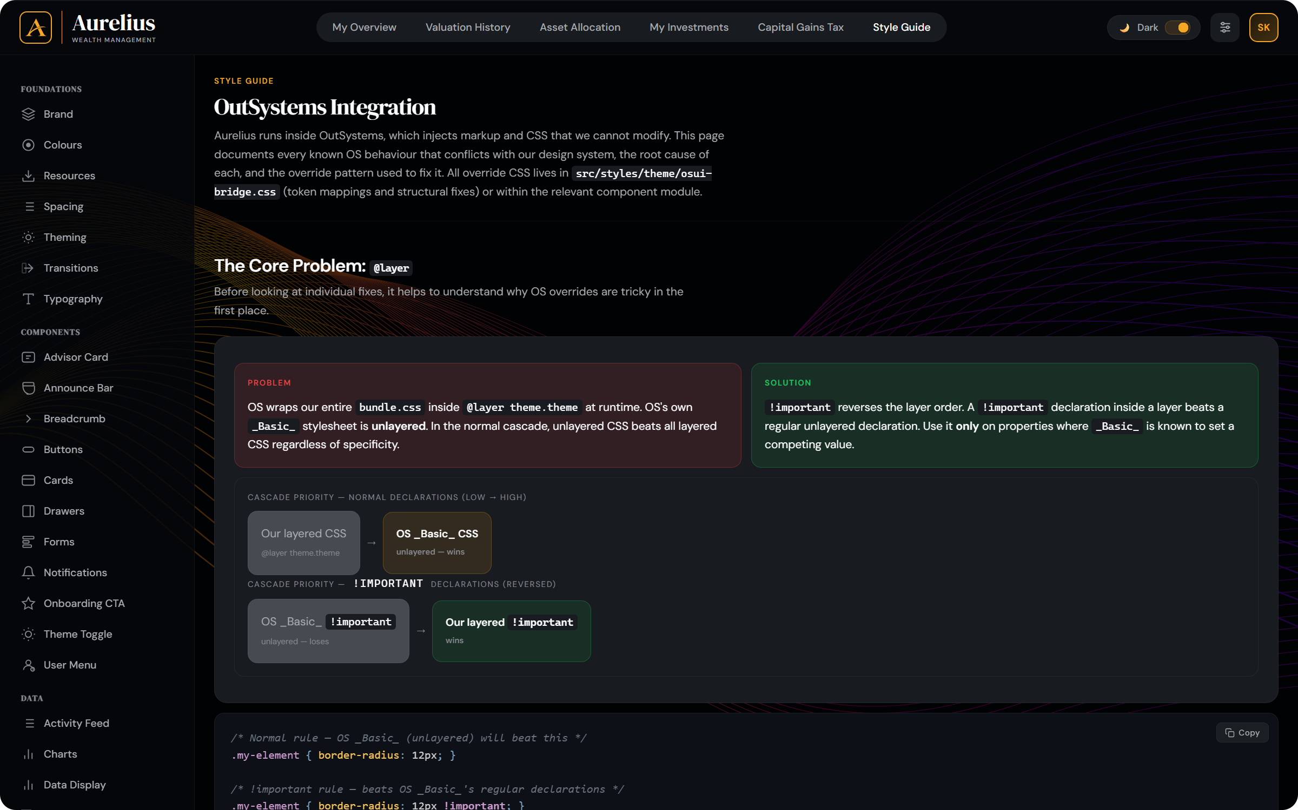
The style guide became the shared language
THE BRIDGE · HANDOVER
the guide needs to be complete documentation so any developer can access it and be able to build a component or a page
Every page carries a live demo, copy-ready HTML, a token table, do and don’t guidance, accessibility notes and OutSystems callouts where relevant.
38
pages of living documentation for developers and designers
Notes:
The style guide is how the front-end work reached anyone else. The brief was explicit: "the guide needs to be complete documentation so any developer can access it and be able to build a component or a page". Each page follows a standard: a live demo, copy-ready HTML, a token table, do and don’t guidance, accessibility notes, and OutSystems callouts where relevant. The OutSystems integration page, shown here, documents each platform conflict, its root cause and the override pattern.
Evidence: PRs #59, #72, #160; project memory note; session transcripts.

Slide 16


A class name should say what a thing is
THE BRIDGE · THE STANDARD UNDER PRESSURE
“they leave you with situations where if things change the class name becomes detached from the use”
Jamie Scott, front end, on utility classes
247
<button class="ais-mode-btn
u-py-xs u-px-base u-radius-card
u-border-0 u-bg-none u-text-2
u-fs-sm u-pointer">
<button class="ais-mode-btn">
/* the component owns its styling */
.u-* utility classes added by the AI’s first attempt at removing inline styles
Rejected on review. All gone before merge.
Named by role
Media queries in the component
Mapped to OSUI widgets
Each class belongs to a component and lives in that component’s partial.
Responsive and state changes stay in CSS, out of the markup.
The guide says which widget each supporting class applies to.
Notes:
A good example of the way of working. When inline styling was removed from the prototype, the AI’s first attempt met the brief mechanically by adding 247 utility classes. The front-end review rejected the approach and the work was redone with classes written for each component, named by role, with media queries handling responsive changes. This matters on OutSystems because component classes can be applied to widgets and documented per widget.
Evidence: PR #188 and its review; project memory note. PR #188 records that this guidance has not yet been run in ODC.

Slide 17
What came out of it
WHERE IT STANDS
A portal
A theme
A way of working
A rounded investment portal that wants to engage people, built in ODC by a skilled team of OutSystems developers.
A documented, token-driven theme with its own bridge to OutSystems UI, built for reuse beyond this one application.
A vibe coding mentality teamed with front-end standards and platform skills, in a team small enough to move quickly.
The portal was the proving ground. The theme and way of working can be reused.
Notes:
Three things came out of this, and the first depends on the people who built it. A rounded investment portal, built in ODC by a skilled team of OutSystems developers. A reusable, documented theme. And a repeatable way of working, teaming a vibe coding mentality with real platform skills. The application itself was not inspected for this deck.
Evidence: The NTT Team’s own account; repository history.

Slide 18



What is still open
WHERE IT STANDS
Newest concepts live in the prototype
Concept
The latest proof-of-concept work has not been carried across to OutSystems.
Accessibility is still owed on proof-of-concept work
Owed
A conscious decision for a demo. The full run-through and mobile pass still need doing.
The latest theme guidance needs proving in ODC
To verify
The cascade was reasoned through rather than run on the platform.
Notes:
The rest is not credible without this slide. Some of the most recent concept work lives only in the prototype, and it was agreed that its accessibility run-through could wait because it is a proof of concept. PR #188 records that its latest theme guidance was reasoned through rather than run in ODC.
Evidence: Project memory notes; PR #188; session transcripts.

Slide 19





What we would carry forward
THE LESSONS
Set the standard before the speed
Team AI with skilled people
Make every correction permanent
AI multiplies whatever direction it is given. Experienced judgement cannot be skipped.
Vibe coding gets you moving. Skilled developers get you to a real application.
A correction that becomes a written rule never has to be made twice.
Prefer what the platform gives you
Design for the destination
Document as you build
Native HTML and CSS meant less code to carry across to OutSystems.
Know how the final host treats your code, then test against it early and often.
A living style guide is what lets a team share the work.
simple to use · platinum level experience · CSS over JS · cutting edge · above all accessible
Notes:
These lessons are an interpretation of the record, not a quotation from it, and they apply to any team combining AI-assisted building with a low-code platform. The line at the bottom restates the philosophies that were repeated in the front-end briefs.
Evidence: An interpretation of the account in this deck. The philosophies at the foot are from the front-end brief.

Slide 20
“this is not just a platinum wealth management experience, it is a platinum grade theme”
Jamie Scott, front end
Notes:
This line sums up the front-end ambition: the portal was the proving ground, and the theme and the way of working behind it are what can be reused.

Slide 21
What this account rests on
APPENDIX
PART OF THE STORY | RESTS ON
The idea, the ambition and the team’s roles | The NTT Team’s own account
The theme, prototype and style guide | Repository history, pull requests and surviving session transcripts
The application built in ODC | The team’s own account. It is not in the theme repository and was not inspected for this deck.
Not verified here
How quotes were handled
Credits
The running ODC application. No Lighthouse score history exists beyond PR #24. Research from the earliest months was not recorded.
Front-end quotes are Jamie Scott’s, with typos and punctuation tidied and some shortened. PR write-ups were drafted by Claude Code.
The onboarding experience was built to a U Impact reference design. Screenshots use demo figures, with the client name masked.
Notes:
Use this slide when relying on the deck as a source document. Technical facts about the theme come from the repository and pull requests. Quotes come from surviving session transcripts. The idea, the team’s roles and the ODC build come from the team’s own account, because that work is not in the theme repository. PR write-ups were drafted by Claude Code, so their claims about OutSystems reflect what was understood when they were written. Evidence for each slide is at the end of its speaker notes.

