Slide 1
VM Scale Set Autoscaling
Jamie Zimmerman
Happy Intern
Notes:
Tip: simple SEO adjustments can make your presentation more discoverable. Read this PDF for best practices: http://seo.ges.symantec.com/seo-best-practices-for-file-optimization.pdf

Slide 2
Initial Project Goals
Deploy a “Hello World” app to a VMSS
Run a Jmeter Load Test on the application
Observe and validate auto scaling triggers when VMs are working too hard
Wrap this all up into VSTS workflow pipeline

Slide 3
Timeline of Struggles
Number One Difficulty: Guess and Check takes too long!
Notes:
This is a Transition Slide Horizontal Picture slide ideal for including a picture with a brief title and optional subtitle.
To customize this slide with your own picture:
Right-click the slide area and choose Format Background from the pop-up menu. From the Fill menu, click Picture and texture fill. Under Insert from/Insert picture from: click File. Locate your new picture and click Insert.
Alternate background pictures are located here: http://syminfo.ges.symantec.com/marketing/globalcommunications/index.asp

Slide 4
ARM Templates
Conditional Flag to use existing VNet infrastructure
Load Balancing on Port 80 (unavailable on Portal)
No public IPs in DEV-TEST
No way to interact with application using an internal load balancer

Slide 5
VSTS Workflow
Deployments kept failing
Each one takes 20 minutes
No error correcting

Slide 6
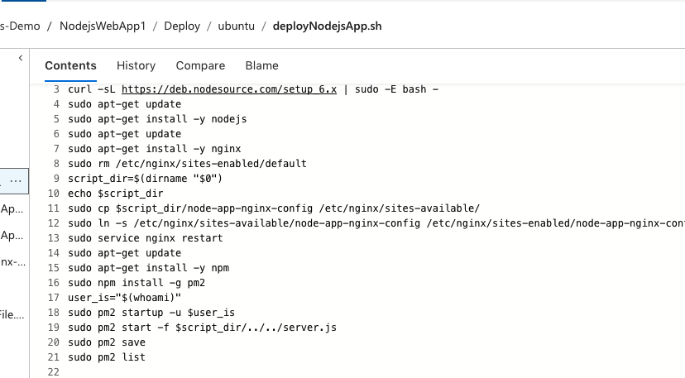
App Debugging
Typescript Nodejs app
Nginx Webserver
Installation script had daemon to start Nginx, but not our application

Slide 7
JMeter Tests
Ran tests via command line
Ran tests on Test Hub in VSTS
Ran tests as part of a Test Task in VSTS Release Definition
Side Note
Jmeter can test all kinds of software but VSTS currently can only support HTTP requests (as of early July)

Slide 8
Cloud-Based Load Testing
Adding a test task or manually running load test should probably be run in the cloud
Pay-per-credit
Measured in VUMs (Virtual User Minutes)
Kept running out and aborting load tests
Agent configuration
Can use a private agent (i.e. your laptop)
Good for developers, but not particularly cross-platform
Hosted agents are easier to manage and can be used across multiple projects
(for build, deploy, and test tasks)

Slide 9
Auto Scaling triggers
All sorts of ways you can measure activity on VMs
Percentage CPU, Network I/O, Disk Read/Write as Data Points
Time variables and calculations seriously effect triggering
metricName – data to be collected
timeGrain – frequency of data collection
statistic – how metrics from multiple vmss instances are combined
timeWindow – the range of time data is collected
timeAggregation – how data points are combined over range of timeWindow
threshold – “percentage of usage that triggers the scaling operation”

Slide 10
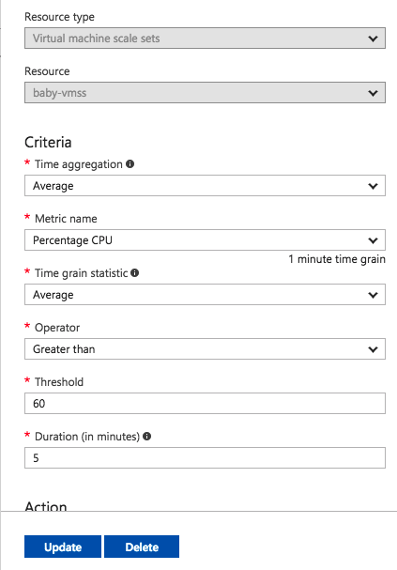
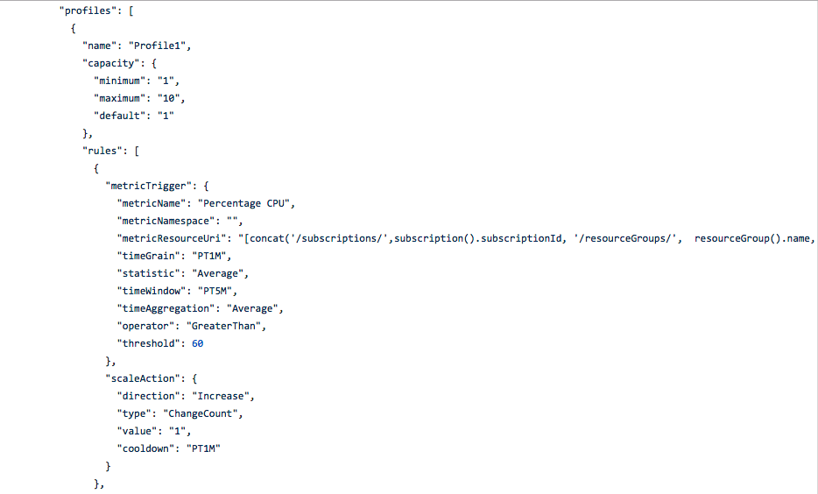
Two Pictures with Captions
Notes:
This is a sample Two Pictures with Captions Layout slide ideal for including two pictures with brief descriptive statements.
To Replace the Pictures on this Sample Slide (this applies to all slides in this template that contain replaceable pictures)
Select the sample picture and press Delete on your keyboard. Click the icon inside the shape to open the Insert Picture dialog box. Navigate to the location where the picture is stored, select desired picture and click on the Insert button to fit the image proportionally within the shape.
Note: Do not right-click the image to change the picture inside the picture placeholder. This will change the frame size of the picture placeholder. Instead, follow the steps outlined above.

Slide 11
Demos
Load Testing options in VSTS
Autoscaling action
Notes:
This is a Transition Slide Horizontal Picture slide ideal for including a picture with a brief title and optional subtitle.
To customize this slide with your own picture:
Right-click the slide area and choose Format Background from the pop-up menu. From the Fill menu, click Picture and texture fill. Under Insert from/Insert picture from: click File. Locate your new picture and click Insert.
Alternate background pictures are located here: http://syminfo.ges.symantec.com/marketing/globalcommunications/index.asp

Slide 12
Ideas for future research and POC
Other load testing frameworks and VSTS plug-ins
Jmeter can test all kinds of software but VSTS currently can only support HTTP requests (as of early July)
Norton suite needs more than just web app testing
Auto scale metrics
Percentage CPU is only one reflection of how hard a VM is working
“threshold” keyword is poorly defined
ARM Template location
Currently in my public Github (for demo purposes only)
Templates can be stored in storage accounts and are accessible to VSTS with SAS tokens
Determine best occasion to perform seriously intensive load-tests
Surely not after each developer commit, load tests are expensive
Contingent on manager approval once a day/week/month?

Slide 13
Jamie Zimmerman
Jamie_Zimmerman@symantec.com

