Slide 1
C - Program Structure
Let us look a bare minimum C program structure so that we can take it as a reference in upcoming chapters.
#include <stdio.h>
int main()
{
/* my first program in C */
printf(“Welcome to C….\n");
return 0;
}

Slide 2
Let us look various parts of the given program:
The first line of the program #include <stdio.h> is a preprocessor command, which tells a C compiler to include stdio.h file before going to actual compilation.
The next line int main() is the main function where program execution begins.
The next line /*...*/ will be ignored by the compiler and it has been put to add additional comments in the program. So such lines are called comments in the program.
The next line printf(...) is another function available in C which causes the message “Welcome to C…" to be displayed on the screen.
The next line return 0; terminates main()function and returns the value 0.

Slide 3
C - Basic Syntax
Tokens in C
A C program consists of various tokens.
A token is either a keyword, an identifier, a constant, a string literal, or a symbol
For example, the following C statement consists of five tokens:
printf
(
printf(“Hello\n”); “Hello\n”
)
;

Slide 4
C++ Programming
C++ is superset of C.
Most of what we already known about C++ also applied to C also.
The most important facilities that C++ adds on to C are:
objects
classes
abstraction
polymorphism
encapsulation
inheritance

Slide 5
A Simple C++ Program
#include<iostream> //include header file
using namespace std;
int main()
{
cout<< “C++ is better than C. \n”; //C++ statement
return 0;
} //End of example

Slide 6
Check the Difference
C
/* my first program in C */
#include <stdio.h>
int main()
{
printf(“Welcome to C….\n");
return 0;
}
C++
//my first program in C++
#include<iostream.h>
int main()
{
cout<< “Welcome to C++…. \n”;
return 0;
}

Slide 7
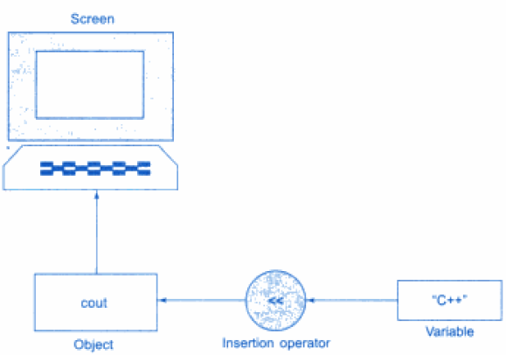
Output operator
cout<< “C++ is better than C. \n”;
The statement causes the string in quotation marks to be displayed on screen.

Slide 8
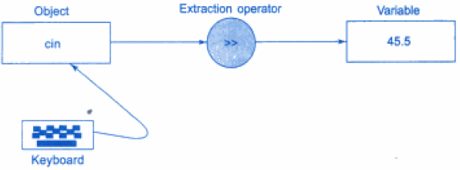
Input operator
The statement
cin>> number;
is an input statement and causes the program to wait for the user to type in a number.

Slide 9
Tokens, Expressions and Control Structure
Tokens in C++
The smallest individual unit in a program known as Tokens
Keywords
Identifiers
Constants
Strings
Operators

Slide 10
C++ Identifiers/variables
A C++ identifier is a name used to identify a variable, function, class, module, or any other user-defined item.
Variables are nothing but reserved memory locations to store values.
An identifier starts with a letter A to Z or a to z or an underscore (_) followed by zero or more letters, underscores, and digits (0 to 9).
C++ does not allow punctuation characters such as @, $, and % within identifiers.
A declared keyword can’t be use as identifier.
C++ is a case-sensitive programming language. Thus, Man and man are two different identifiers in C++.
Examples
ram zara abc move_name a_123 myname50 _temp j a23b9 retVal

Slide 11
Constants
Constants refer to fixed values that do not change during the execution of program.
C++ supports several kinds of literal constants like integers, characters, floating points, numbers and strings.
Examples
123 //integers
12.24 //floating points
‘A’ // character
O37 // octal integer
“ABC” //string constants

Slide 12
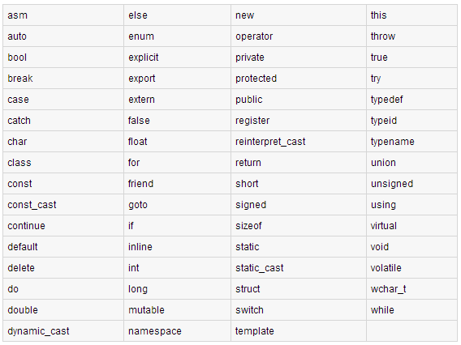
Keywords in C++
Keywords are reserved identifiers and can not be use as a name for the program variables or other user defined program variables.
The following list shows the reserved words in C++.

Slide 13
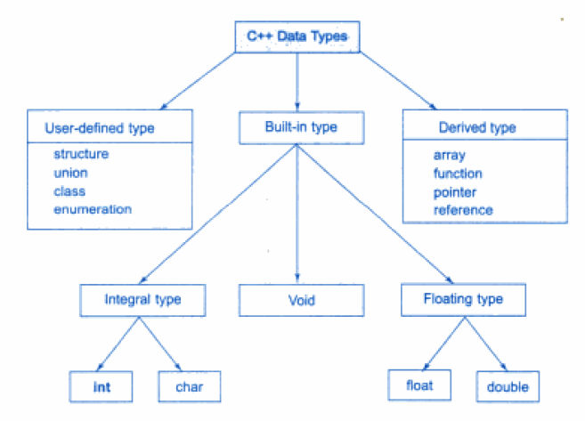
Basic Data Types

Slide 14
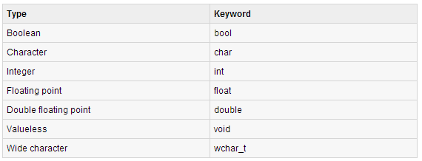
Basic Data Types
While doing programming you need to use various variables to store various information.
Based on the data type of a variable, the operating system allocates memory and decides what can be stored in the reserved memory.
C++ offer the programmer a rich assortment of built-in as well as user defined data types. Following table lists down seven basic C++ data types:

Slide 15
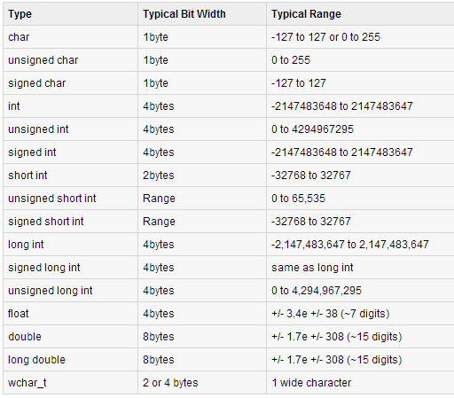
The following table shows the variable type, how much memory it takes to store the value in memory, and what is maximum and minimum value which can be stored in such type of variables.

Slide 16
Variable Definition in C++
A variable definition means to tell the compiler where and how much to create the storage for the variable.
A variable definition specifies a data type, and contains a list of one or more variables of that type.
Syntax : type variable_list;
where,
-type must be a valid C++ data type including char, w_char, int, float, double, bool etc.
-variable_list may consist of one or more identifier names separated by commas.
Some valid declarations are shown here:
int i, j, k;
char c, ch;
float f, salary;
double d;

Slide 17
Variables can be initialized (assigned an initial value) in their declaration. The initializer consists of an equal sign followed by a constant expression.
Syntax: type variable_name = value;
Example:
extern int d = 3, f = 5; // declaration of d and f.
int d = 3, f = 5; // definition and initializing d and f.
byte z = 22; // definition and initializes z.
char x = 'x'; // the variable x has the value 'x'.

Slide 18
Operators in C++
An operator is a symbol that tells the compiler to perform specific mathematical or logical manipulations.
C++ is rich in built-in operators and provides the following types of operators:
Arithmetic Operators
Relational Operators
Logical Operators
Bitwise Operators
Assignment Operators
Misc Operators

Slide 19
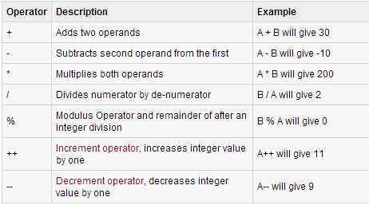
Arithmetic Operators:
There are following arithmetic operators supported by C++ language:
Assume variable A holds 10 and variable B holds 20, then:

Slide 20
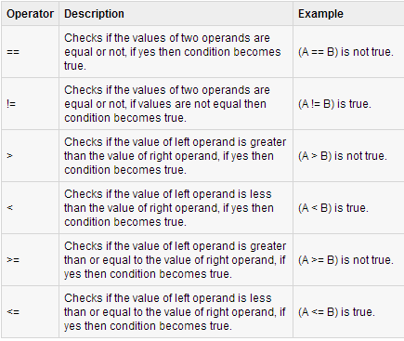
Relational Operators:
There are following relational operators supported by C++ language
Assume variable A holds 10 and variable B holds 20, then:

Slide 21
Bitwise Operators:
Bitwise operator works on bits and perform bit-by-bit operation.
The truth tables for &, |, and ^ are as follows:
Assume if A = 60; and B = 13; now in binary format they will be as follows:
A = 0011 1100
B = 0000 1101
-----------------
A&B = 0000 1100
A|B = 0011 1101
A^B = 0011 0001
P | Q | P&Q | P|Q | P^Q
0 | 0 | 0 | 0 | 0
0 | 1 | 0 | 1 | 1
1 | 0 | 0 | 1 | 1
1 | 1 | 1 | 1 | 0

Slide 22
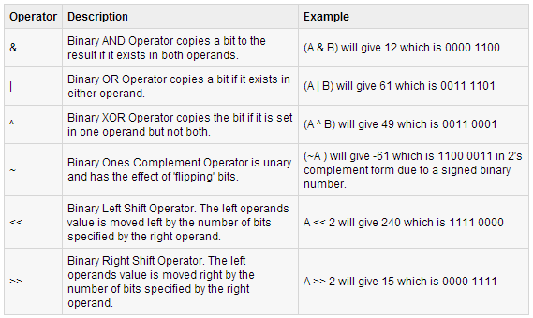
(cont..)
The Bitwise operators supported by C++ language are listed in the following table.
Assume variable A holds 60 and variable B holds 13, then:

Slide 23
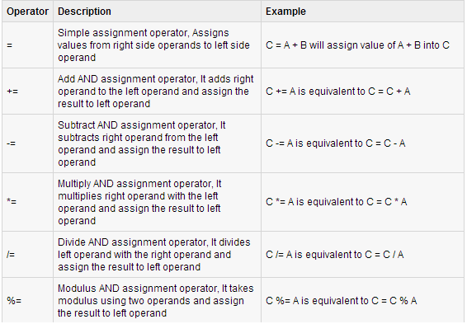
Assignment Operators
There are following assignment operators supported by C++ language:

Slide 24
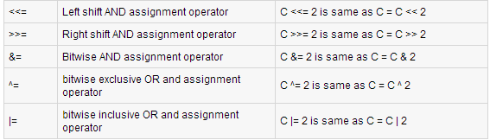
(cont..)

Slide 25
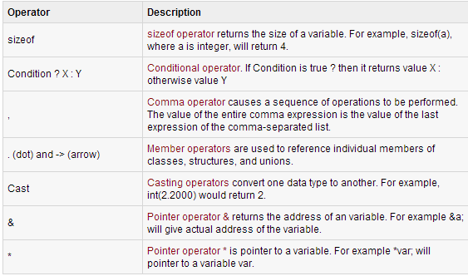
Misc Operators
There are few other operators supported by C++ Language.

Slide 26
Operators Precedence in C++
This affects how an expression is evaluated.
Certain operators have higher precedence than others.
For example, the multiplication operator has higher precedence than the addition operator:
x = 7 + 3 * 2;
here, x is assigned 13, not 20 because operator * has higher precedence than +, so it first gets multiplied with 3*2 and then adds into 7.

Slide 27
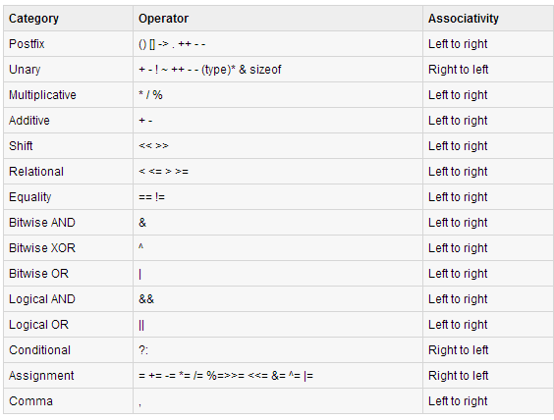
(cont..)
Here, operators with the highest precedence appear at the top of the table, those with the lowest appear at the bottom. Within an expression, higher precedence operators will be evaluated first.

Slide 28
Expressions and Their Types
An expression is combination of operators, constants and variables arranged as per rules of language.
It may consist one or more operands, zero or more operators to produce values.
Expressions may be of following types.
Constant Expressions
Integral Expressions
Float Expressions
Relational Expressions
Logical Expressions
Bitwise Expressions

Slide 29
(const..)
Constant Expression
It only contain constant values.
Example: 2+4*5;
15;
‘x’;
2. Integral Expression
It produce integer result after performing all automatic and explicit conversions.
Example: m;
m+n-5; here m and n are integer variables
5+ int(2.0);

Slide 30
3. Float Expression
After performing all conversion it produce float value.
Example 10.89;
x*y/9; here x and y are float variables
5+float(2);
4.Relational Expression
It yields a Boolean value as result which is true or false.
Example x<=y;
a+b == c-d;
m+n > 100;

Slide 31
5.Logical Expression
It combine two or more relational expressions and produce Boolean result.
Example a>b && c<=d;
x==10 || z==15;
6.Bitwise Expression
Use of bitwise expression to manipulate data at bit level.
Example x>>1;
z<<2;

Slide 32
Control Structures
One of the instructions, statements or groups of statements in a programming language which determines the sequence of execution of other instructions or statements is called control structure.
In C++ there are three Control Structures.
Sequence Structure (straight line)
Selection Structure (branching)
Loop Structure (iteration or repetation)

Slide 33
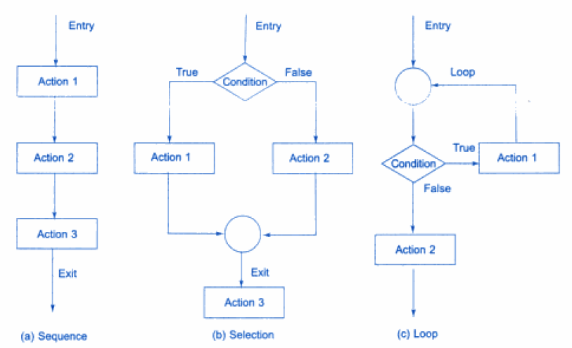
(cont..)

Slide 34
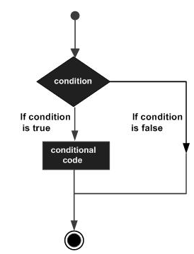
Selection Structure (Branching)
It require that the programmer specify one or more conditions to be evaluated or tested by the program, along with a statement or statements to be executed if the condition is determined to be true, and optionally, other statements to be executed if the condition is determined to be false.

Slide 35
Selection Structure (Branching)
C++ programming language provides following types of selection statements.
if statements
if .. else statements
switch statements
Nested if statements

Slide 36
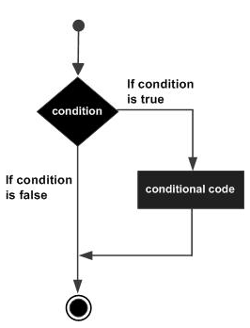
if statement
An if statement consists of a Boolean expression followed by one or more statements.
Syntax: if(boolean_expression)
{
// statement(s) will execute if the boolean //expression is true
}

Slide 37
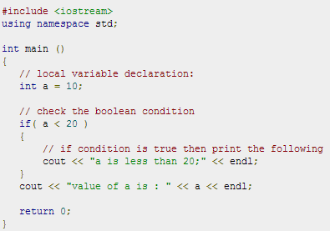

Slide 38
if…else statement
An if statement can be followed by an optional else statement, which executes when the boolean expression is false.
Syntax: if(boolean_expression)
{
// statement(s) will execute if //the boolean expression is true }
else
{
// statement(s) will execute if the //boolean expression is false
}

Slide 39
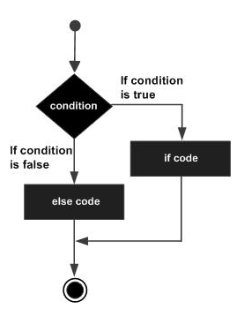

Slide 40
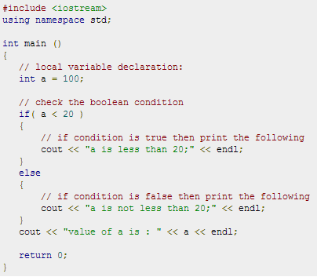

Slide 41
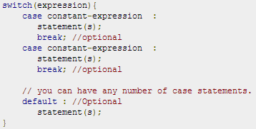
switch statement
A switch statement allows a variable to be tested for equality against a list of values.
Each value is called a case, and the variable being switched on is checked for each case.
Syntax:

Slide 42
The following rules apply to a switch statement:
The expression used in a switch statement must have an integral or enumerated type.
You can have any number of case statements within a switch. Each case is followed by the value to be compared to and a colon.
The constant-expression for a case must be the same data type as the variable in the switch.
When the variable being switched on is equal to a case, the statements following that case will execute until a break statement is reached.
When a break statement is reached, the switch terminates, and the flow of control jumps to the next line following the switch statement.
Not every case needs to contain a break. If no break appears, the flow of control will fall through to subsequent cases until a break is reached.
A switch statement can have an optional default case, which must appear at the end of the switch. The default case can be used for performing a task when none of the cases is true. No break is needed in the default case.

Slide 43
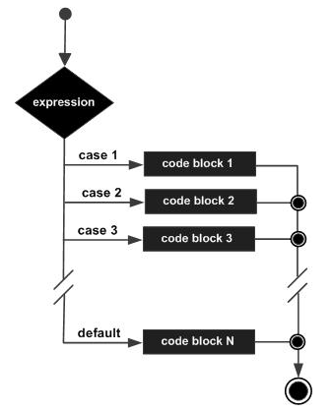

Slide 44
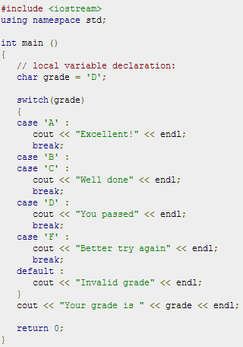

Slide 45
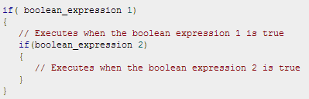
Nested if.. else
It is always legal to nest if-else statements, which means you can use one if or else if statement inside another if or else if statement(s).
Syntax:

Slide 46
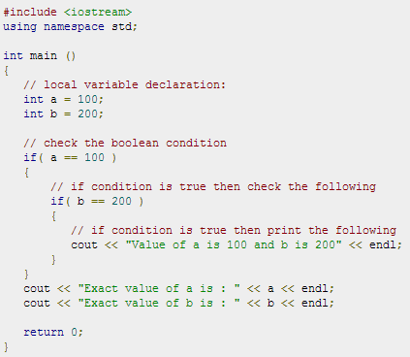

Slide 47
Loop Structures
There may be a situation, when you need to execute a block of code several number of times.
A loop statement allows us to execute a statement or group of statements multiple times.
following is the general from of a loop statement in most of the programming languages:

Slide 48
C++ programming language provides the following types of loop to handle looping requirements.
for loop
while loop
do..while loop
Nested loop

Slide 49

for loop
A for loop is a repetition control structure that allows you to efficiently write a loop that needs to execute a specific number of times.
Syntax:

Slide 50
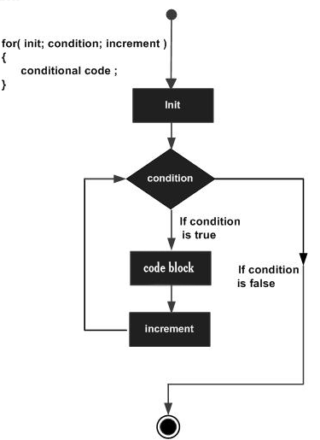

Slide 51
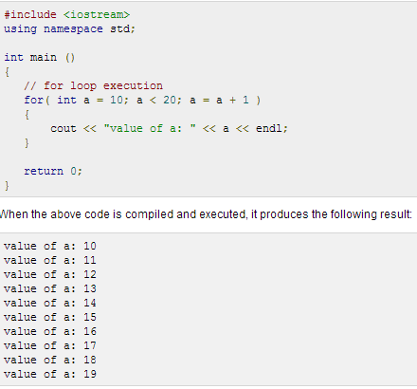

Slide 52

while( ) loop
A while loop statement repeatedly executes a target statement as long as a given condition is true.
Syntax:

Slide 53
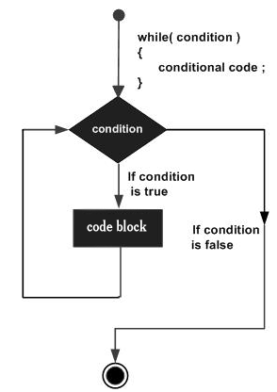

Slide 54
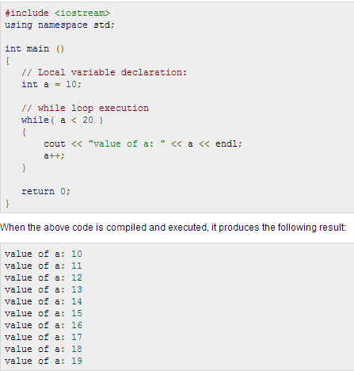

Slide 55

do..while( ) loop
Unlike for and while loops, which test the loop condition at the top of the loop, the do...while loop checks its condition at the bottom of the loop.
A do...while loop is similar to a while loop, except that a do...while loop is guaranteed to execute at least one time.
Syntax:

Slide 56
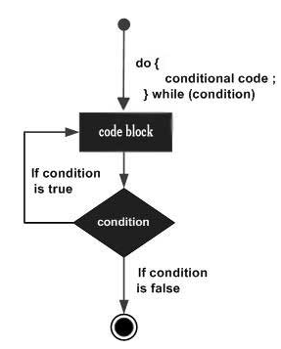

Slide 57
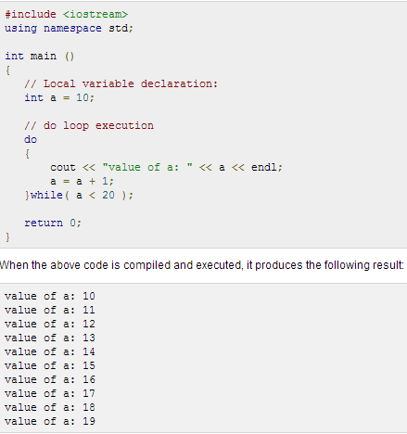

Slide 58
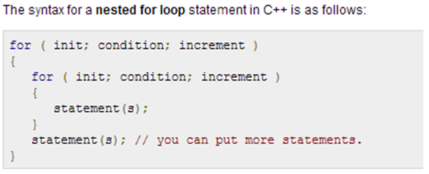
Nested Loops
A loop can be nested inside of another loop.

Slide 59
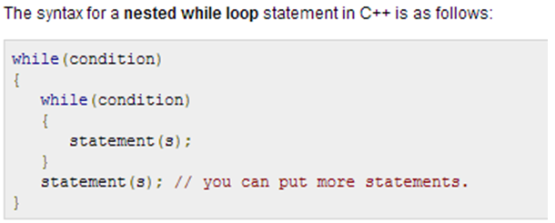

Slide 60
