Slide 1


Principles of Cognition: MSc in Cognitive and Decision Science at UCL
Active inference decisions and curiosity
Karl Friston, University College London
Abstract: This talk offers a formal account of insight and learning in terms of active (Bayesian) inference. It deals with the dual problem of inferring states of the world and learning its statistical structure. In contrast to current trends in machine learning, we focus on how agents learn from a small number of ambiguous outcomes to form insights. We will use simulations of abstract rule-learning and approximate Bayesian inference to see how minimising (expected) free energy leads to active sampling of novel contingencies. This epistemic, curious, novelty-seeking behaviour closes ‘explanatory gaps’ in knowledge about the causal structure of the world, in addition to resolving uncertainty about states of the known world. We then move from inference to model selection or structure learning to show how abductive processes emerge when agents test plausible hypotheses about symmetries in their generative models. The ensuing Bayesian model reduction evokes mechanisms that have all the hallmarks of ‘aha moments’.
Key words: active inference ∙ insight ∙ novelty ∙ curiosity ∙ model reduction ∙ free energy ∙ epistemic value ∙ structure learning

Slide 2
A game (abstract rule)
Your prior beliefs:
You will choose the correct colour based on the arrangement of the three large circles.
The location of the correct colour depends upon the colour of the upper circle.

Slide 3
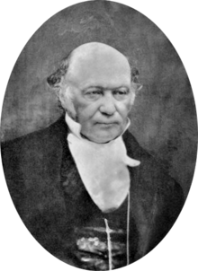
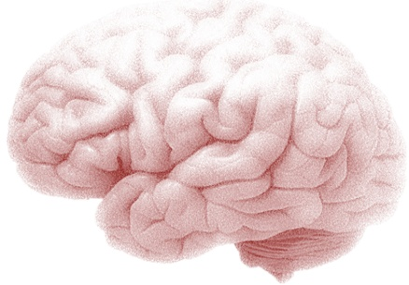
Active inference
Action and the path of least resistance
Generative models and active inference
Artificial insight and aha moments

Slide 4
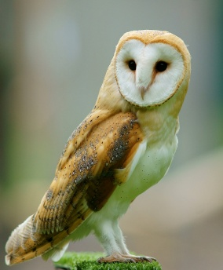



Imagine you are an owl – and you are hungry…

Slide 5
Optimal action depends on states of the world
Optimal action depends on beliefs about states
and subsequent action
Bellman’s Optimality Principle:
Optimal control theory
Dynamic programming
Reinforcement learning and expected utility
Backwards induction
State-action policy iteration
MDP
….
Hamilton's Principle of least Action:
Free energy principle
Active inference
Artificial curiosity and intrinsic motivation
Bayesian decision theory
Bayesian sequential policy optimisation
POMDP
….

Slide 6
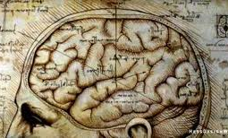

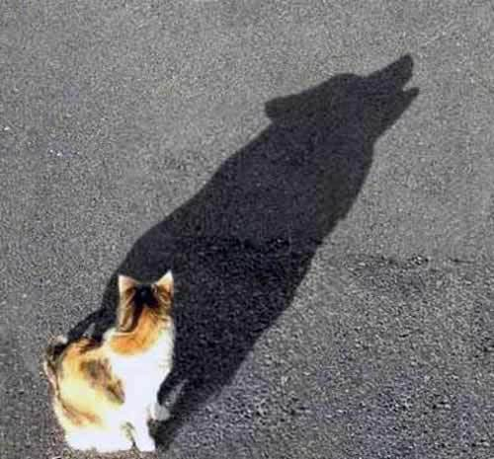
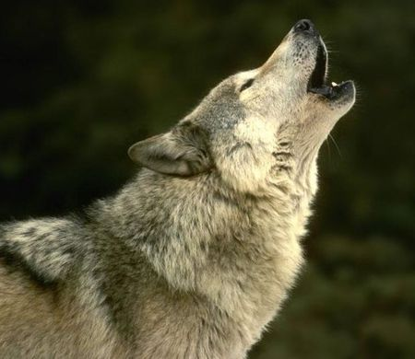

Perceptual inference and free energy
Perception
Evidence
Divergence
Accuracy
Complexity
prediction
accuracy

Slide 7

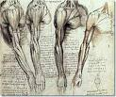
Active inference and self-evidencing
Evidence
Divergence
Free energy
Action
Perception
Changing sensations to maximise evidence
Changing beliefs to minimise divergence

Slide 8
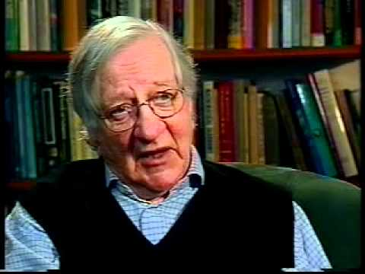
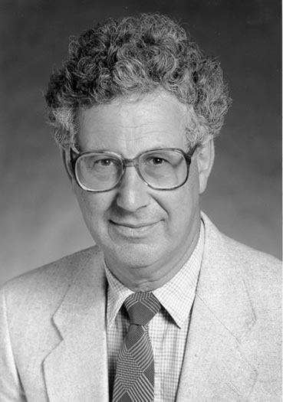
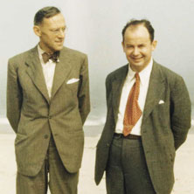
Active inference, self-evidencing and free energy
Perception
Policy selection
Extrinsic value
Epistemic value or information gain
Bayesian surprise and Infomax
No prior beliefs or preferences:
KL or risk-sensitive control
No ambiguity (i.e., known states):
Expected utility theory
No uncertainty or risk:
Bayesian surprise
Divergence from priors
Expected value
Mutual information

Slide 9
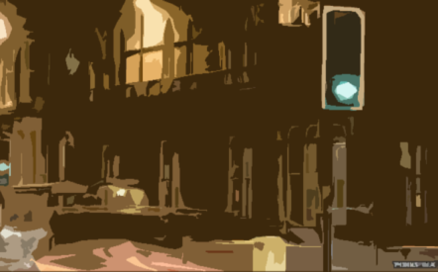
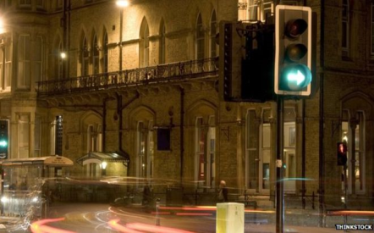


Epistemic foraging and active inference
True state
Epistemic value or information gain

Slide 10
Overview
Action and the path of least resistance
Generative models and active inference
Artificial insight and aha moments

Slide 11

A (Markovian) generative model
Likelihood
Empirical priors – hidden states
Precision
– control states
Policy
Full priors
Hidden states
Approximate posterior

Slide 12
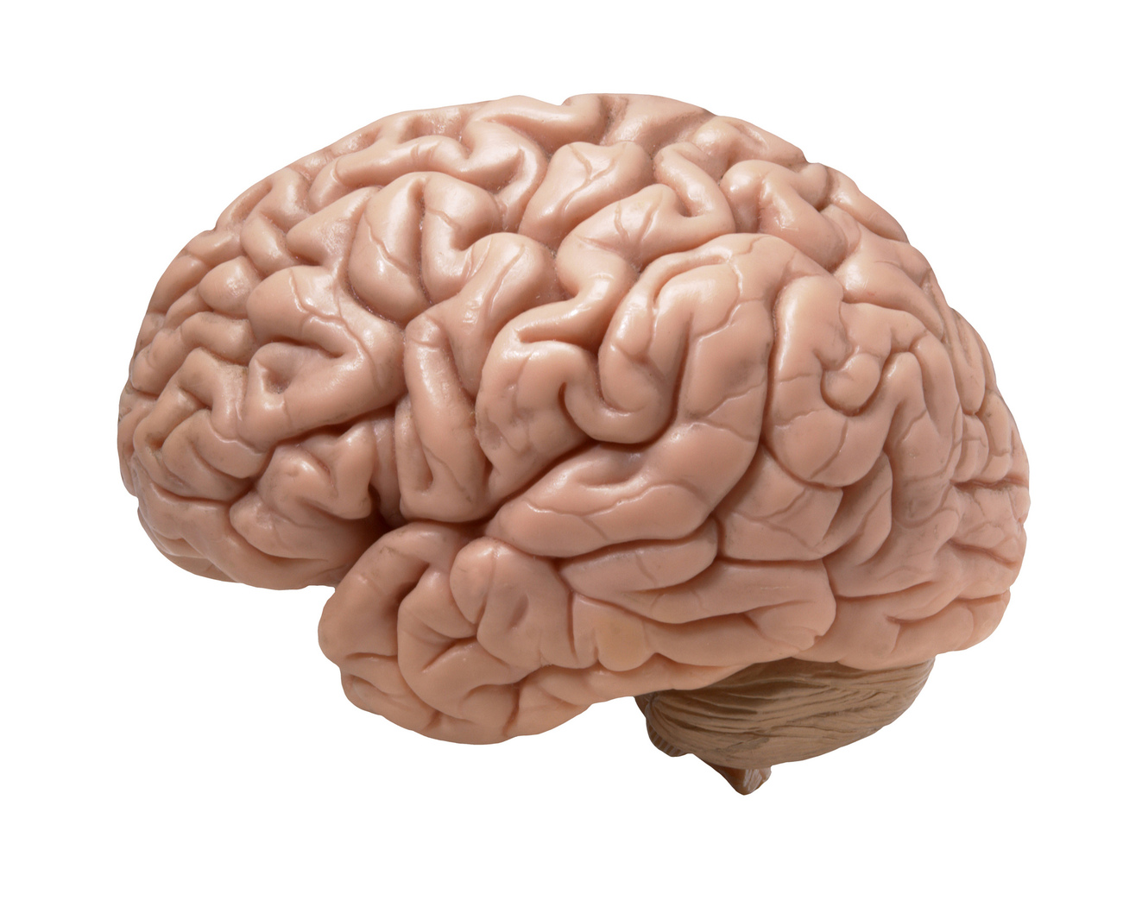
Belief updating
Functional anatomy
Perception
Policy selection
Precision
Predicted action
Dorsal prefrontal
Motor Cortex
Bayesian model average of next state
motor Cortex
Learning
Policy
selection
striatum
occipital Cortex
Precision
Striatum & VTA/SN
prefrontal Cortex
Evaluation of policies
State estimation under plausible policies
Sensory input
Action selection
Ventral prefrontal
Hippocampus
Occipital Cortex
hippocampus
VTA/SN

Slide 13
Overview
Action and the path of least resistance
Generative models and active inference
Artificial insight and aha moments

Slide 14


A game (abstract rule)
Your prior beliefs:
You will choose the correct colour based on the arrangement of the three large circles.
The location of the correct colour depends upon the colour of the upper circle.
…..
Choosing where to look next

Slide 15





Our game
Hidden states
rule
colour
where
centre
left
start
right
left center right
Priors
choice
r
g
b
r
g
b
r
what
g
b
r
g
b
r
g
b
r
g
b
Correct color
Correct color
where
centre
left
start
right
feedback
Outcomes

Slide 16

Rule learning
Initial state and policy selection
Policy
2
4
6
5
10
15
20
25
30
Final outcome and performance
5
Expected utility
0
-5
5
10
15
20
25
30
Free energy
34
nats
32
30
28
26
5
10
15
20
25
30
Confidence
nats
-6.5
-7
-7.5
5
10
15
trial
20
25
30

Slide 17
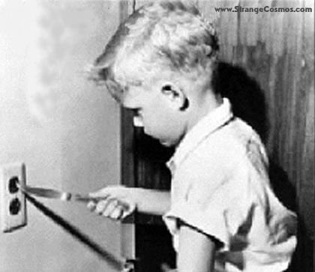
Expected free energy and novelty
Novelty: “what happens if I do that?”
So far, we have considered expected free energy in terms of risk and ambiguity that reflect uncertainty about states. Exactly the same principles can be applied to model parameters leading to epistemic policies that resolve ignorance; i.e., search out novel contingencies.
novelty
intrinsic value
extrinsic
ignorance
risk
ambiguity

Slide 18
Overview
Action and the path of least resistance
Generative models and active inference
Artificial insight and aha moments

Slide 19
Bayes optimal rule learning?
Initial state and policy selection
Policy
2
4
6
5
10
15
20
25
30
Final outcome and performance
5
Expected utility
0
-5
5
10
15
20
25
30
Free energy
34
nats
32
30
28
26
5
10
15
20
25
30
Confidence
nats
-6.5
-7
-7.5
5
10
15
trial
20
25
30

Slide 20
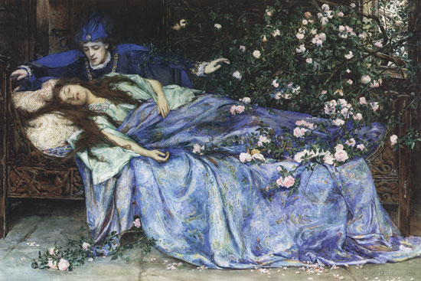
Bayesian model reduction and insight
So far, we have considered optimising expectations about states and parameters ; however, we can also optimise the model itself with respect to free energy. This is known as Bayesian model comparison or reduction that can proceed in the absence of new information. For example, the awake brain learns causal associations in synaptic connections, while during sleep redundant connections are removed (Tononi and Cirelli, 2006) to minimise complexity (Hobson and Friston, 2012) – literally to ‘clear one's mind’. Here, plausible models are implicitly defined under the prior belief that there is a rule (i.e. a symmetry or invariance of contingencies in the likelihood mapping)
By applying Bayes rules to the full and reduced models it is straightforward to show that the change in free energy can be expressed in terms of posterior concentration parameters a, prior concentration parameters a and the prior concentration parameters that define a reduced or simpler model a’:
This equation returns the difference in free energy we would have observed, had we started observing outcomes with simpler prior beliefs.

Slide 21



Insight and model reduction
Sample: left - center - right
Priors
Rule: right - center - left
Correct color
Correct color
Posteriors
Reduced
Correct color
Correct color

Slide 22
The emergence of insight
Without model reduction
With model reduction
64 subjects

Slide 23
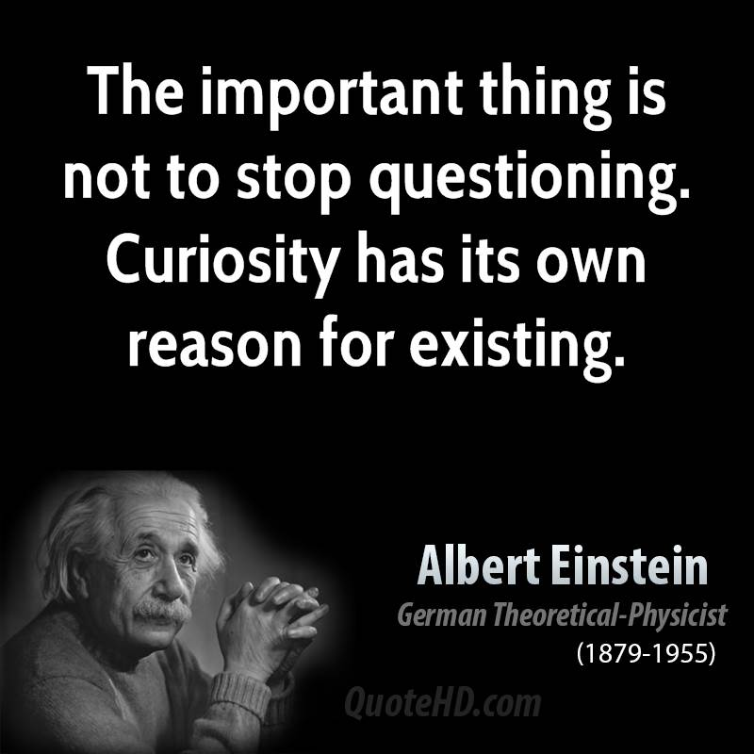

Slide 24
Thank you
And thanks to collaborators:
Rick Adams
Ryszard Auksztulewicz
Andre Bastos
Sven Bestmann
Harriet Brown
Jean Daunizeau
Mark Edwards
Chris Frith
Thomas FitzGerald
Xiaosi Gu
Stefan Kiebel
James Kilner
Christoph Mathys
Jérémie Mattout
Rosalyn Moran
Dimitri Ognibene
Sasha Ondobaka
Will Penny
Giovanni Pezzulo
Lisa Quattrocki Knight
Francesco Rigoli
Klaas Stephan
Philipp Schwartenbeck
And colleagues:
Micah Allen
Felix Blankenburg
Andy Clark
Peter Dayan
Ray Dolan
Allan Hobson
Paul Fletcher
Pascal Fries
Geoffrey Hinton
James Hopkins
Jakob Hohwy
Mateus Joffily
Henry Kennedy
Simon McGregor
Read Montague
Tobias Nolte
Anil Seth
Mark Solms
Paul Verschure
And many others

