Slide 1
RHIC Status
Haixin Huang
Time Meeting
02/8/2011

Slide 2
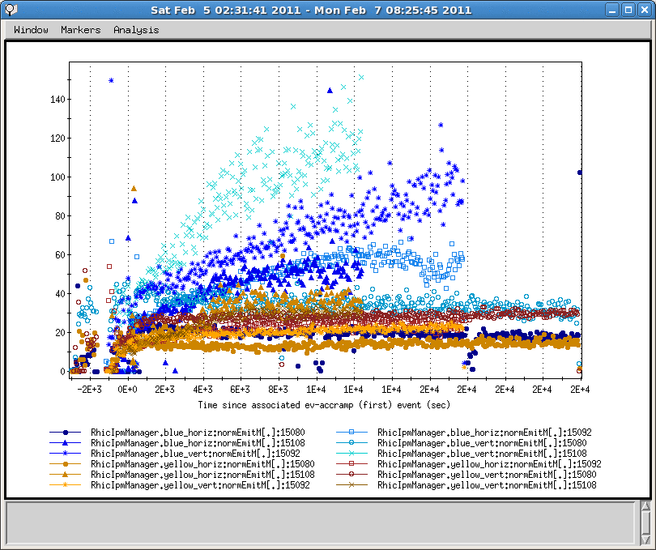
Emittance In Three Overnight Stores

Slide 3
Chronicle History of Last Week
Feb. 1Provide 28x28 collisions overnight per STAR’s request. It ended due to P/S failure.
Feb. 2 Provide 65x65 collisions overnight. Some 9MHz cavity commissioning was done.
Feb. 3. Maintenance day and orbit feedback work continued in the evening shift. 76x76 store eneded by yi3-tq4 trip.
Feb. 4 109x109 collisions for overnight store. 9MHz cavity development. Collimator setup was retuned.
Feb. 5 109x109 collisions for overnight store. New orbit feedback algorithm commissioned but not finished.
Feb. 6 Finished new orbit feedback algorithm development. RMS and mean orbits are within 0.2mm through ramp. 109x109 collisions overnight, but with large blue vertical emittance growth.
Feb. 7 AGS RF water leak and warm snake problem prevented beam development during day and evening shifts. Struggled overnight to provide a store.
Feb. 8 Searching for the source of the blue emittance growth.

Slide 4
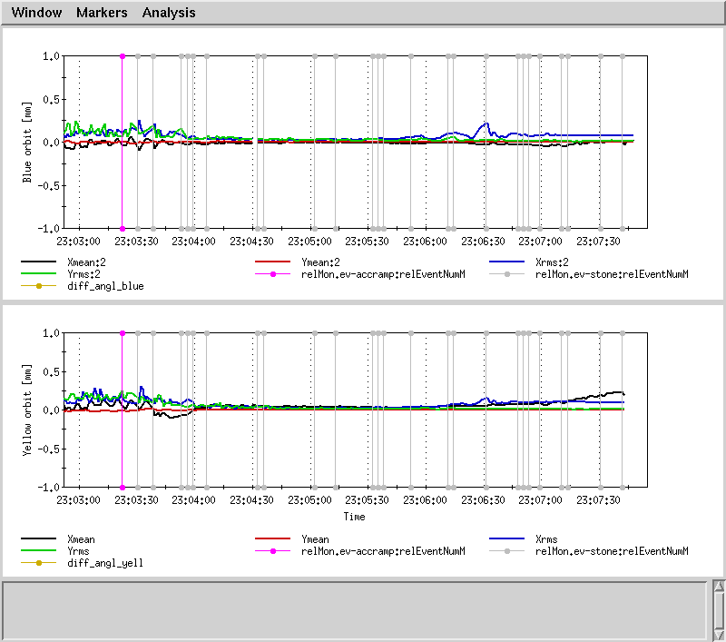
Orbit on Ramp with New Feedback

Slide 5
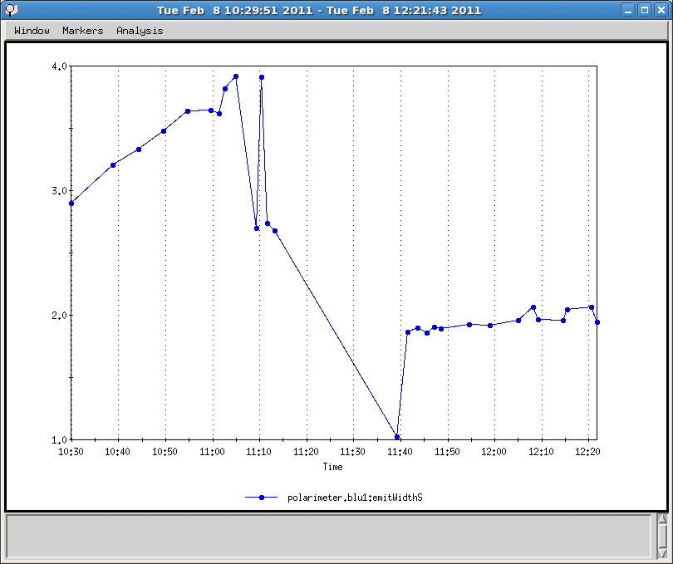
Blue Vertical Emittnace from CNI
Tune near 0.7
Tune near 0.9

Slide 6
Plan for 2/8/2011
Measure chromaticity on the ramp and correct them.
Search for the source of blue emittance growth.
Put a store of 109x109 for experiments
Increase bunch intensity with steps.

