Slide 1

PHENIX Run-14 Status January 28, 2014
Klaus Dehmelt

Slide 2
Starting up PHENIX
Detector installation is complete
Pink/Blue/White Sheets complete
Final magnet tests performed
Final gas leak checks performed
Final walk-through and final signatures obtained
Two-person watch-shifts since Jan. 09
Will be switching over to full shifts next week

Slide 3
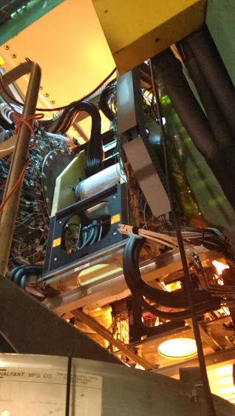
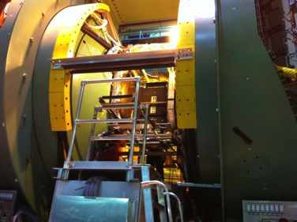
Detector Installation
Refurbished VTX together with FVTX installed in IR, surveyed and being commissioned
Beginning of December 2013
Today

Slide 4
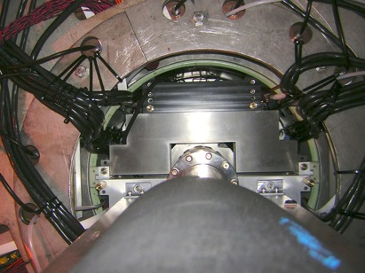
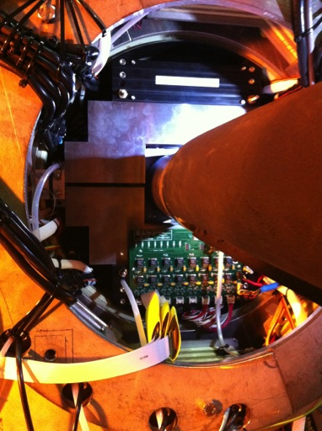
Detector Installation
Muon Piston Calorimeter Extension partially installed

Slide 5
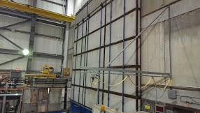
Preparations
Shield wall closed

Slide 6
Commissioning
Preparation and commissioning of
DAQ
Sub-detectors
ongoing
Flowing gas through gas-detectors started; pretty stable conditions, detectors being operated
VTX/FVTX cooled, closed and insulated, being commissioned

Slide 7
Upcoming Plans
Operation of sub-detectors
Commissioning to run conditions
Operation of DAQ
Cosmic ray runs with operating magnets

Slide 8
Calendar
Cool down to 4 K: starting from Feb. 03
Cool down to 4 K established by Feb. 08
Setup for Au-Au collisions at sqrt(s) = 14.6 GeV finished by Feb. 15
Expect to loose access of IR on Feb. 06
First collisions in PHENIX expected by Feb. 16

