Slide 1
Week 5
After lab

Slide 2
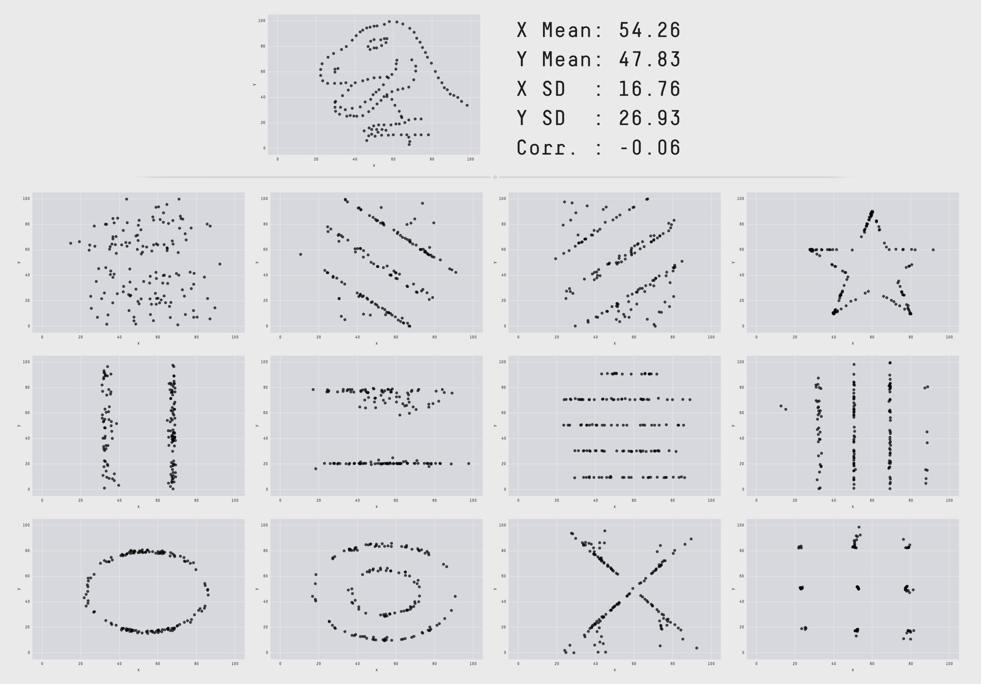
Is the relationship linear?
Datasaurus dozen from Autodesk research
All plots have the same mean, x and y variance/standard deviation, and x-y correlation
Inspired by Albert Cairo

Slide 3
Things to cover
Partial, semi-partial
Teminology: zero-order, partial, semi-partial/part
Partial: r_{x1y1.x2} is the partial correlation between X₁ and Y₁ controlling for X₂
Semi-partial: r_{y1(x1.x2)} is the semi-partial correlation between X₁ and Y₁ controlling for X₂
Relation to multiple regression (MR->semipartial)
Missing data
missing completely at random
missing at random – random within levels of measured variable
missing not at random – missingness related to unmeasured variables
Data dictionaries, class dataset
More depth on chi-square coming later
More examples?

