Slide 1
Slide from Tobias Gerstenberg (Stanford Psychology)

Slide 2
Slide from Tobias Gerstenberg (Stanford Psychology)

Slide 3
Slide from Tobias Gerstenberg (Stanford Psychology)

Slide 4
Slide from Tobias Gerstenberg (Stanford Psychology)

Slide 5
Conducting a Power Analysis
Literature Review
Analyze information from papers with similar methods to get estimate of effect size
Pilot Study
Allow you to get rough estimate of effect size
Cohen’s Recommendation
Not super reliable but common
Cohen d of .2 is small, .5 is medium, and .8 is large
Notes:
to conduct a power analysis, we ask the question, if there is a true effect (of some expected size) and we take a random sample and conduct a NHST – what is the probability that we will reject the null (correctly because we assume there is an effect)?
So to do a power analysis, we need to know (1) the expected (target) effect size, (2) the alpha at which we would reject the null, and (3) the sample size. or more commonly, we can start with the desired power and ask what sample size we need to achieve it.

Slide 6
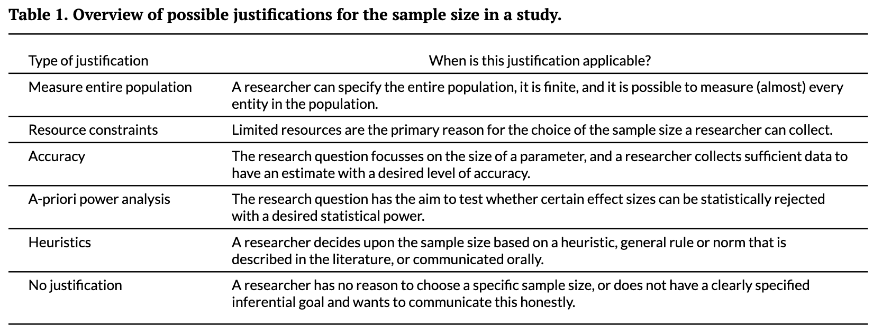
From Lakens (2022) “Sample Size Justification”

Slide 7
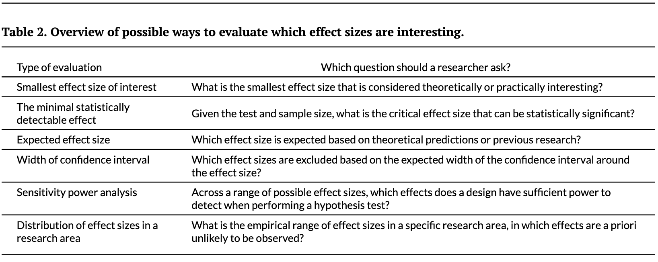
From Lakens (2022) “Sample Size Justification”

Slide 8
Power Calculations and Sample size statements examples from Psychological Science Nov 2022 (online first articles)

Slide 9
Seeing Soft Materials Draped Over Objects: A Case Study of Intuitive Physics in Perception, Attention, and Memory
Kimberly W. Wong
Wenyan Bi
Amir A. Soltani
Ilker Yildirim
Brian J. Scholl
Two hundred observers (79 female; mean age = 24.55 years) participated for monetary compensation using the Prolific online platform (Palan & Schitter, 2018), and this preregistered sample size was determined before data collection began.
… we reran the same experiment on a larger group of 400 independent observers from the same pool (145 female; mean age = 25.89 years). This preregistered sample size was chosen to be exactly twice that from Experiment 1a …
All articles are from Psychological Science (2022)

Slide 10
From the Viscera to First Impressions: Phase-Dependent Cardio-Visual Signals Bias the Perceived Trustworthiness of Faces
Ruben T. Azevedo, Mariana von Mohr, and Manos Tsakiris
A total of 35 volunteers (age: M = 22.6 years, SD = 3.4; 27 females) were recruited via the departmental subject pool. Calculations in G*Power (Version 3.1; Faul et al., 2007), based on a previous study of cardiac gating on emotional valence (Garfinkel et al., 2014), indicated that a sample size of 35 would be needed to obtain an effect size (f ²) of .40 at a power of 85% with an α of .05, which is consistent with other studies in the field (Azevedo et al., 2018; Li et al., 2020).
The effect size obtained in Study 1 (η_{p}² = .093) suggested that at least 27 participants were needed to obtain a power of 95% (power analysis run in G*Power Version 3.1; Faul et al., 2007). Thus, a similar sample size was selected for this study. Specifically, 30 volunteers (age: M = 24.17 years, SD = 4.90; 21 females) were recruited …
All articles are from Psychological Science (2022)

Slide 11
Today’s Older Adults Are Cognitively Fitter Than Older Adults Were 20 Years Ago, but When and How They Decline Is No Different Than in the Past
Denis Gerstorf , Nilam Ram, and Paolo Ghisletta
report on subset of an existing data set
Our analysis of cohort differences made use of 2,008 measurements of older adults’ perceptual-motor speed data obtained from matched subsamples of participants in two independent studies: BASE, launched in 1990/1993 (Lindenberger & Baltes, 1997), and BASE-II, launched in 2010 (Bertram et al., 2014). … Data obtained from 228 BASE participants (earlier-born cohort, born between 1889 and 1922) were matched with data obtained from 583 BASE-II participants (later-born cohort, born between 1925 and 1948). Selectivity analyses reported in the Supplemental Material (see the Sample Description section) highlight two aspects of the samples. First, both samples represent positively select portions of populations living in the greater Berlin, Germany, area (specifically with respect to education and income). As a consequence, findings obtained may not necessarily generalize to less resource-rich populations. Second, and most important for interpretation of our findings, the selectivity analyses suggest that our case-matched control design (described below) provides a relatively conservative test of cohort differences because either the amount of positive selection was comparable across the cohort samples or the earlier-born participants were even more positively selected than the later-born participants.

Slide 12
Severe Developmental Dyscalculia Is Characterized by Core Deficits in Both Symbolic and Nonsymbolic Number Sense
Gisella Decarli , Francesco Sella, […], and Marco Zorzi
The sample size (58 with developmental dyscalculia and 42 controls) provides 80% power to detect an effect size of 0.57 (i.e., Cohen’s d) with .05 (two-tailed) significance level (G*Power, Version 3.1; Faul et al., 2007).

Slide 13
The Effect of Auditory and Visual Recommendations on Choice
Shwetha Mariadassou, Christopher J. Bechler, and Jonathan Levav
Sample sizes were determined prior to data collection, and we aimed for at least 200 participants per cell (Simmons et al., 2011).

Slide 14
A Self-Controlled Mind Is Reflected by Stable Mental Processing
Tobias Kleinert , Kyle Nash , […], and Bastian Schiller
Based on an estimated medium effect size of associations between resting-state microstate characteristics and trait variables in similar research (Schiller, Kleinert, et al., 2020), 56 participants (α = .05, power = .85, r = .35) were needed to detect a significant effect.

Slide 15
Racial Prejudice Predicts Police Militarization
Tyler Jimenez , Peter J. Helm, and Jamie Arndt
A sample of English-speaking, U.S. adults was recruited through the survey research company Centiment (http://centiment.co) from April 21 to 24, 2021.¹ The raw data included 1,006 participants, all of whom passed an attention check. Because nonprobability sampling was used, participation was limited to individuals who had Internet access. However, Centiment recruited participants to ensure that the sample was representative of the U.S. population in terms of age, gender, geographic region, and household income. The sample was further representative in terms of race; however, only White participants were retained given the focus on anti-Black and anti-Native American prejudice.² Participants who failed to complete at least one item were removed from analyses (n = 8). The final sample included 765 participants (49.9% women, 49.8% men, 0.3% transgender; age: M = 54.57 years, SD = 15.45). The sample size was informed by available funds.

Slide 16
Test Anxiety Does Not Predict Exam Performance When Knowledge Is Controlled For: Strong Evidence Against the Interference Hypothesis of Test Anxiety
Maria Theobald , Jasmin Breitwieser , and Garvin Brod
The final sample was composed of 309 students (71% female, mean age = 25.90 years, SD = 3.25 years). A post hoc power analysis revealed that a sample size of 309 was sufficient to detect a correlation (r = .24) between test anxiety and academic achievement with high statistical power (β = 0.99).

Slide 17
Reporting a power analysis
If your sample size statement includes a power analysis, there should be 4 pieces of information
effect size (expected)
alpha threshold (often .05)
power (often 80%)
sample size

