Slide 1
setting up an Rstudio project
Jamil Palacios Bhanji

Slide 2
What is an RStudio project?
a way to divide your work into multiple contexts, each with their own working directory, workspace, history, and documents (including data files and R Markdown docs
consists of a folder with one *.rproj file at the top level of the folder
all files for the project are within that folder (e.g., within “data”, “r_docs”, “images” sub-folders)
you can also have non-R files (e.g., spss) files within the same folder
see https://support.rstudio.com/hc/en-us/articles/200526207-Using-Projects for more

Slide 3
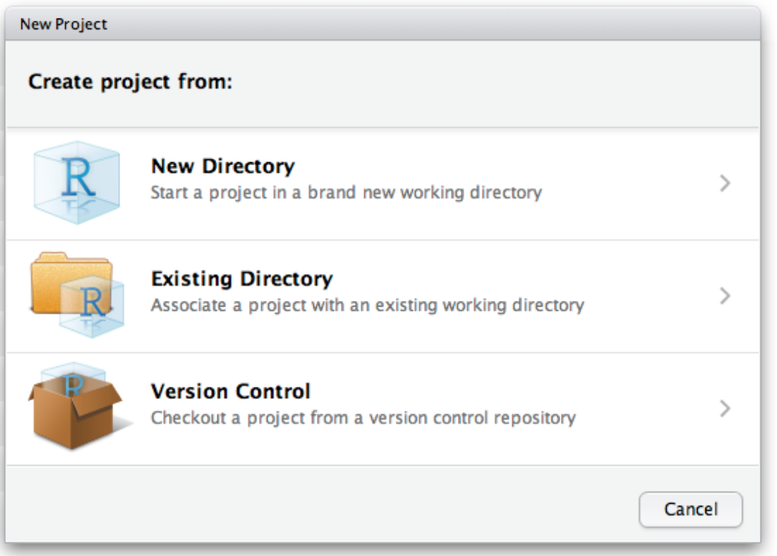
How to create an R Project
File -> New Project
Select “Existing Directory” – because we have already created the folder and sub-folders when we did the SPSS lab activity
Anytime you want to work on this project, start by opening the project file (double-click on the Project file or go to Rstudio->File->Open Project (not “Open File”)

Slide 4
class-activities/
├── week1-setup-import
│ ├── week1-setup-import.Rproj # RStudio project file
│ ├── data # save raw datasets here
│ │ └── dataset.csv
│ ├── r_docs # save R analysis work here
│ │ ├── week1-setup-import.Rmd # analysis code, charts, & notes
│ │ └── week1-setup-import.html # knit version of *.Rmd file
│ ├── spss # save all spss files here
│ │ ├── week1-setup-import.sav # spss datafile
│ │ ├── week1-setup-import-syntax.sps # spss syntax (analysis code)
│ │ ├── week1-setup-import-output.spv # spss output file (code & charts)
│ │ └── week1-setup-import-notes.{txt/doc/etc} # notes in your fave format
│ └── images #if needed, save chart images here
│ ├── fig1.png
│ └── fig1.svg

Slide 5
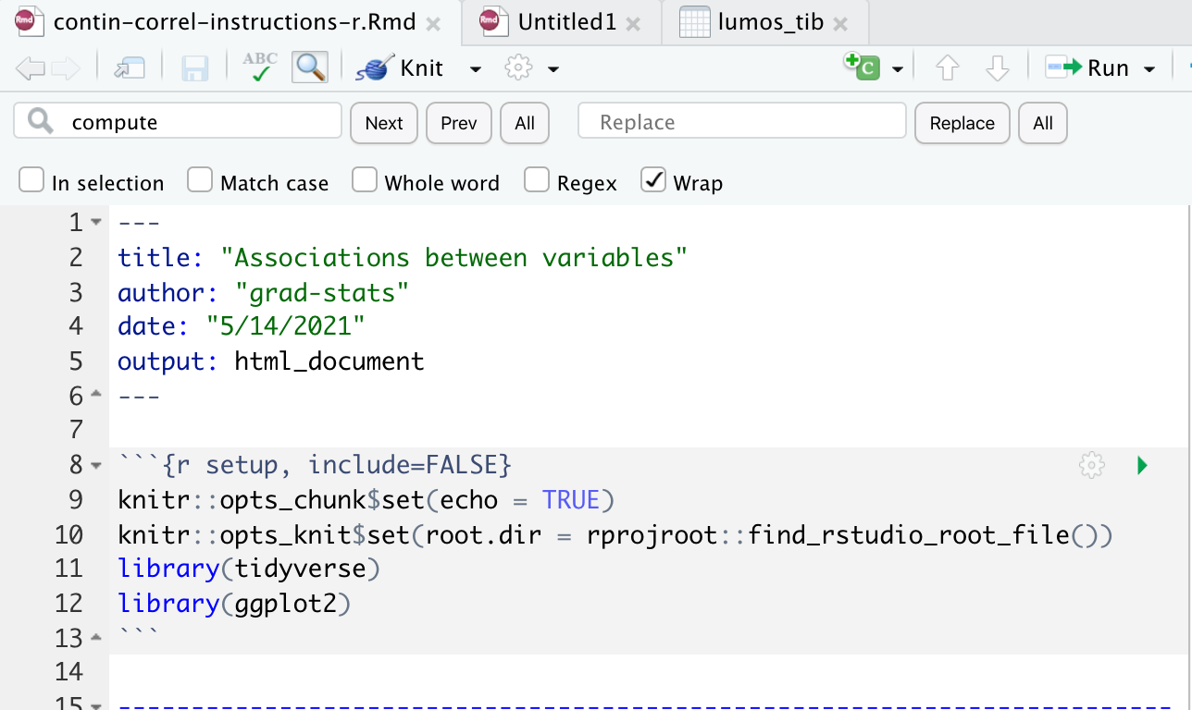
How to start an R markdown
File->New File->Rmarkdown
then Edit the setup code chunk and Save in your “r_docs” sub-folder
use this file for all your notes, code, and visuals
run your code chunks in order!
knitr::opts_knit$set(root.dir = rprojroot::find_rstudio_root_file())
This line sets the root directory in your project environment to be the R project folder. This way, you can write paths starting from the project folder.
Alternatively, you can
specify paths from the folder where your Rmd is stored.
use the here::here() function

Slide 6
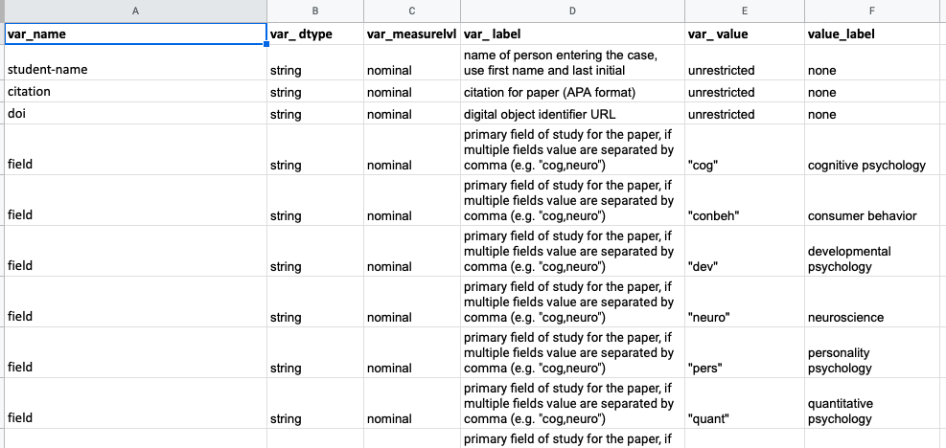
Data dictionary?

Slide 7
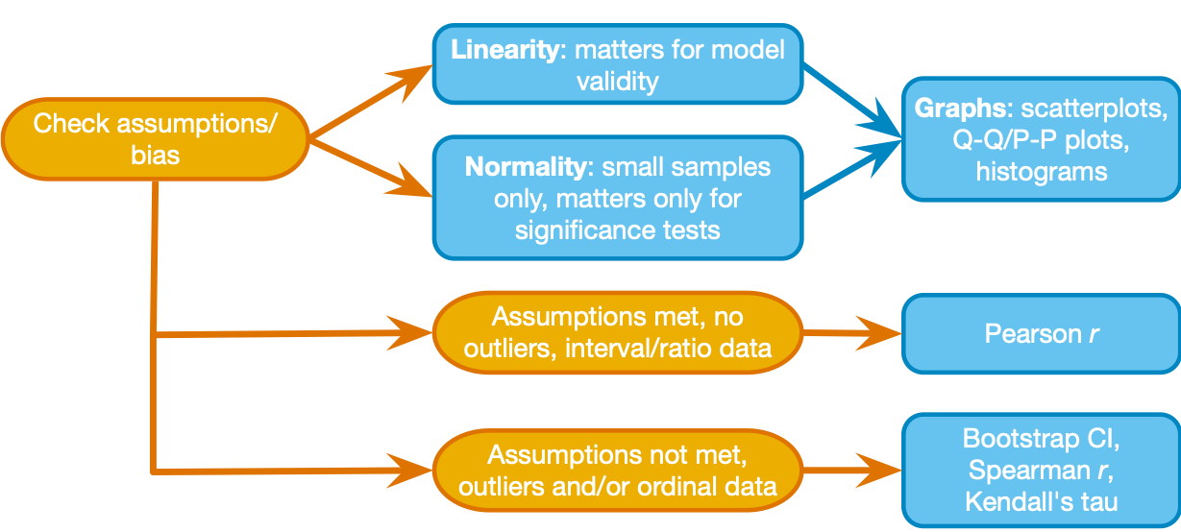
assumptions

Slide 8
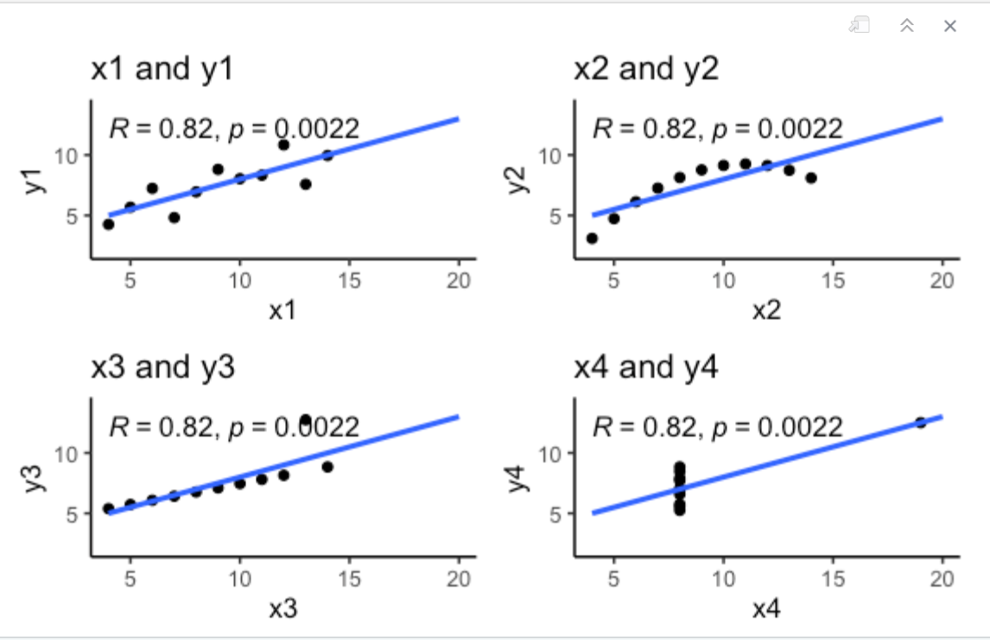
same coefficient, different associations

Slide 9
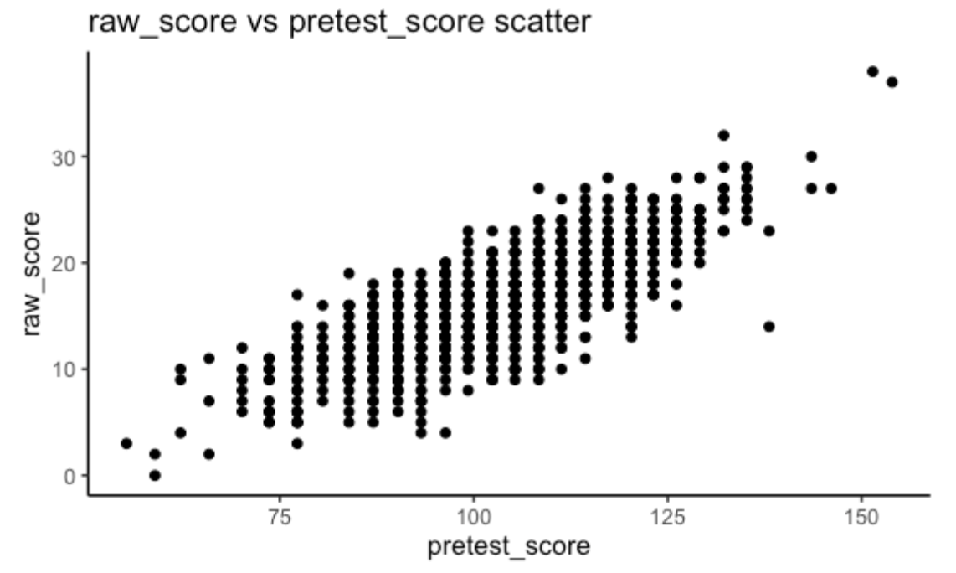
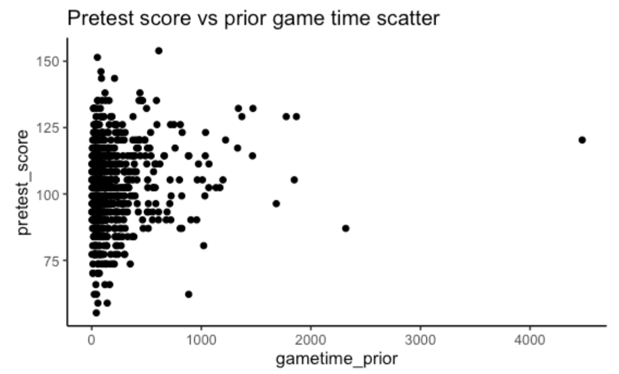
linearity assumption

Slide 10
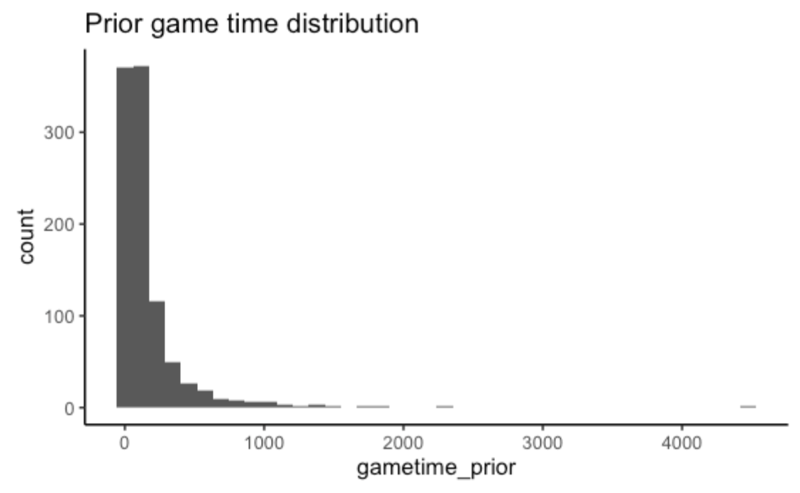
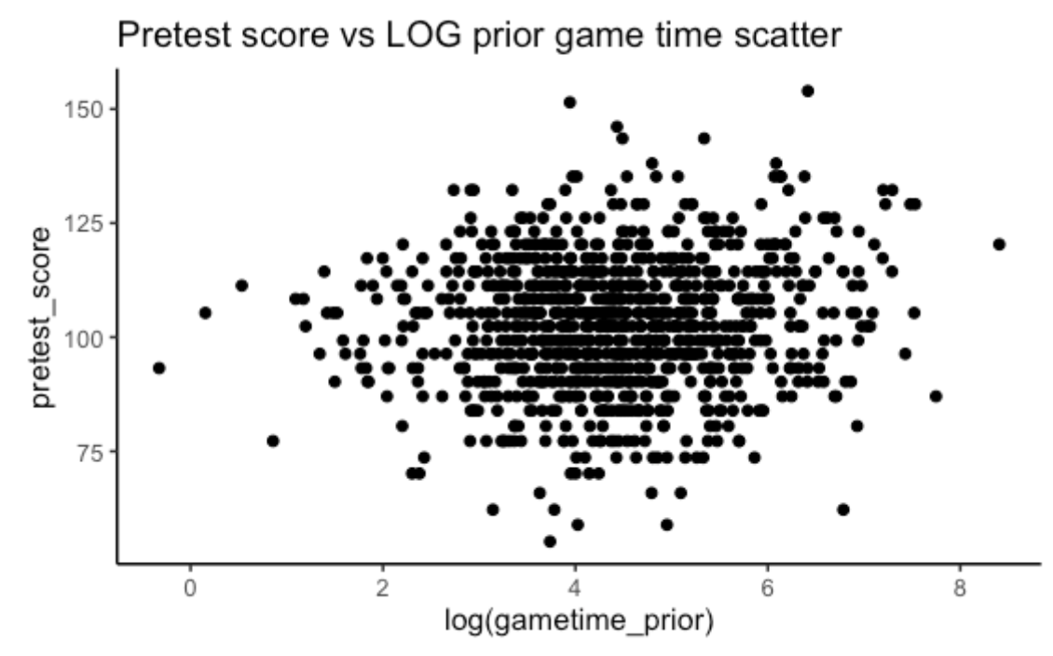
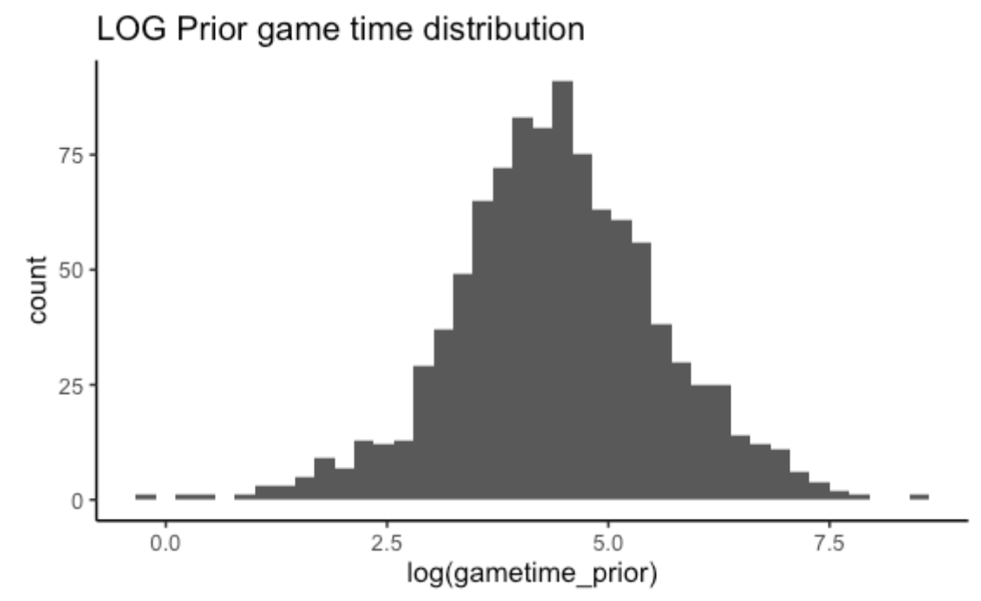
log transformation of game_time_prior

