Slide 1
ANOVA output in SPSS, R
Jamil Bhanji & Vanessa Lobue
Nov 10 2022

Slide 2
Collaborative Dataset
Spreadsheet at https://docs.google.com/spreadsheets/d/1K8UNbjxmhO063mpV1x7MJ_WbXsXmY_GI/edit?usp=sharing&ouid=105289136415129959644&rtpof=true&sd=true
Data Dictionary at https://docs.google.com/spreadsheets/d/1TGw2ARzN5T3f6QZoxdAApxFygYg7YMvs/edit?usp=sharing&ouid=105289136415129959644&rtpof=true&sd=true
Please follow the data types outlined in the data dictionary. The main issue is that participant counts should be a single integer value (not a percentage, not a list for each study – if multi-study paper then sum the Ns across studies or enter studies as separate rows).

Slide 3
Data for today
shared data from the publication Oveis, C., Gu, Y., Ocampo, J. M., Hangen, E. J., & Jamieson, J. P. (2020). Emotion regulation contagion: Stress reappraisal promotes challenge responses in teammates. Journal of Experimental Psychology: General, 149(11), 2187.
DV and covariate:
card_out_react_prep - Cardiac output during interaction with a partner (preparing for a marketing pitch about a hypothetical product). Higher cardiac output is thought to represent an interpretation of a stressor as a “challenge” (as opposed to a threat; e.g., Mendes, et al., 2001)
prepIOS_cent - closeness rating (mean centered). participants rated how connected they felt to their partner during the interaction (higher values indicate greater connectedness)
IVs (3x2 between participants design):
Emotion regulation condition (emoreg_cond): “control”, “suppress”, ”reappraise”
Instruction Target (direct_cond): “self”, “partner”

Slide 4
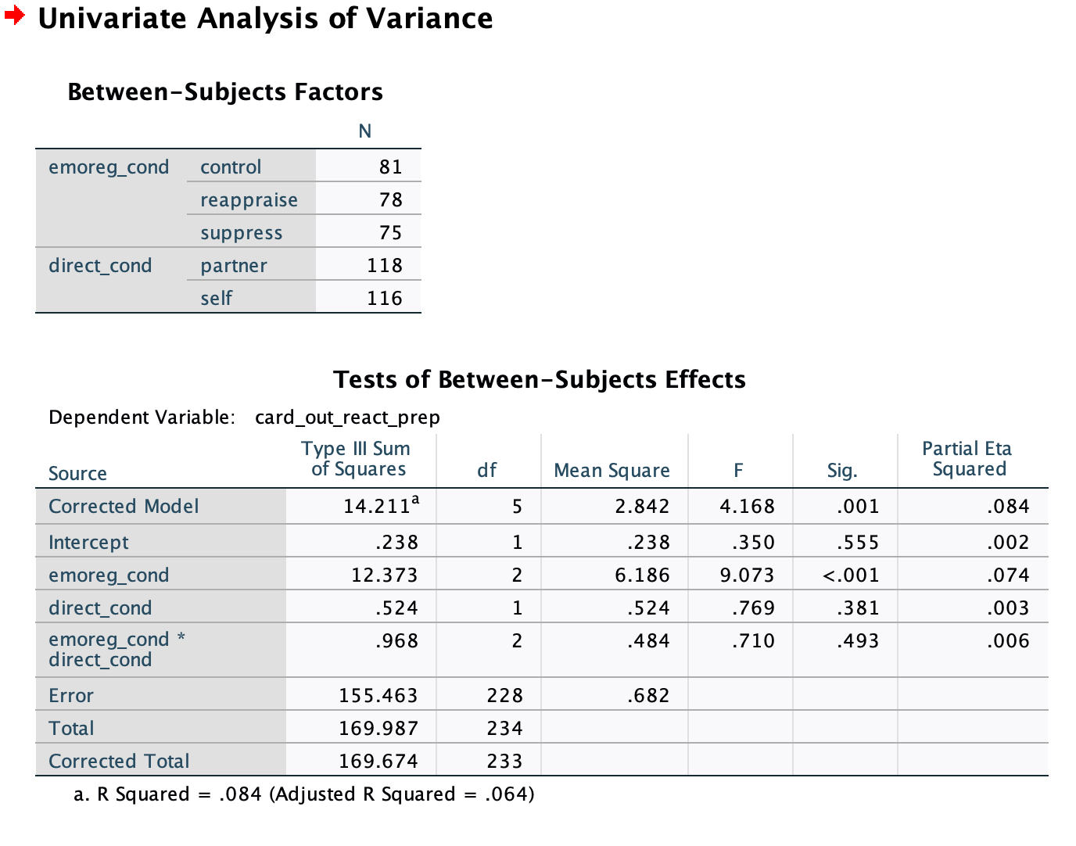
Univariate GLM in SPSS
F, Sig, Partial Eta-squared for each component of the model
F, Sig test the null hypothesis that there is no true population effect (no association of the factor/interaction with the DV)
Partial eta-squared is effect size, comparable to R²
“The Corrected model SS are sums of squares that can be attributed to the set of all the between-subjects effects, excluding the intercept”
not commonly reported

Slide 5
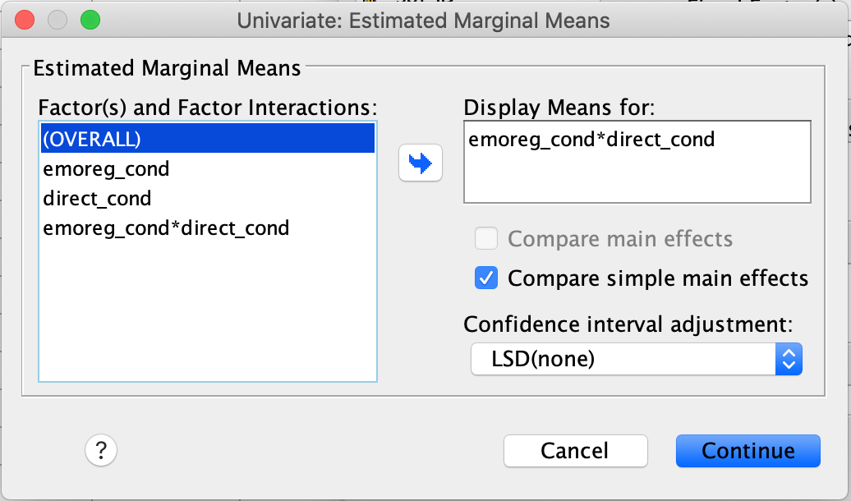
Univariate GLM in SPSS – simple effects w/ EM Means
use the “EM Means” button to get post-hoc comparisons of means (w conf intervals)
what is a marginal mean?
the mean of a variable at a particular level of IV
called “marginal” because you would find it in the margins (i.e. the edges) of a contingency table
output gives confidence intervals for the difference between all pairs of means within each level of a factor (what? let’s look at the output)

Slide 6
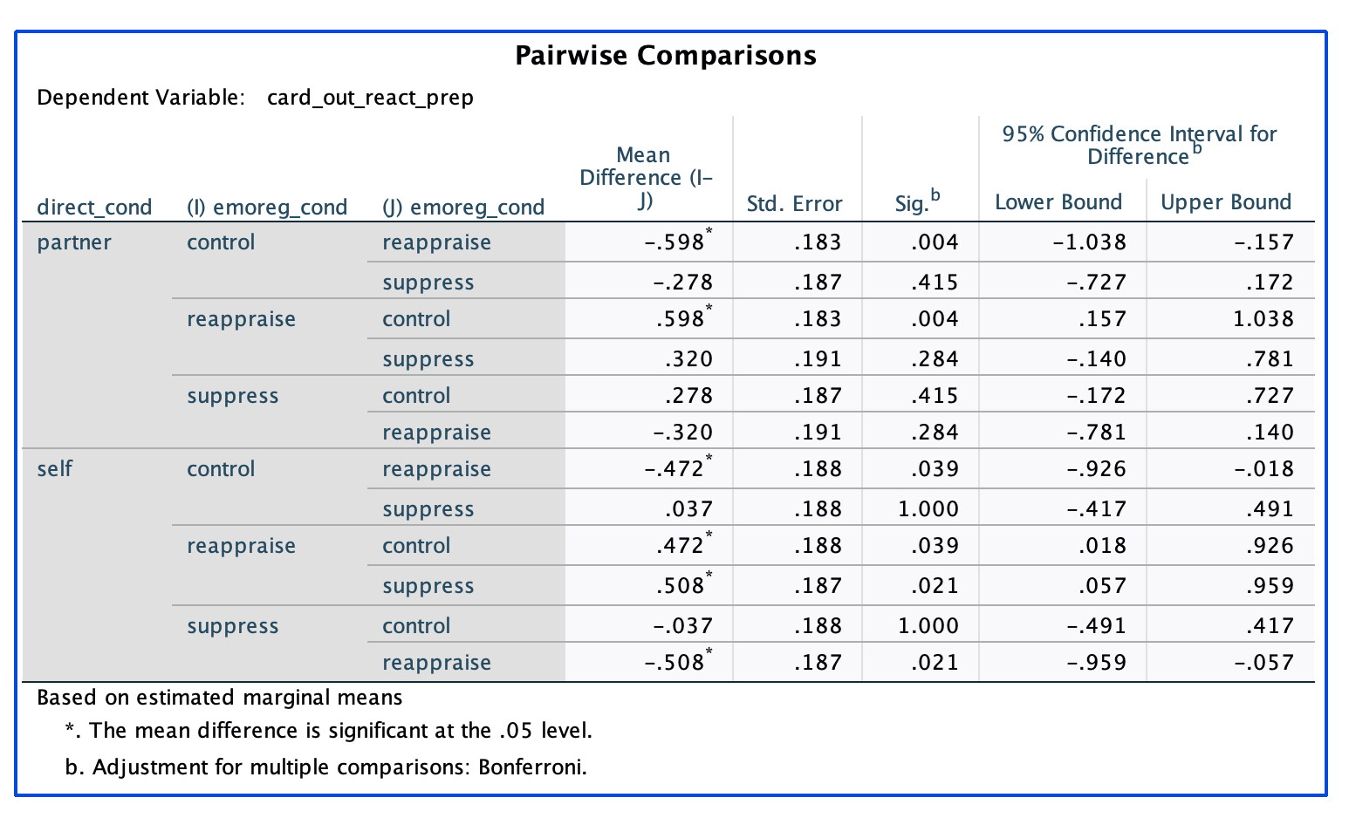
Univariate GLM in SPSS – simple effects w/ EM Means
output of EM Means post-hoc pairwise

Slide 7
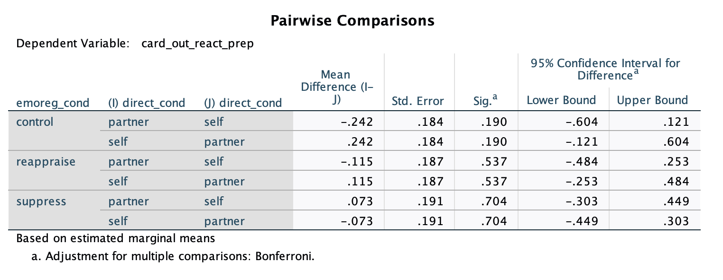
Univariate GLM in SPSS – EM means & simple effects
output of EM Means post-hoc pairwise

Slide 8
ANOVA in R
a million different functions to accomplish the same thing
base R: lm(), aov()
aov() actually uses lm() beneath the hood.
easy to get confused by the anova() function
anova() (and cars::Anova()) does not fit a model, it takes a fitted model (from lm() for example) and summarizes it in terms of variance components (output is an ANOVA table)
you use anova() after you have estimated the model, similar to how you use the summary() function

Slide 9
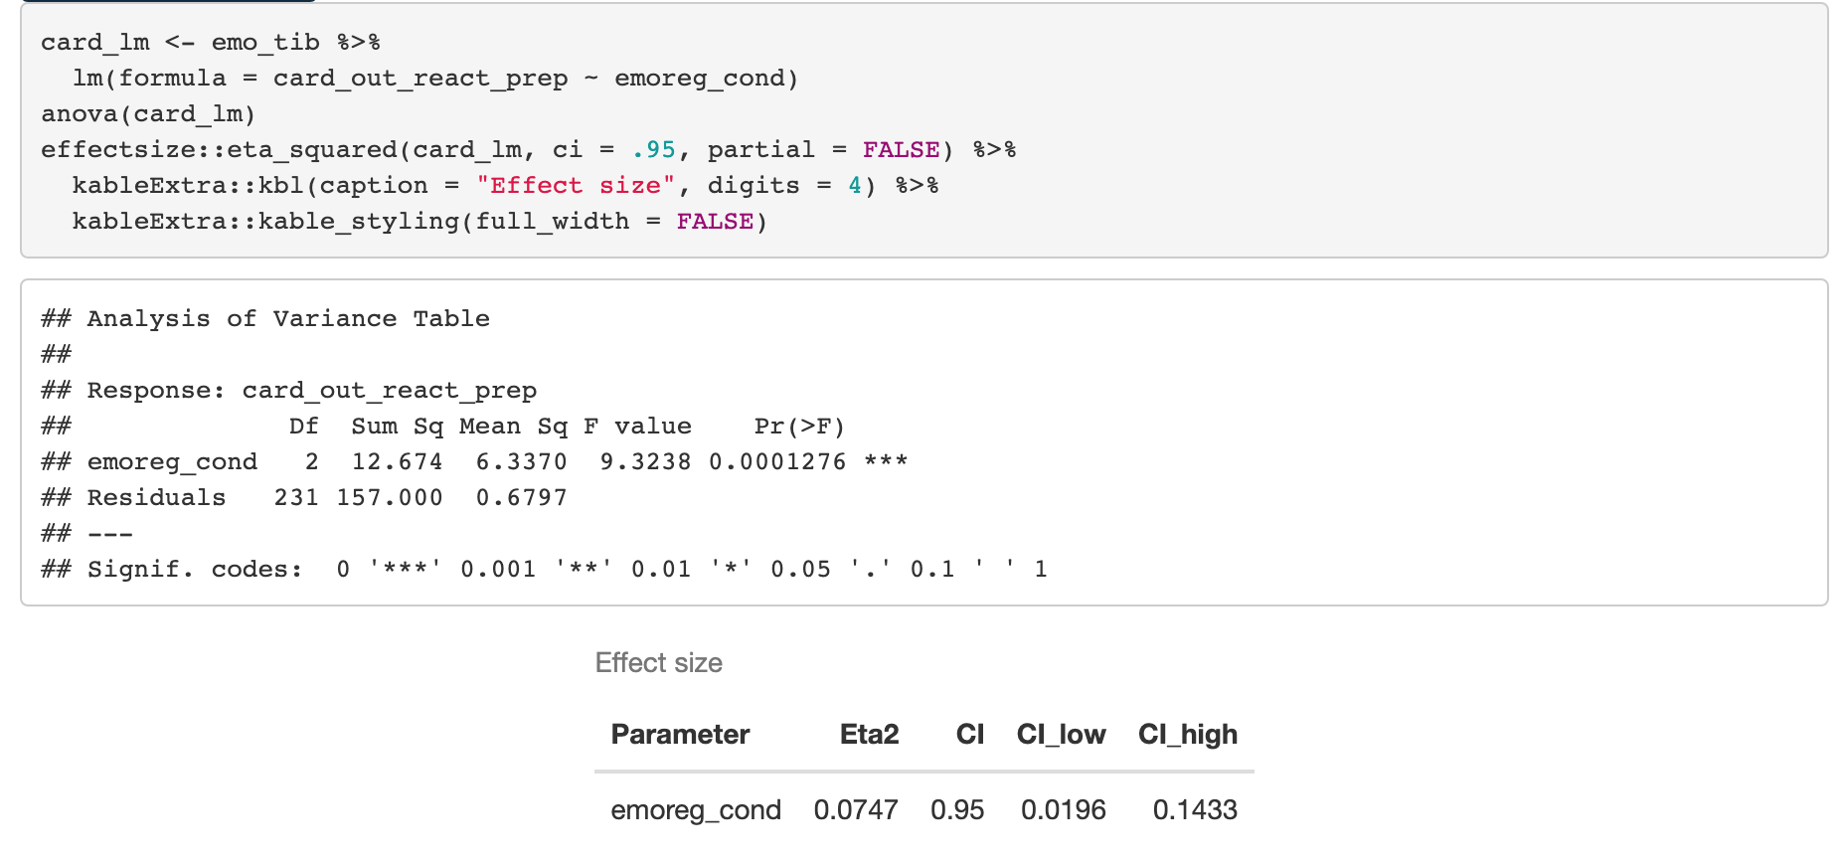
ANOVA in R – output of anova()
CAUTION: anova() uses sequential (Type 1) SS, so order of predictors matters (NBD if there is only one predictor)!
use cars::Anova(type=3) for type 3 SS, which is more likely what you want for a factorial design.

Slide 10
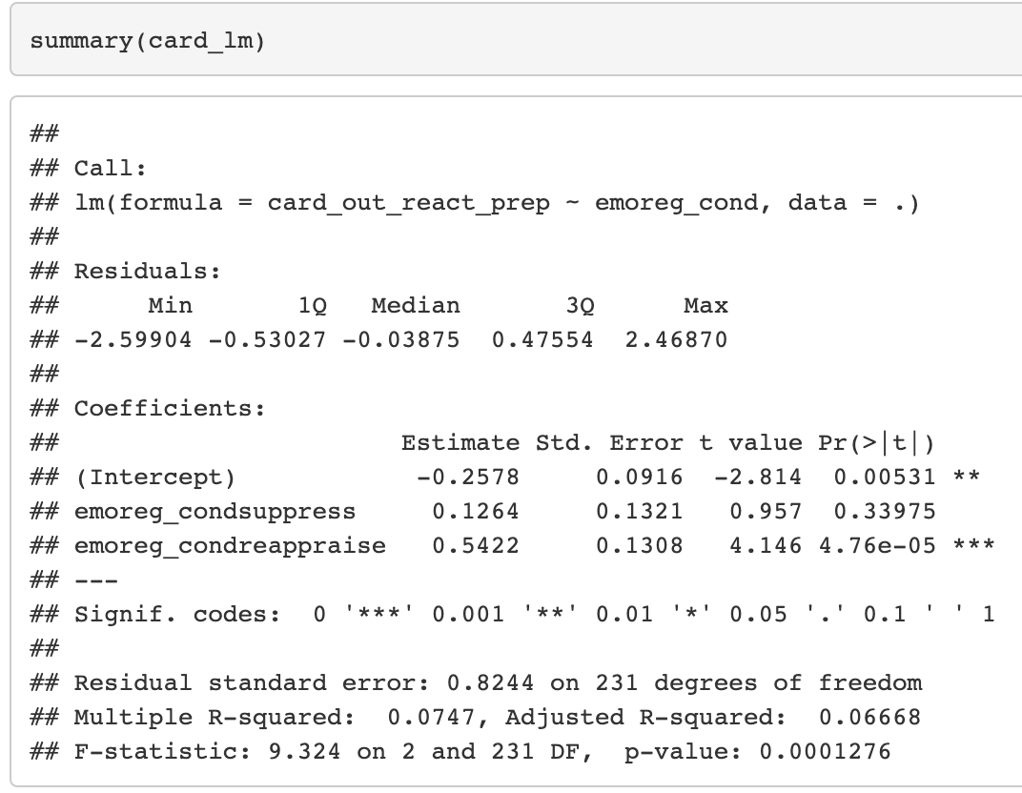
ANOVA in R – output of summary() from the same fitted model
Notes:
Same F-stat, p, R-squared = eta-squared

