Slide 1
data visualization
histograms, box plots, Q-Q plots were covered in Week 2– revisit it!
this week’s examples are for plotting means and associations between variables
before starting this activity – let’s talk about how to talk about graphics

Slide 2
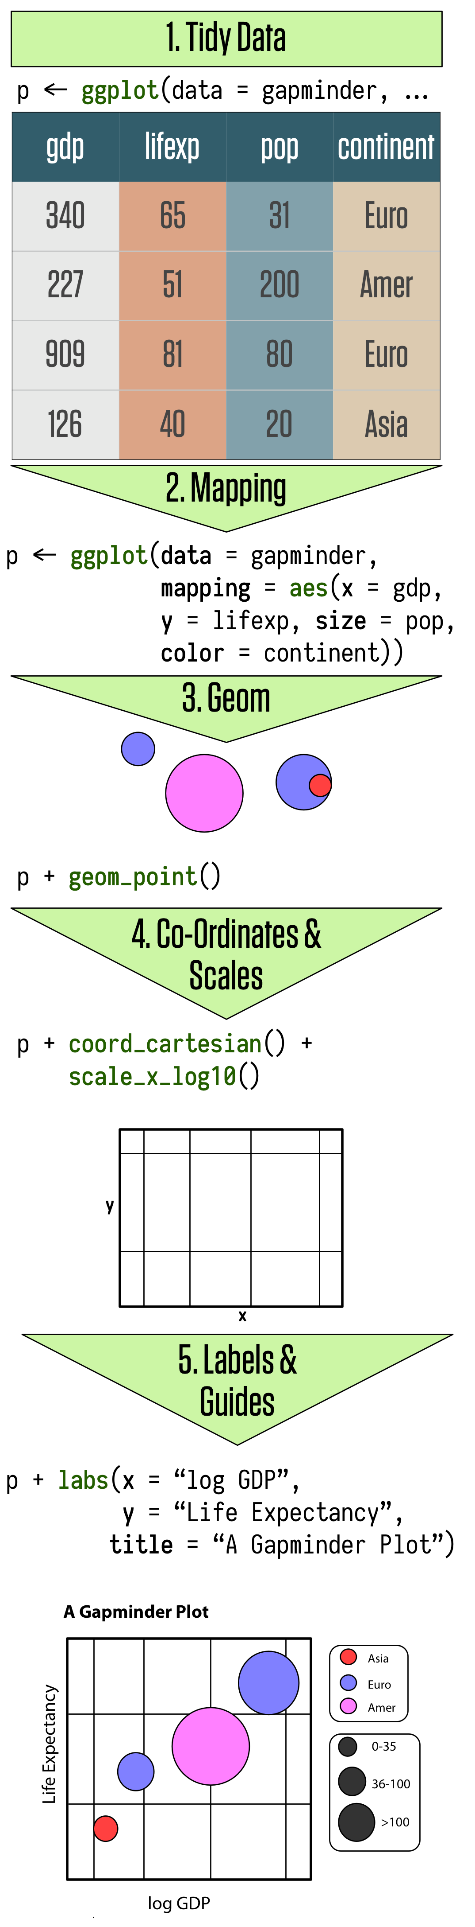
A Grammar of Graphics
Terminology to refer to elements of a data visualization
described by Leland Wilkinson (1999). The Grammar of Graphics . Springer.
implemented in the R package “ggplot” (now “ggplot2”) by Hadley Wickham
Key elements of a visualization
Data
Aesthetics (mapping of data to visual components, e.g., x=height, y=weight, color=region, …)
Geometric objects (points, bars, lines, error bars, …)
additional layers
image from https://socviz.co/makeplot.html - Data Visualization:
A practical introduction, by Kieran Healy (Duke University)

Slide 3
steps to make a visualization
select the data you want to show
may require filtering and aggregation

Slide 4
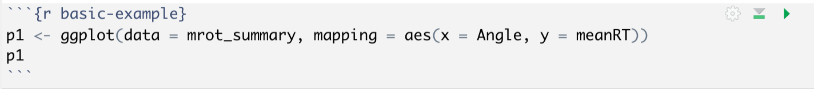
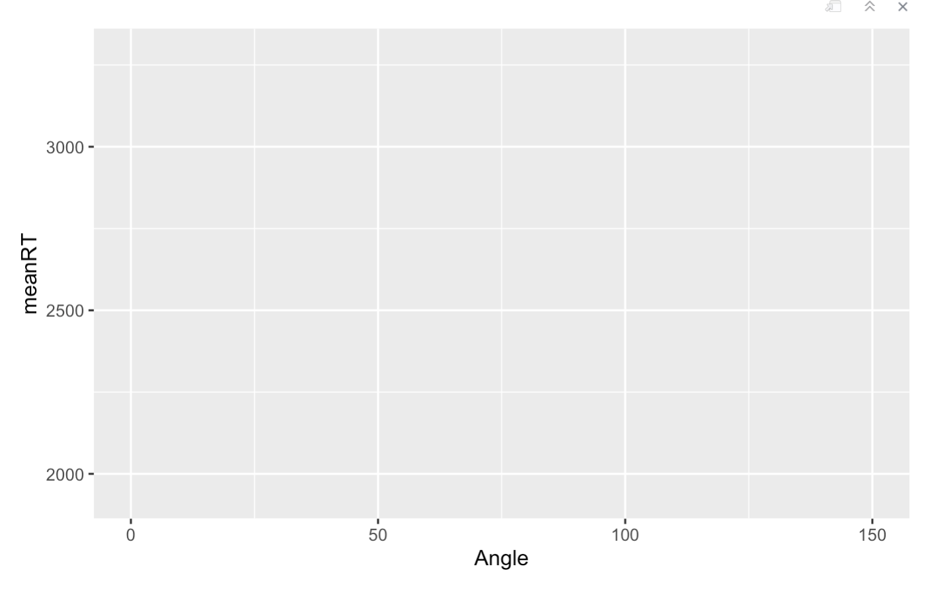
How to use ggplot2 to make a graphic
1. start with the ggplot() function, and specify the data and aesthetic mapping:

Slide 5
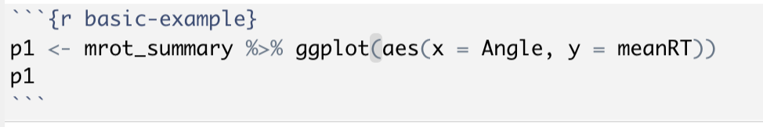
How to use ggplot2 to make a graphic
1. start with the ggplot() function, and specify the data and aesthetic mapping:
More commonly you will see this equivalent syntax:

Slide 6
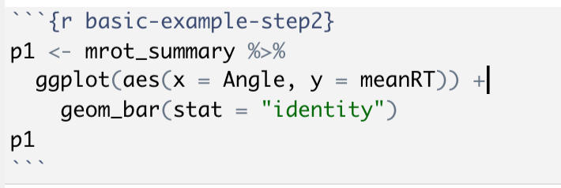
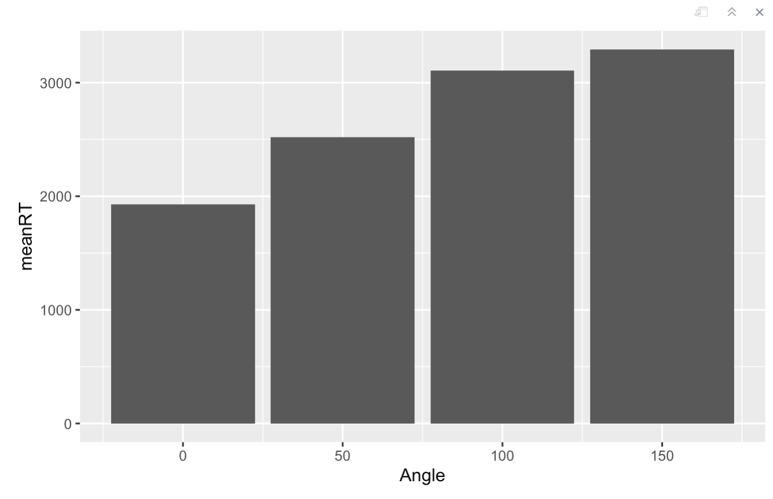
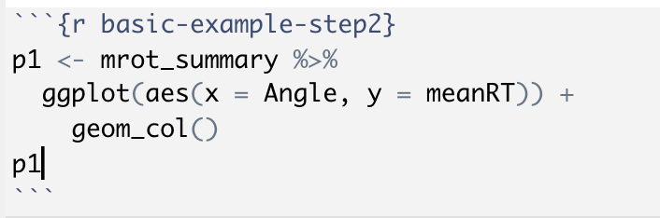
How to use ggplot2 to make a graphic
2. Now add layers using ”+” . First use a geometric object function to show the data mapping:
equivalent to:

Slide 7
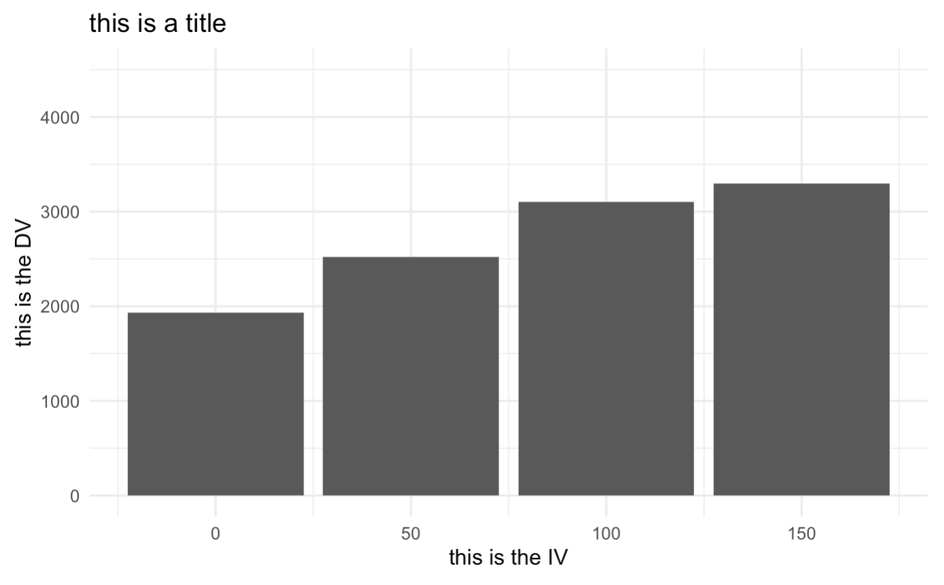
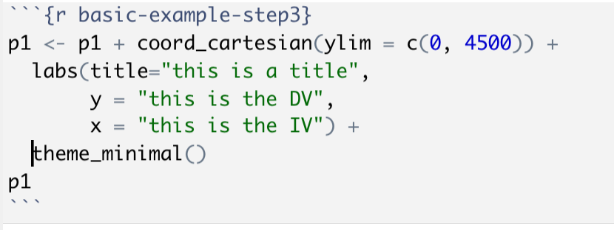
How to use ggplot2 to make a graphic
3. Add more layers using “+”
- coordinate system to control limits and scales
- labels (to override defaults)
- themes (to control appearance)
- add additional geoms (like error bars)
Be careful when limiting the axis range!

Slide 8
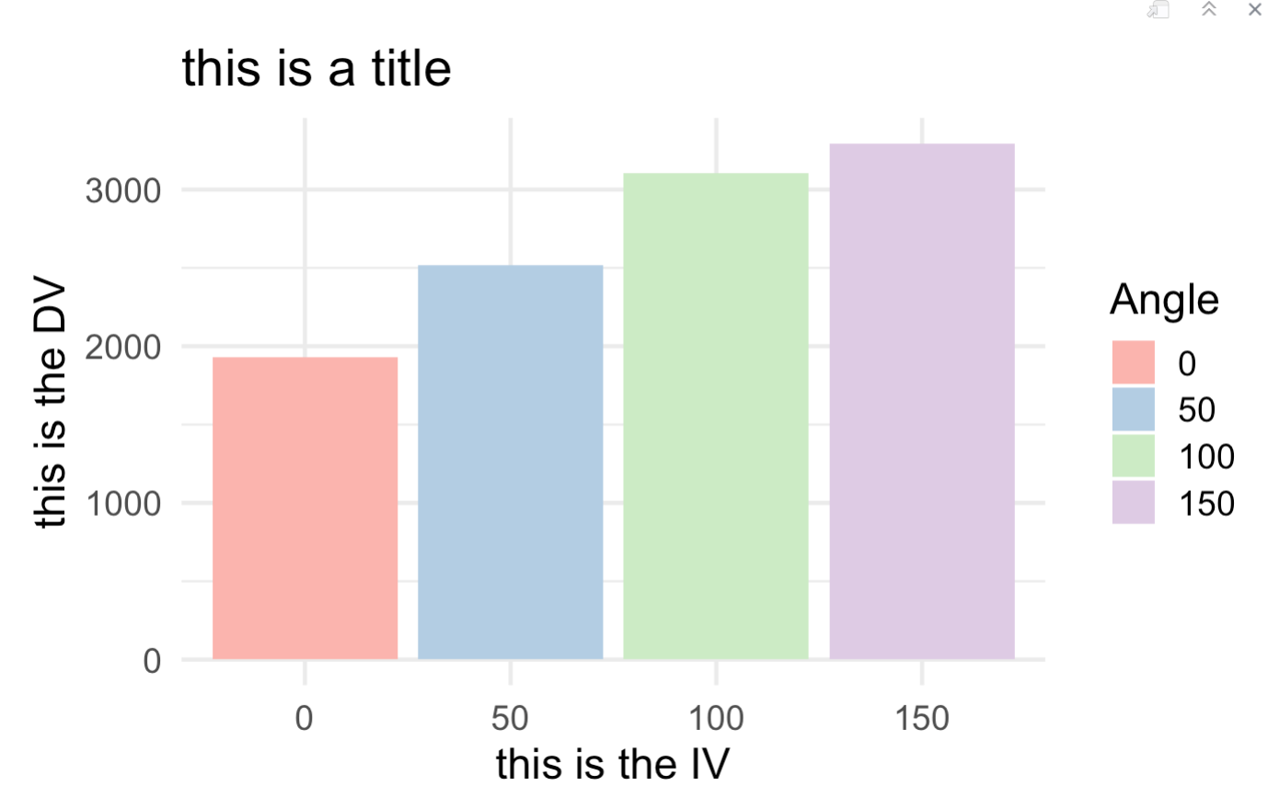
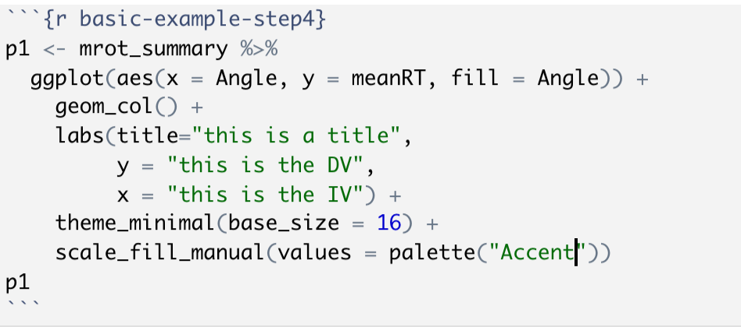
How to use ggplot2 to make a graphic
4. control individual elements by adding more layers or arguments to functions
Chartjunk?

Slide 9
