Slide 1
Notes on repeated measures ANOVA
Jamil Bhanji & Vanessa Lobue
Nov 17 2022

Slide 2
Reminders
class is on Tuesday next week

Slide 3
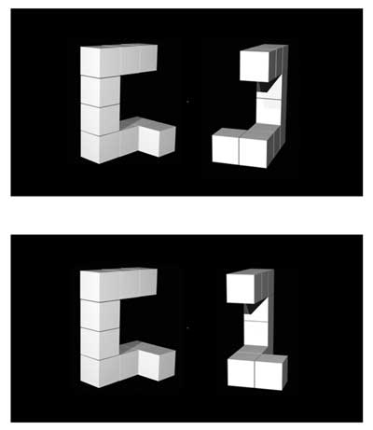
Data for today
From Ganis and Kievit (2016), a replication of the Shephard and Metzler (1971) mental rotation experiment.
Respond whether a shape was the same or different compared to a reference shape.
IV1: Angle of rotation (0, 50, 100, or 150 degrees)
IV2: Desired response (trial type: shape was actually "same" or "different").
DV: response time (milliseconds) – mean across all trials of a cell for a participant (only trials with correct responses are included).
Is the shape on the right the same as the shape on the left? (Angle=150, top: same, bottom: different)

Slide 4
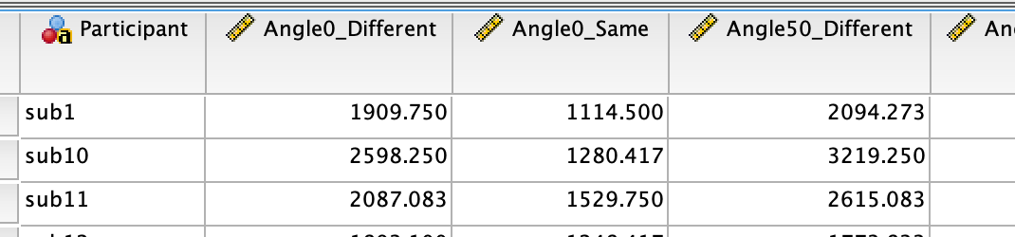
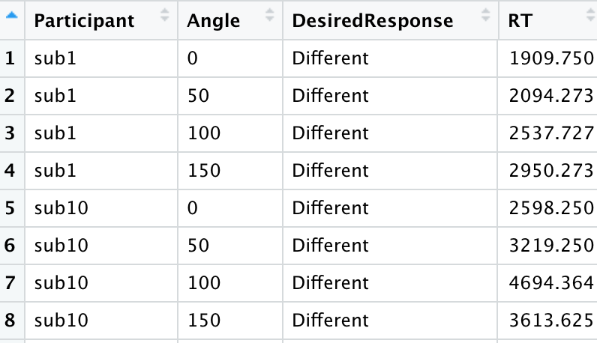
Data Formats (same data, different structure)
SPSS GLM-Repeated Measures requires data in wide format (1 row per subject)
R (most functions) require data in long (tidy) format

Slide 5
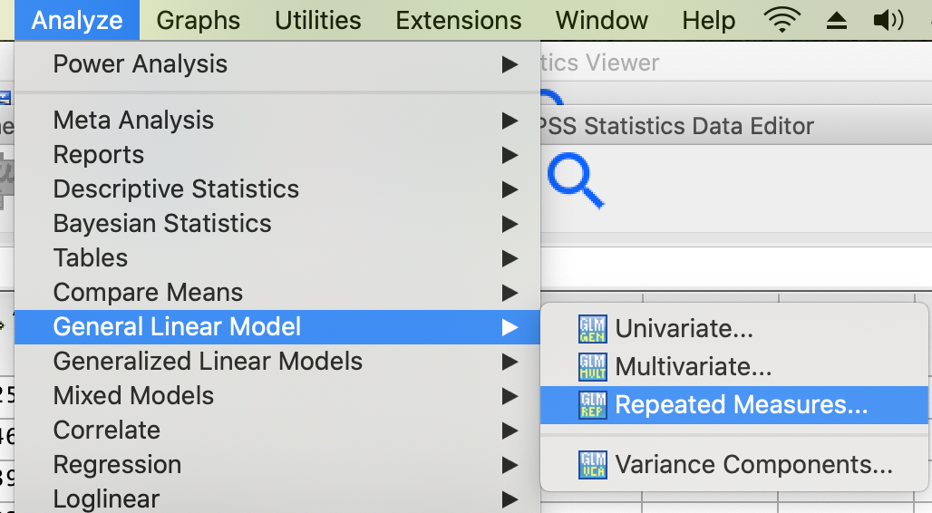
Repeated Measures GLM in SPSS

Slide 6
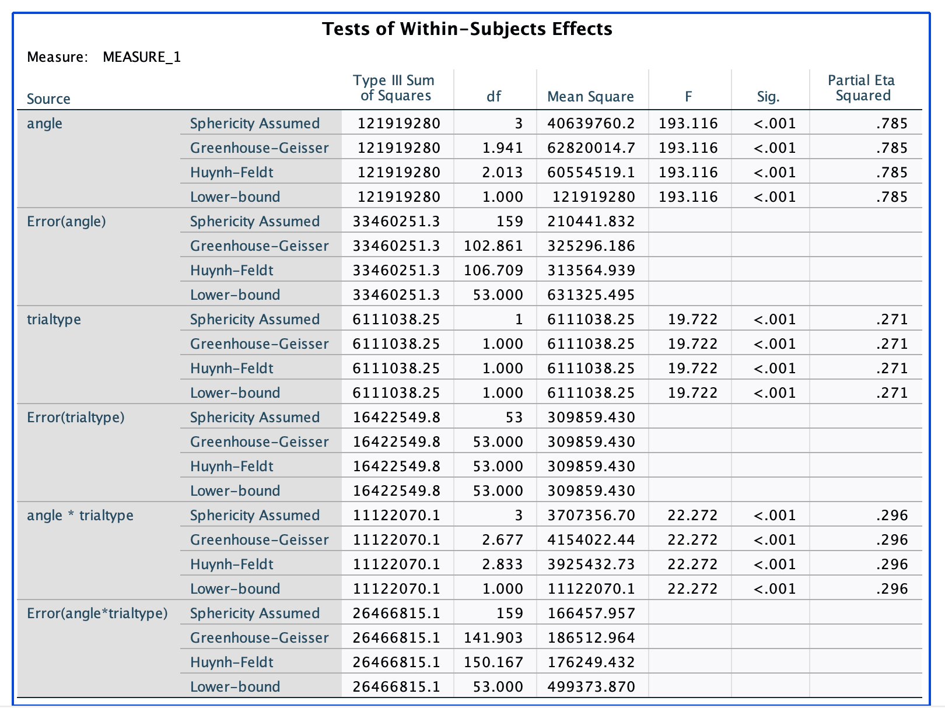
Repeated Measures GLM in SPSS
F, Sig, Partial Eta-squared for each component of the model
F, Sig test the null hypothesis (no association of the factor/interaction with the DV)
multiple rows for each term correspond to different non-sphericity correction methods
Partial eta-squared is effect size, comparable to R², but specific to within-subjects design
an alternative is generalized eta-squared, which generalizes to between-subjects designs (no simple way to calculate it in SPSS) – the difference is analogous to the between (independent) vs within (paired) Cohen’s d measure that we discussed for two group comparisons.

Slide 7
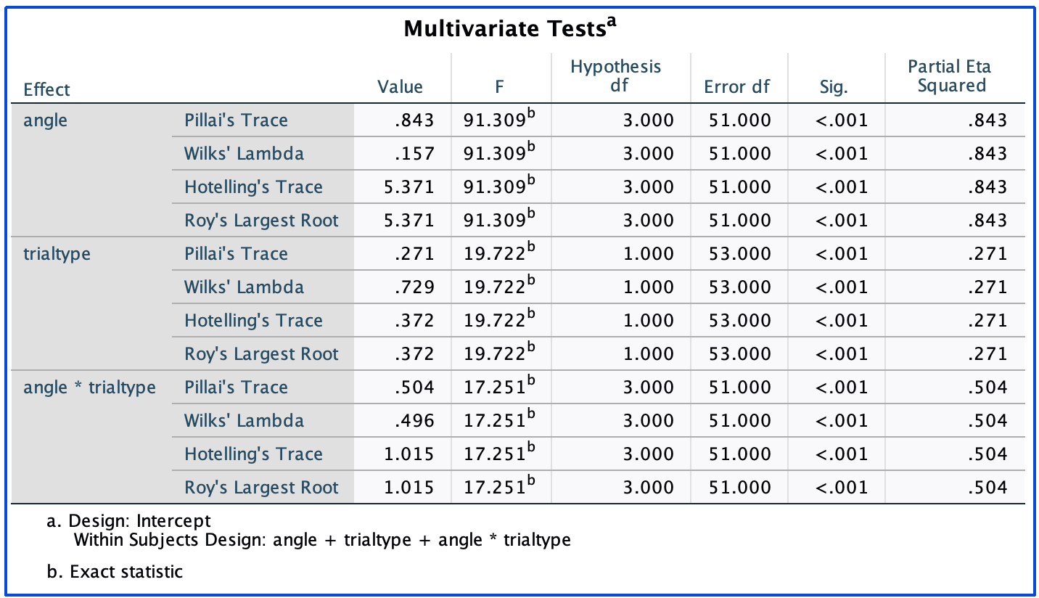
What is the Multivariate Tests Table?
An alternative model: Multivariate Analysis of Variance (MANOVA)
no sphericity assumption
generally less powerful & less commonly reported
similar results to univariate when data are spherical
From Andy Field: “MANOVA … [uses] a specific error term for contrasts …, each contrast is only ever associated with its specific error term (rather than the pooled error terms used in ANOVA)”

Slide 8
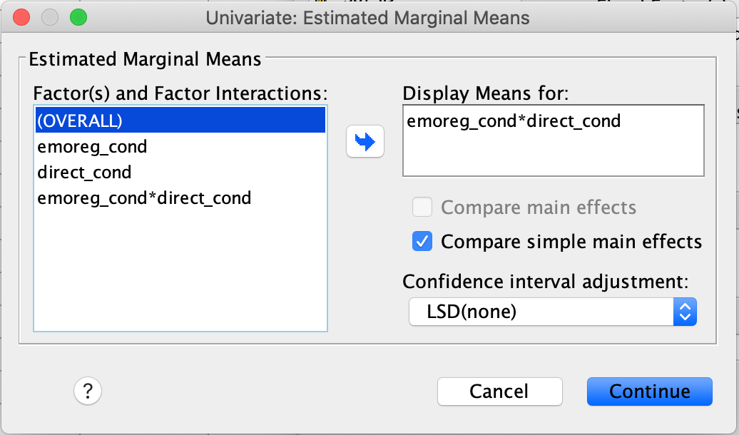
Univariate GLM in SPSS – EM means & simple effects (same as between subjects example)
use the “EM Means” button to get estimated marginal means (w conf intervals)
output gives confidence intervals for the difference between all pairs of means within each level of a factor (what? let’s look at the output)
The number of pairwise comparisons increases quickly in factorial designs!

Slide 9
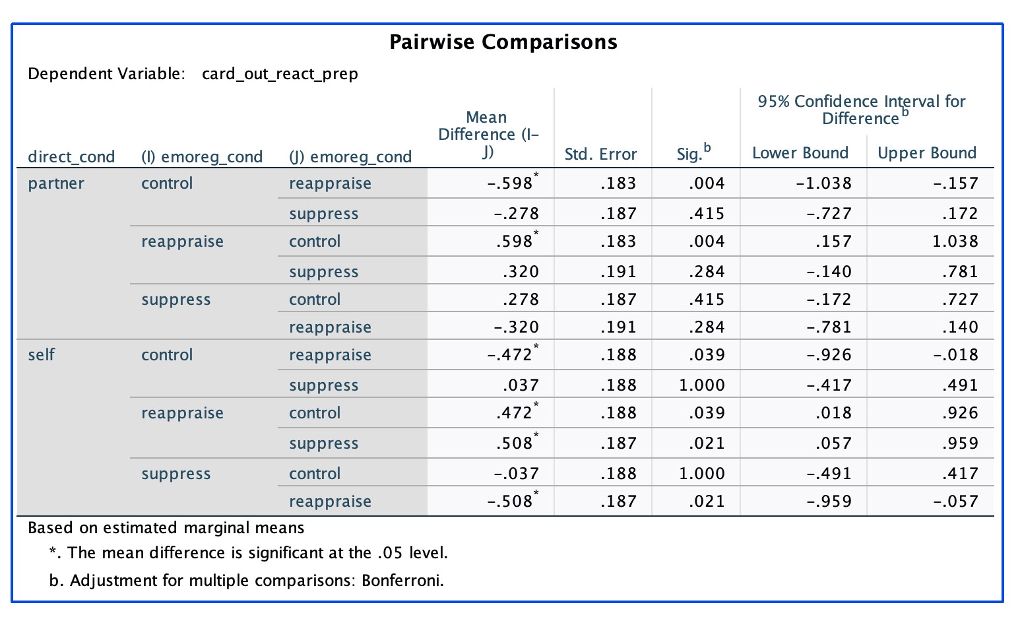
Univariate GLM in SPSS – EM means & simple effects
use the “EM Means” button to get estimated marginal means (w conf intervals)
output gives confidence intervals for the difference between all pairs of means within each level of a factor

Slide 10
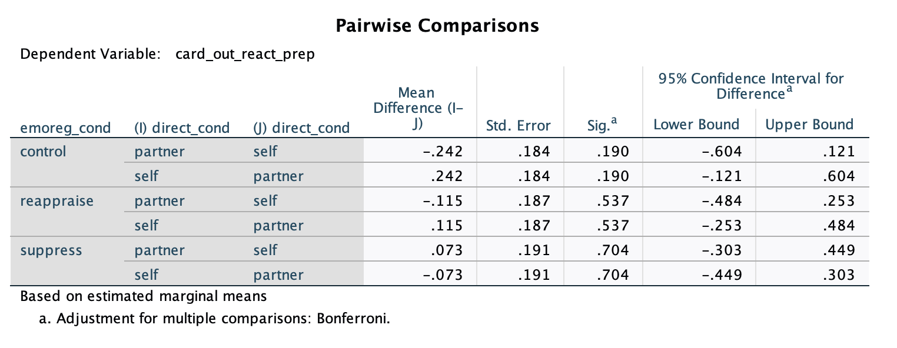
Univariate GLM in SPSS – EM means & simple effects
use the “EM Means” button to get estimated marginal means (w conf intervals)
output gives confidence intervals for the difference between all pairs of means within each level of a factor
separate table for each factor (each has pairwise comparisons within levels of a factor)

Slide 11
ANOVA in R
Use afex::aov_4() -- it is called aov_4() because it follows the package lme4 – a more general purpose tool for mixed effects modeling.
Anova Table output by calling the model_name. More detail (sphericity epsilon and tests) by using summary(model_name)
generalised eta-squared is automatically reported, for partial eta-square use effectsize::eta_squared()
for simple effects use emmeans::joint_tests() – we can review after lab
for pairwise comparisons use emmeans::emmeans()

