Slide 1
Reading output from a linear regression
Statistical Methods Fall 2024
Jamil Palacios Bhanji
with contributions from Vanessa Lobue

Slide 2

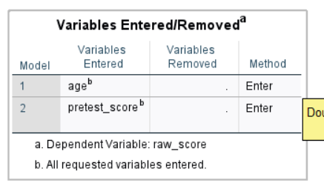
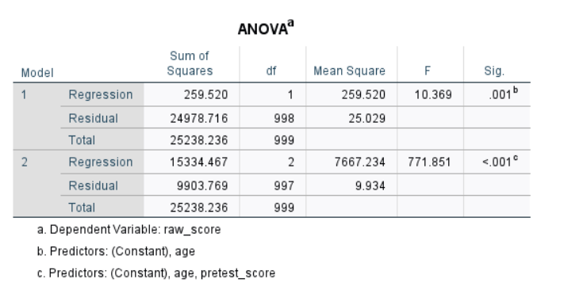
SPSS Regression->Linear
raw_score = b₀ + b₁age + b₂pretest_score
model 1
model 2

Slide 3
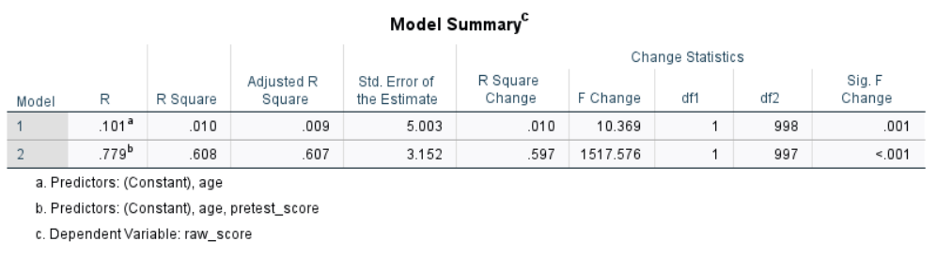
SPSS Regression->Linear
raw_score = b₀ + b₁age + b₂pretest_score
model 1
model 2

Slide 4
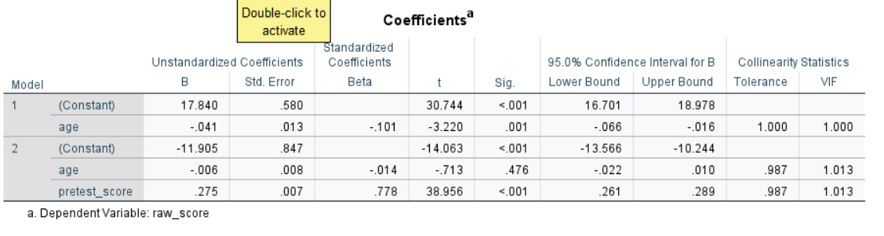
SPSS Regression->Linear
raw_score = b₀ + b₁age + b₂pretest_score

Slide 5
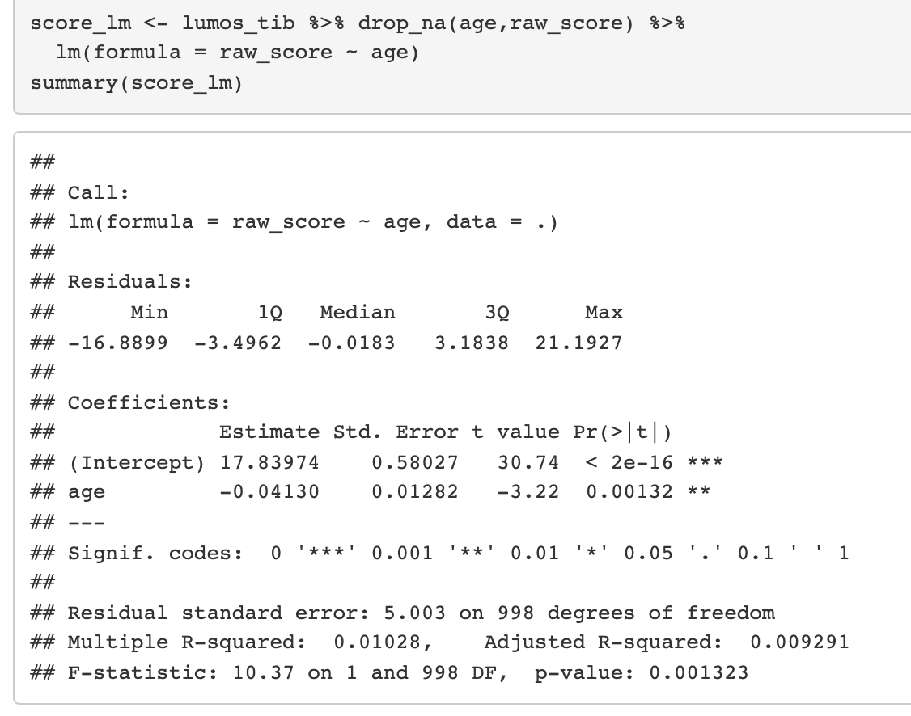
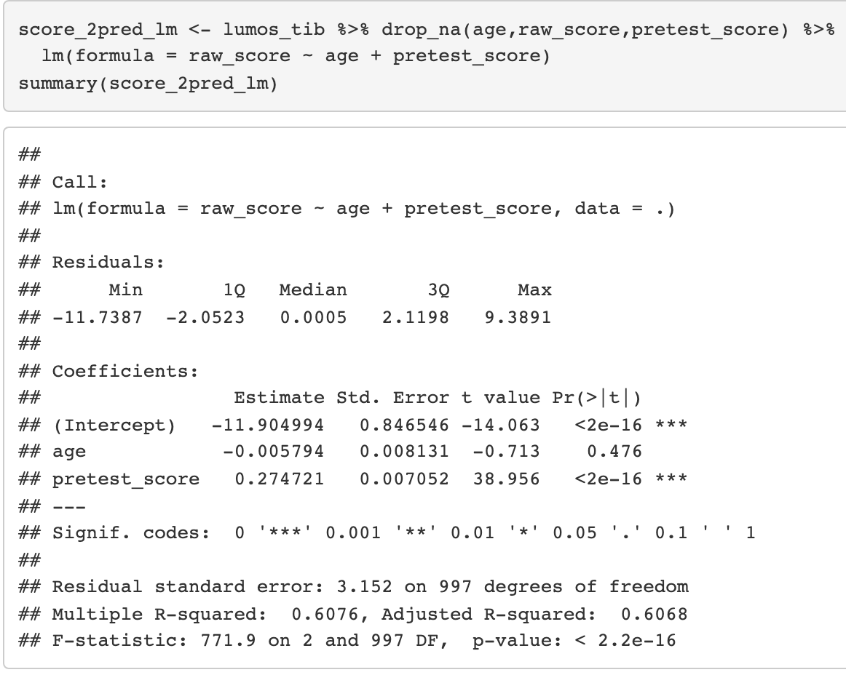
R lm()
raw_score = b₀ + b₁age + b₂pretest_score
model 1
model 2

Slide 6
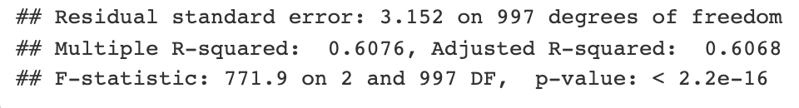
R lm()
raw_score = b₀ + b₁age + b₂pretest_score
model 2

Slide 7
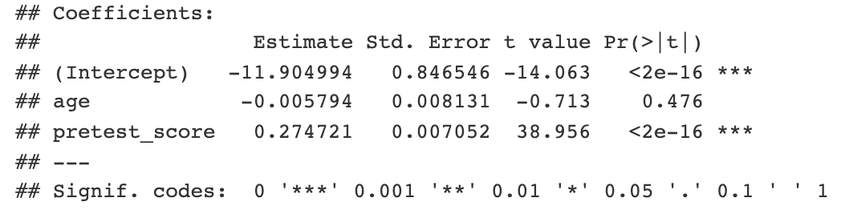
R lm()
raw_score = b₀ + b₁age + b₂pretest_score
model 2

Slide 8
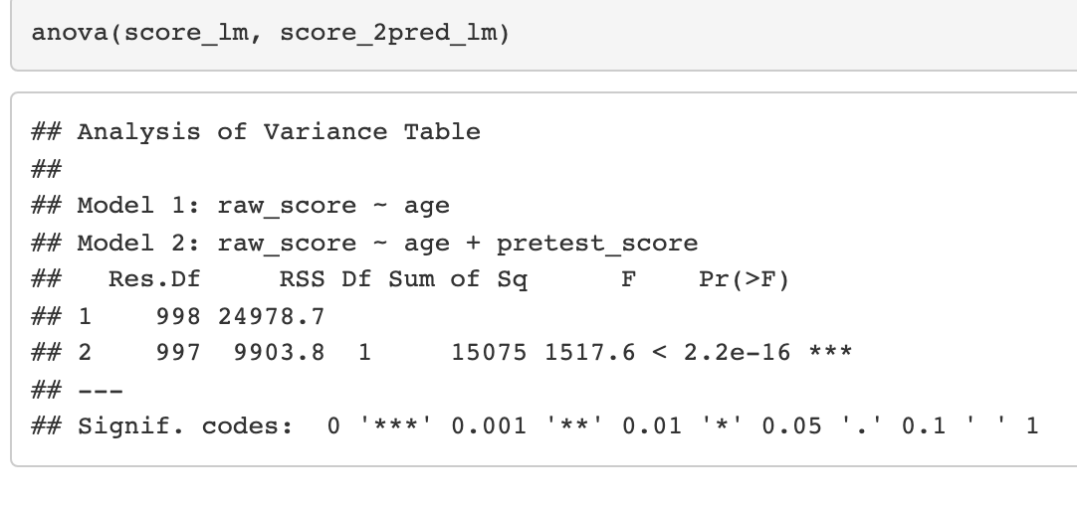
R lm()
raw_score = b₀ + b₁age + b₂pretest_score
model 1
model 2

Slide 9
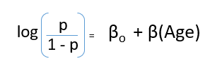
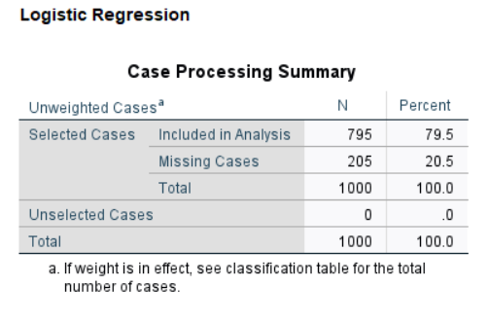
SPSS Regression->Binary Logistic
(years_edu)

Slide 10
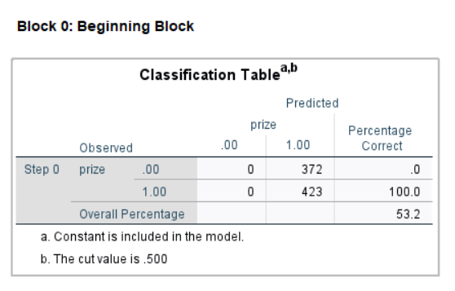
SPSS Regression->Binary Logistic
(years_edu)
NULL model
always predicts the most
common outcome

Slide 11
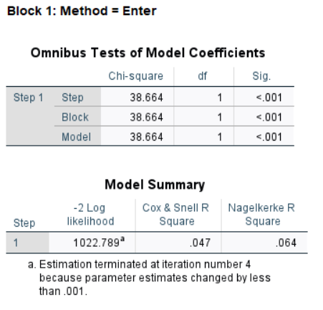
SPSS Regression->Binary Logistic
(years_edu)
overall fit: analogous to overall F of
a linear model

Slide 12
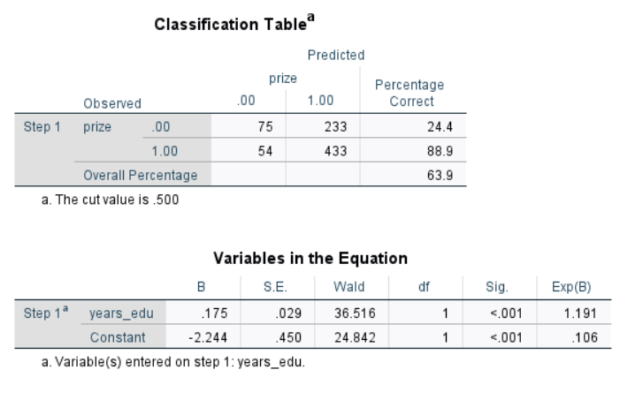
SPSS Regression->Binary Logistic
(years_edu)
Classification Table:
Predictions made by the model for each case in the data (probability >.5 determines prediction)

Slide 13
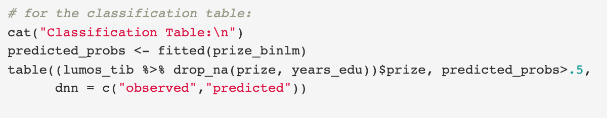
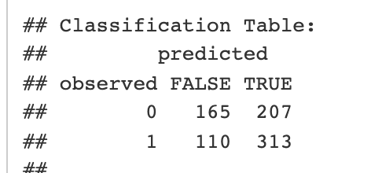
R logistic - using glm(family=binomial)
(years_edu)

Slide 14

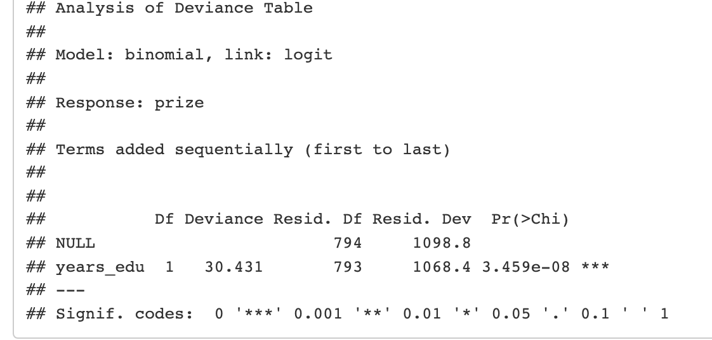

R logistic - using glm(family=binomial)
(years_edu)

Slide 15
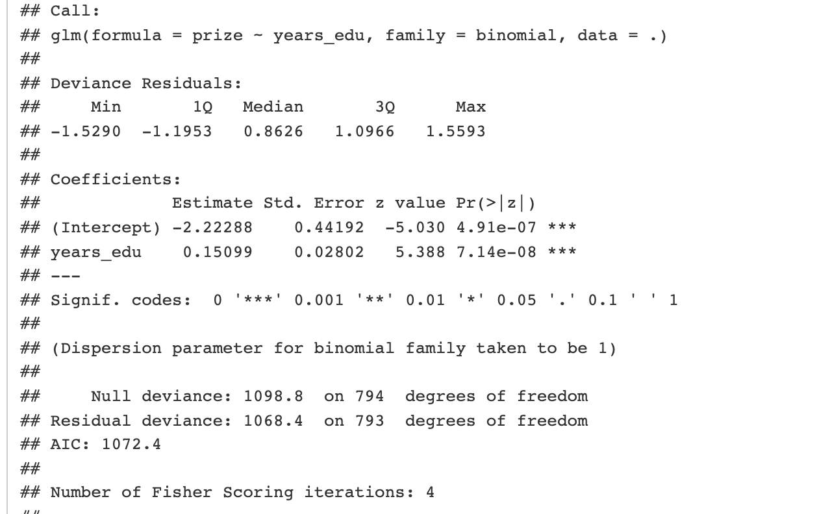
R logistic - using glm(family=binomial)
(years_edu)

Slide 16
DV/IV (assigning predictor vs outcome doesn’t determine causation)
fitting the noise
Lots of terms
heirarchical entry (heirarchical forced), HLM
lm() vs glm()

