Slide 1
Mixed Effects Models
Lobue & Bhanji
Dec 8 2021

Slide 2
What is a mixed effects model?
Often refers to a design that includes both between-subject factors and within-subject factors
e.g., Raio et al 2013 “Cognitive emotion regulation fails the stress test”
Acute Stress manipulation between subjects
Cognitive emotion regulation manipulation within subjects

Slide 3
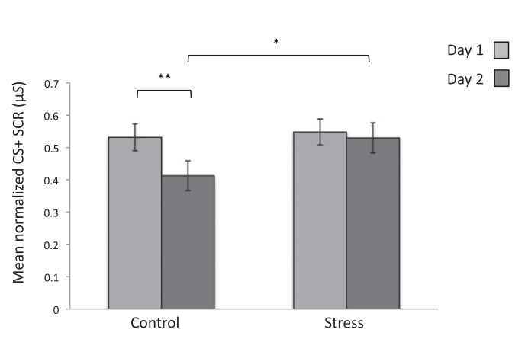
Mixed design example – Raio et al 2013
within-subjects
2 groups (Control, Stress), each participant has two measures
Day1=noregulation
Day2=cognitive regulation)
DV = skin conductance response to CS+
repeated measures ANOVA with added between-subjects factor
repeated measures is required because within-subjects measures violate the independence assumption
between-subjects

Slide 4
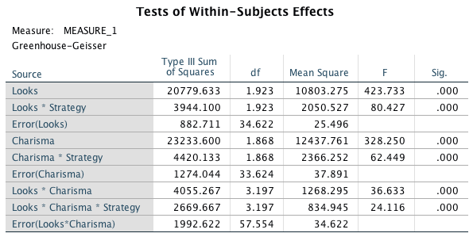
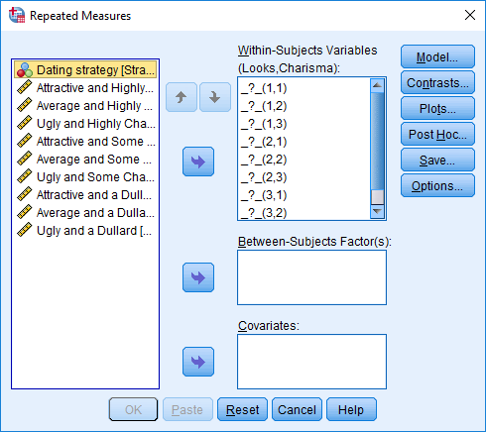
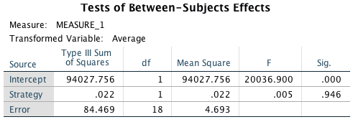
Mixed design example – Raio et al 2013
2 groups (Control, Stress), each participant has two measures
Day1=noregulation
Day2=cognitive regulation)
repeated measures ANOVA with added between-subjects factor
repeated measures is required because within-subjects measures violate the independence assumption
in SPSS use General Linear Model->Repeated Measures
interpretation of output is exactly the same as before – interactions of within and between factors appear in “Within-Subjects” table
Greenhouse-Geisser correction for non-sphericity in within-subjects effects

Slide 5
Mixed design example – Raio et al 2013
Use same methods (planned contrasts, pairwise comparisons) to interpret an interaction effect
“We conducted a repeated-measures ANOVA using condition (stress, control) as a between-subject factor and session (day 1, day 2) as a within-subject factor. We observed a main effect of session [F(1, 78) = 8.45, P = 0.005], no effect of condition [F(1, 78) = 1.32, P = 0.25], and a significant session X condition interaction [F(1, 78) = 4.55, P = 0.03]. Paired samples t-tests confirmed that the control group showed a significant decrease in SCR to the CS+ across sessions [t(43) = 3.65, P = 0.001], whereas the stress group showed no such reduction [t(35) = 0.546, P = 0.59]. Mean SCR to the CS+ did not differ between groups on day 1 [t(78) = −0.28, P = 0.78, one-tailed]; however, on day 2 stressed participants showed significantly stronger SCR to the CS+ than did the control group, despite both groups undergoing the regulation training [t(78) = −1.76, P = 0.04, one-tailed].”

Slide 6
What is a mixed effects model?
Often refers to a design that includes both between-subject factors and within-subject factors
e.g., Raio et al 2013 “Cognitive emotion regulation fails the stress test”
Acute Stress manipulation between subjects
Cognitive emotion regulation manipulation within subjects
More generally, “linear mixed effects models” refer to linear models that incorporate both fixed and random effects
fixed effects = variables that are systematically examined
random effects = clusters of dependent data points (e.g. observations from the same subject, or from the same stimulus/item)

Slide 7
What is a mixed effects model?
Often refers to a design that includes both between-subject factors and within-subject factors
e.g., Raio et al 2013 “Cognitive emotion regulation fails the stress test”
Acute Stress manipulation between subjects
Cognitive emotion regulation manipulation within subjects
More generally, “linear mixed effects models” refer to linear models that incorporate both fixed and random effects
fixed effects = variables that are systematically examined
random effects = clusters of dependent data points (e.g. observations from the same subject, from the same stimulus/item, from the same classroom)

Slide 8
More on random effects
think of “random effects” as “cluster-level effects”, or “cluster-varying effects”
Designs can have crosses random effects or nested random effects structures
crossed random effects: levels of one variable occur across levels other variables – e.g., each participant (random var1) sees each stimulus (random var2)
nested random effects: levels of one variable occur within levels of other variables – e.g., each student (random var1) is nested within one classroom (random var2)
our activity today is an example of crossed random effects

Slide 9
Advantages of linear mixed models
captures variance (e.g. trial-to-trial) that may be important for accurately estimating effects of interest
allows modeling of multiple random variables (e.g., participants and stimuli), whereas ANOVA approaches allow only one random variable
participants are a sample from larger population
usually stimuli are also sampled from a larger population
in ANOVA you must choose to model only one random effect (usually participant effect, ignoring stimulus effect – Judd, Westfall & Kenny, 2012)
handles unbalanced designs (and missing data)
handles categorical or continuous predictors, coefficients give magnitude and direction of effects (as opposed to ANOVA approach)
extends to other types of outcome variables (e.g., binary)

Slide 10
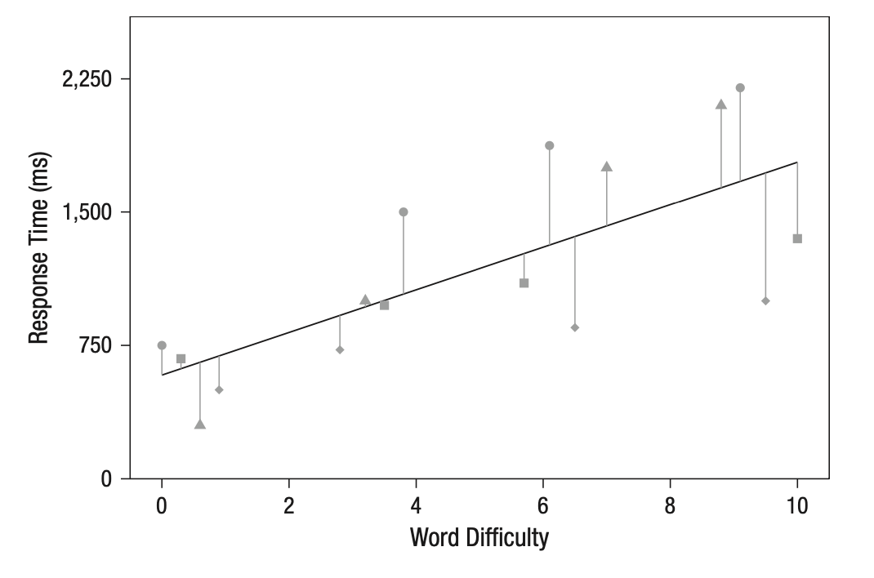
Example – DV=response time, IV=word difficulty
fixed effects only does not capture subject or item variance

Slide 11
Random intercepts by participant
random intercepts by participant capture variance in the height of the outcome by participant
e.g. some participants tend to respond more slowly
terminology in formula specification:
(1|participantID)

Slide 12
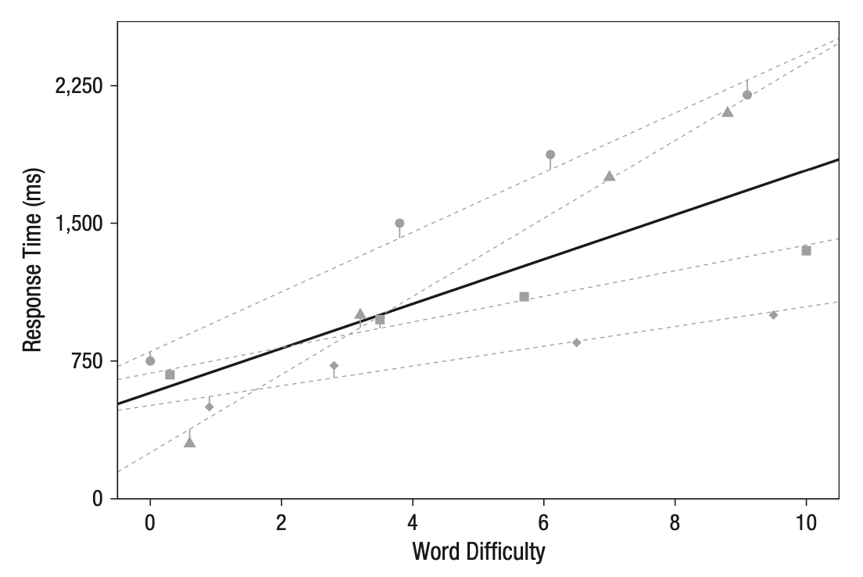
Random intercepts and slopes by participant
random slopes by participant capture variance in the magnitude of the effect across participants
e.g. some participants are more influenced by the manipulation
intercept and slope are often correlated (e.g. slower participants are less affected by the manipulation) – can estimate correlation with mixed model
terminology in formula specification:
(1 + difficulty|participantID)

