Slide 1
setting up and documenting your work
Jamil Palacios Bhanji
Vanessa Lobue

Slide 2
Note
Install one more package in R:
install.packages(“Hmisc”)

Slide 3
Organizing and documenting your work
Goal is for a researcher (including your future self) to be able to recreate your work
Keep things organized! For this class:
make a project folder for each week’s activity e.g. “import-examine”
use a consistent method for naming files and variables
Preserve copies of your data file(s) in their original state
Keep sensitive data in a sequestered, protected part of your project
Create reader-friendly notes to record every step of data processing/analysis (text file, comments in SPSS syntax file, R markdown)
When you reach a project milestone (e.g., publication), save file versions of all necessary files with easily identifiable filenames and do not edit them further (do any further work on a copy of the files)
Data dictionary to document your data

Slide 4
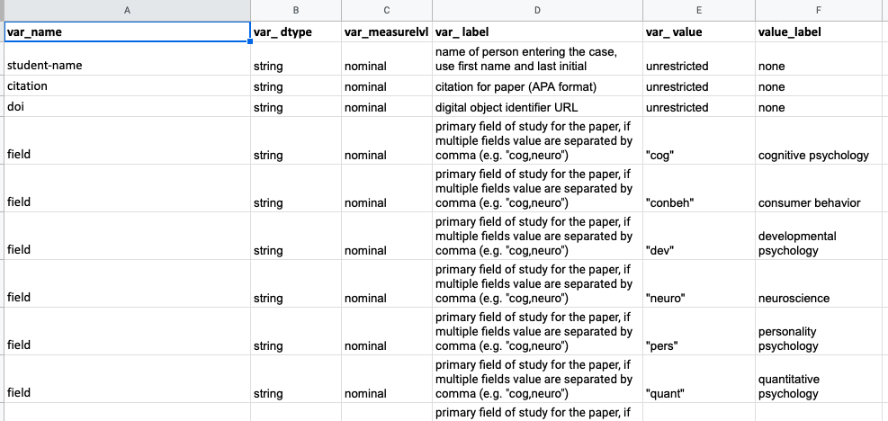
Data dictionary

Slide 5
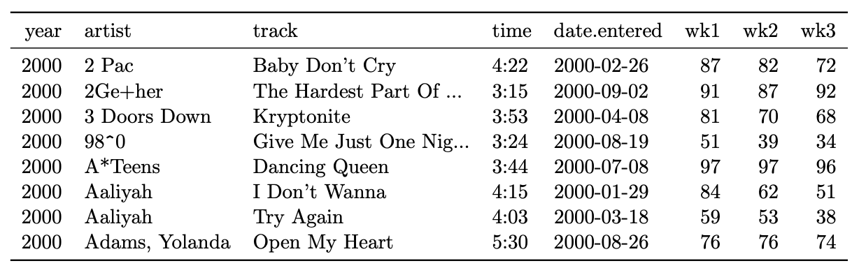
Data table: wide
Wickham, H. (2014) Tidy data. J Statistical Software.

Slide 6
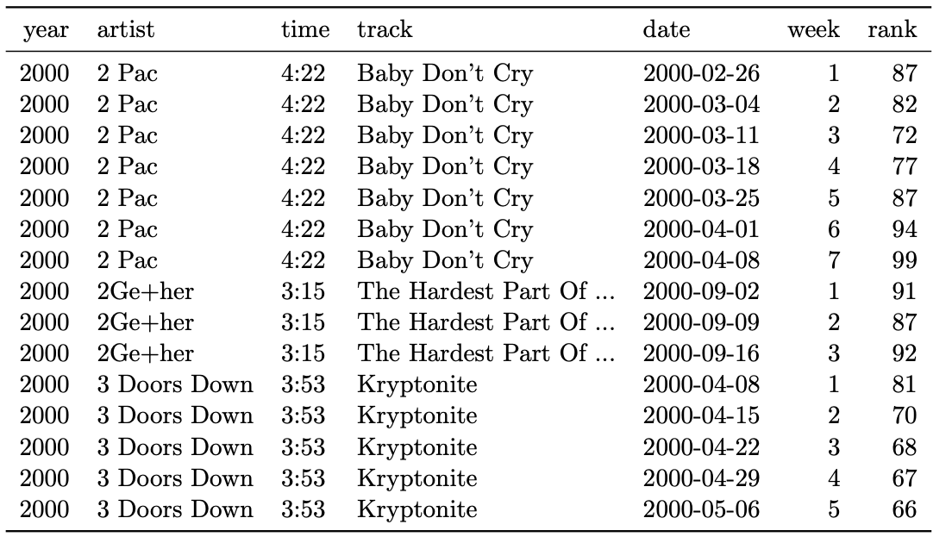
Data table: long
Wickham, H. (2014) Tidy data. J Statistical Software.

Slide 7
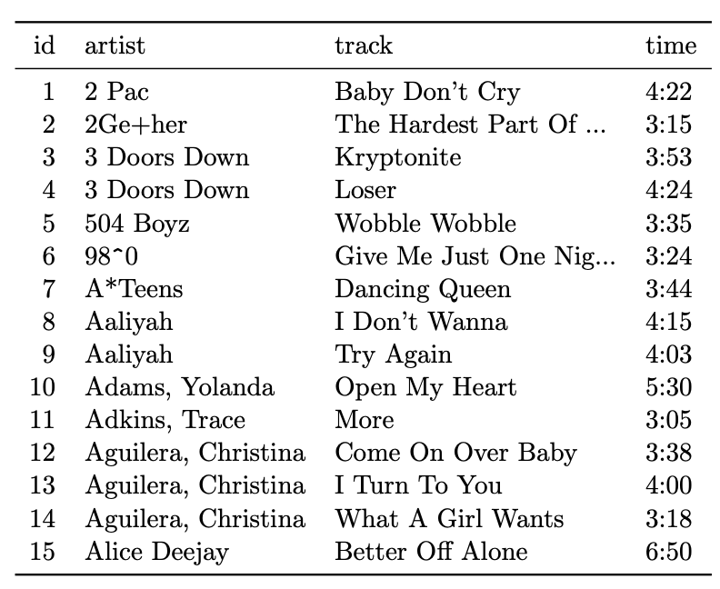
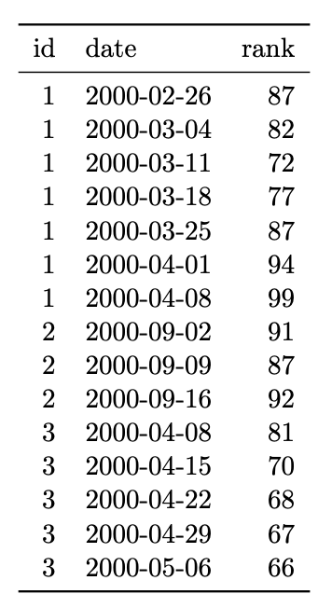
Data tables: tidy
observational unit: song
observational unit: rank (by week)
each variable gets a column
each observation gets a row
each type of observational unit gets a table
Wickham, H. (2014) Tidy data. J Statistical Software.

Slide 8
how should I keep my data?
Depends on your goals and your process (e.g. some functions require data in wide vs long format)
For widely shared data: Tidy data is most easily machine-readable
Avoid storing messy data:
DON’T: have column names represent variable values
DON’T: let single columns contain values for multiple variables
DON’T: have variables in both rows and columns
DON’T: have data for one observational unit spread across multiple data sets/files
from Spencer, J (2017) “The life changing magic of tidying up your data: The art and science of making data usable.

Slide 9
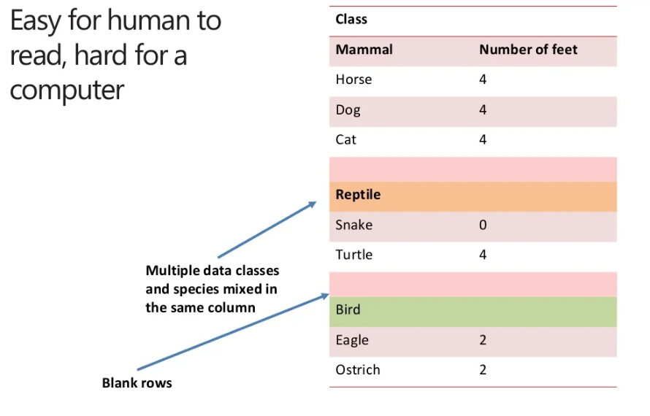
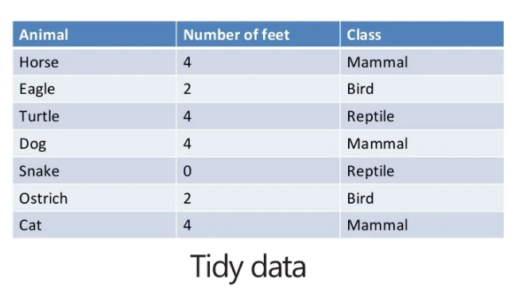
how should I keep my data?
Messy!
Tidy!
from Spencer, J (2017) “The life changing magic of tidying up your data: The art and science of making data usable.

Slide 10
class-activities/
├── week1-setup-import
│ ├── week1-setup-import.Rproj # RStudio project file
│ ├── data # save raw datasets here
│ │ └── dataset.csv
│ ├── r_docs # save R analysis work here
│ │ ├── week1-setup-import.Rmd # analysis code, charts, & notes
│ │ └── week1-setup-import.html # knit version of *.Rmd file
│ ├── spss # save all spss files here
│ │ ├── week1-setup-import.sav # spss datafile
│ │ ├── week1-setup-import-syntax.sps # spss syntax (analysis code)
│ │ ├── week1-setup-import-output.spv # spss output file (code & charts)
│ │ └── week1-setup-import-notes.{txt/doc/etc} # notes in your fave format
│ └── images #if needed, save chart images here
│ ├── fig1.png
│ └── fig1.svg

Slide 11
What is an RStudio project?
a way to divide your work into multiple contexts, each with their own working directory, workspace, history, and documents (including data files and R Markdown docs
consists of a folder with one *.rproj file at the top level of the folder
all files for the project are within that folder (e.g., within “data”, “r_docs”, “images” sub-folders)
you can also have non-R files (e.g., spss) files within the same folder
file paths (e.g., data file locations) can be specified relative to the project folder, allowing you to port the whole folder from one location to another (makes sharing easier)
see https://support.rstudio.com/hc/en-us/articles/200526207-Using-Projects for more

Slide 12
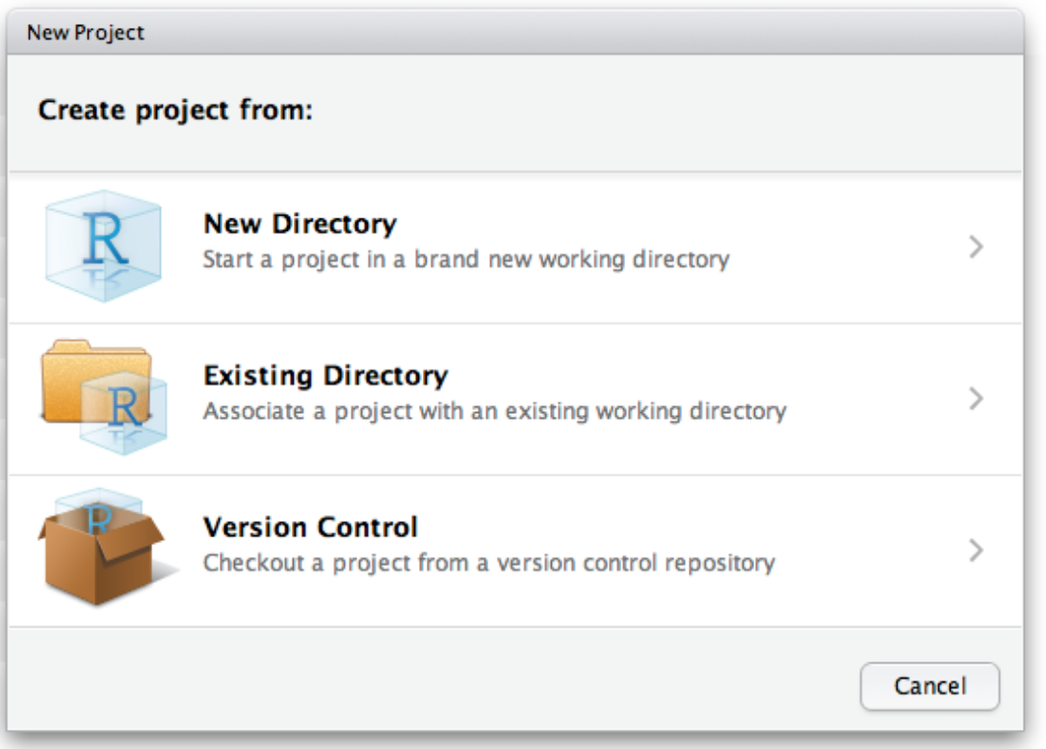
How to create an R Project
File -> New Project
Select “Existing Directory” – because we have already created the folder and sub-folders when we did the SPSS lab activity
Anytime you want to work on this project, start by opening the project file (double-click on the Project file or go to Rstudio->File->Open Project (not “Open File”)

Slide 13
class-activities/
├── week1-setup-import
│ ├── week1-setup-import.Rproj # RStudio project file
│ ├── data # save raw datasets here
│ │ └── dataset.csv
│ ├── r_docs # save R analysis work here
│ │ ├── week1-setup-import.Rmd # analysis code, charts, & notes
│ │ └── week1-setup-import.html # knit version of *.Rmd file
│ ├── spss # save all spss files here
│ │ ├── week1-setup-import.sav # spss datafile
│ │ ├── week1-setup-import-syntax.sps # spss syntax (analysis code)
│ │ ├── week1-setup-import-output.spv # spss output file (code & charts)
│ │ └── week1-setup-import-notes.{txt/doc/etc} # notes in your fave format
│ └── images #if needed, save chart images here
│ ├── fig1.png
│ └── fig1.svg

Slide 14
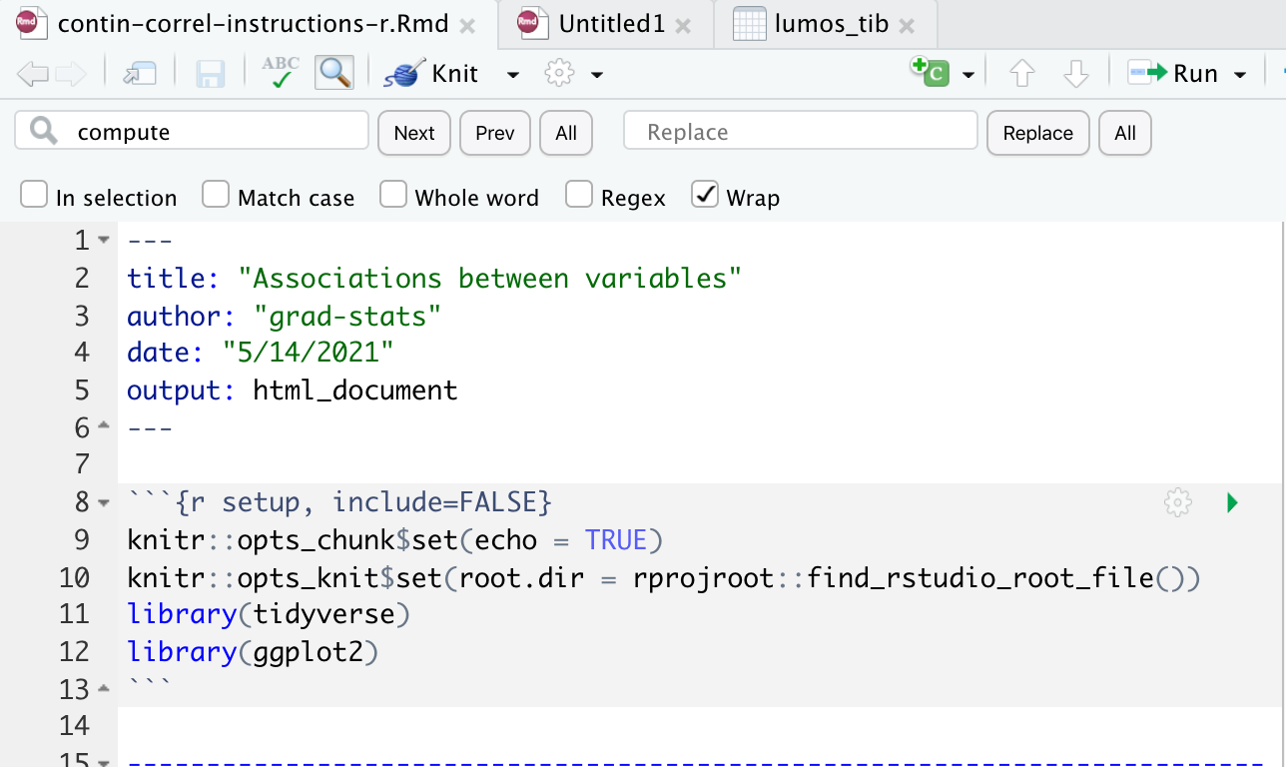
How to start an R markdown
File->New File->Rmarkdown
then Edit the setup code chunk and Save in your “r_docs” sub-folder
use this file for all your notes, code, and visuals
run your code chunks in order!
knitr::opts_knit$set(root.dir = rprojroot::find_rstudio_root_file())
This line sets the root directory in your project environment to be the R project folder. This way, you can write paths starting from the project folder.
Alternatively, you can
specify paths from the folder where your Rmd is stored.
use the here::here() function

Slide 15
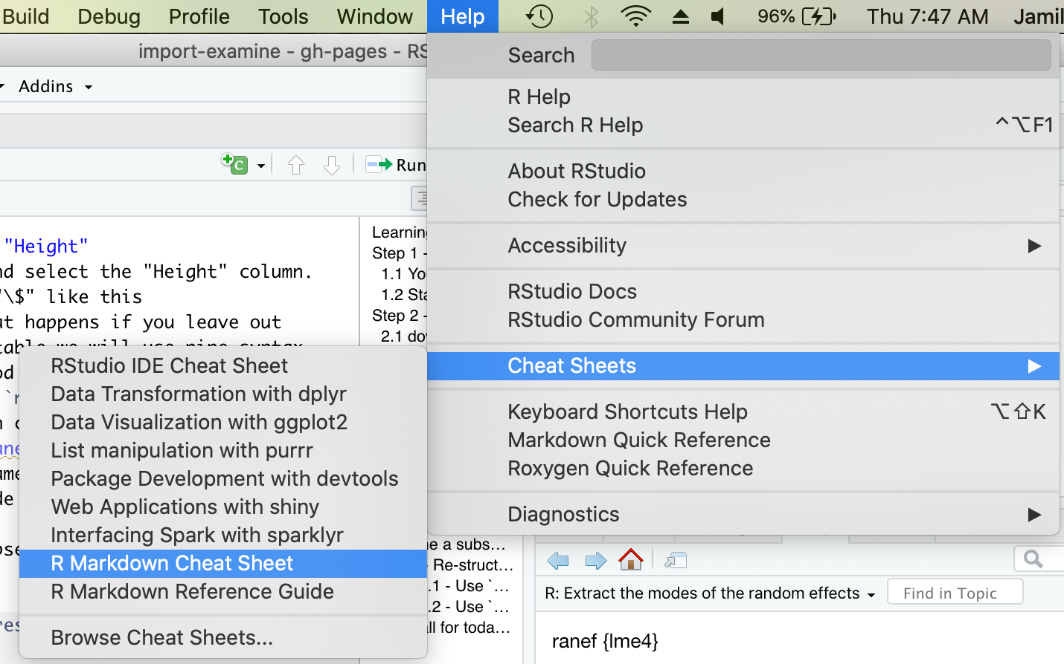
Why use R markdown?
Alternatives:
typing code directly in the Console
good for testing/exploring/learning
no documentation of your work, no
sharing
R script
good for documenting & sharing your
work
visualizations are contained outside of
the script
R Markdown
good for documentation, sharing
visualizations can be incorporated with your code and notes
extras: can include & execute code in other languages (e.g. python), lot’s of options to control your output (html, slides, interactive pages, …) – see https://rmarkdown.rstudio.com/lesson-1.html

