Slide 1
GLM 5: mixed designs
Prof. Andy Field

Slide 2
Aims
What is a mixed design?
Analyzing mixed designs using IBM SPSS Statistics
Interpretation
Main effects
Interactions

Slide 3
A speed-dating example
Dating strategies:
If someone is committed to pursuing a relationship with a person who plays hard to get, they will find that person more desirable but less likeable (Dai, Dong, and Jia, 2014)
Field (2017) fictitious study to look at the interplay between looks, personality and dating strategies on evaluations of a date
Design
IV 1 (attractiveness): Attractive, Average, Ugly
IV 2 (charisma): High Charisma, Some Charisma, Dullard
IV 3 (strategy): normal or playing hard to get
Outcome: P’s rating of the date
100% = ‘I’d pay a large sum of money for their phone number’
0% = ‘I’d pay a large sum of money for a plane ticket to get me as far away from them as possible’

Slide 4
Charisma | High Charisma |  |  | Some Charisma |  |  | Dullard
Looks | Attractive | Average | Unattractive | Attractive | Average | Unattractive | Attractive | Average | Unattractive
Strategy
Hard to get | 86 | 84 | 67 | 88 | 69 | 50 | 97 | 48 | 47
 | 91 | 83 | 53 | 83 | 74 | 48 | 86 | 50 | 46
 | 89 | 88 | 48 | 99 | 70 | 48 | 90 | 45 | 48
 | 89 | 69 | 58 | 86 | 77 | 40 | 87 | 47 | 53
 | 80 | 81 | 57 | 88 | 71 | 50 | 82 | 50 | 45
 | 80 | 84 | 51 | 96 | 63 | 42 | 92 | 48 | 43
 | 89 | 85 | 61 | 87 | 79 | 44 | 86 | 50 | 45
 | 100 | 94 | 56 | 86 | 71 | 54 | 84 | 54 | 47
 | 90 | 74 | 54 | 92 | 71 | 58 | 78 | 38 | 45
 | 89 | 86 | 63 | 80 | 73 | 49 | 91 | 48 | 39
Normal | 89 | 91 | 93 | 88 | 65 | 54 | 55 | 48 | 52
 | 84 | 90 | 85 | 95 | 70 | 60 | 50 | 44 | 45
 | 99 | 100 | 89 | 80 | 79 | 53 | 51 | 48 | 44
 | 86 | 89 | 83 | 86 | 74 | 58 | 52 | 48 | 47
 | 89 | 87 | 80 | 83 | 74 | 43 | 58 | 50 | 48
 | 80 | 81 | 79 | 86 | 59 | 47 | 51 | 47 | 40
 | 82 | 92 | 85 | 81 | 66 | 47 | 50 | 45 | 47
 | 97 | 69 | 87 | 95 | 72 | 51 | 45 | 48 | 46
 | 95 | 92 | 90 | 98 | 64 | 53 | 54 | 53 | 45
 | 95 | 93 | 96 | 79 | 66 | 46 | 52 | 39 | 47

Slide 5
Mixed designs: process

Slide 6
Effects
Main effects
We will get an F-ratio for the main effect of each independent variable:
Attractiveness
Charisma
Strategy
Two-way interactions
We will get F-ratios for all possible interactions between pairs of variables:
Attractiveness × Charisma
Attractiveness × Strategy
Charisma × Strategy
Three-way Interaction
We will get an F-ratio for the interaction between all three variables
Attractiveness × Charisma × Strategy

Slide 7
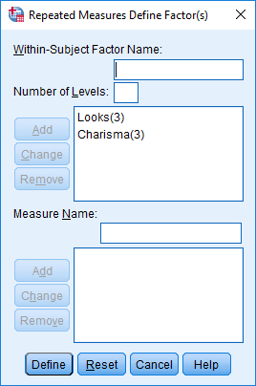
Define the repeated-measures variables

Slide 8
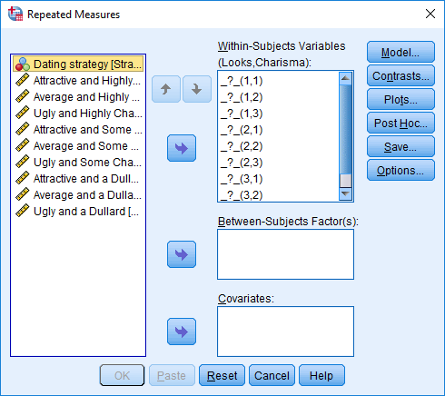
Define levels of the repeated-measures variables

Slide 9
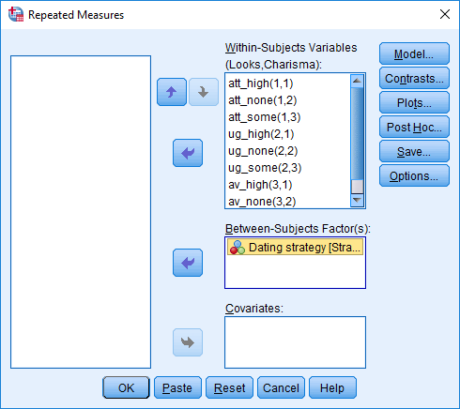
Define levels of the repeated-measures variables and select the between-group variable

Slide 10
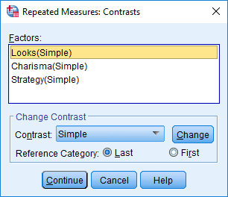
Define Contrasts

Slide 11
Define interaction graphs

Slide 12
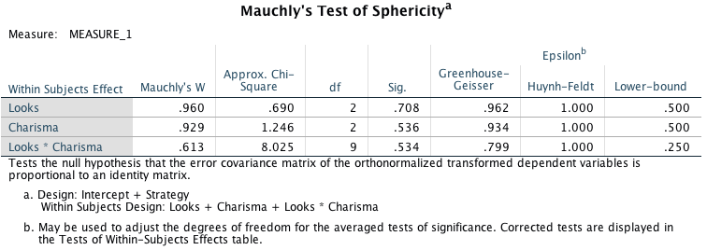
Output: sphericity

Slide 13
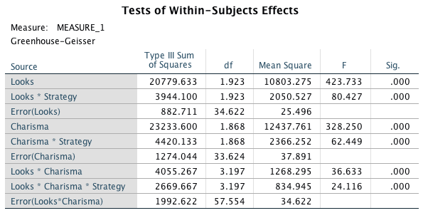
Repeated-measures effects
Notes:
Note that I’ve collapsed the table across sphericity corrections so that you can actually read it

Slide 14
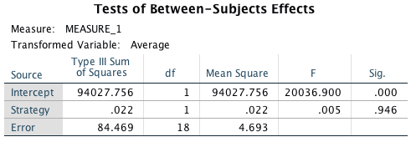
Between-subjects effect

Slide 15
Main effect of strategy

Slide 16
Main effect of looks

Slide 17
Main effect of charisma

Slide 18
The strategy × looks interaction

Slide 19
The strategy× charisma interaction

Slide 20
The looks × charisma interaction

Slide 21
The strategy × looks × charisma interaction

Slide 22
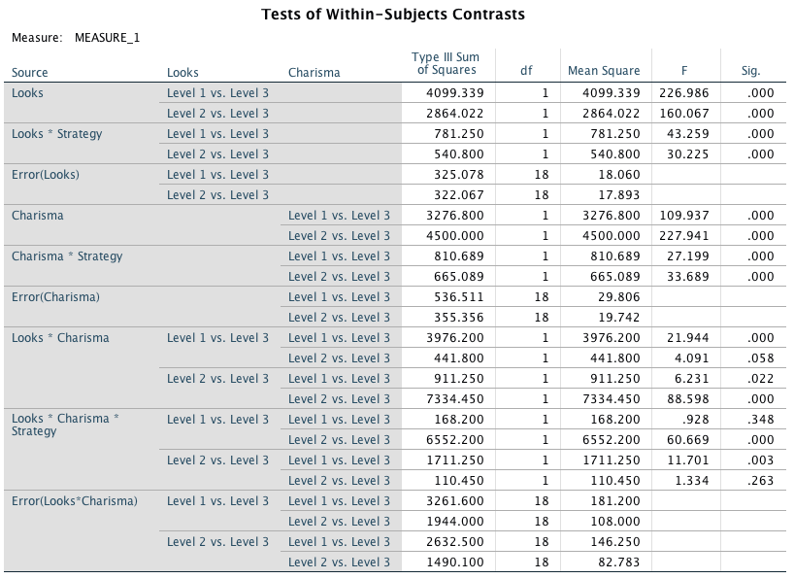
Breaking down the interaction

