Slide 1
Building Safe & Resource Efficient NN through architectural collapse
J. Gafur
Feb 2026

Slide 2
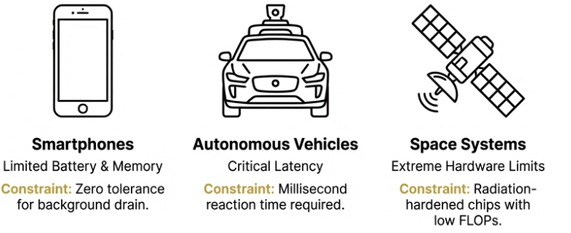
The Big Picture
Modern neural networks succeed, and fail, for the same reason
Massively Overparameterized
Redundant Structures
High Resource Utilization
These are issue for deploying models on resource constrained devices.
Logarithmic scale used for both axes.
Notes:
We are utilizing neural networks more than ever and the very thing that makes them great is what is causing issues – at the end of the day everything is a resource constrained device,

Slide 3
One Problem, Four Parts
How safe and deployable are resource efficient neural networks?
What happens to the network after pruning?
Deployable Security
Network Efficiency
Architectural Optimization
Future Work
Understanding deployed model vulnerability.
Can we change the structure of a network for better resource efficiency?

Slide 4
Deployable Security
Networks undergo resource optimization during deployment; deployed models are susceptible to attacks.
These optimizations focus on reducing the resource utilization of the network.
Understand how common protection techniques affect transfer attacks based on network size.

Slide 5
Deployable Security
Manifold Hypothesis
Different models trained on similar data learn similar decision boundaries, even if their architectures differ.

Slide 6
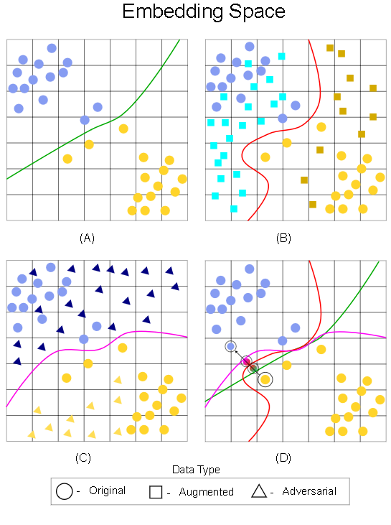
Deployable Security
Manifold Hypothesis
Different models trained on similar data learn similar decision boundaries, even if their architectures differ.

Slide 7
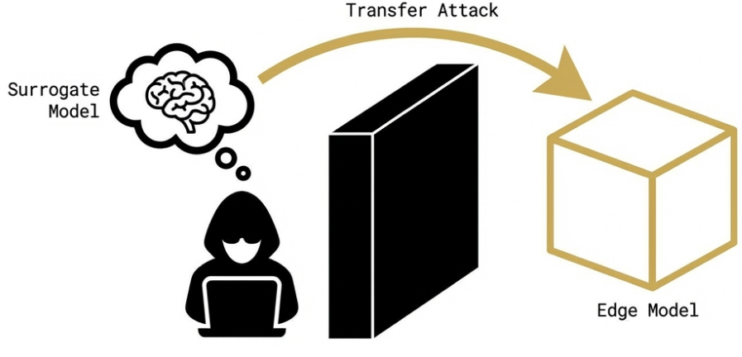
Deployable Security
Transfer attacks: The process of generating adversarial attacks on a surrogate that attacks a target model.

Slide 8
Deployable Security
Transfer attacks: The process of generating adversarial attacks on a surrogate that attacks a target model.
You can traverse the input space (black box approach)
You can traverse the embedding space (white box approach)

Slide 9




Deployable Security
Train a set of surrogate
model with varying resource utilization and security
Generated attacks specific to a surrogate model
Analyzed how easy it was to attack these networks
Tested the transferability of these attacks to all other models in the set

Slide 10

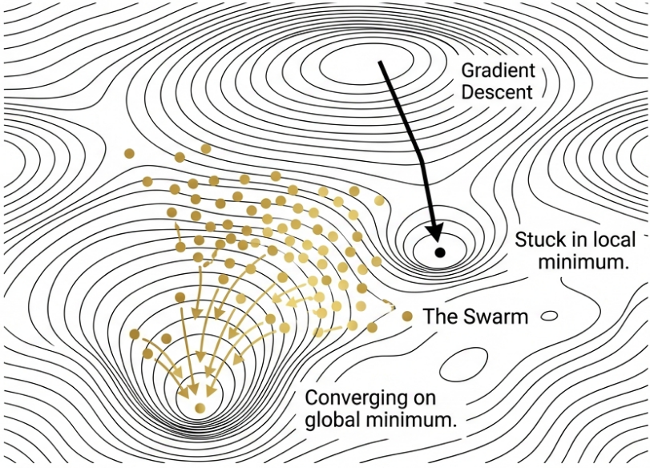
Deployable Security
Gafur et al.
2024
Adversarial Particle Swarm Optimization (APSO)
Derivative-Free: Does not rely on gradients
Population-Based: A swarm of particle explore the input space simultaneously
Social Intelligence: Particles communicate to find global weakness, not just local artifacts

Slide 11
Deployable Security
Gafur et al.
2024
Adversarial Particle Swarm Optimization (APSO)
Infinitely generated adversarial inputs with high misclassification rate

Slide 12
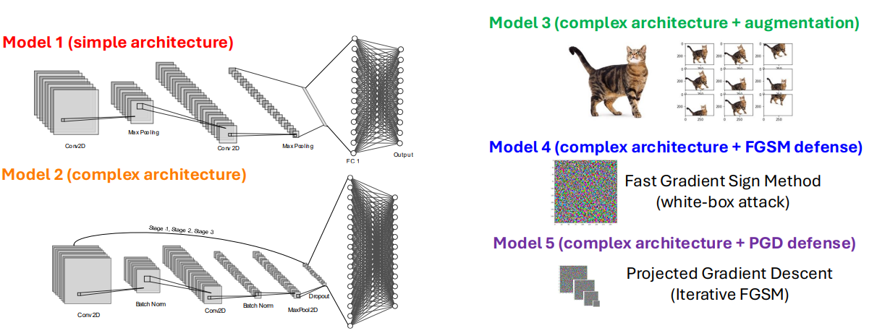
Deployable Security
Network hardening is the process of training a network with adversarial data to increase its robustness.

Slide 13
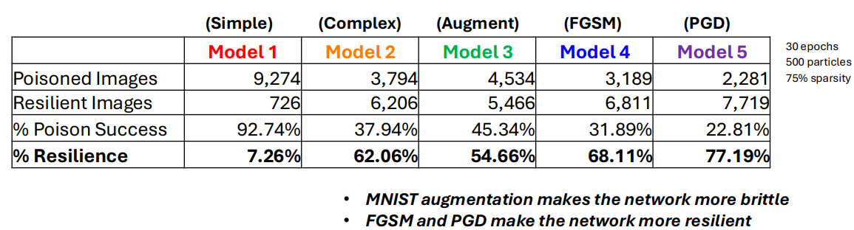
Individual model adversarial attacks
Given a single pass of APSO on a trained network, how many images are successfully poisoned to a target label?

Slide 14
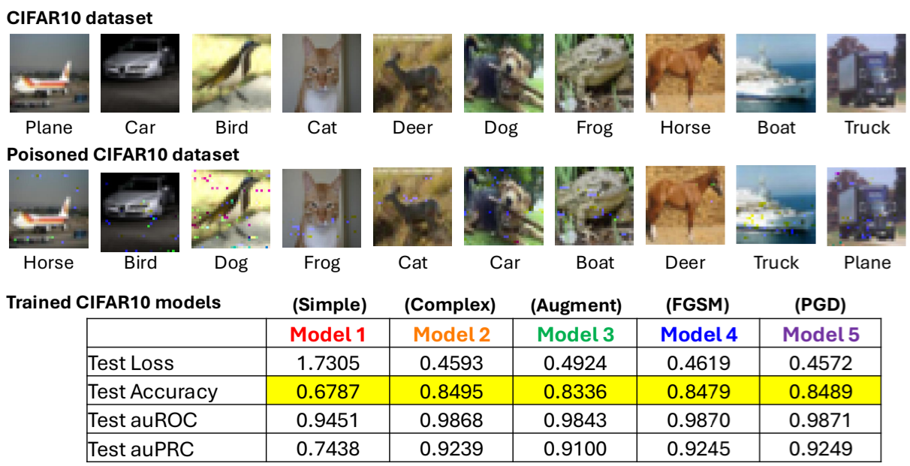
Increased Data Complexity

Slide 15
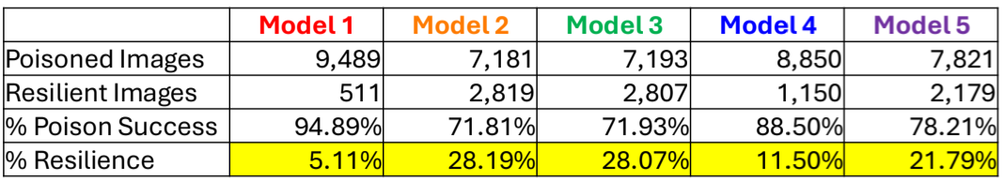
Increased Data Complexity
Simple models are easy to attack
Hardening can increase brittleness
Accuracy ≠ resilience

Slide 16
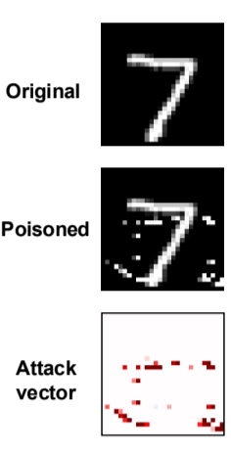
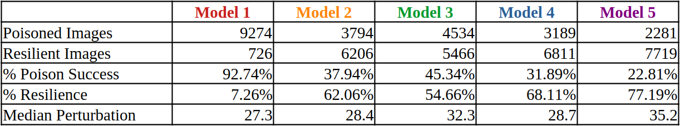
Individual model adversarial attacks
Resilience does not necessarily correlate with amount of perturbation required

Slide 17
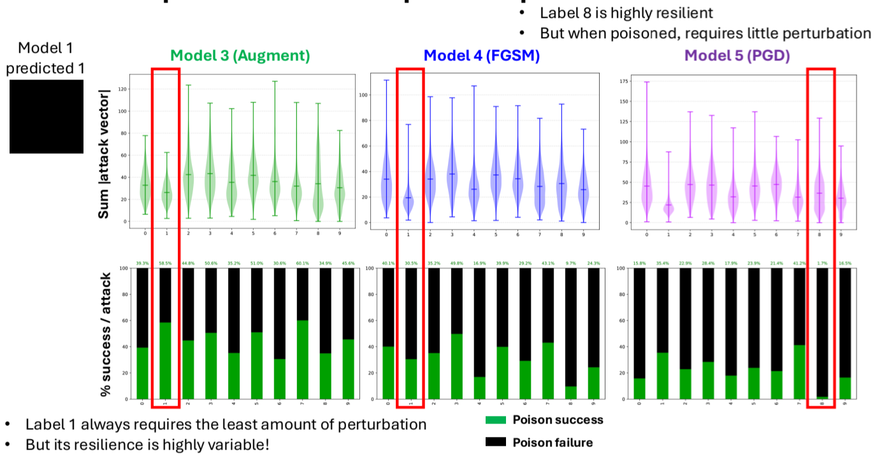
Individual model adversarial attacks
Small perturbation ≠ weakest resistance
Reliance, performance, and perturbation are not correlated

Slide 18
How much perturbation is required to poison a true label?
Label 8 demonstrates strong resilience at moderate perturbation levels.
"The route to poisoning is not always linear, sometimes it is distant and straightforward, other times nearby but requiring a more intricate path."

Slide 19
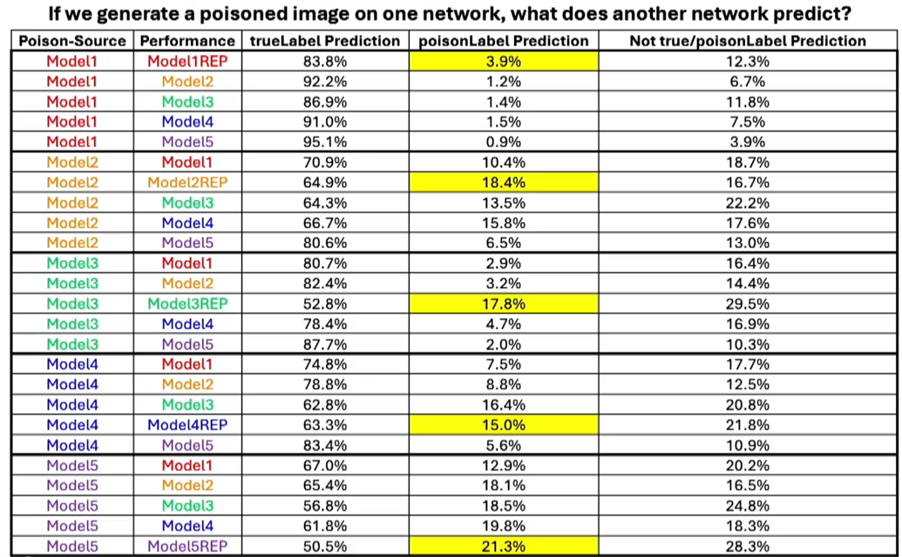

Slide 20
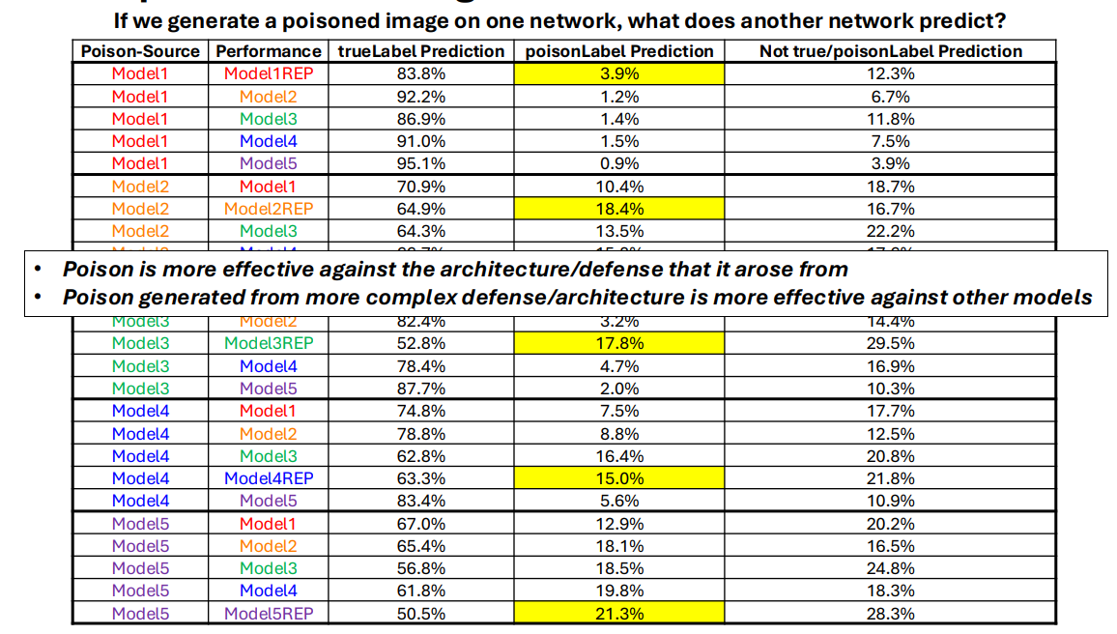
How well does targeted poison transfer?

Slide 21
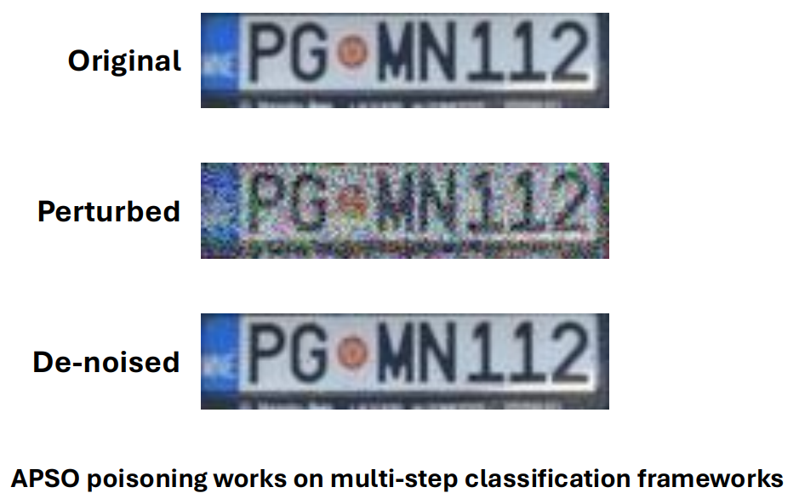
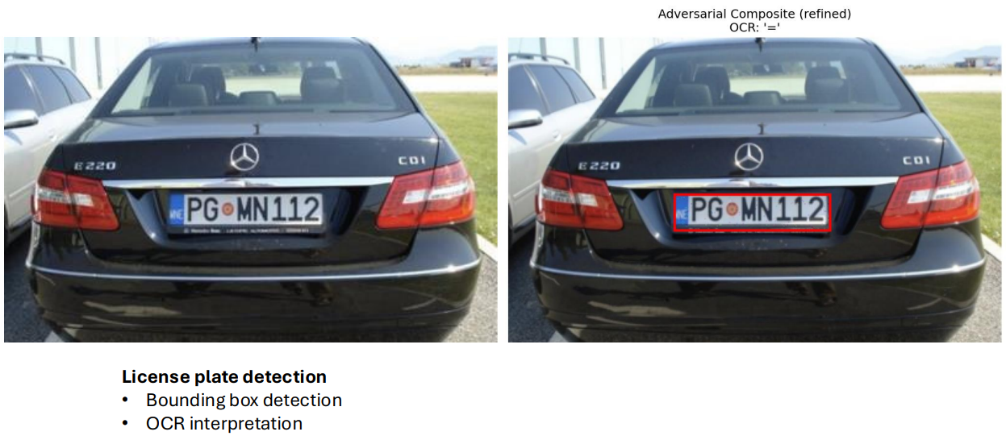
Real world applications of untargeted attack

Slide 22
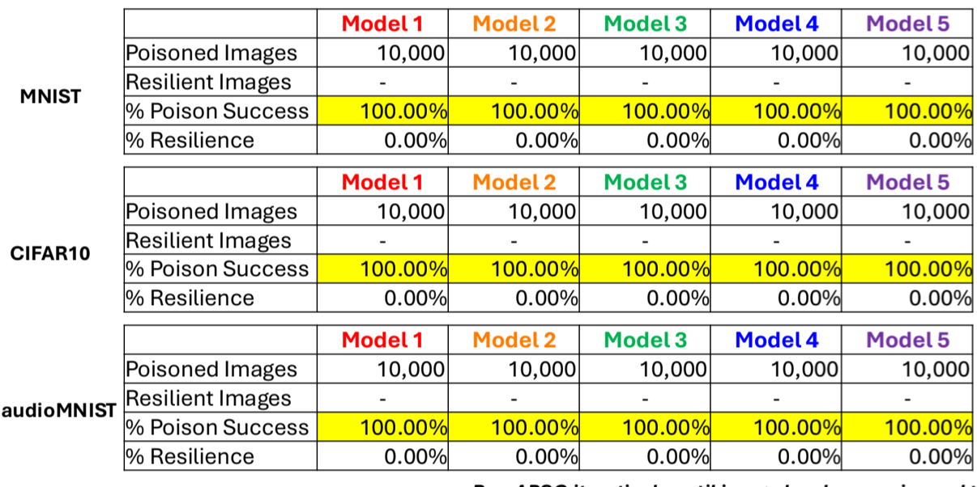
What about untargeted attacks?
APSO is a stochastic process runs until image has been poisoned

Slide 23
One Problem, Four Parts
How safe and deployable are resource efficient neural networks?
What happens to the network after pruning?
Deployable Security
Network Efficiency
Architectural Optimization
Future Work
Understanding deployed model vulnerability.
Can we change the structure of a network for better resource efficiency?

Slide 24
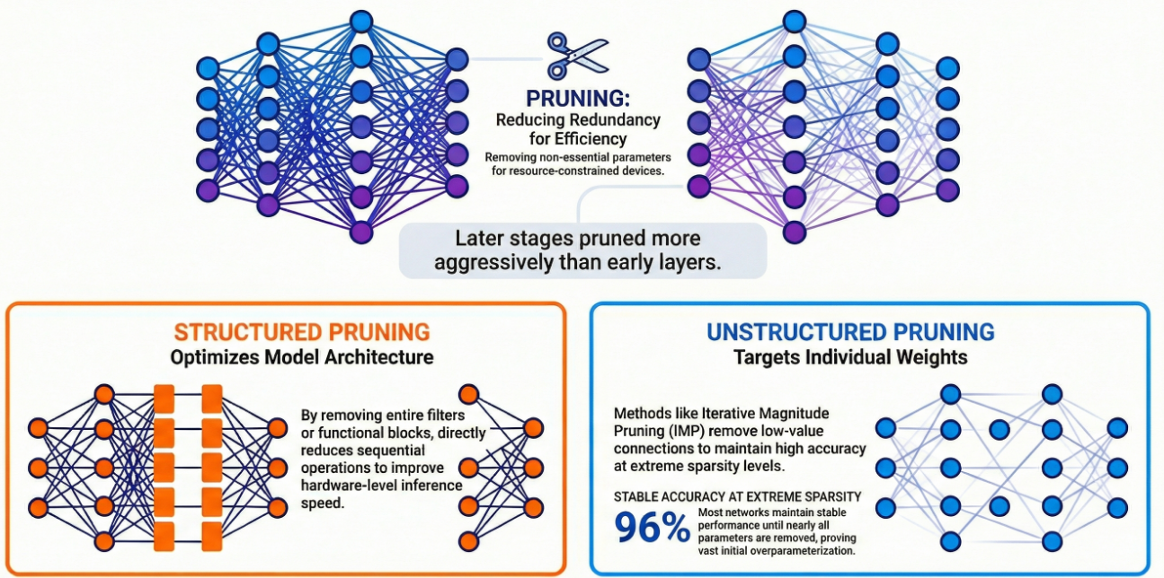


Network Efficiency
What happens to the network after pruning?
Investigation
Resource Optimization

Slide 25
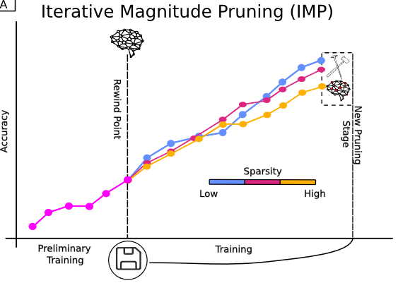
Unstructured pruning with IMP
Train the network
Saves the weights
Continues training
Removes unneeded weights
Reset remaining weights to (2)
Notes:
SUP: model vs NN

Slide 26
Related Works
How do we make these models' resource efficient?
Neural Network Pruning & Sparse Matrix representation
Initial lit review showed a speed up after 60% sparsity, we did not see it.
Need for specialized kernel calls on specialized hardware
Where is the sparsity occurring?​
What was happening inside these pruned models. ​
Notes:
SUP: explain sparse ; new question:

Slide 27
Related Works
Large networks are expensive in compute, memory, and energy.
Pruning creates a highly sparse representation of a model that theoretically can be more resource efficient.
These sparse models are not smaller.
The weights are just set to zero
Notes:
SUP: Sparse matrix representation

Slide 28
What happens to the network after pruning?

Slide 29
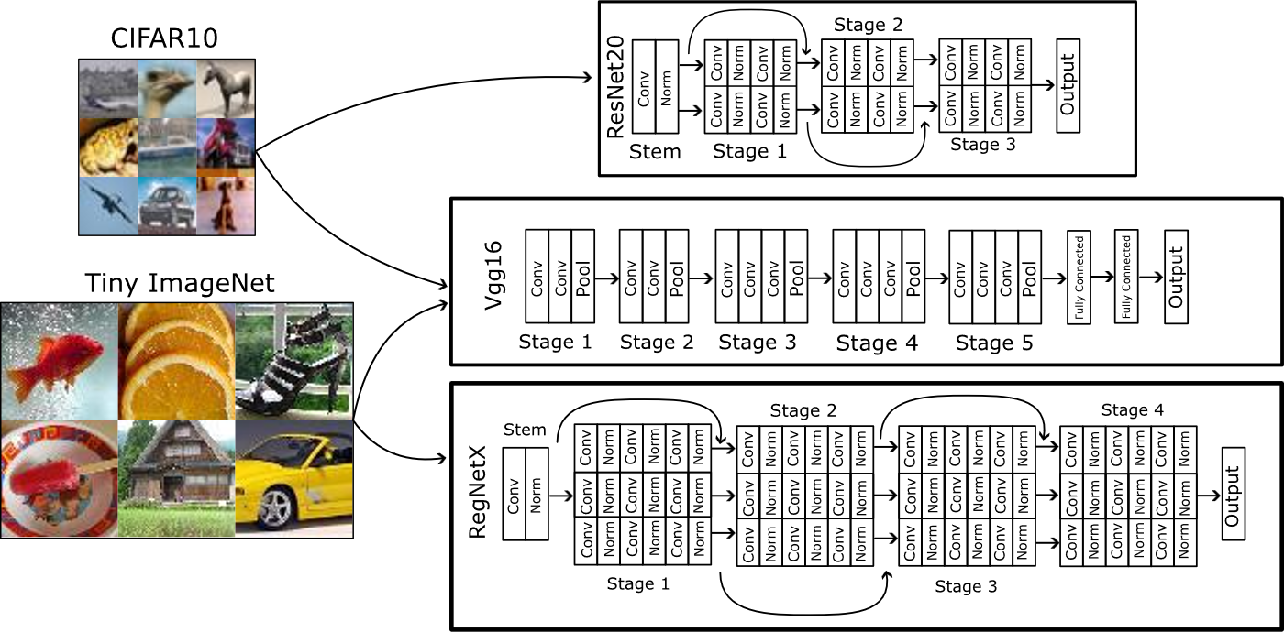
Models/Datasets
Notes:
Stages show similar groupings

Slide 30
Preferential Pruning of Deep Layers
Later stages are pruned more than early stages.
This pattern emerges early in the unstructured pruning process.
Notes:
Add annotation

Slide 31
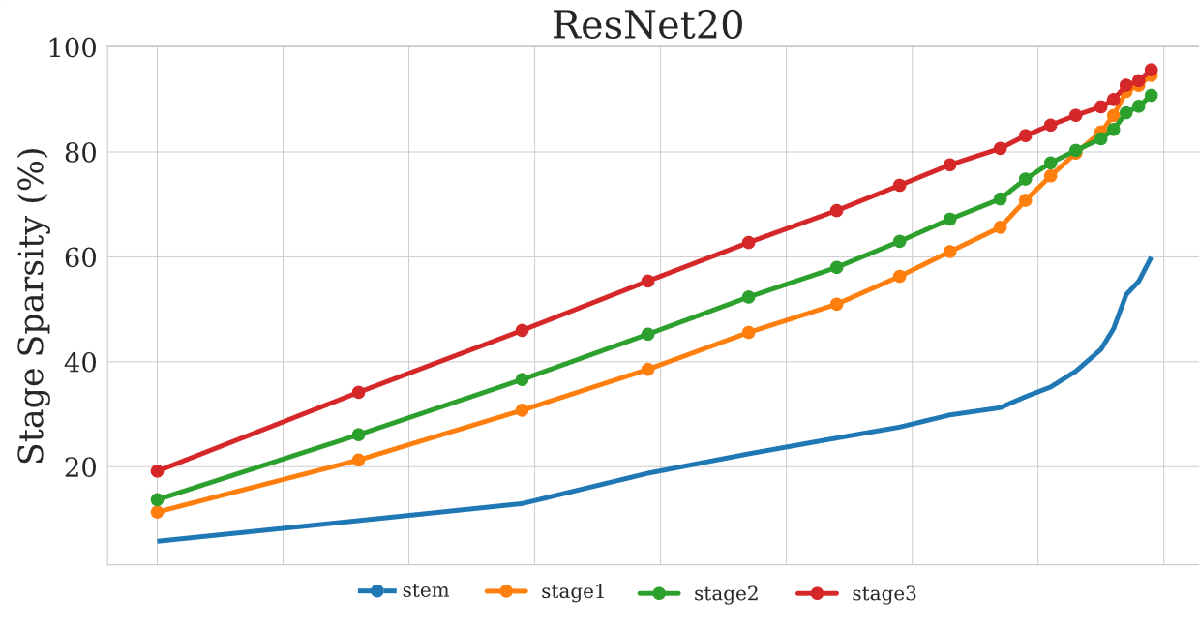
Preferential Pruning of Deep Layers
Later stages are pruned more than early stages.
This pattern emerges early in the unstructured pruning process.
Less Network Sparse
More Network Sparse
Notes:
Add annotation

Slide 32
Persistence of Sparse Neurons
Even at high sparsity's there are NO Neurons that are completely removed.
The remaining weights in a neuron undergo larger gradient updates, decreasing the probability of their future removal

Slide 33
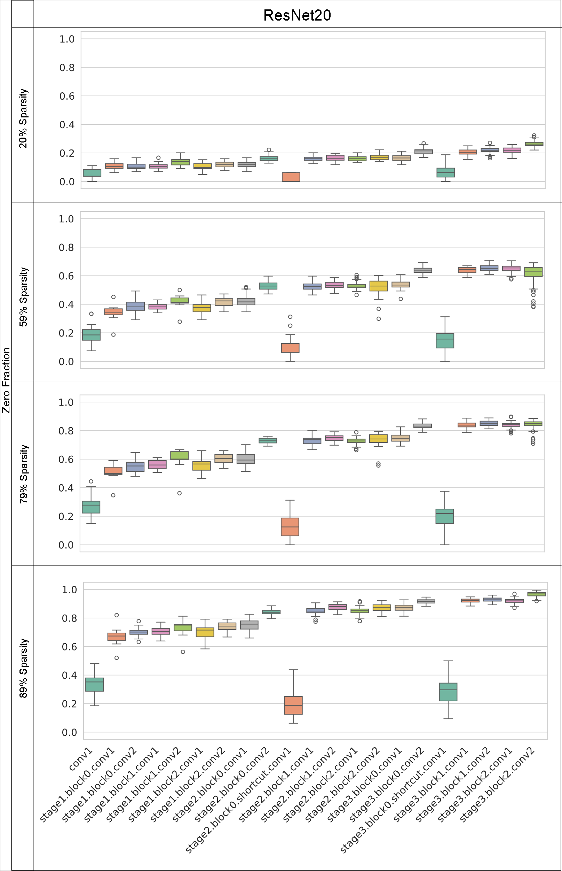
Persistence of Sparse Neurons
ResNet20 Cifar10
There are NO neurons that are completely removed.
The remaining weights have larger gradients.
More sparse
Less sparse
Earlier
Deeper

Slide 34
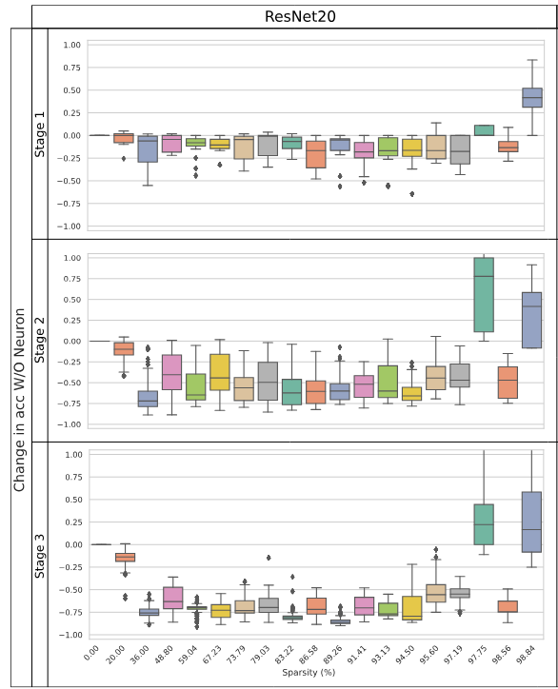
Stable Neuron-Level Sensitivity
Neuron Zeroing: Ablation study of each neuron for change in accuracy.
As stages/neurons get sparser – their impact grows.

Slide 35
Preservation of Feature Representations

Slide 36
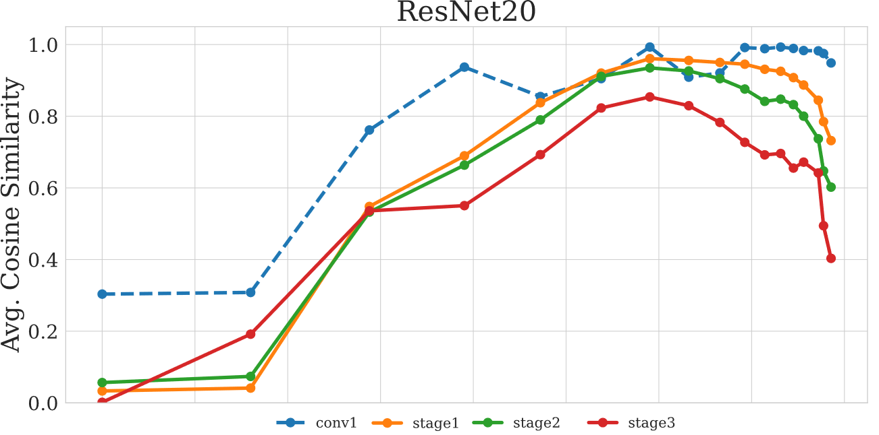
Preservation of Feature Representations
High
similarity
Low
similarity
Low sparsity
High sparsity

Slide 37
What internal changes occur when networks are pruned?
How does unstructured pruning redistribute weights across layers/neurons?
Deeper layers get pruned more.
Do neurons get effectively removed?
No, there always exists some small weights.
How important are the remaining neurons?
Increase in importance as you go deeper into the network.
How stable are activations and representations under pruning?
Front layers have the highest feature similarity.

Slide 38
What happens to the network after pruning?
IMP creates a surprising amount of internal structure
Preferential pruning of deep layers, preservation of feature representations.
We can reach around 97% sparsity without drop in accuracy, but it is difficult to take advantage of the sparsity
Under review to the Journal of Applied Intelligence
This work was authored by the National Renewable Energy Laboratory for the U.S. Department of Energy (DOE) under Contract No. DE-AC36-08GO28308.

Slide 39
One Problem, Four Parts
How safe and deployable are resource efficient neural networks?
What happens to the network after pruning?
Deployable Security
Network Efficiency
Architectural Optimization
Future Work
Understanding deployed model vulnerability.
Can we change the structure of a network for better resource efficiency?

Slide 40
"Blind" Pruning vs. Structural Insight
Can we identify entire architectural blocks that are functionally redundant using only cheap, zero-shot diagnostics?

Slide 41
Zero-Shot Heuristic Profiling
We need to find an optimal way to identify sections of the network to remove
The Diagnostic Tool:
Activation Variance & Depth: Measures the dynamic range of a layer. Low variance indicates "dead" or static features. High variance indicates important features.
Preserve the feature manifold and gradient flow while removing the computational cost of spatial filtering and non-linearities.
Notes:
SUP: explain sparse ; new question:

Slide 42
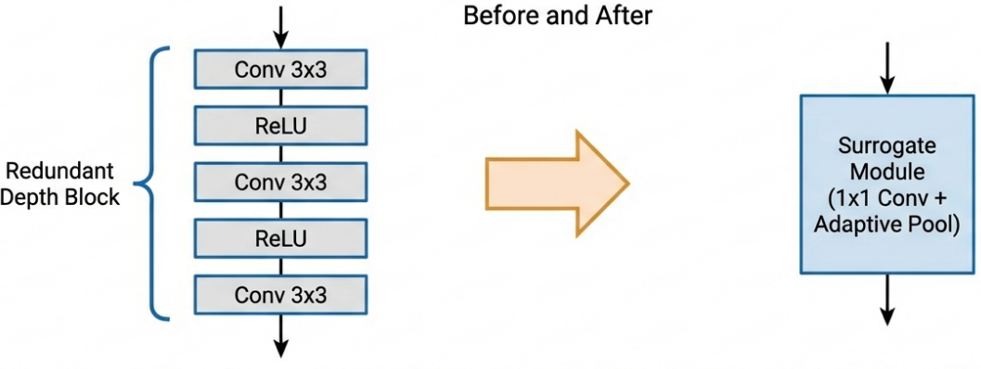
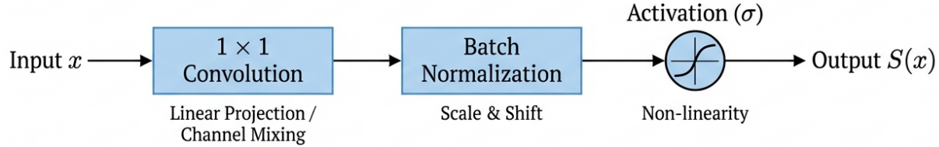
Layer-by-Layer Collapse
Given a subset of adjacent layers, we collapse them into a 1x1 convolution projection feature space without changing spatial resolution, halting unnecessary expansion.

Slide 43
Preliminary Results

Slide 44
Activation Variance Heuristic
Zero-shot diagnostic:
Predicts “crash sites”
No training, no gradients
Acts like an EKG of network health
Signal interpretation:
High variance → critical feature extraction → do not prune
Low variance → dead / static features → safe to collapse

Slide 45
Legacy Architectures

Slide 46
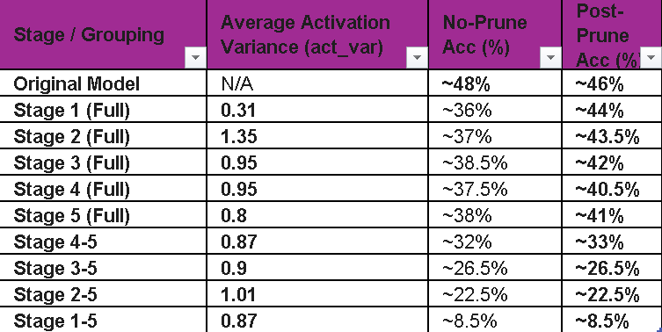
VGG-16

Slide 47
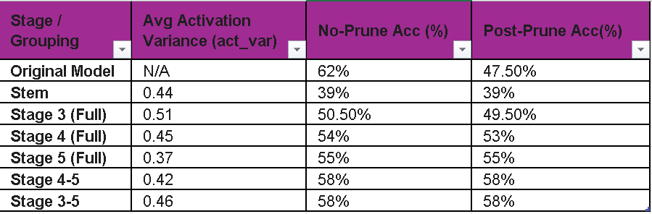
InceptionNet

Slide 48
Legacy Architectures
Both architectures exhibit significant structural slack in the final convolutional layers
In both models, stages with the lowest average activation variance consistently proved safe or beneficial to prune

Slide 49
Resource Efficient Networks

Slide 50
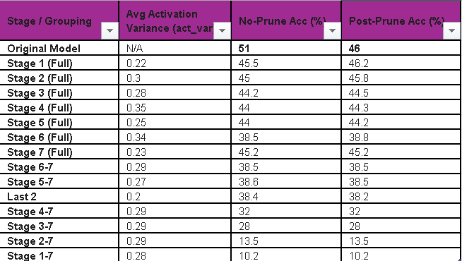
MobileNet

Slide 51
MobileNet

Slide 52
Key take aways
MobileNet's variance is remarkably consistent and low, hovering between 0.20 and 0.35 across the board.
There is no single stage where pruning causes a disproportionate drop. Accuracy remains stable (~44–46%) for all single-stage pruning experiments.

Slide 53
One Problem, Four Parts
How safe and deployable are resource efficient neural networks?
What happens to the network after pruning?
Deployable Security
Network Efficiency
Architectural Optimization
Future Work
Understanding deployed model vulnerability.
Can we change the structure of a network for better resource efficiency?

Slide 54
Where are we?
Poison is more effective against architecture that it arose from
Poison generated from more complex defenses/architecture are more effective
Network pruning targets later layers but needs specialized hardware
You can optimize the network by utilizing LBL and Activation Variance

Slide 55
How Safe and Deployable are Resource Efficient Neural Network?
To be Continued…

Slide 56







Acknowledgements
Coauthors:
Collaborators:
UI/Goddard Lab
Cornell U./ EpiGenomics Core Lai Lab
Cornell U./Pugh Lab
Dr. Steve Goddard
Dr. William Lai
Dr. Olivia Lang
Justin Cha
Amy Lyndaker
Devin Mellini
Catie Smugereski
Dr. Ruihao Li
Zimo Zhu
Kritika Grover
NREL
Dr. Kevin Griffin
Dr. Nicholas Wimer
Penn State ICDS
UI/Adv. Drug and Gene Delivery Lab
Zazzle
Gretta Kellogg
Esraa Mohamed
Dr. Charles Tripp
Vanderbilt U.
Special Thanks/LANL
Patrick Diehl
Philipp Edelmann
Hailey Marie Lloyd
Max Milkert

Slide 57
Thank You

