Slide 1
Clarity Insights Data Science Challenge: Zoo Animal Classification
Jaime A. Millan
11/09/17

Slide 2
Challenge Description
Given an the these traits, predict to which animal class type this animal belongs to:
✓
Hair
Milk
LEGS = 4
✓
To which animal class it belongs to?
Mammal? Bird? …
✓
Toothed
Backbone
✓
*Task : Develop a classification algorithm

Slide 3
Dataset Overview
Dataset consists of 101 animals from a zoo.
There are 16 features (hair, feathers, eggs, milk, airborne, aquatic, predator, toothed, backboned, breathes, venomous, fins, legs, tail, domestic, catsize).
There are 7 animal class types: Mammal, Bird, Reptile, Fish, Amphibian, Bug and Invertebrate.
The task is to be able to predict the classification animals with the aid of a machine learning algorithm.

Slide 4
Data Cleaning/Description
Dataset is quite clean (No entries missing!)
Al features are boolean
Analysis perfomed (info() and describe())
In [280]: data. info()
<class 'pandas.core.frame.DataFrame'>
Int64Index: 101 entries, 0 to 100
Data columns (total 18 columns):
animal name 101 non-null object
hair 101 non-null int64
feathers 101 non-null int64
eggs 101 non-null int64
milk 101 non-null int64
airborne 101 non-null int64
aquatic 101 non-null int64
predator 101 non-null int64
memory usage: 15.0+ KB
0.1
In [281]: data. describe()
Out[281]: hair feathers eggs milk airborne aquatic n
count 101.000000 101.000000 101.000000 101.000000 101.000000 101.000000
mean 0.425743 0.198020 0.584158 0.405941 0.237624 0.356436
std 0.496921 0.400495 0.495325 0.493522 0.427750 0.481335
min 0.000000 0.000000 0.000000 0.000000 0.000000 0.000000
25% 0.000000 0.000000 0.000000 0.000000 0.000000 0.000000
50% 0.000000 0.000000 1.000000 0.000000 0.000000 0.000000
75% 1.000000 0.000000 1.000000 1.000000 0.000000 1.000000
max 1.000000 1.000000 1.000000 1.000000 1.000000 1.000000

Slide 5
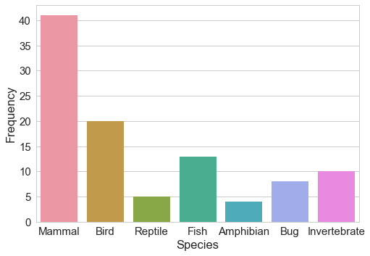
Animal Class Distribution
* Sample is small and some animal classes might be undersampled, thus so careful model selection/tuning and cross validation is needed

Slide 6
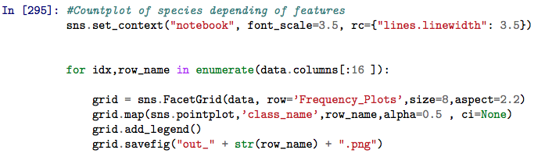
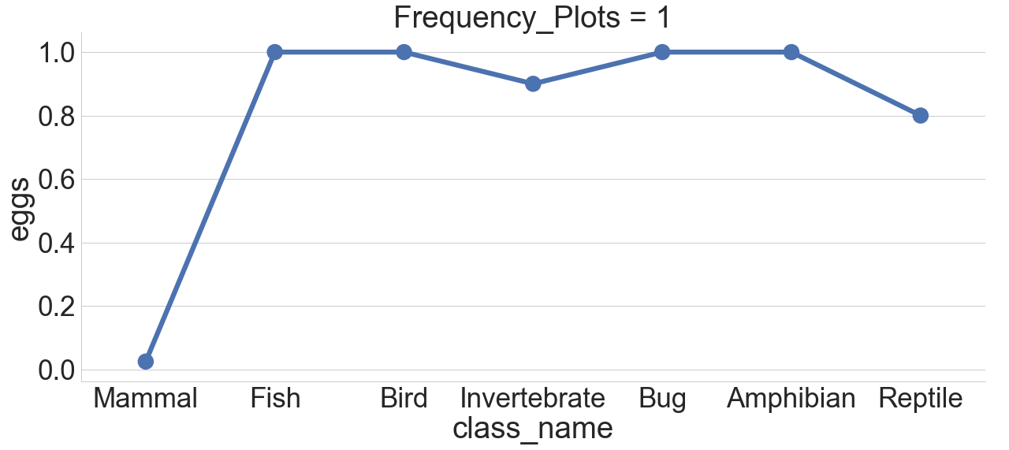
Feathers Mean Value Distributions

Slide 7
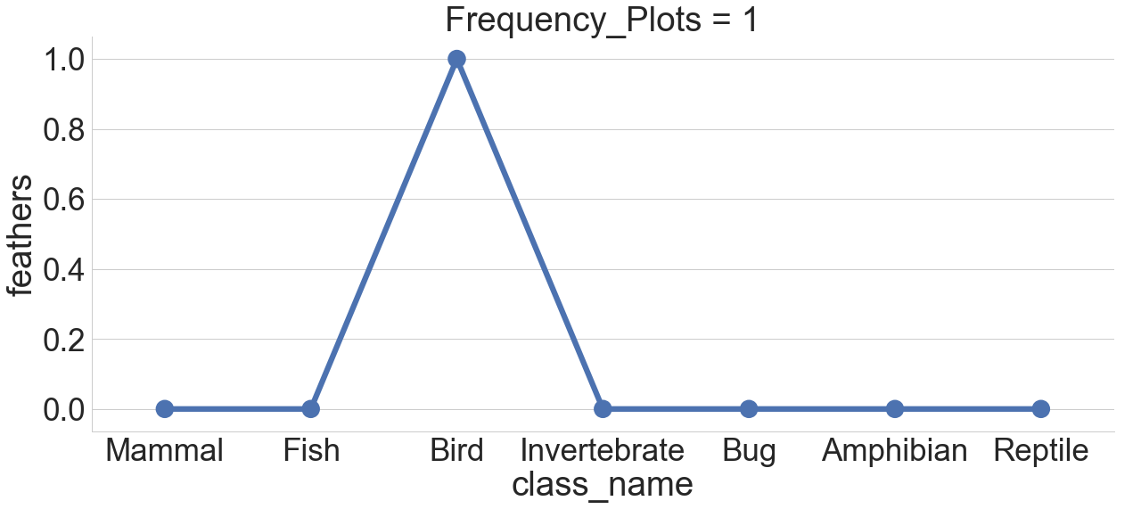
‘Feathers’ Feature Mean Value Distributions

Slide 8
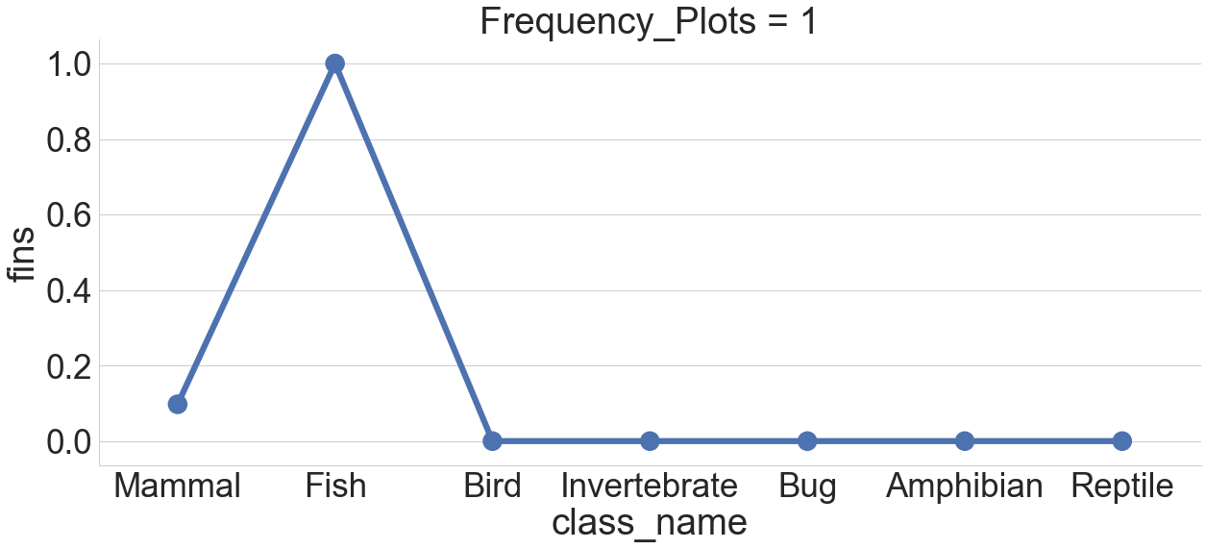
Fins Feature Mean Value Distributions
Anomalies! Get rid of them!

Slide 9
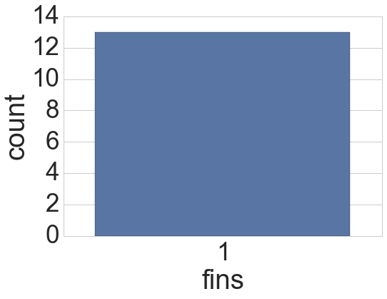
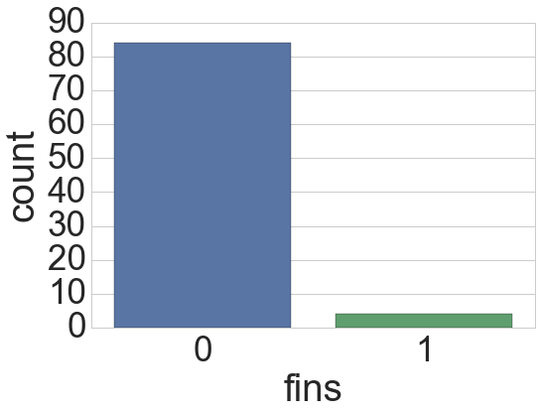
Importance of Fins trait
Fish
Non-Fish
*This feature could be importance in one-vs-Rest (p_value =4.86e-15)

Slide 10
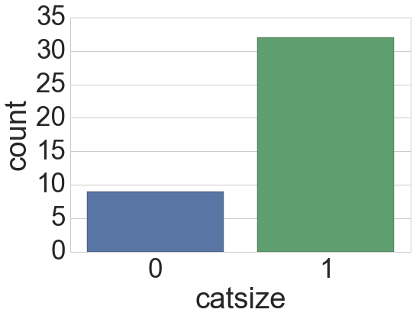
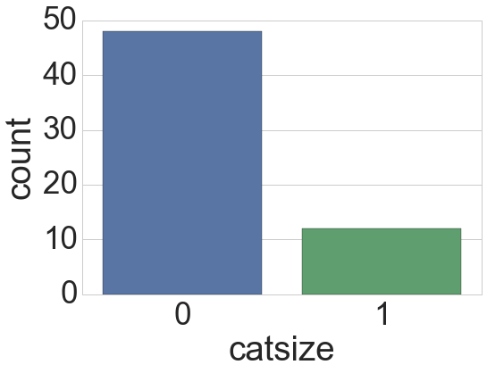
Importance of “Catsize” trait
Mammal
Non-Mammal
*This feature could be importance in one-vs-Rest (p_value =1.49e-5)

Slide 11
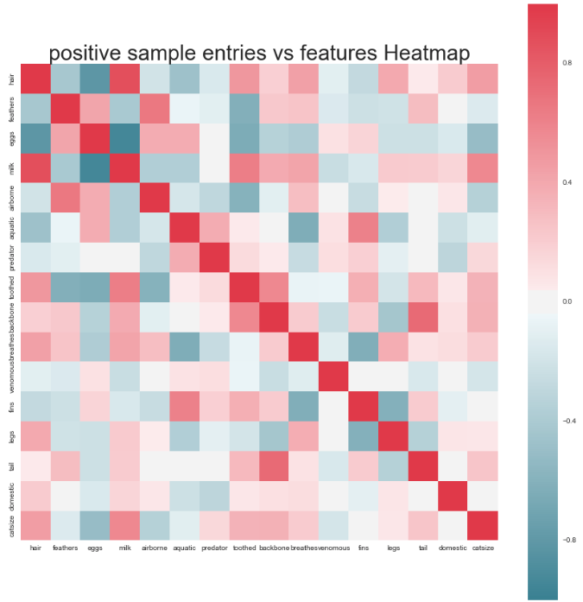
Feature Pearson Correlation
1.0
*Eggs-hair and Eggs-milk anti-correlate
*Milk-hair correlate
0.5
(P-values ~0)
0.0
-0.5
-1.0

Slide 12

Feature Importance: Chi-Square Test
Animal Class
Feature A = 1
Feature A = 0
Mammal | O_{i}=80 ( E_{i} = 50) | O_{i}=20 (E_{i}= 50) | 100
Bird | O_{i}= 20 (E_{i}= 50) | O_{i}= 80 (E_{i}= 50) | 100
Total | 100 | 100 | 200
= (80-50)² / 50 + …. = 72 , p-value =1.59e-15
(wikipedia.org)

Slide 13
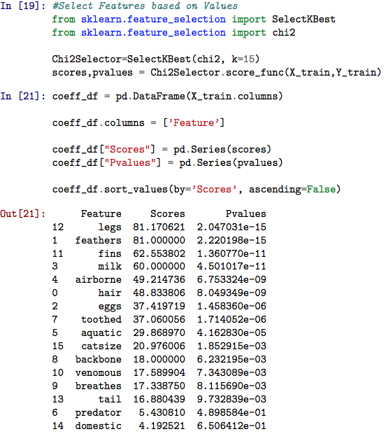

Slide 14
Principal Component Analysis (PCA)
PCA finds orthorgonal dimensions (eigenvectors of covariance matrix)
It ranks this dimensions by its variance (eigenvalues of covariance matrix)
y
z₁ (high variance)
x
Z₁ (high variance)

Slide 15
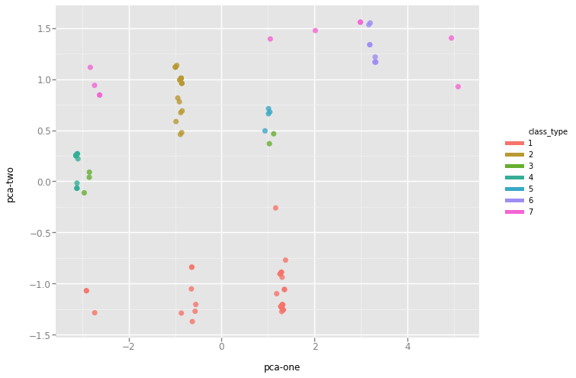
PCA 2D Plots
Animal Class
Mammal
Bird
Pca-two
Reptile
Fish
Amphibian
Bug
Invetebrate
Pca-one

Slide 16
Approach
Use all multi-class data or All V.S. One approach.
Check if PCA improves algorithm performance.
or transformation, respectively.
Use (stratified) k-fold cross-validation to test different models
Perform hyperdimensional tuning to find best estimators.
Multi-class
or
One-vs.-Rest
Cross-Validation
(k-fold)
Algorithm
Tuning
Select best Estimator
PCA

Slide 17
Model Selection
Given the small size of the data set, complex ensemble model could be easily trained (Random Forrest).
PCA Decomposition suggest that Cluster Models like K-Nearest-Neighbors could useful.
An accuracy score (Jaccard similarity score) is utilized to measure performance of model.

Slide 18
Decision Tree
Cons:
Feature 1
Weak Learner.
Tend to overfit. (High Variance
Sensitive to initial conditions.
Non-Convex problem (ID3 aproach)
Yes
No
Feature 2
Feature 4
Yes
No
Yes
Pros:
No
White Box.
Easy to understand. (Visualization)
No need of big samples for training.
Bird
Non-Bird
Bird
Non-Bird
*Gini Purity:
, J are the different
classes {Bird,Non-Bird}
Grus, Joel M. Data Science from Scratch. City:O’Reillly Media, Inc, 2015. Print.

Slide 19
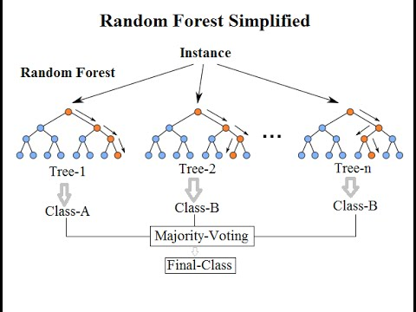
Random Forest
Ensemble approach
Where multiple Tree are Built.
Bagging Sampling.
Feature Bagging.
https://www.kdnuggets.com/2017/10/random-forests-explained.html

Slide 20
K-Nearest Neighbors (KNN)
Easy Model
All that is needed is a
metric and that points close
to each other are similar
?
K=3
K=5

Slide 21
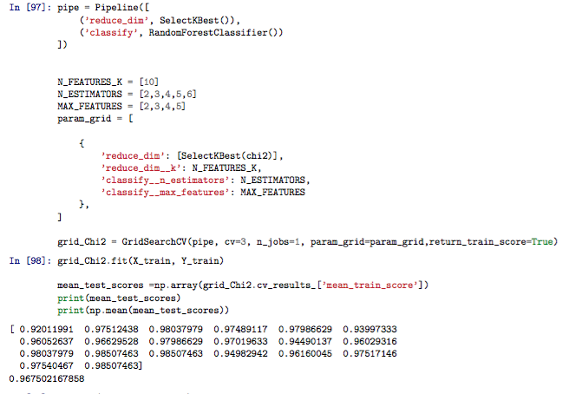
Sample Code (Pipeline)

Slide 22
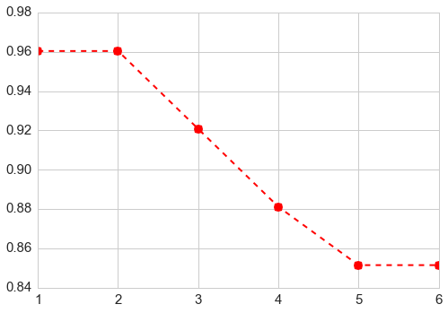
Multi-class Classification
Random Forest performs better KNN similarly with scores =0.98 and 0.96, respectively.
Accuracy vs. K Nearest Neighbors
Accuracy Score
K

Slide 23
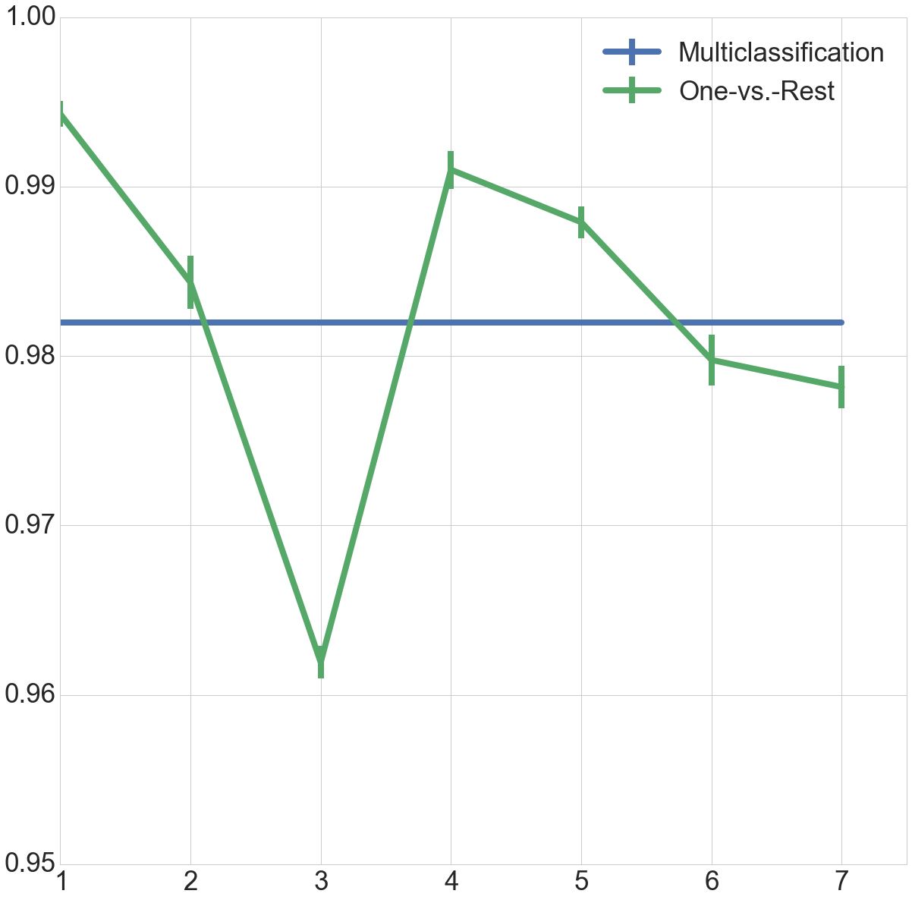
Multi-class Classification vs. One-vs. -Rest
Random Forest showed same performance as Random Forest clustering .
Accuracy per animal class type
Accuracy Score

Slide 24
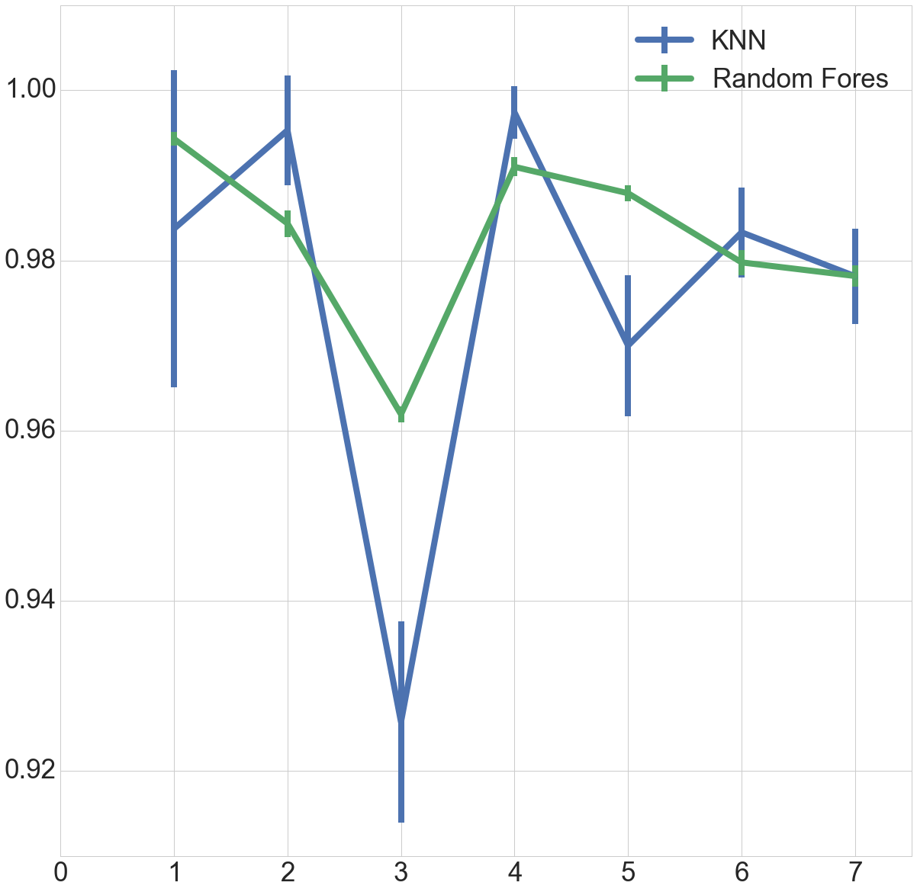
Random Forest vs KNN (One vs. Rest)
One vs. Rest strategy showed better results than multiclass-classification.
Accuracy per animal class type
Accuracy

Slide 25
Feature Importance (Random Forest)
Amphibian | Hair | Feather | Eggs
Invertebrate | Backbone | Legs | Breathes
Fish | Fins | Breathes | Legs
Bird | Feathers | Legs | Tail
Mammal | Eggs | Hair | Milk
Reptile | Aquatic | Feathers | Toothed
Bug | Legs | Backbone | Tail
(*extracted form feature_importances attribute)

Slide 26
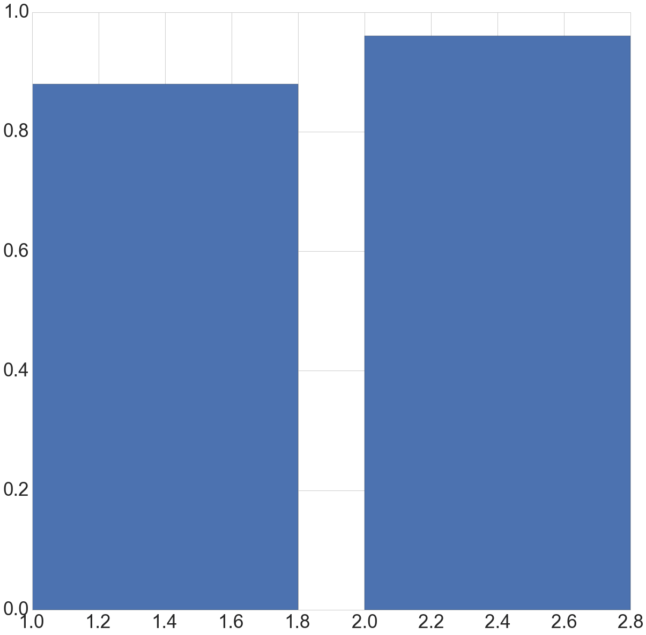
PCA vs. Original Features (Random Forest Multiclassification)
*PCA scores = 0.88 vs Chi-Square-test score = 0.97
1.0
0.8
0.6
Accuracy Score
0.4
0.2
0.0
P.C.A
Original Features

Slide 27
Conclusion
Original Features act as predictors.
One vs.-rest strategy is better that multi-classification strategy.
Feature importance depends of the class-type animal (One-vs.-rest strategy)

