Slide 1
EECE 2160 Collision Detection Algorithm Improvement
Jamin Eisenberg

Slide 2
Project Overview
Used the DE1-SoC board’s VGA port to display free-moving and rotating shapes that could bounce off each other
Breakdown
Read from the keypad
Write to the VGA port and the speaker
Produce a system to represent any polygon on-screen
Implement an IEEE algorithm for collision detection
Improve that algorithm
Make the shapes interact with each other
Evaluate the algorithms
4 weeks

Slide 3
Polygon System
Polygons contain
Lines which contain
Vectors which contain
X and Y coordinates
CollisionPairs contain 2 Polygons that are colliding
Can resolve the collision

Slide 4
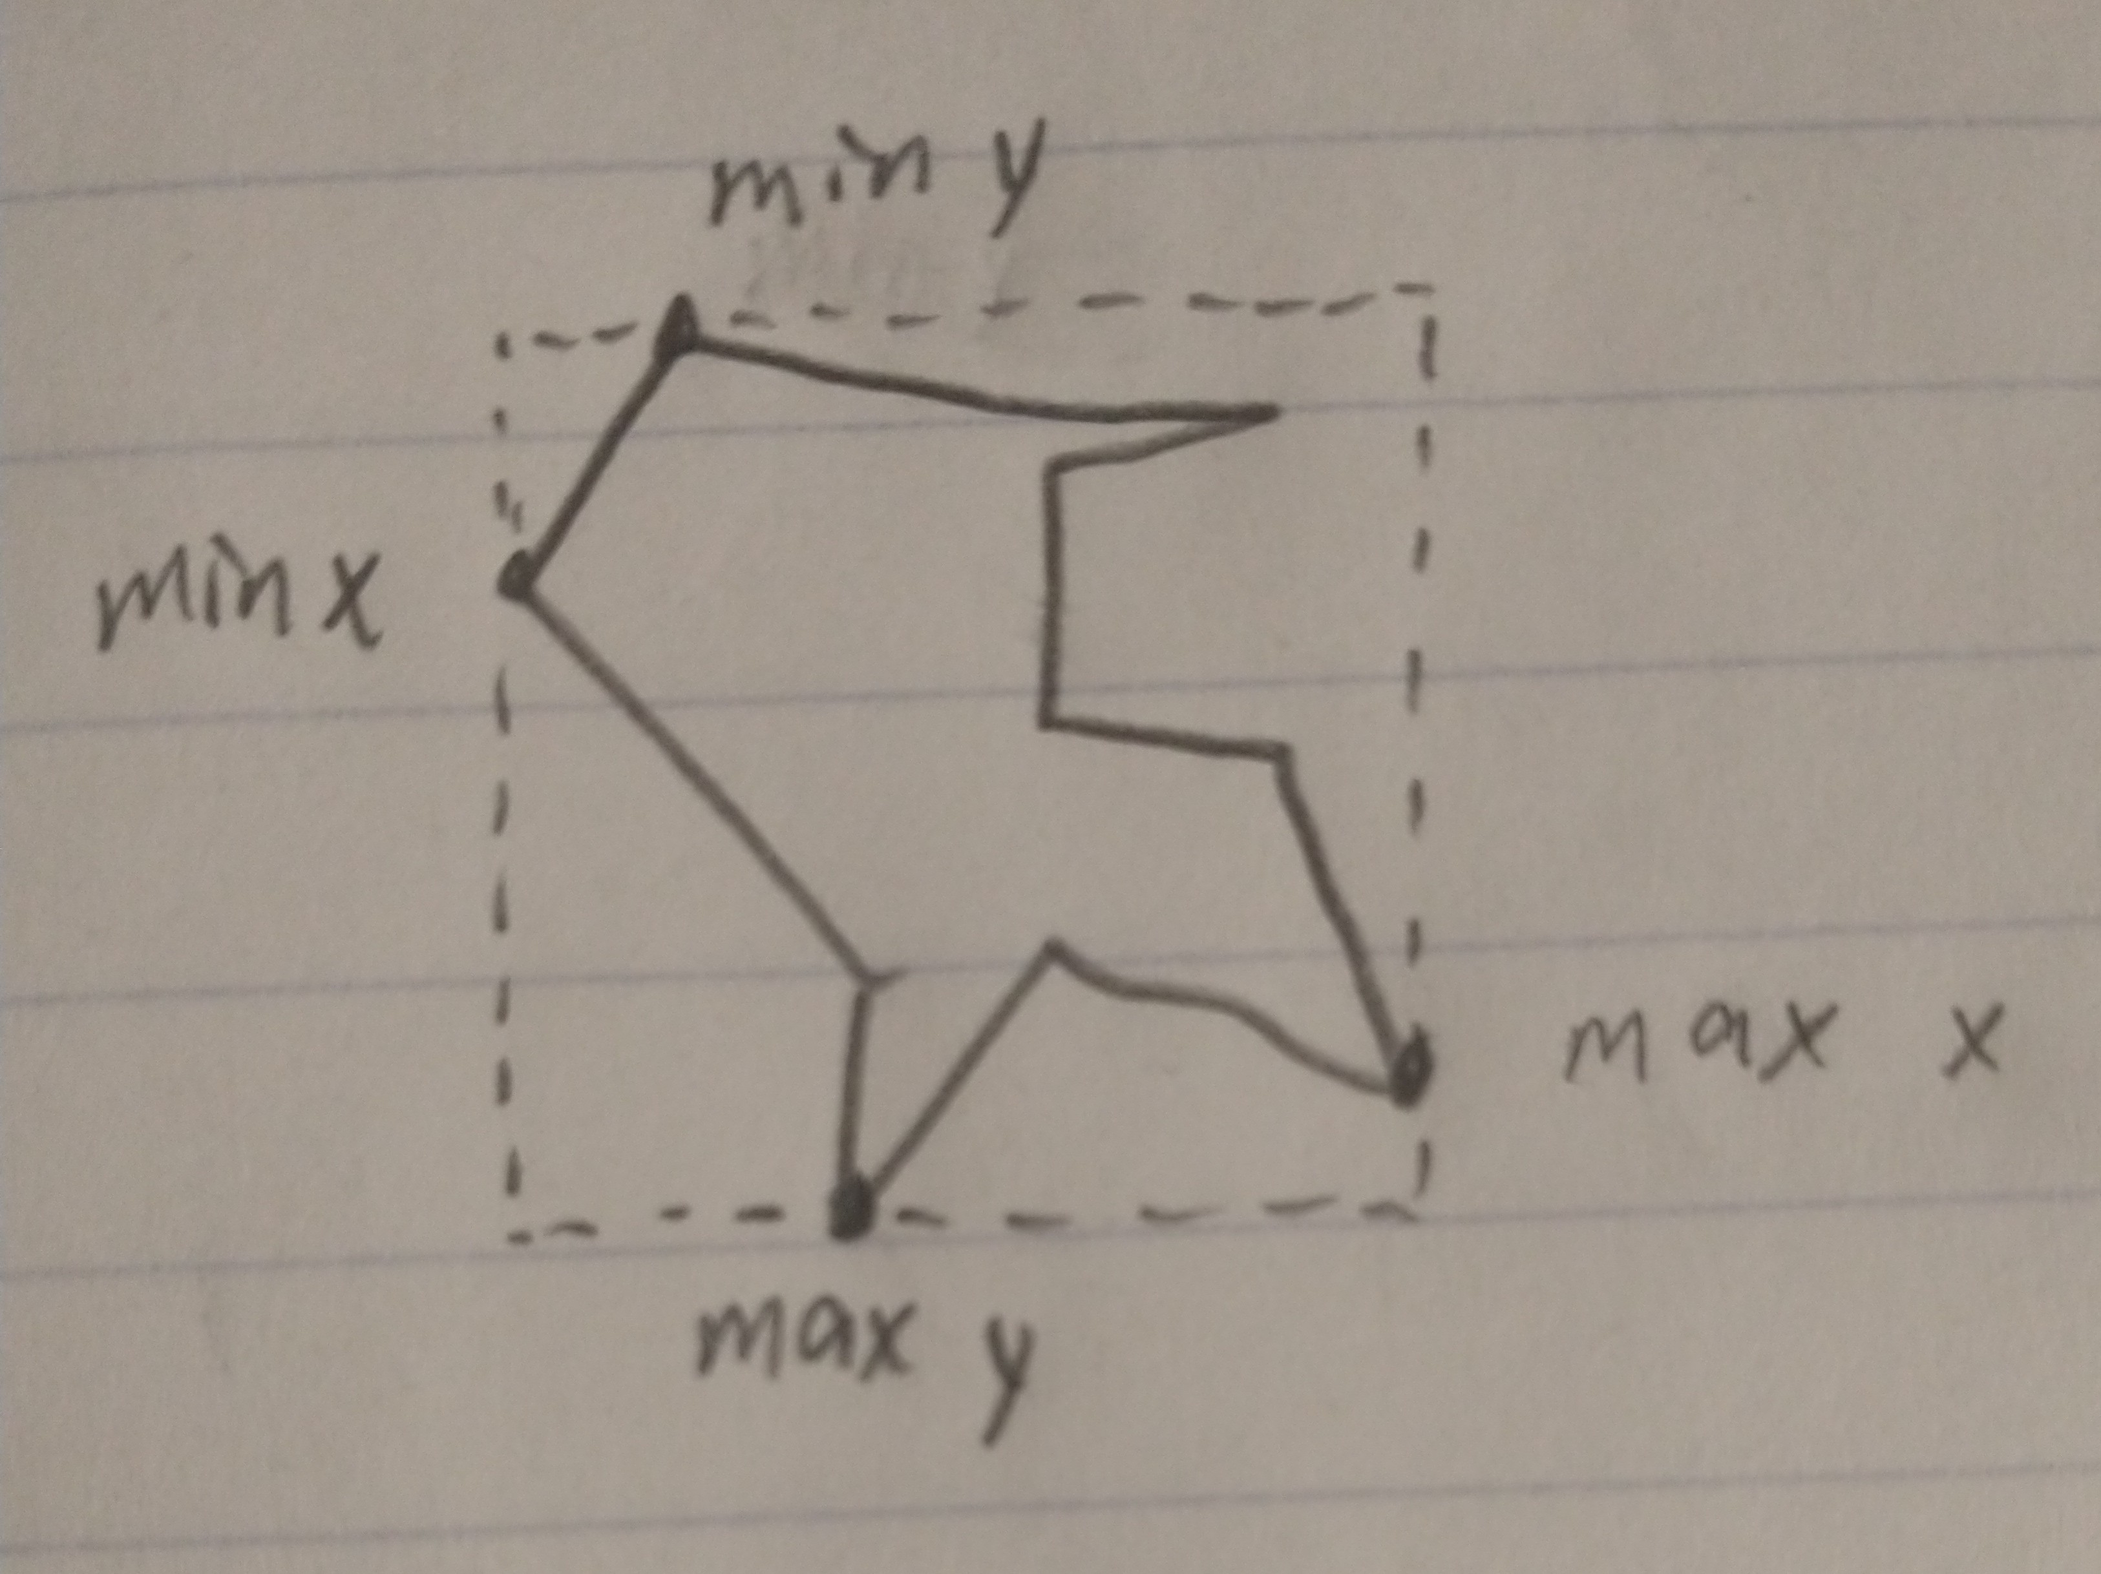
Original Algorithm
AABBs: two points that define the limits of a shape
For each shape called i
For each shape called j
If i is the same as j, they’re not colliding
If i and j are colliding, make a CollisionPair with them
i and j are colliding if
The x distance between the shapes is less than half their combined width
OR the same thing with y distance and height
Slow!

Slide 5
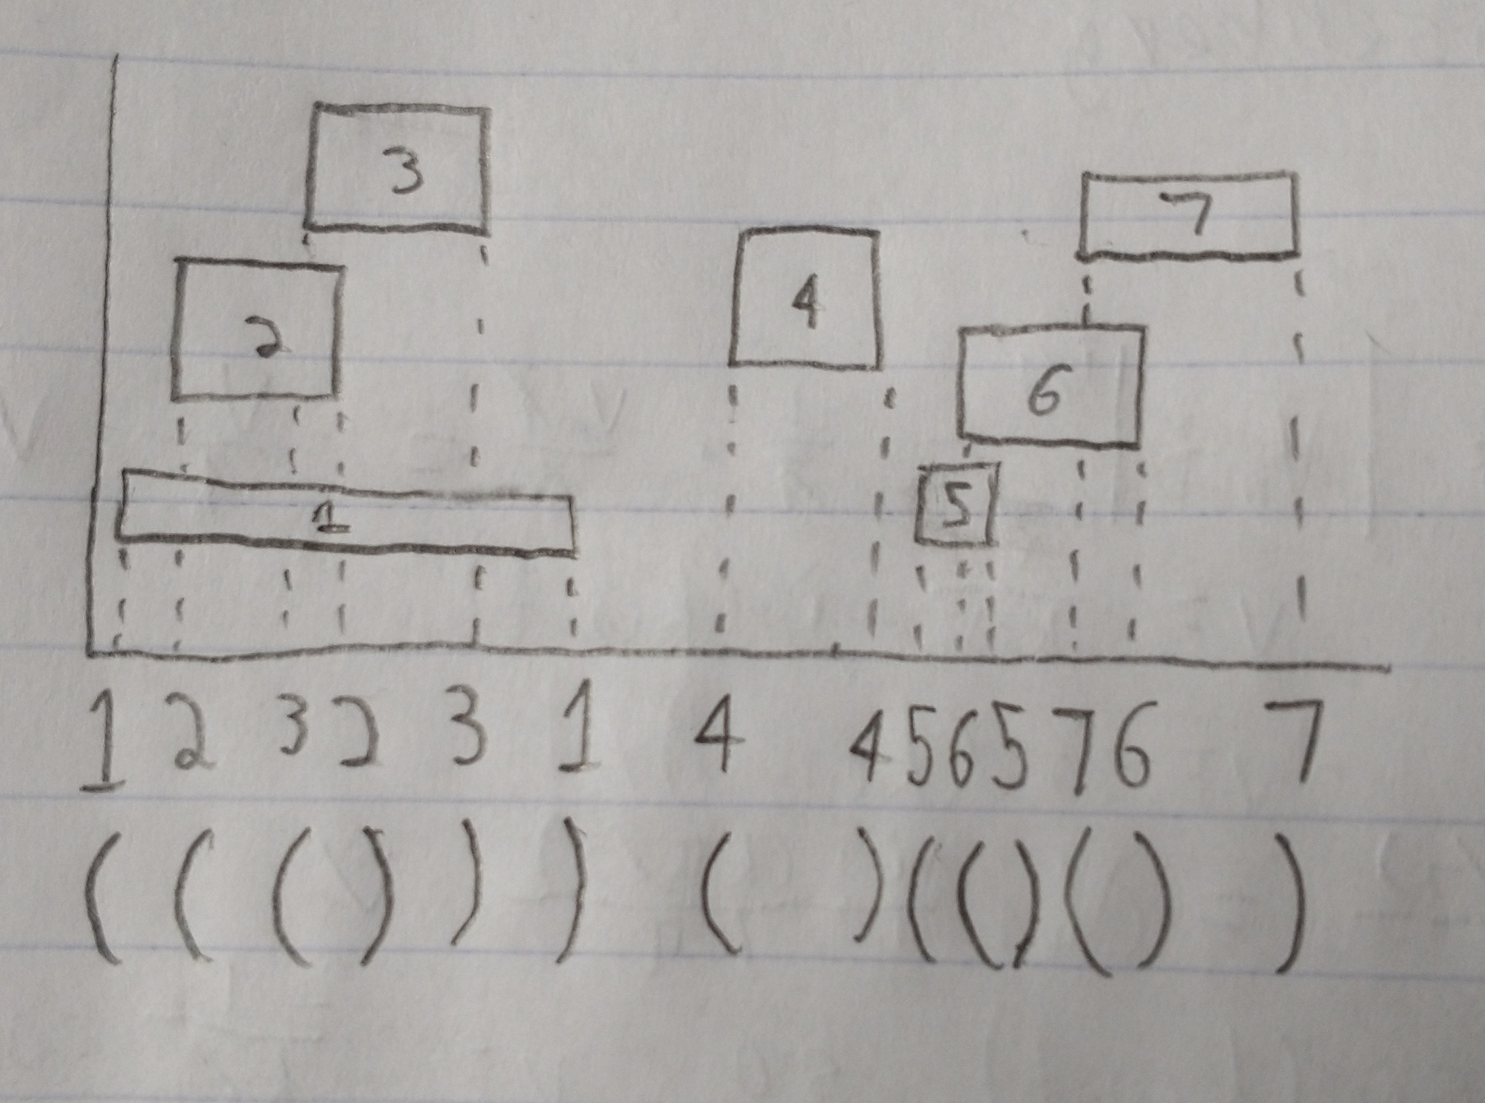
Improved Algorithm
Sorting makes everything faster
Problem can be separated in 2
X collisions
Y collisions
If shapes are colliding in x and y, they’re colliding
Shapes can be reduced to “intervals”
For every shape’s interval
If the interval is the start of the shape
It’s colliding with all the currently active intervals
Add it to the list of active intervals
Otherwise
Remove the start of this interval from the active list
Fast!

Slide 6
Algorithm Comparison
My improved algorithm is faster than the original in every case
236x faster in the case of 100 Xs

Slide 7
Issue 1: Memory Mapping
Delay: 5 days (non-intensive)
Tried to access the physical addresses of the machine to write to the VGA port
Got segmentation fault
Reviewed memory mapping
Mapped the physical memory to virtual memory and read and wrote to there

Slide 8
Issue 2: Set Intersection
Delay: 2 days
Sets in C++ are ordered, so we need a way to order its elements
All the sets were of CollisionPairs
How do you order elements that contain two other elements?
Lexicographically
operator< override wasn’t working, so a struct was made

Slide 9
Issue 3: Collision Handling
Delay: ongoing
Collision handling works sometimes and I can’t tell what differentiates the cases where it works and where it doesn’t
My approach:
Calculate relative positions and velocities between 2 shapes
Calculate the x and y overlap of the two shapes
If the x overlap is greater, resolve the collision in the y direction
Otherwise, resolve in the x direction
To resolve the collision:
Calculate the collision normal, then the relative velocity in the normal’s direction
If that’s negative, don’t resolve
Change the shapes’ velocities according to their mass relative to the total mass

Slide 10
Demo

Slide 11
EECE 2160 Collision Detection Algorithm Improvement
Jamin Eisenberg

