Slide 1
MnM4SDS Project Outline
Jamis Bruening

Slide 2
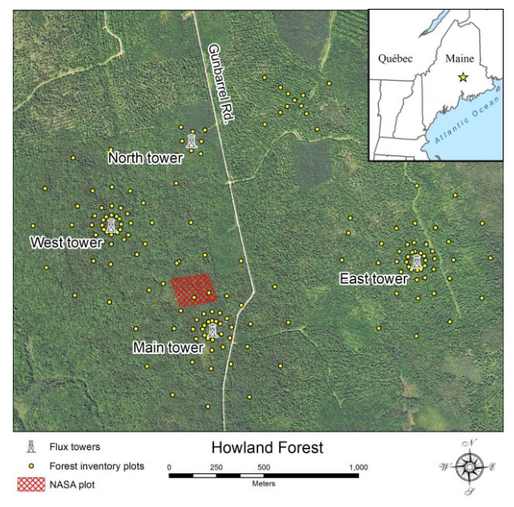

Slide 3
Howland Forest plot data
NASA plot: 3 hectare area (30k m²) of monitored forest
Measurements collected in 1989 and 2016
Tree position (xy), height, DBH
10% of trees cored, canopy projection area
Soil moisture data (25m res)
Sapling data in 2016
GEDI calval site (LiDAR data)
Oldest phenocam timeseries in network

Slide 4
Analysis plan
ESDA – spatial autocorrelation in environmental data
Species composition, physical structure
Age related trends in space
Climate related trends (pending data availability)
Growth related trends from tree rings
GWR

Slide 5
Objective
To increase my knowledge of this forest and dynamic processes at play
Site at which I’m parameterizing a forest growth model to simulate forest growth
Ultimate goal; predict forest stand age from vertical structure

