Slide 1
Measuring the Dream Index Adaptations for a Local Context
Frank Ridzi, PhD
Central New York Community Foundation
Jamison Crawford, MPA
Deloitte

Slide 2
Preface 1 / 2
During the Community Indicators Consortium’s 2020 Community Impact Summit, Angela Glover Blackwell, the founder of Policy Link, gave the keynote address.

Slide 3
Preface 2 / 2
She stated that this was a historic moment for the use of community indicators.
Listen as the activist of 40 years explains why.

Slide 4
Video removed for space.

Slide 5
Angela Glover Blackwell Keynote Address, 2020 Community Impact Summit
“If you want change, you must use data to understand, to understand what change you need.
…
Change does not happen if we do not measure how we are doing. We need to have a north star, and it needs to be a results-based north star.

Slide 6
Angela Glover Blackwell Keynote Address, 2020 Community Impact Summit
We need to know: Who? How much? How many? How long? How will we know when we get there?
...
And when we know exactly what that is, we need to measure all along the way so that we can see and feel the indicators. The indicators guide us to the north star.”

Slide 7
Takeaways 2020 Community Impact Summit
Community indicators guide us in change.
Give direction and catalyze action
They embolden the activist
They awaken sympathies
Push changeaphobes to the sidelines
Offer public accountability on progress
People can “see and feel the indicators”

Slide 8
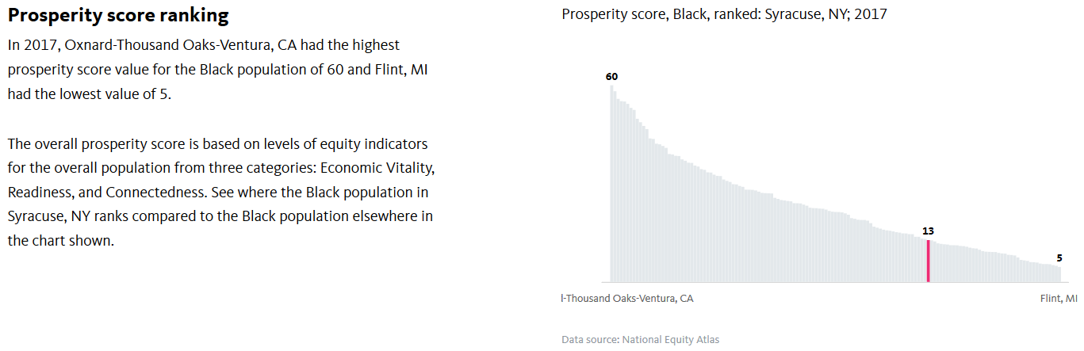
National Equity Atlas The Nation’s Most Detailed Report Card on Racial Equity
Visit the Website

Slide 9
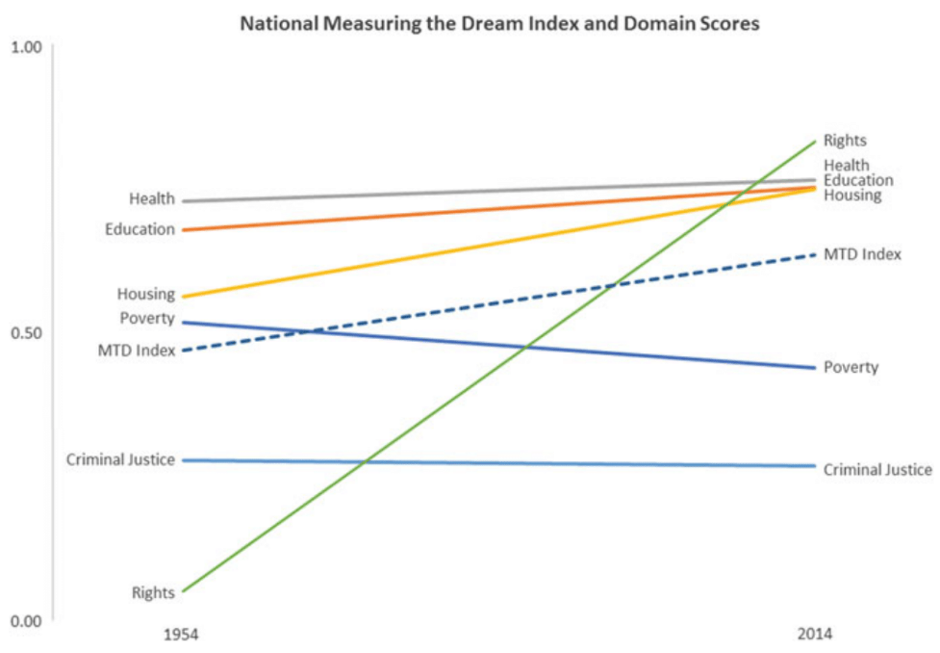
Measuring the Dream Visualizing the Index
O’Connell, Young, & Botchwey (2020)
Community Quality-of-Life Indicators
Best Cases VIII
View the Publication

Slide 10
What Is the MTDI? A National Level Index for Racial Equity
The “Measuring the Dream Index” (MTDI):
Identifies 6 dimensions in “struggle for equal justice”
Each dimension made of 4-8 indicators
Selected per evaluated academic rigor in Thriving Cities Group
Data span from pre-1950 to 2016
Sources include CDC, BLS, Census
Geography is at national level

Slide 11
Dimensions & Indicators Criminal Justice
Arrests: Arrests per 100 K pop.
Incarceration: Incarceration per 100 K pop.
Capital Punishment: Executions per 1 M pop.
Violent Crime Rate: Victims per 1 K pop.
Probation: Probation per 1 M pop.
Suspension: Percent of public-school students suspended, gr. 6-12

Slide 12
Dimensions & Indicators Education
4+ Years High School: Percent of pop.
Adult Illiteracy: Percent of pop.
Preschool Enrollment: Percent of pop. aged 3-4
4th Grade Reading: National assessment scores
College Graduate or More: Percent of pop.
8th Grade Math: National assessment scores
Advanced Placement: Percent of passing AP students
Bachelor’s Degree Median Income: Aged 25-34, FTE

Slide 13
Dimensions & Indicators Health
Life Expectancy: Average expected lifetime in years
Infant Mortality: Deaths per 1,000 live births
Age-Adjusted Death Rate, Heart: Deaths per 100 K pop.
No Health Insurance: Percent of pop. under 65
4+ Chronic Conditions: Percent of respondents to NHIS

Slide 14
Dimensions & Indicators Housing
Home Ownership: Percent of pop. that own home
1-Year Resident Stability: Percent of pop. resident ≤ 1 year
Median Home Price: Average home value in dollars
Cost Burdened Households: 30%+ income on housing
Travel Time to Work: Percent of population, 90+ minutes

Slide 15
Dimensions & Indicators Poverty
Unemployment: Percent seeking employment
Income: Median income in dollars
Child Poverty: Percent of pop. under 18 in poverty
Food Insecurity: Percent of pop. reporting worsening diets
Family Wealth: Median family wealth in dollars

Slide 16
Dimensions & Indicators Rights
Vote Presidential: Percent of pop. voting in pres. elec.
Registered: Percent of pop. with active voter registration
Congressional Representation: Percent of elected fed. reps
Vote Non-Presidential: Perc. of pop. voting in non-pres. elec.

Slide 17
Measuring the Dream Visualizing the Index
O’Connell, Young, & Botchwey (2020)
Community Quality-of-Life Indicators
Best Cases VIII
View the Publication

Slide 18
Methodology Approach to Calculation
Data standardized using ration of Black to White pop.
Ratio is calculated each year; so relative, not absolute
Each indicator’s percent change is calculated
Each domain’s average calculated for a domain score
All domain scores are averaged for an MTDI score

Slide 19
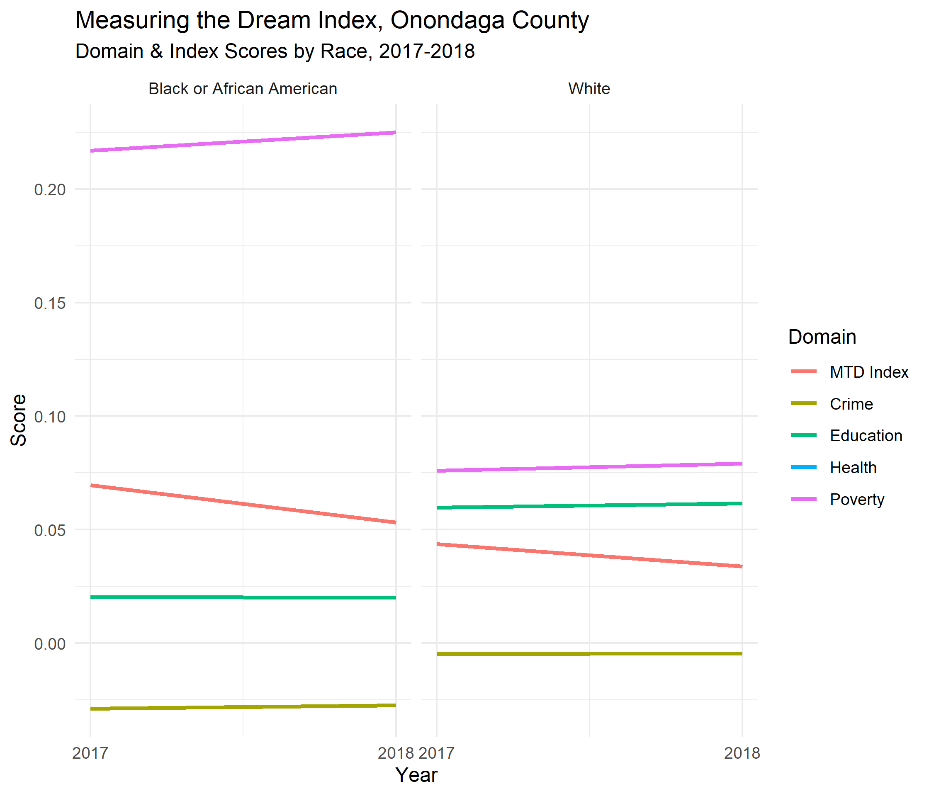
Localizing the MTDI Slope Chart, 2017-2018
Increased granularity:
Geographically
Chronologically

Slide 20
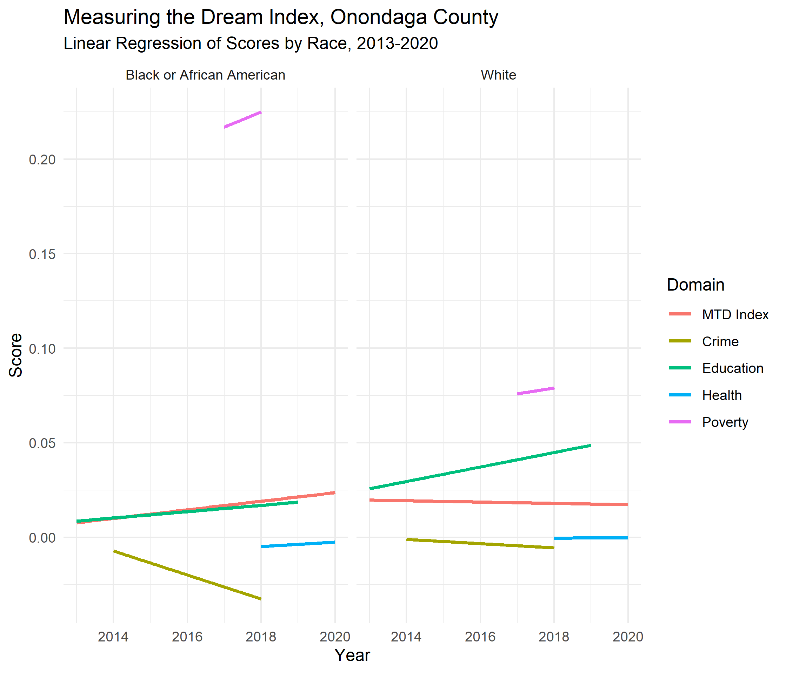
Localizing the MTDI Linear Regression, 2013-2020
Different limitations:
Comparability
Longitudinality

Slide 21
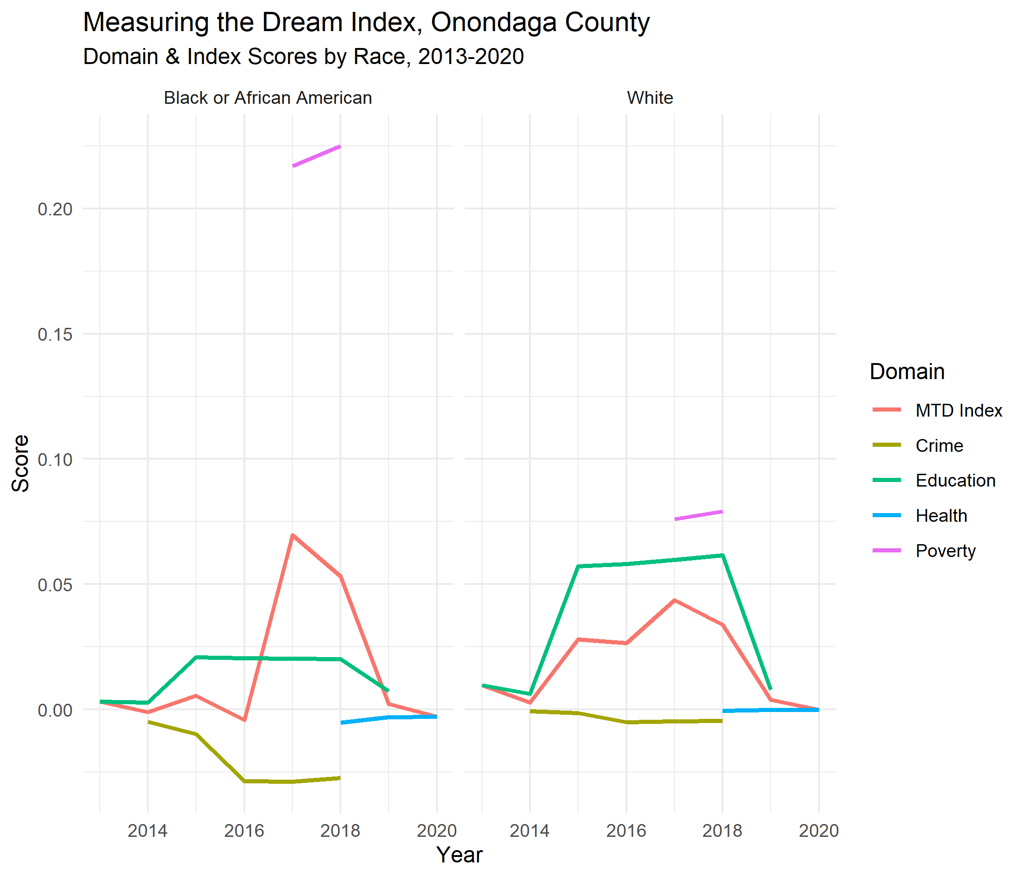
Localizing the MTDI Time Series, 2013-2020
The Reality:
Highly Granular
Unattainable?

Slide 22
Local MTDI Indicator Sources The Data We Have
Domain | Indicator | Source | Years
Education | Grade 4 Reading | NYS Education Dep. | 6
Education | Grade 8 Math | NYS Education Dep. | 6
Education | 4+ Years of High School | US Census | 5
Education | Bachelors or Higher | US Census | 4
Education | Advanced Placement | College Board | 5
Crime | Incarceration | Annual Survey of Jails | 5
Crime | Probation | NYS Div. of Criminal Justice Services | 3
Crime | Violent Crime Rate | NYS Div. of Criminal Justice Services | 3
Crime | Arrests | NYS Div. of Criminal Justice Services | 3
Health | Mortality Rate | County Health Rankings | 3
Health | Life Expectancy | County Health Rankings | 2
Health | Infant Mortality | County Health Rankings | 3
Poverty | Median Income | US Census | 2
Poverty | Child Poverty | US Census | 2
View
Research
Matrix Here

Slide 23
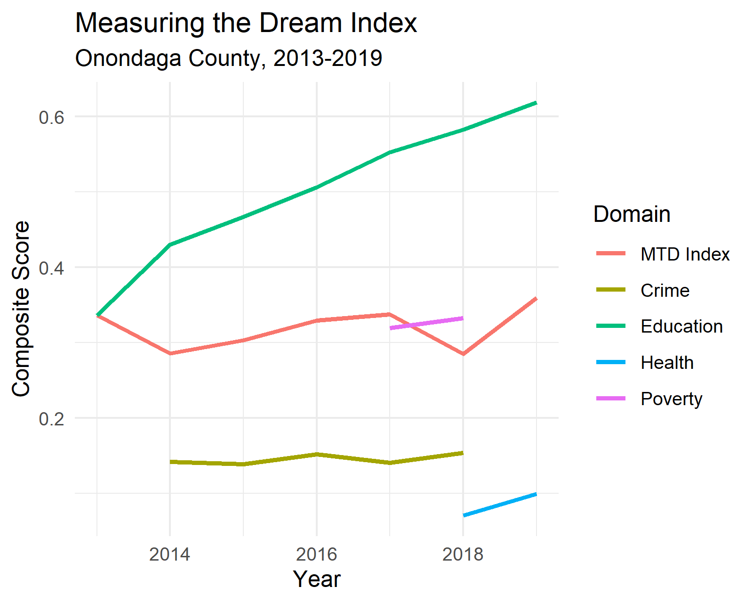
The Good News We’re All a Little Better Off (On Paper)

Slide 24
We Want You To Point Us to Some Good Data
We have ~30% of indicators covered.
Even then, we don’t have the historical data.
Want to Contribute?
Email: Jamison Crawford
jamisoncrawford@gmail.com
Visit the Project GitHub:
github.com/jamisoncrawford/mtdi

Slide 25
Questions & Thanks
Get the Presentation & All Resources:
github.com/jamisoncrawford/mtdi

