Slide 1
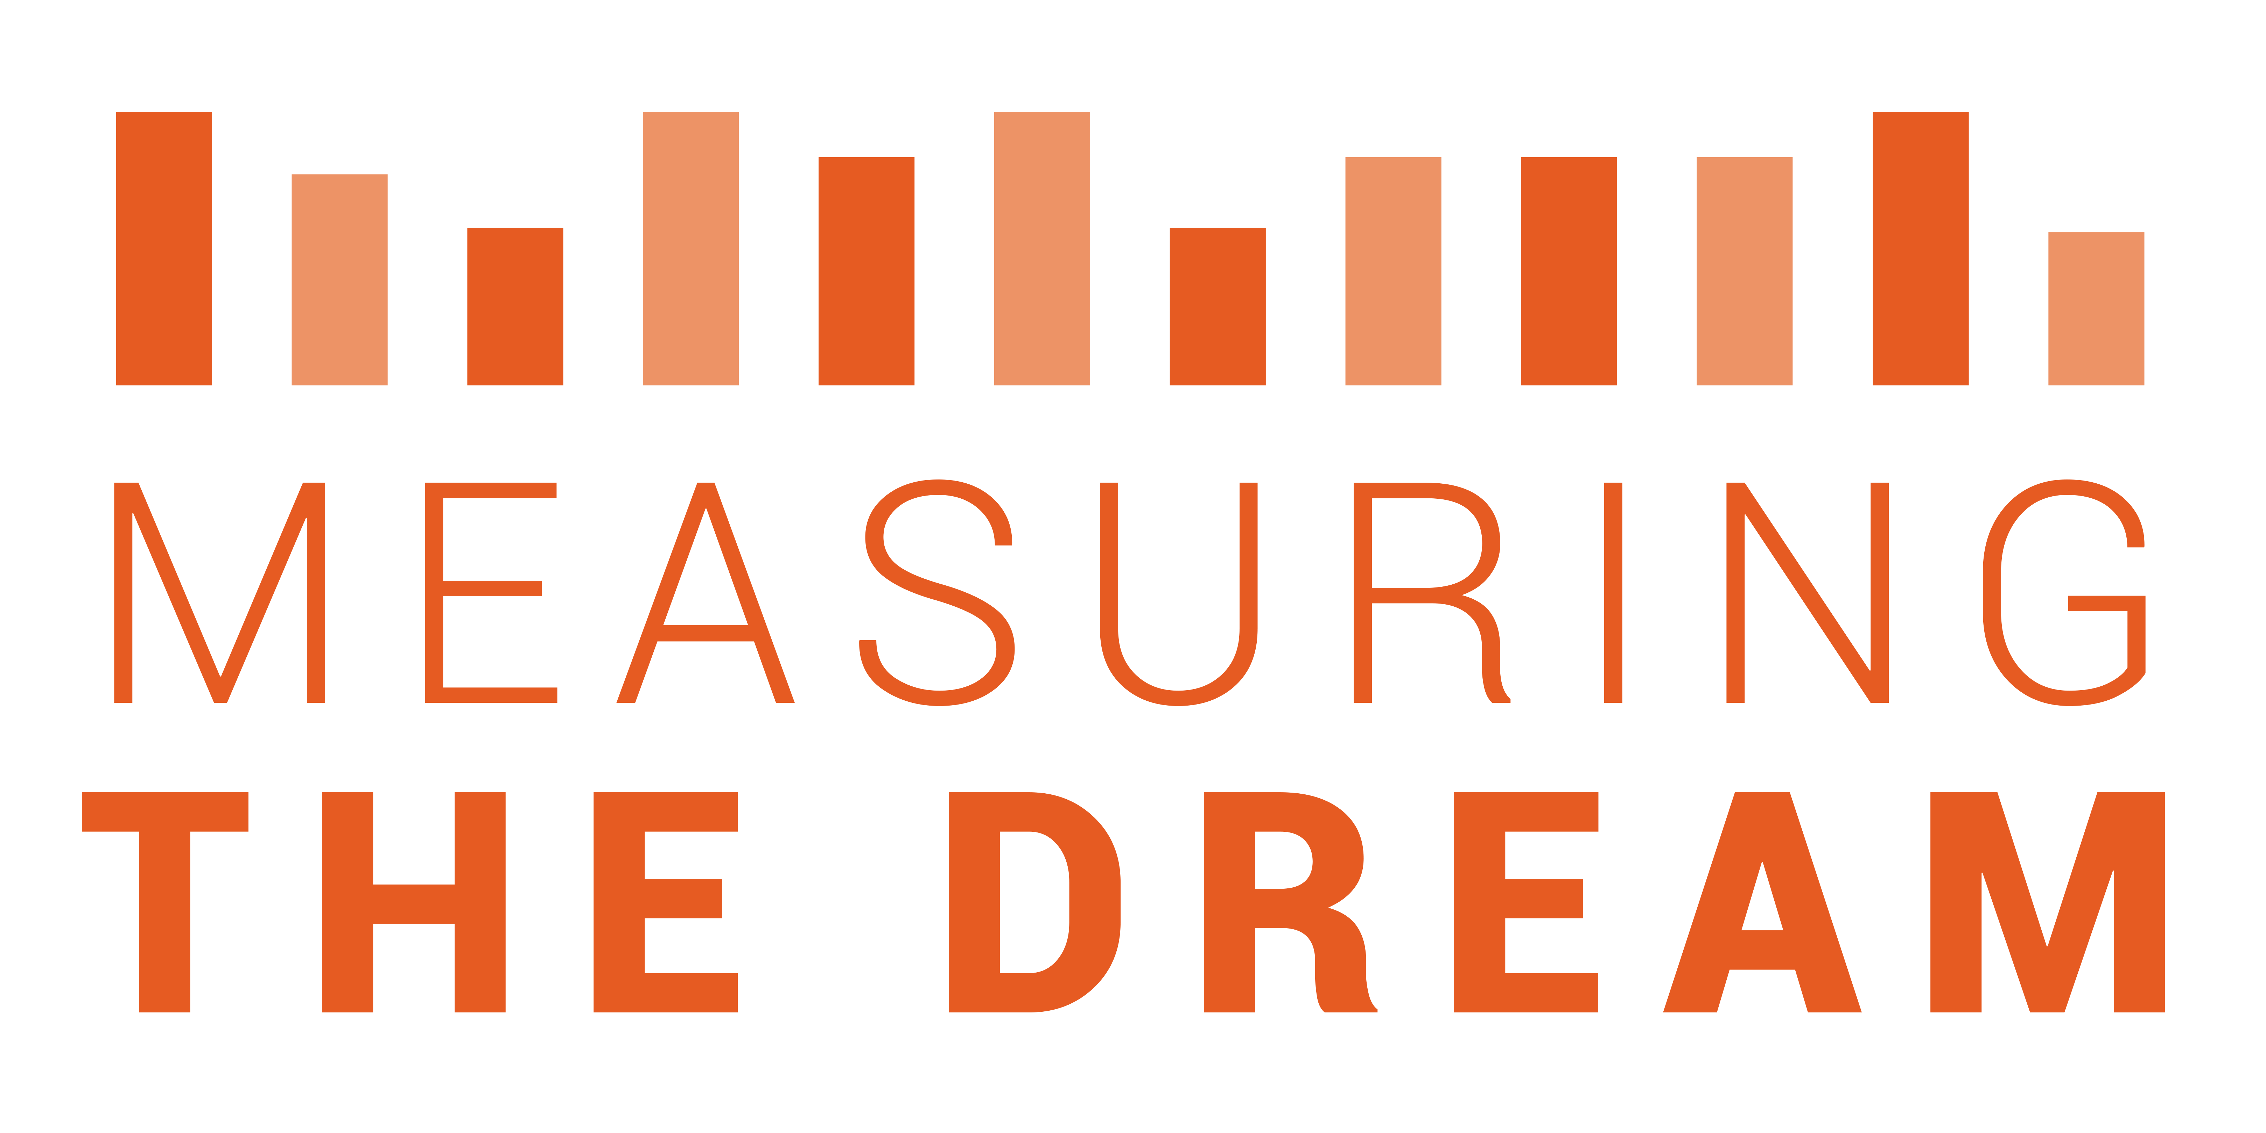
…… THE INDEX ……

Slide 2
Purpose of the Measuring the Dream Project
Resources to inform, enable and inspire a diverse audience to understand the history of the journey toward a more equal society.
A comprehensive resource for a reasoned discussion over the legacy of segregation and discrimination against African-Americans and other groups.
Resources to guide the current and next generation of social justice advocates—to see what works

Slide 3
Agenda Highlights & Plan for the Day
Overview of Indexes
Dream Index: Methodology Focus
Charge Forward

Slide 4
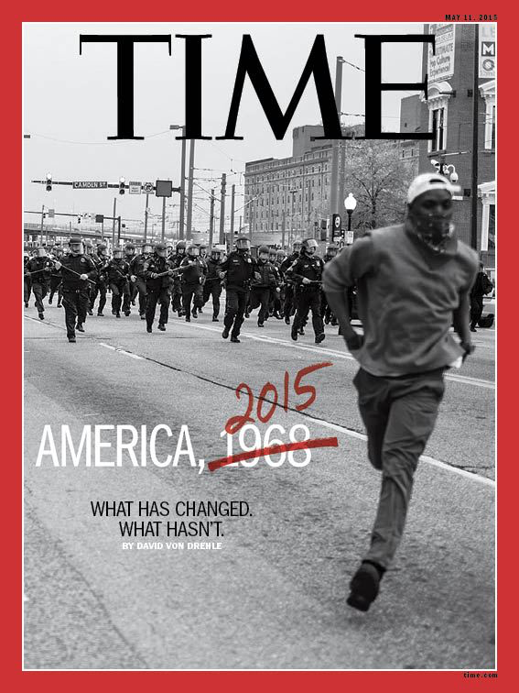
How do we measure the progress toward the realization of Dr. King’s Dream?
Nearly 50 years after the Dreamer was killed, what has become of the Dream?
Notes:
In his speech, Dr. King issued a call for social, political and economic equality for African Americans. Today, the measurable data on virtually every area that formed the basis for Dr. King’s call for equality in the Dream speech reveal that the reality experienced by African Americans compares unfavorably to the reality for White Americans.
How do we measure the progress toward the realization of that Dream? Nearly 50 years after the Dreamer was killed, what has become of the Dream?

Slide 5
What is an Index?
An Indicator or Measure of Something.
It is used to compare variables or different measures.
It measures change.

Slide 6
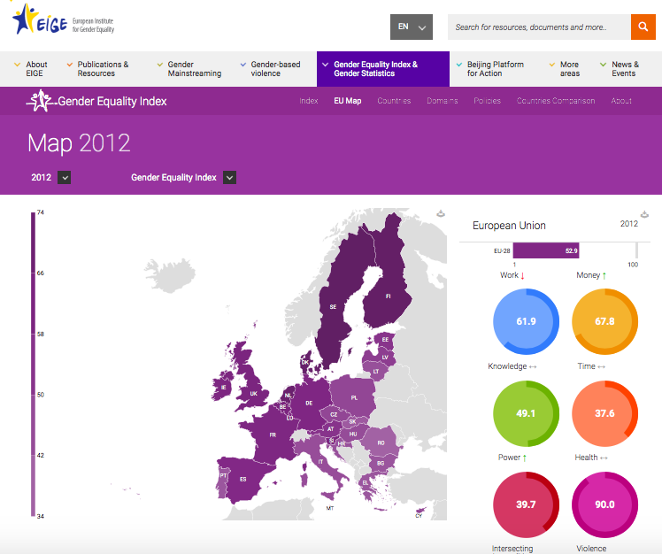
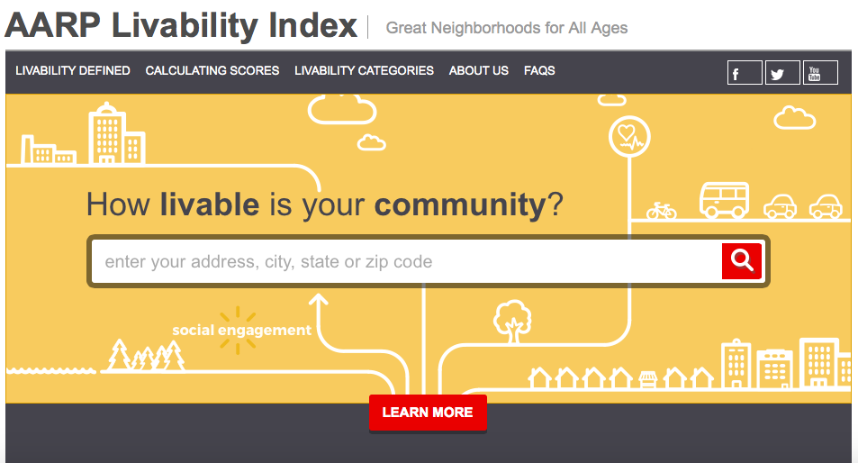
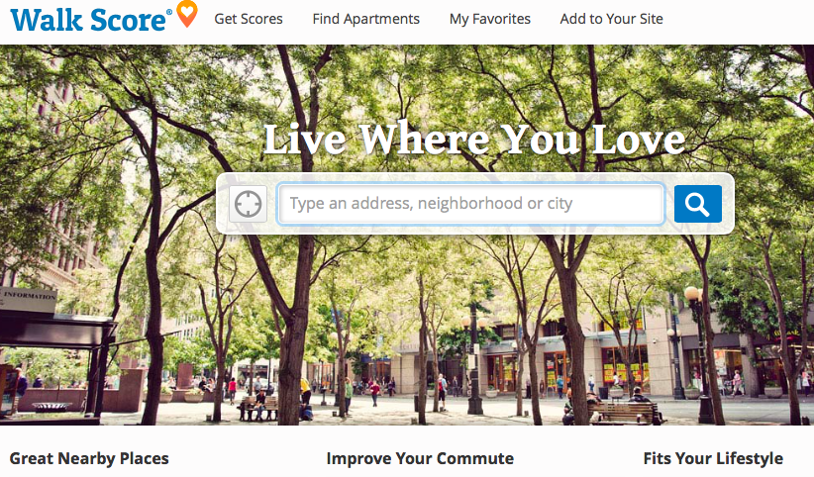
Notes:
I have been involved in the creation of AARP’s livability index, and we are familiar with walkscore and probably the Gender Equality Index.
The take away for us was their ability to quickly communicate a clear message and progress toward a target. These are two things we hoped to incorporate in our work.
So we set out to create a index that would be measured over time and across domains from the 1950s to present. In our attempt to do so, we located, transcribed and imputed values at the national level, determined the strength of the variables within domains based on peer reviewed literature to determine those to include in the analysis, imputed missing data and then we ran statistical analysis to determine which measures to include and at what weighting. In presenting this work to our advisory group and were encouraged to go back to the drawing board. What we wanted to get out of the data was too much and our methods were too complicated.
So, here we are. We’ve gone through a few additional iterations, more research, more conversations about what it means and we hope to proof it with this group.

Slide 7
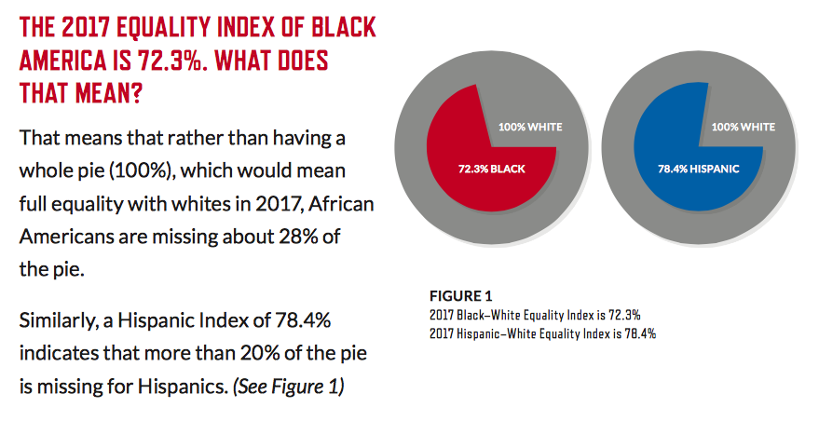
So how equitable are we today?
Notes:
For our purposes today, how can we best represent the trends in the key areas of equality as articulated by Dr. King? The chart above comes from the National Urban League and shows their 2017 Equality Index of Black and Hispanic America, compared to White America. It shows that AA realize about 72.3% of equality relative to white America, and Hispanics are at 78.4%. We think the work the National Urban League is doing is very helpful, and we built on this and other similar products in the development of our Dream measure.

Slide 8
Reason for MTD Index
100+ variables
Resources to inform, enable and inspire a diverse audience to understand the history of the journey toward a more equal society.
A comprehensive resource for a reasoned discussion over the legacy of segregation and discrimination against African-Americans and other groups.
Resources to guide the current and next generation of social justice advocates—to see what works

Slide 9
EITC expansion (‘93)
Temporary Assistance for Needy Families (‘97)
Earned Income Tax Credit (‘74)
Definition: Median income is the amount that divides the income distribution into two equal groups, half having income above that amount, and half having income below that amount
White
Black
Data from Census CPS

Slide 10
EITC (‘74)
EITC expansion (‘93)
TANF (‘97)
Definition: Child poverty is the percent of children living below an income threshold set by the Census Bureau. It varies by family size and composition.
Black
White
Data from Census CPS

Slide 11
4970
Definition: Supervised by correctional system includes all people in prison, jail, on parole, or on probation
Nixon declares War on Drugs (‘71)
Black – Supervised by correctional system
Sentencing Reform Act (‘84)
Crime Bill (‘94)
1163
Black
White – Supervised by correctional system
White
Data from Bureau of Justice Statistics

Slide 12
Definition: Educational attainment is the percent of population that completed 4 years or more of high school
Elementary & Secondary Education Act (65)
Brown v Board of Education (54)
White
Black
Data from Census CPS

Slide 13
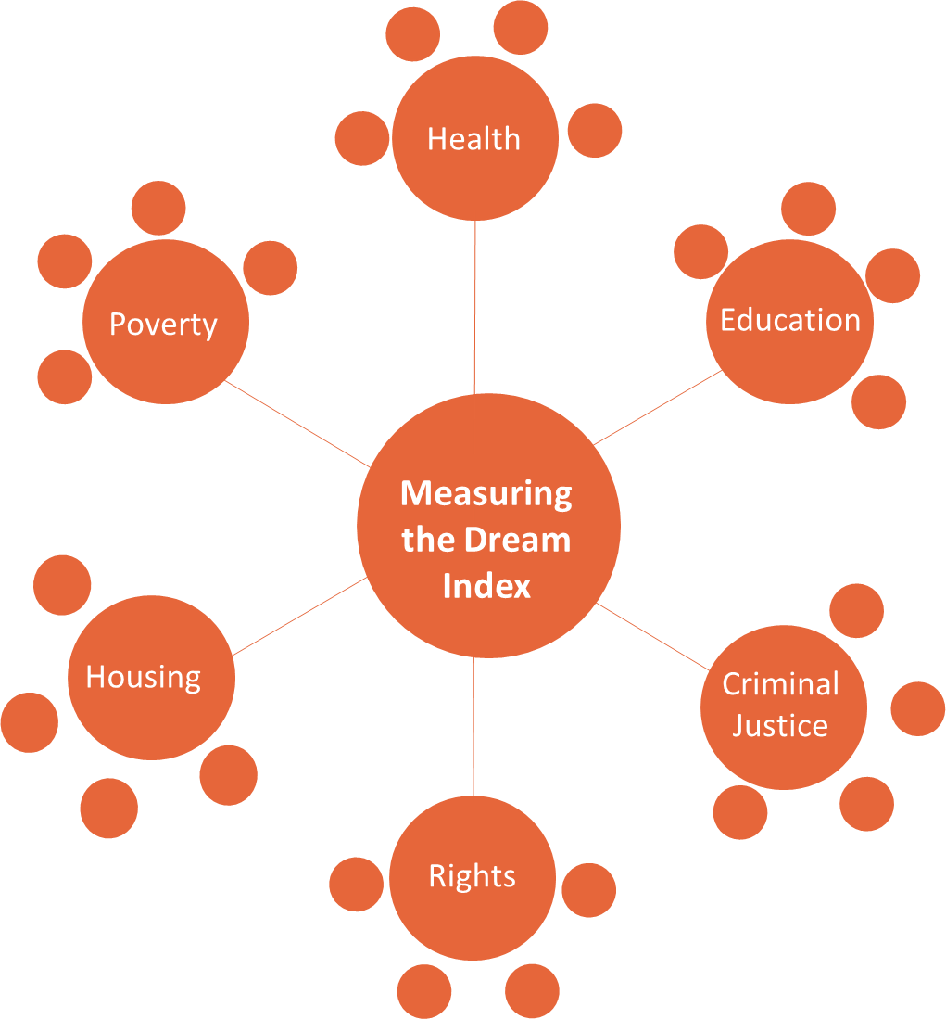
method
24 variables across 6 domains
Based off of Canadian Index of Wellbeing (CIW)
Take ratio, with a goal of 1:1 equality
Average each ratio to produce a domain index score
Average each domain index score to produce MTDream Score

Slide 14
Construction
Dream Index
Calculate ratio of black population value to white population value, for each indicator, for each year, within each domain
Use inverse for “negative” indicators
Calculate the mean of all ratios for each domain for each year
Calculate the mean of the means to get the Index score for each year

Slide 15
(1954 - 1968)
(1969 - 1980)
(1979-1993)
(1994-2016)
Home Ownership
Home Ownership
Home Ownership
Home Ownership
Median Home Price
Median Home Price
1 year stability
Median Home Price
Median Home Price
1 year stability
Cost burdened households

Slide 17
1:1 Equality
 | 1954 | 2014
Criminal Justice | 0.27 | 0.42
Education | 0.31 | 0.87
Health | 0.73 | 0.91
Housing | 0.56 | 0.71
Poverty | 0.51 | 0.51
Rights | 0.05 | 0.79
Overall Index | 0.40 | 0.70
Health
Housing
Poverty
MTDream Index
Education
Criminal Justice
Rights

Slide 18
Dr. King speaks at the Mason Temple in support of the Memphis sanitation workers’ strike, shortly before his assassination. [Memphis Press-Scimitar via the Civil Rights Digital Library]
Notes:
In nearly 2 months, we will commemorate 50 years since Dr. King’s assassination on the balcony of the Lorraine Hotel in Memphis Tennessee. He was speaking there in support of the sanitation workers, despite numerous and serious threats on his life. In the speech he gave on April 4th 1968 at the Mason Temple, his Mountain Top Speech, or otherwise referred to as his ‘woke’ speech he moves us from dreaming to waking.
Allow me to read a short snippet of his speech…
“Let us develop a kind of dangerous unselfishness. One day a man came to Jesus, and he wanted to raise some questions about some vital matters of life. At points he wanted to trick Jesus, and show him that he knew a little more than Jesus knew and throw him off base....
Now that question could have easily ended up in a philosophical and theological debate. But Jesus immediately pulled that question from mid-air, and placed it on a dangerous curve between Jerusalem and Jericho. And he talked about a certain man, who fell among thieves. You remember that a Levite and a priest passed by on the other side. They didn’t stop to help him. And finally a man of another race came by. He got down from his beast, decided not to be compassionate by proxy. But he got down with him, administered first aid, and helped the man in need. Jesus ended up saying, this was the good man, this was the great man, because he had the capacity to project the “I” into the “thou,” and to be concerned about his brother.
Dr. King continues to talk about the levite and the good samaritan, then poses the question, harkening back to himself and what brought him to Memphis.
The question is “Not, “If I stop to help the sanitation workers, what will happen to my job. Not, “If I stop to help the sanitation workers what will happen to all of the hours that I usually spend in my office every day and every week as a pastor?” The question is not, “If I stop to help this man in need, what will happen to me?” The question is, “If I do not stop to help the sanitation workers, what will happen to them?” That’s the question.”
What if we do not wake up from our dreams and help those around us? The kids who need healthier and safe school environments, quality out of school time instruction? What if we do not work to change the rules that have led to the current state of inequality for so many black and brown people in America? What will happen to them?
Dr. King wanted equality and economic justice for all people. He gave his life for his dream, yet how far will we go to seeing his and our dreams realized?

