Slide 1
Quiz Maker
Python + SQLite capstone project with file import, role-based access, randomized quizzes, and full admin CRUD.
Project summary
End-to-end workflow
Creates quizzes from a SQLite question bank
Imports questions from CSV into the database
Registers users and stores password hashes with Argon2
Uses getpass so passwords do not display in the terminal
Saves quiz results for later review
Lets admins manage users and questions through the menu
1. Setup DB
Creates Users, Questions, and QuizResults tables plus the starting admin account.
2. Import CSV
Reads questions.csv and inserts 30 question records into SQLite.
What the live walkthrough shows
$ python db_setup.py
Users / Questions / QuizResults tables created
$ python import_questions.py
30 questions loaded from CSV
$ python quiz_app.py
admin login -> register user -> take quiz -> view scores
promote user to admin -> add/delete question -> delete user
3. Register / Login
Uses getpass for hidden entry and Argon2 for password hashing + verification.
10-minute presentation plan
4. Student quiz
Draws 10 random questions, shows feedback, and saves results with a timestamp.
1) problem and goals
2) design and rubric coverage
3) setup + CSV import
4) student flow
5) admin flow
6) security + conclusions
5. Admin tools
Lets admins manage questions and users directly from the interactive menu.
Notes:
[Sources] - User-provided project files and terminal transcript. - Scoring rubric PDF uploaded by the user.

Slide 2
How the application works
The project combines three data entities, Python classes, CSV file input, and an interactive menu.
Student flow
Admin flow
Security + quality
Data model used by the app
Register a new account or log in.
Take a randomized 10-question quiz.
Receive immediate right/wrong feedback.
Quiz score is stored in QuizResults.
Use View My Scores to review prior attempts.
Log in as admin from the same menu system.
View all questions and users.
Add, edit, and delete questions.
Promote standard users to admin.
Reset passwords and delete users when needed.
Passwords are hidden with getpass.
Passwords are stored as Argon2 hashes instead of plain text.
Input validation rejects invalid quiz answers.
Cancel prompts reduce accidental admin changes.
The database is not static because menu actions update data live.
Users
user_id, username, password_hash, is_admin
Questions
question_id, prompt, choice_a-d, correct_answer
QuizResults
result_id, user_id, score, total_questions, date_taken
These 3 tables satisfy the rubric requirement for at least 3 entities, and the transcript shows 30 imported questions plus user/result rows during the demo.
Notes:
[Sources] - User-provided code files: QuizDB.py, quiz_app.py, db_setup.py, import_questions.py. - User-provided rubric PDF.

Slide 3
Rubric alignment at a glance
This version of the presentation explicitly shows the functionality demonstrated in the terminal walkthrough.
Documentation
Inline comments explain the workflow, and the presentation includes approach, design, ethics, and critical thinking.
SQL + CRUD
Users and questions support create, retrieve, update, and delete actions from the menu.
File I/O
questions.csv is opened, parsed, confirmed, and inserted into SQLite.
Error handling
The app handles invalid IDs, invalid quiz answer choices, missing users, and cancel actions.
Object oriented
Separate classes manage the database tables while QuizApp handles user interaction.
Interactive menu
Standard users see quiz options, while admins also see management options.
Presentation quality
Slides follow a clear story: setup, student flow, admin flow, security, and proof of results.
Suggested speaking point: “Our live walkthrough now proves registration, login, role changes, question CRUD, score storage, and user deletion.”
Notes:
[Sources] - User-provided rubric PDF. - User-provided terminal transcript showing the demonstrated features.

Slide 4
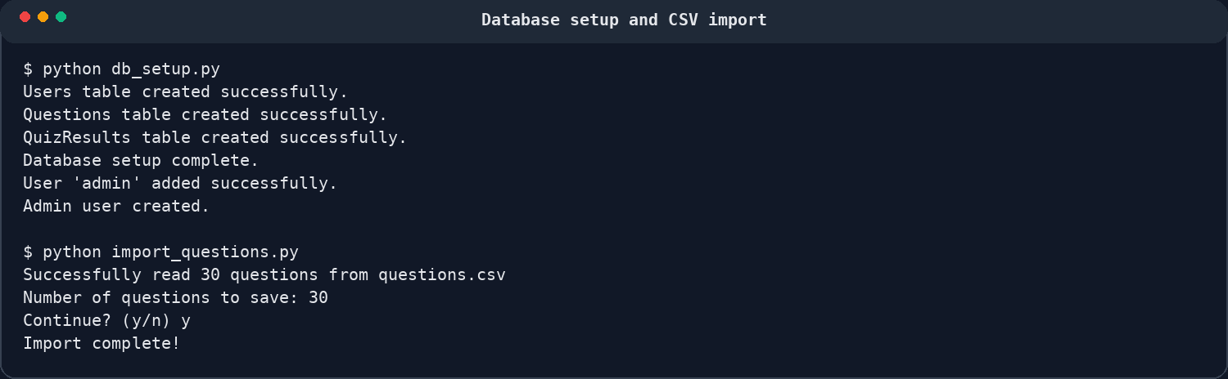
Demo 1 - environment setup and CSV import
The first part of the walkthrough proves that the database is created and populated dynamically from a CSV file.
What the terminal output proves
A virtual environment is created and requirements are installed.
db_setup.py creates the Users, Questions, and QuizResults tables.
An initial admin user is inserted into the Users table.
import_questions.py reads questions.csv and saves 30 question rows into SQLite.
This satisfies both the database and file-I/O parts of the rubric.
Suggested timing: about 1 minute
Notes:
[Sources] - User-provided setup screenshot and terminal transcript. - User-provided files db_setup.py, import_questions.py, and questions.csv.

Slide 5
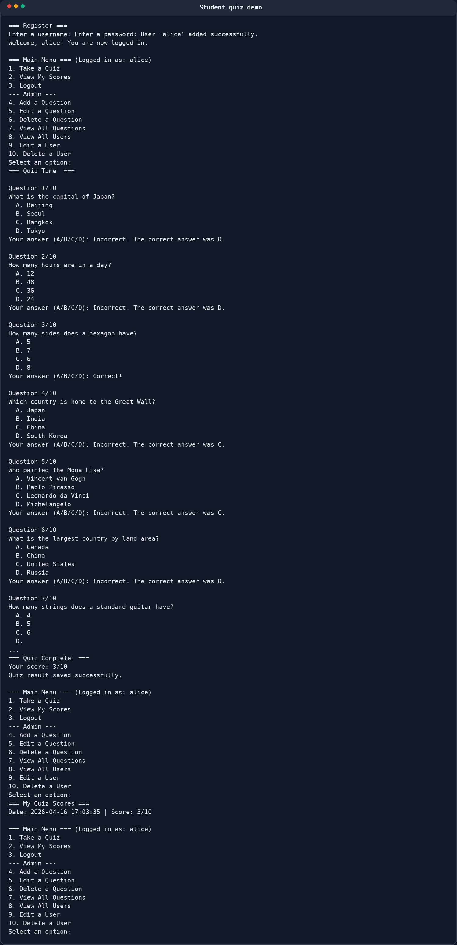
Demo 2 - authentication, registration, and student quiz flow
This portion of the run shows secure login, role-based menus, randomized quiz questions, and saved scores.
Student actions shown
Register a new user (jorton4).
Login succeeds with password hidden in the terminal.
Standard user menu shows only quiz, scores, and logout.
Take a 10-question randomized quiz.
Score is saved to QuizResults and later displayed.
Security upgrade shown in code
getpass hides password entry.
Argon2 hashes passwords before storage.
Login verifies the stored hash instead of comparing plain text.
Transcript highlights
=== Register ===
User 'jorton4' added successfully.
=== Quiz Complete! ===
Your score: 0/10
Date: 2026-04-16 ... | Score: 0/10
Notes:
[Sources] - User-provided student demo screenshot and terminal transcript. - User-provided updated quiz_app.py logic for getpass and Argon2.

Slide 6
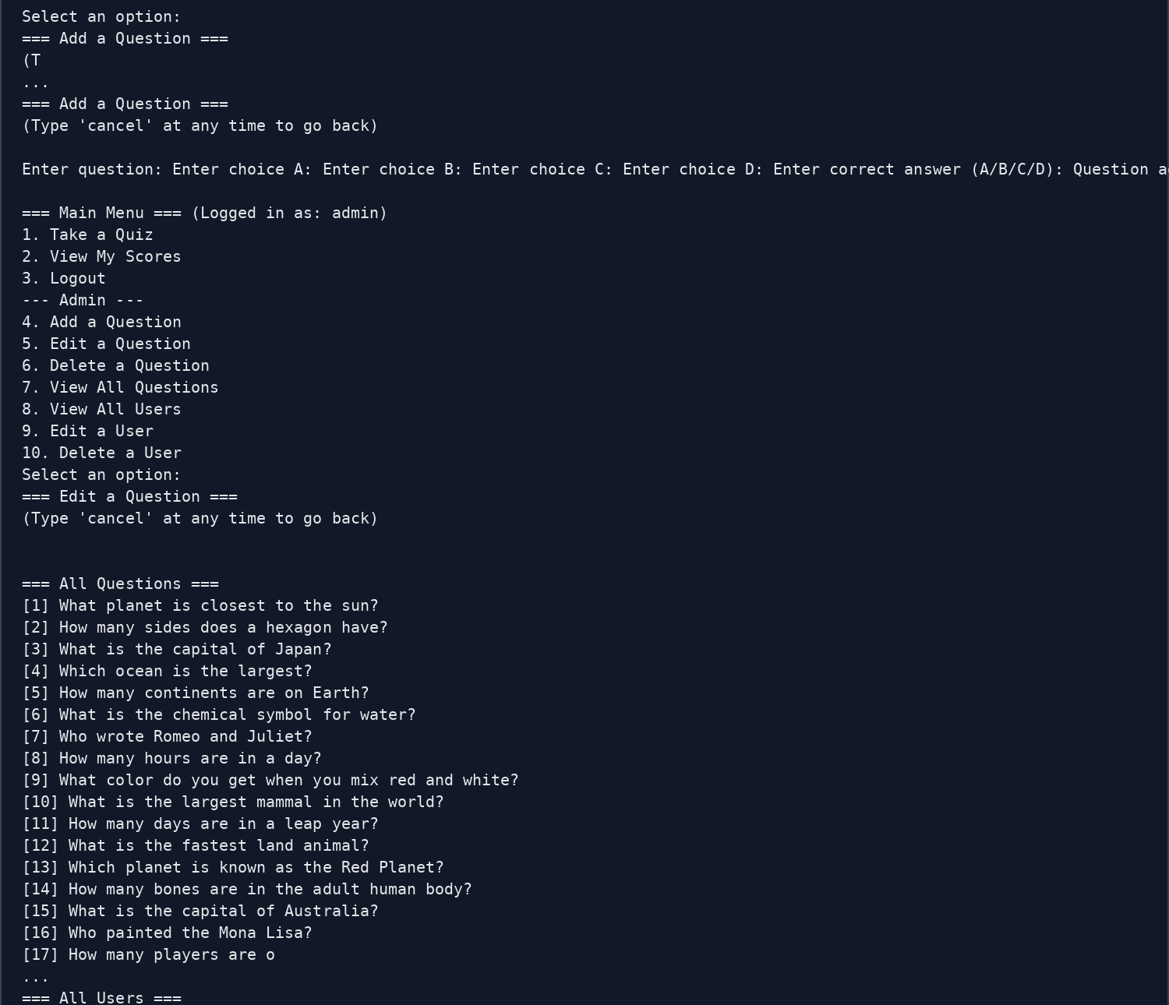
Demo 3 - admin user management
Admins can manage accounts without touching the database manually. The transcript shows promotion, password reset, and deletion.
User management features demonstrated
View all users with role labels.
Edit a user to change username, password, and admin status.
Promote a standard user to admin by setting is_admin = y.
Delete a user account after confirmation.
Promotion example from the transcript
Enter user ID to edit: 2
Enter new username [jorton4]:
Leave password blank to keep the current password.
Is this user an admin? (y/n) [n]: y
User updated successfully.
Proof that the role changed
=== All Users ===
[1] admin - Admin
[2] jorton4 - Admin
Logging in as jorton4 now shows the admin menu.
Notes:
[Sources] - User-provided admin demo screenshot and terminal transcript. - User-provided admin_edit_user and admin_delete_user functionality.

Slide 7
Demo 4 - admin question CRUD and data changes
The app also demonstrates question management directly from the interactive menu.
Question CRUD shown live
Proof of the data changing
View all questions already loaded from the CSV file.
Add a new test question through the admin menu.
View the new question in the question list.
Delete the question with confirmation.
View the list again to prove the deletion worked.
Before delete:
[31] Here is my test question? (Answer A)
After delete:
Question list ends at [30] What year did World War II end?
This proves the app is interacting with SQLite live rather than using static data.
Add question snippet
Delete question snippet
=== Add a Question ===
Enter question: Here is my test question?
Enter choice A: yes
Enter choice B: no
Enter choice C: maybe
Enter choice D: idk
Enter correct answer (A/B/C/D): a
Question added successfully.
=== Delete a Question ===
Enter question ID to delete: 31
Are you sure you want to delete question 31? (y/n): y
Question ID 31 deleted successfully.
Notes:
[Sources] - User-provided terminal transcript. - User-provided admin question CRUD methods in quiz_app.py / QuizDB.py.

Slide 8
Error handling, ethics, and critical thinking
The code goes beyond a happy-path demo by validating input and reducing risky actions.
Error handling
Ethics / critical thinking
OOP and collaboration value
Next improvements
Rejects invalid quiz answers until the user enters A, B, C, or D.
Catches non-numeric IDs during edit and delete operations.
Shows “User ID not found” or “Question ID not found” when records do not exist.
Uses cancel prompts to back out of admin actions safely.
Using Argon2 and getpass protects credentials better than storing plain text passwords.
Role-based access keeps standard users from seeing admin controls.
Delete actions ask for confirmation to avoid accidental data loss.
Stored quiz results provide an honest record of student performance.
Separate classes organize DB logic and application logic.
This structure lets teammates work on setup, import, app flow, and admin logic separately.
Inline comments explain purpose and improve maintainability.
Add better UI formatting for long terminal output.
Improve password reset UX with confirmation.
Add question categories or difficulty levels.
Create a future web front end on top of the same database design.
Notes:
[Sources] - User-provided code and project description. - User-provided terminal transcript showing validation and confirmation flows.

Slide 9
Suggested closing demo script
This slide helps keep the presentation under 10 minutes while covering all required functionality.
0:00-1:00
Introduce the problem: instructors need reusable quizzes, student accounts, and saved results.
1:00-2:00
Explain the 3-table SQLite design and how CSV import populates the database.
2:00-3:30
Show db_setup.py and import_questions.py running successfully.
3:30-5:30
Register a student, take a randomized quiz, and view saved scores.
5:30-8:00
Log in as admin, show users, promote a user to admin, and discuss password hashing.
8:00-9:15
Add and delete a question to prove CRUD against SQLite.
9:15-10:00
Close with rubric alignment, ethics, and future improvements.
Final takeaway: the project now demonstrates setup, import, secure authentication, student quiz-taking, score persistence, admin promotion, admin CRUD, and deletion end to end.
Notes:
[Sources] - User-provided project files, rubric, and terminal transcript.

