Slide 1

Mediatr2azure
https://github.com/jamkin

Slide 2
Why would we write code like this?

Slide 3







Goals
Reduce Development Time
Reduce Configuration Errors
Fully Decouple Business Logic from Code

Slide 4
Inspirations
Entity Framework Code-First
Domain-Driven Design
Infrastructure-as-Code

Slide 5

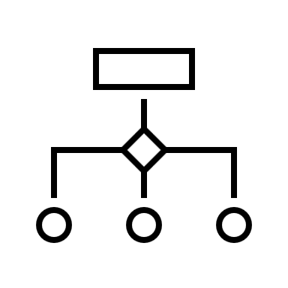




Architecture
Your Code Base
MediatR
Business Objects and Logic
Infra Config
Developed
(C#)
Infra Generation Framework
Extensions
JSON
Infra Builder Core
Application Hosting (C#)
Azure Service Bus
Messaging
Generated
Azure Functions

Slide 6





Architecture (HIGH-Level)
Rather than building core code for service (models, business logic, etc.) directly against physical concepts like reliable message queues (or particularly reliable message queue technology), a framework acts as a bridge from the core code and the “real world”
Ideally, the service layer would not even have an awareness of concept like a “message queue”
Service
Service
Framework
Hosting/Infra
Hosting/Infra

Slide 7


Architecture (Mid-Level)
Domain
Domain-DTO Mappings
Infrastructure Builder
Notifications
Requests
Serialization
Services
Models
Dev Area
Code Generation
Data Transfer Objects
Infra Builder
Extensions
Framework
JSON Serialization
Infrastructure as Code
Azure ARM Generation
Worker
Azure Function App Generation
Generated!

Slide 8


Mediatr-to-azure (V0)
Not Microservices: Create logical division of domain
Worker support for Function App
Messaging support for Service Bus
Fluent API for building worker and messaging layer

Slide 9

Infrastructure builder
MediatR | Azure
1-1 mapping between requests and handlers | Service Bus Queue
1-N mapping between notifications and handlers | Service Bus Topic + Subscriptions
ISender.Send<MyCommand>(…)
…
IRequestHandler.Handle<MyCommand>(…)
…
INotificationHandler.Handle<MyEvent>(…)
IPublisher.Publish<MyEvent>(…)
…
INotificationHandler.Handle<MyEvent>(…)
…
INotificationHandler.Handle<MyEvent>(…)

Slide 10
Ideas for V1+?
Logical groupings can each map to their own SB namespace and FA
Allow more customization over namings (rather than default convention)

Slide 11

Thank You
https://github.com/jamkin

