Slide 1
Data (All observations)
1. Split dataset
2. Split again and find optimal hyper-parameter combination within training set
Training (70%)
Testing (30%)
4. Use final model to predict the testing set
Training
Testing
(Cross-validated x5)
Results
(Repeated for each hyper-parameter combo)
3. Use best
hyper-parameters to retrain model on entire training set
Best
hyper-parameter
combination
Final model

Slide 2
id_var | Item 1 | Item 2 | Item 3 | ... | Item N
1 | soda | cereals | vegetables
2 | cheeses | poultry | Ice cream
...
N
id_var | item_no | items
1 | 1 | soda
1 | 2 | cereals
1 | 3 | vegetables
... | ... | ...
2 | 1 | cheeses
2 | 2 | poulty
2 | 3 | Ice cream
... | ... | ...
N | N

Slide 3
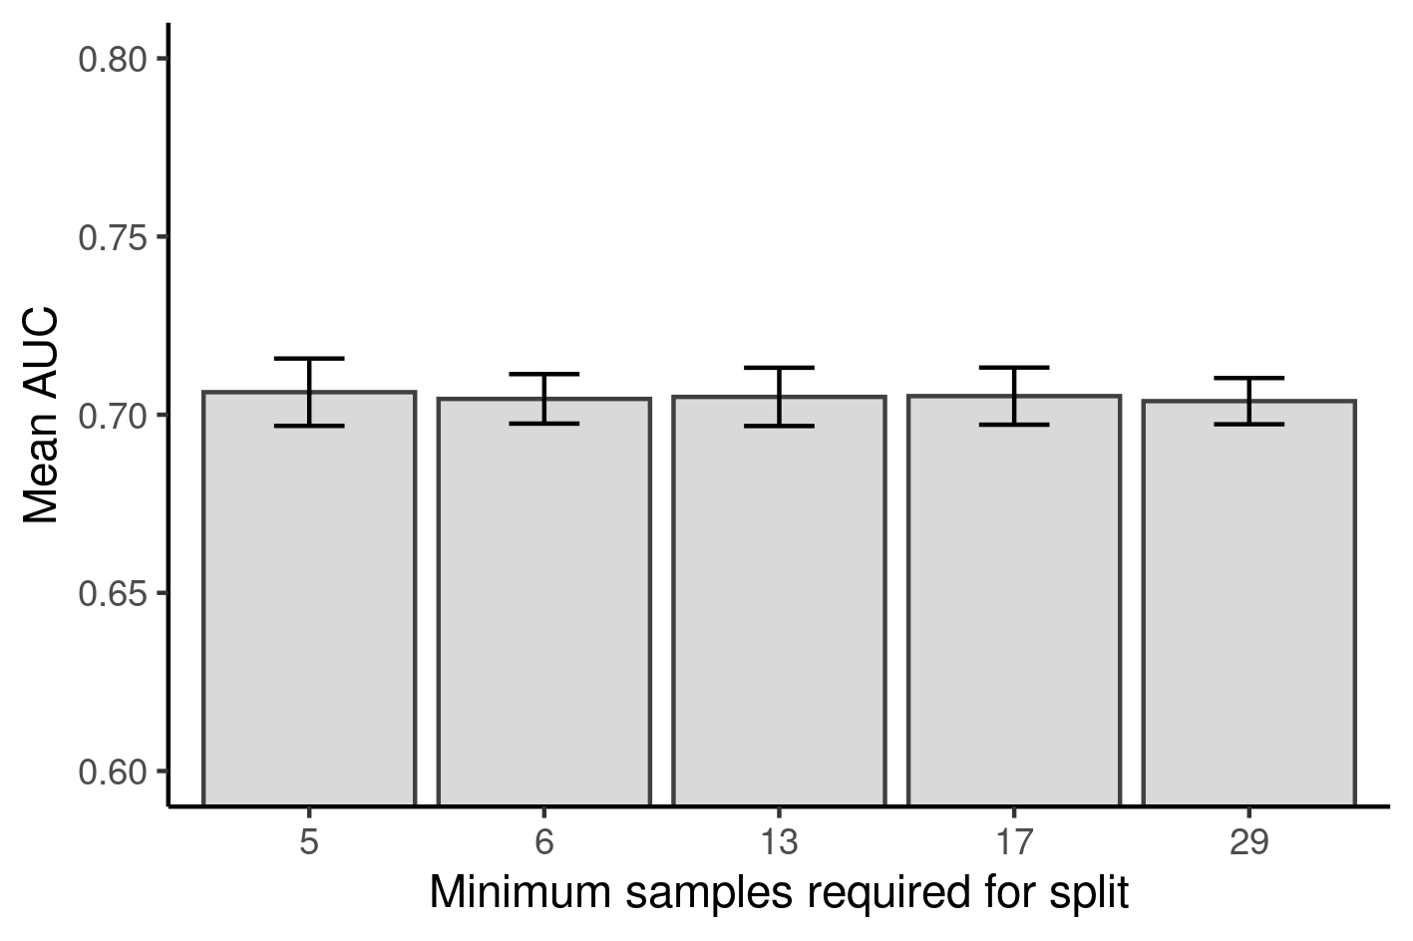
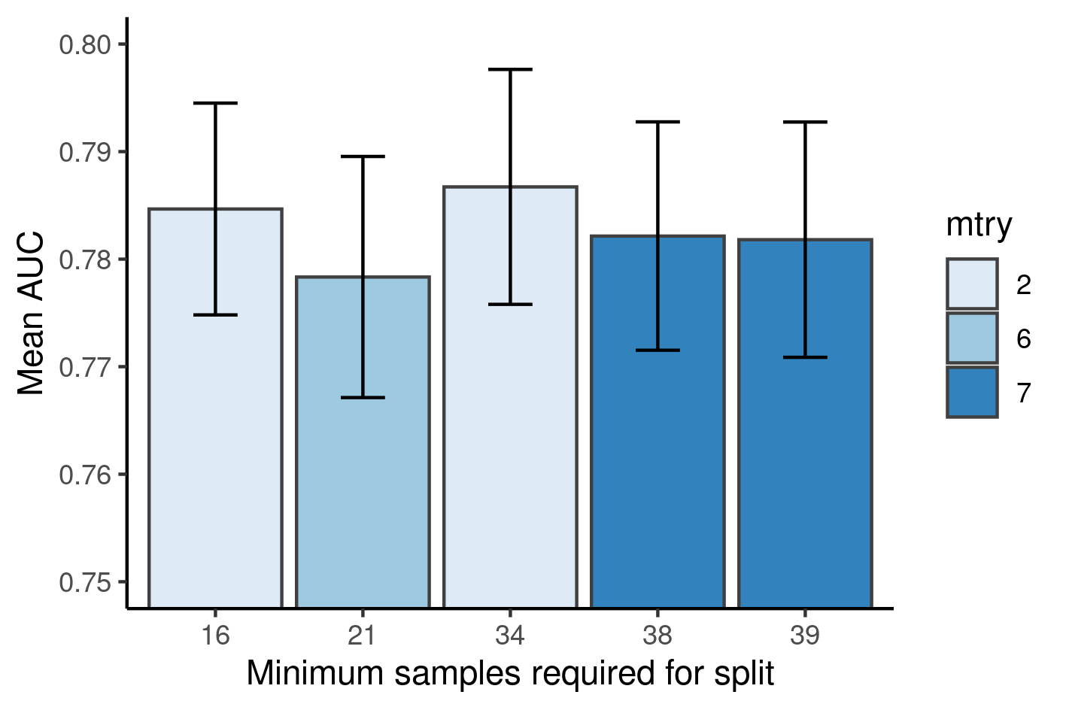
A
B

