Slide 1

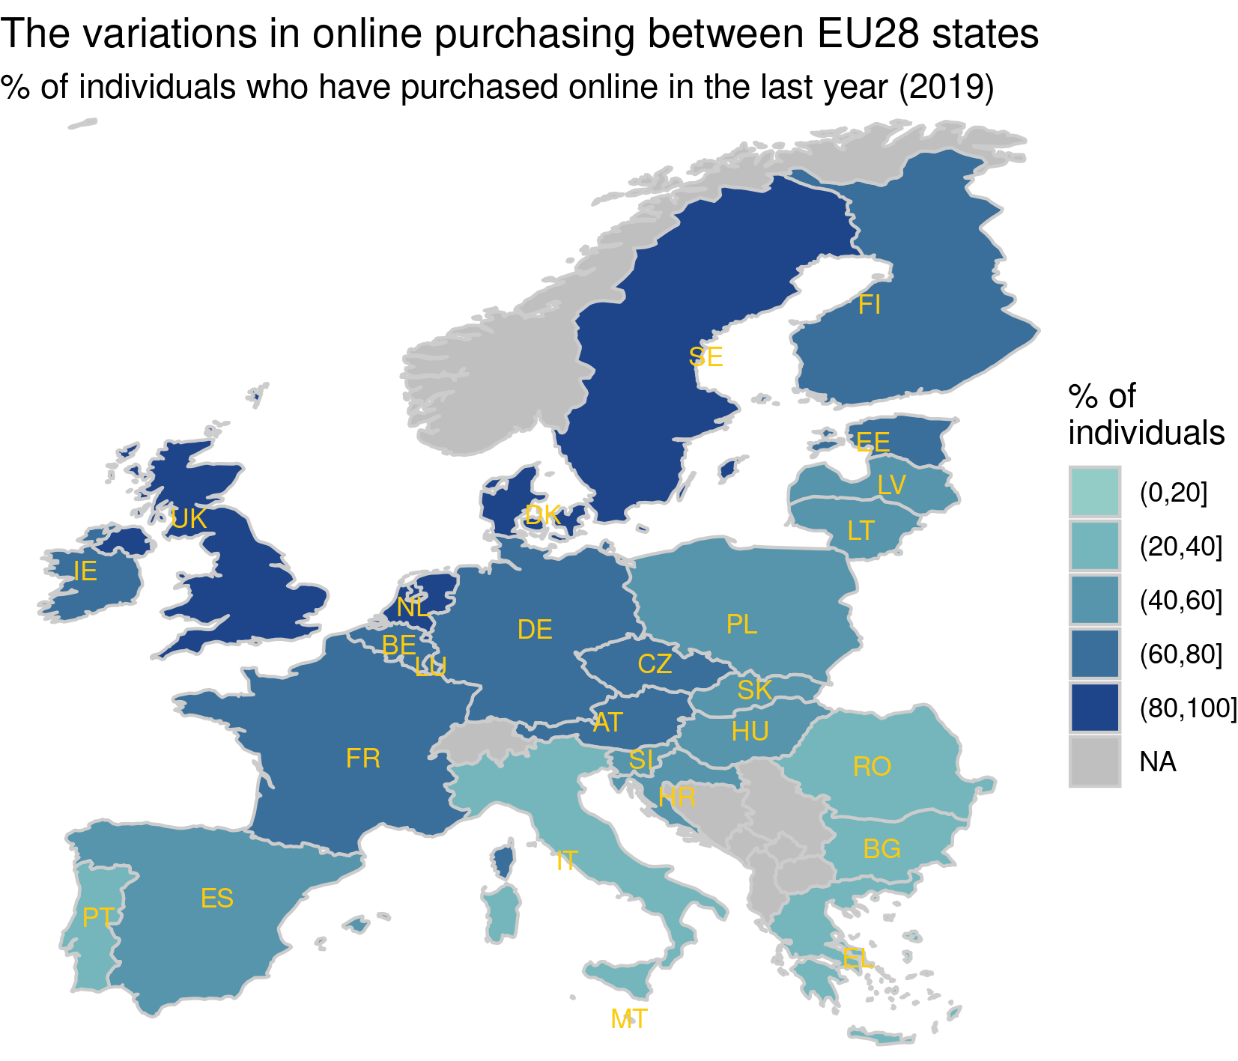



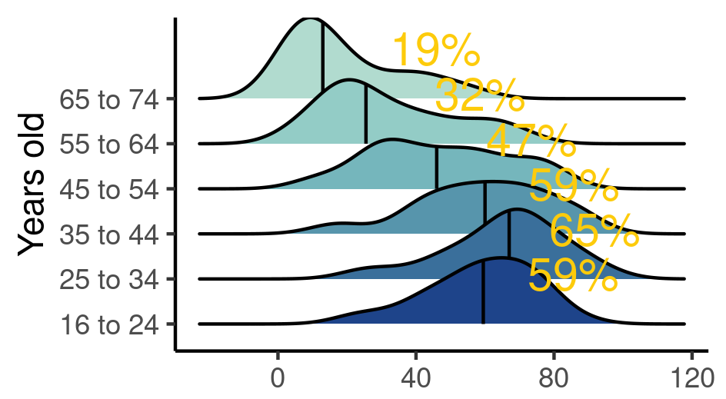





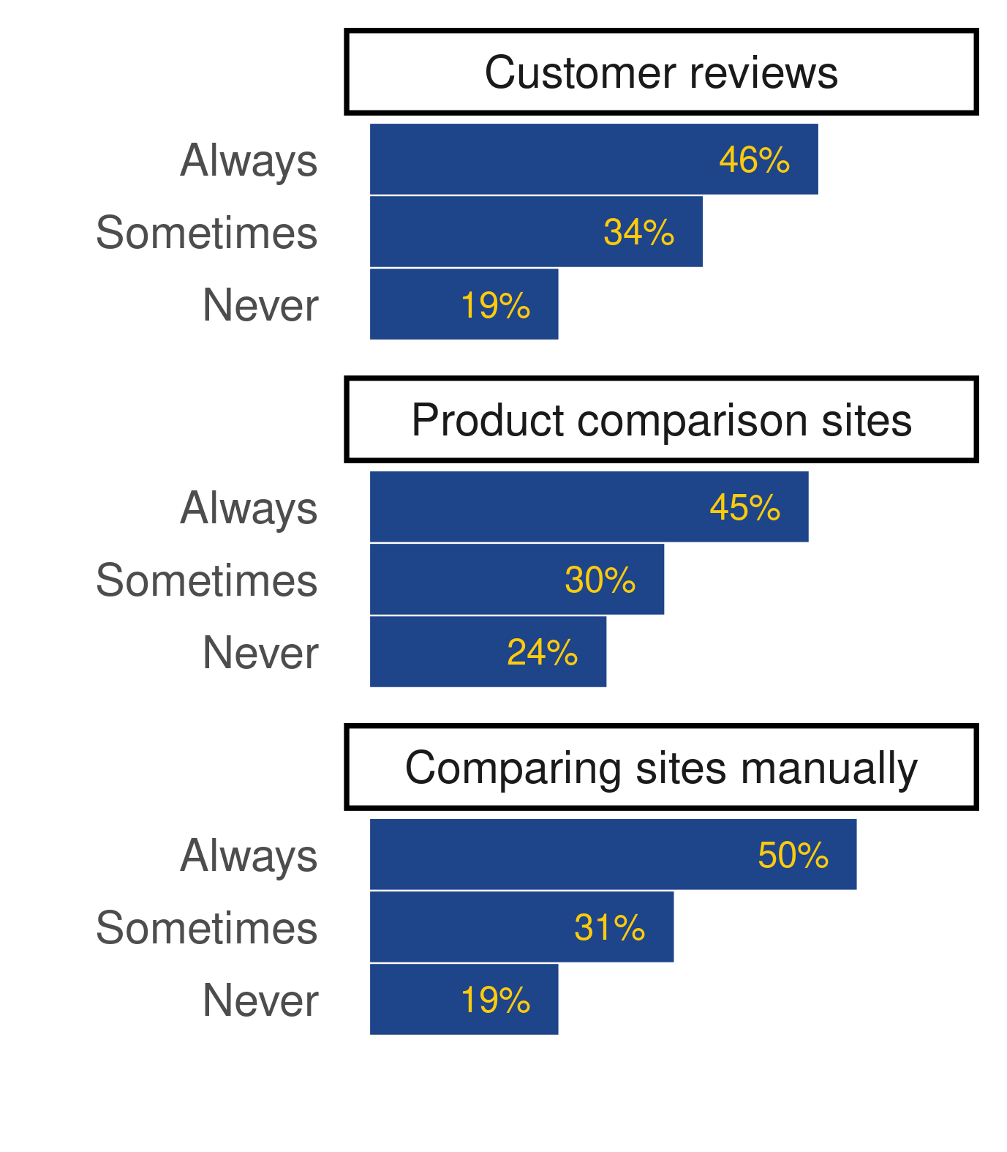
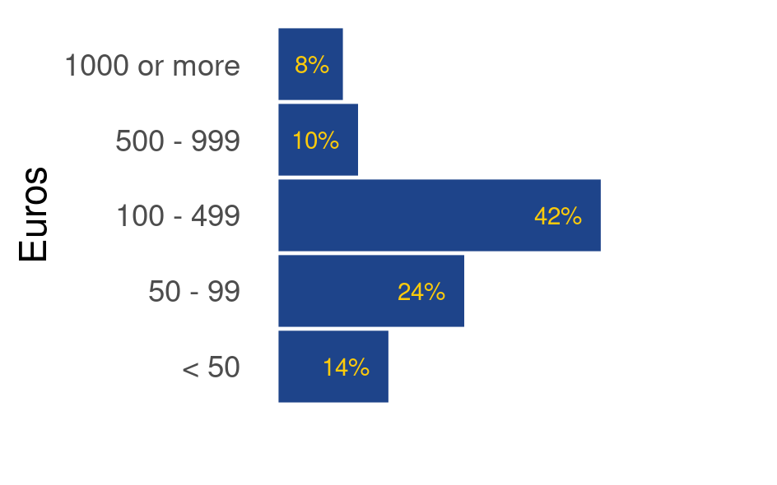






Online shopping in the EU28
Buying online is more popular than ever, but how to the individuals from the EU28 differ?
Data extracted for Eurostat database
Icons with permission of Iconmonstr.com
Which states
shopped online
the most per
capita in 2019?
Are there demographic differences between online shoppers making purchases in the last 3 months?
0 – 20%
20 – 40%
40 – 60%
60 – 80%
80 – 100%
Holidays 74%
Gender
Age
48.5%
Which state’s shoppers
buy the most of these?
Event tickets 70%
45%
Electronics 74%
Household 60%
Do they use strategies when buying online?
Do they encounter problems buying online?
Clothes 76%
How much do they spend in 3 months?
Highest % of individuals in the top and bottom spending brackets
FN 18%
UK 16%
LU 14%
€1000 or
more
LV 42%
PT 37%
BG 36%
< €50

Slide 2





Clothes
Print media
Print media
Bulgaria
76%
Bulgaria
76%
Bulgaria
76%
Clothes 76%
76%
Which states shoppers
buy the most of these?
Event tickets 70%
Household 60%
Holidays 74%
Electronics 74%

