Slide 1

ARCHITECTURE & ATTENTION
What Holds a Claim Up?
Somebody tells you something. Before you decide whether to believe it, ask a different question: what is holding it up, and who pays if it turns out to be wrong?
The argument of the working paper The Architecture of Truth | James Maconochie
Notes:
Eighteen sheets. Part one is the argument, part two a case where everything was in place and it failed anyway, part three the limits.

Slide 2
WHERE THIS SITS
There is more language in the world than anyone can attend to. The obvious fix, an AI that reads it all for you and tells you what is true, does not work: the judgement that would take requires having been wrong at your own expense, and nothing a model does costs it anything. So the judging stays with people, and almost nothing we currently inspect can tell whether a person actually judged or simply agreed.
01
Why Does It All Feel Like Too Much?
02
Why Can’t You Just Be Told?
03
What Holds a Claim Up?
04
How Would You Know?
05
Who Pays If It’s Wrong?
06
What Would You Build Instead?
Six short pieces, each drawn from a working paper. Each one stands on its own; this is the third. They are ordered so that every piece ends by raising the question the next one is called.
Notes:
Apparatus, not argument. The same slide is in all six decks.

Slide 3
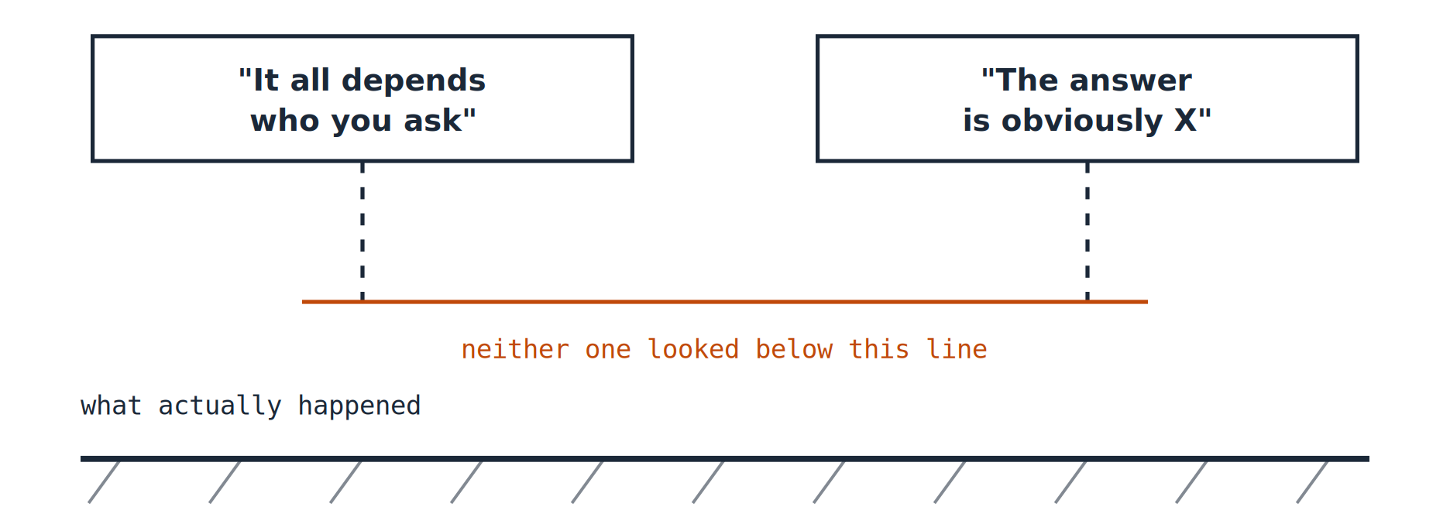
PART ONE · THE ARGUMENT
Two people, one report, two mistakes
One reads it and decides nothing is really true. The other does the arithmetic carefully and announces an answer, when nothing in the report could have settled that question. Both end up holding a conclusion with nothing underneath it.
1
Notes:
These look like opposite failures. They are the same failure.

Slide 4
PART ONE · THE ARGUMENT
This is not a new problem
Eighteen hundred years ago a Roman emperor wrote himself an instruction about exactly this.
"Do not say more to yourself than the first impressions report."
Marcus Aurelius, Meditations, Book 8
Something arrives. We add to it: a cause, a motive, a story. Then we treat the addition as though it had arrived with the observation. That is the whole failure, named before anybody had a printing press, let alone a feed.
2
Notes:
The famous line about opinions and perspectives is a modern condensation, not in the Meditations. This one is real.

Slide 5
PART ONE · THE ARGUMENT
Everything rests on something
A bridge holds because of what it stands on. Not always directly underneath: on a suspension bridge the load runs up the cables, over the towers and down into the anchorages at each end.
But wherever the path goes, it ends in the ground, and an engineer can walk it. A claim works the same way. Almost nobody walks it.
THE LOAD PATH
the deck
the cables
the towers
the anchorages
the ground
This is not about lying. Most claims that fail were made by careful people who believed them. What failed was underneath.
3
Notes:
Support need not be beneath you, but it always terminates in the ground, and it is always walkable.

Slide 6
PART ONE · THE ARGUMENT
The ground has two parts
WHAT HAPPENED
WHY IT HAPPENED
The cup fell. The plane came down at 9:42. The price was 4.7 times income.
You can often see these for yourself.
Nobody has ever seen a why. It has to be worked out.
Working it out is the hardest thing in this whole explanation.
Almost every argument that goes wrong goes wrong here, by treating the second kind as though it were the first.
4
Notes:
Facts and the causal account behind them are different objects with different costs.

Slide 7
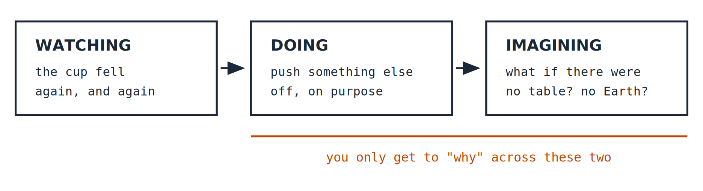
PART ONE · THE ARGUMENT
How you get to a "why"
Watching a hundred things fall off a hundred tables will never give you gravity. Watching only tells you what happened.
Both of the other two cost something. That is why a good story usually arrives first: a story is cheap and a tested cause is expensive.
5
Notes:
Pearl calls these three a ladder: watching, doing, imagining.

Slide 8
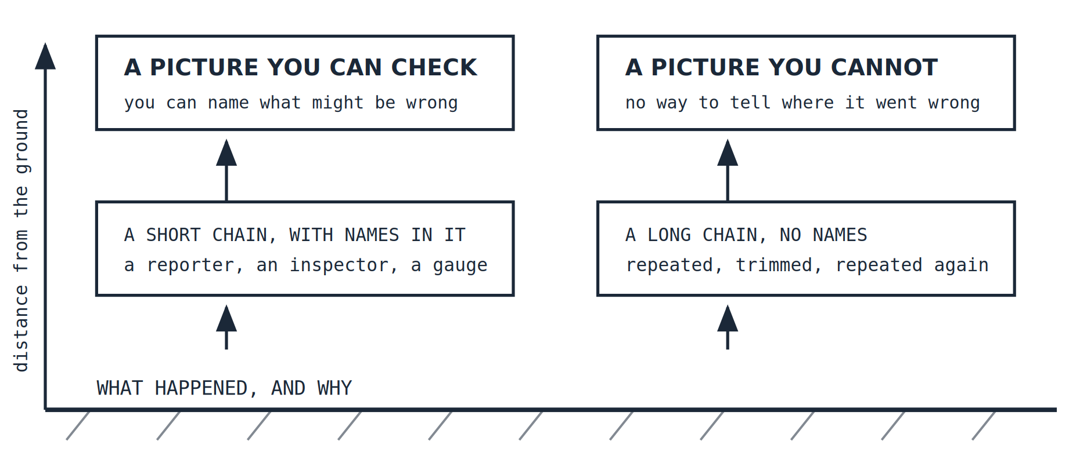
PART ONE · THE ARGUMENT
You were not there
Almost nothing reaches you directly. It travelled. Travelling does not improve it: every step is a place where something could have been dropped, sharpened or misread.
6
Notes:
Further from the ground, not higher up. What separates the two is whether you can name the fault.

Slide 9
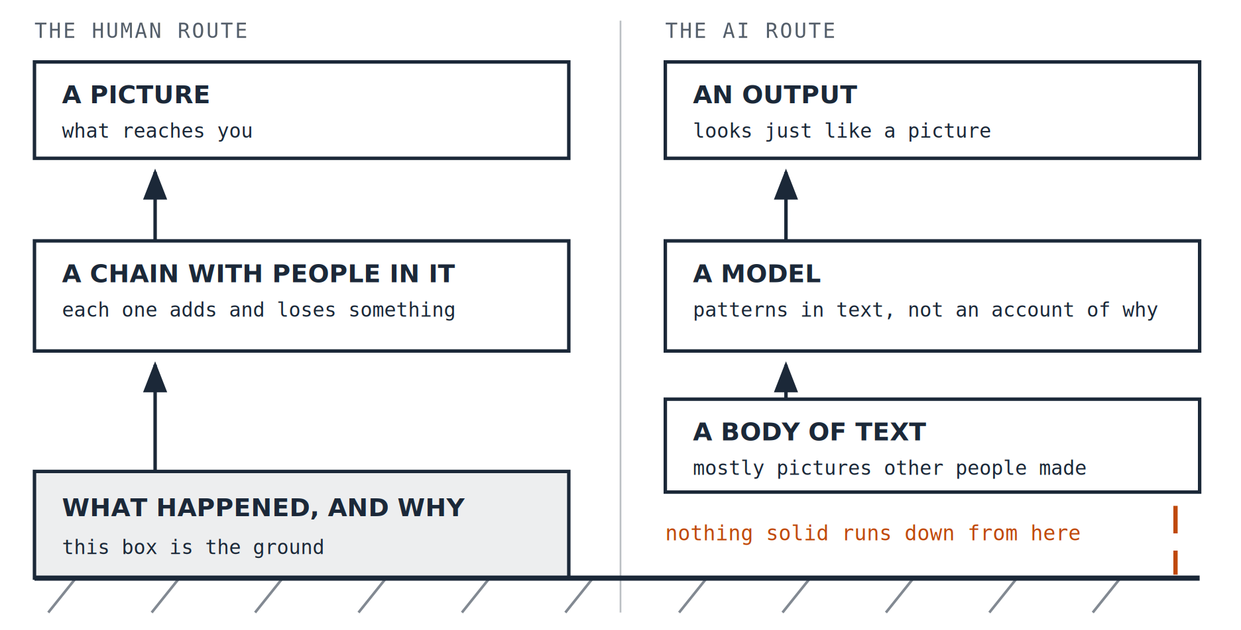
PART ONE · THE ARGUMENT
One new thing is not a longer chain
A newspaper report, however poor, starts at something that happened. An AI answer starts somewhere else: the training reads text, it does not go to the places the text describes.
7
Notes:
This does not mean an AI answer cannot be checked. It means you cannot check it by reading it.

Slide 10
PART ONE · THE ARGUMENT
Four questions worth asking
These are the questions people ask when being wrong is expensive: an accident investigator, an engineer signing off a structure, a doctor choosing a treatment.
IS THE CAUSE REAL?
WOULD THEY HAVE DISAGREED?
HAS ANYONE ATTACKED IT?
HAS IT LASTED?
Not "does this story hang together", but has anybody changed something on purpose and watched what happened.
Three papers running the same wire story are not three witnesses. Agreement counts only when disagreement was possible.
Being open to criticism produces no criticism. Only criticism does. Did somebody with skill and a motive try?
Does anyone keep a record of what was claimed before, and does anyone go back and read it?
8
Notes:
Formally: cause, independence, attack, time.

Slide 11
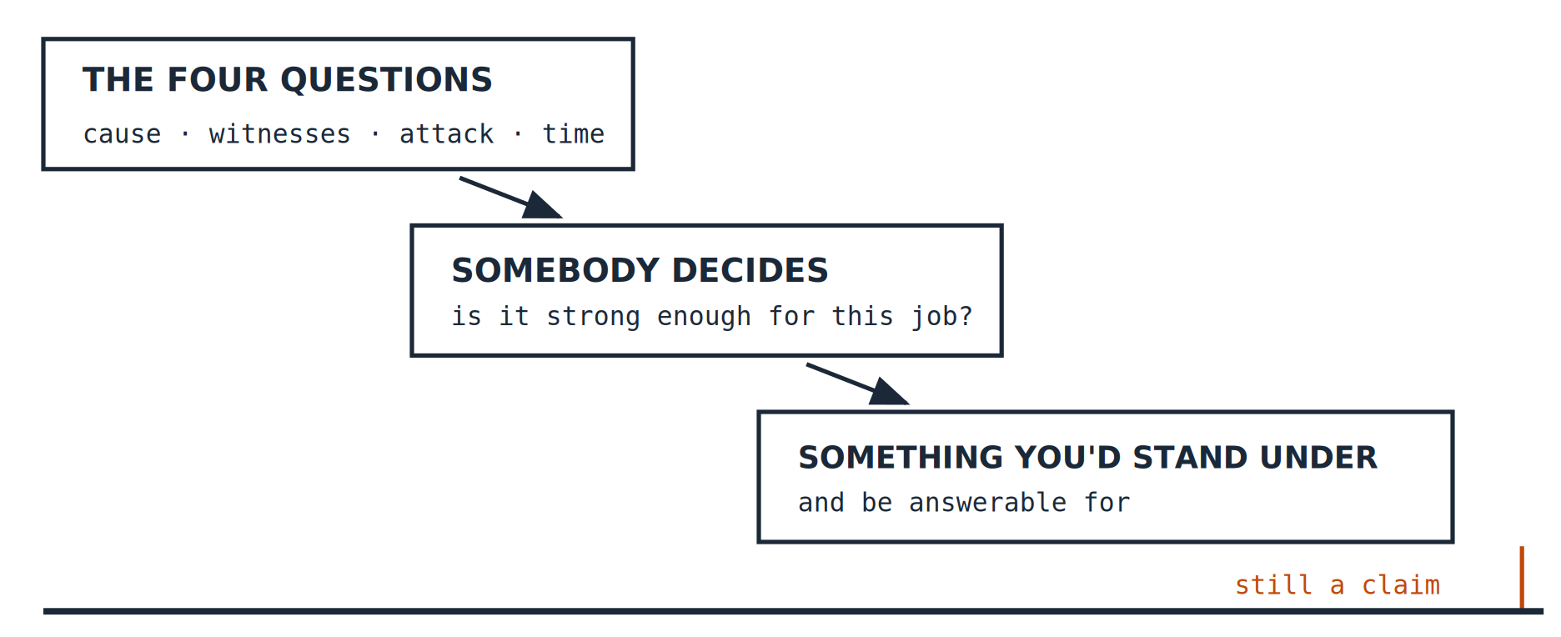
PART ONE · THE ARGUMENT
Passing is not the same as being true
Clear all four and you have something worth taking seriously. You do not yet have something to act on.
9
Notes:
The questions shorten the drop. They never close it.

Slide 12
PART ONE · THE ARGUMENT
Somebody has to decide, and no procedure does it
After the questions have been asked and answered well, a person still has to look at the claim, look at the decision it is about to be used for, and say: that is strong enough for this.
Nothing performs that step. Not a checklist, not a model, not a committee process.
10
Notes:
This is the hinge of the whole argument, and the reason the paper exists.

Slide 13
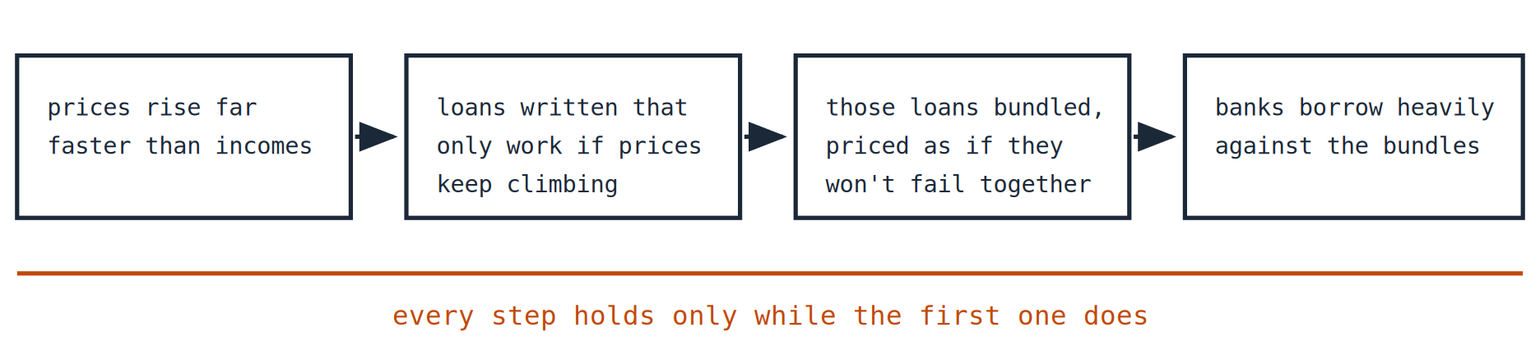
PART TWO · WHAT IT LOOKS LIKE WHEN IT FAILS
The Federal Reserve, 2006
America's central bank: the one body with the independence, the data and the standing to say out loud that something was building up. Every support was in place, and the thing fell down anyway.
4.7 × INCOME
23% → 38%
What a typical house cost against a typical income in 2005, the highest since at least 1980.
Harvard Joint Center for Housing Studies
Share of subprime loans written with little or no proof of income, 2001 to 2007.
Demyanyk & Van Hemert, Review of Financial Studies, 2011
11
Notes:
Both facts were public. What made them dangerous was how they were joined to each other.

Slide 14
PART TWO · WHAT IT LOOKS LIKE WHEN IT FAILS
The Fed had everything you would want
INDEPENDENCE
ACCESS
DISSENT
PUBLICATION
LONG MEMORY
Written into law, with terms longer than any president’s.
Better access to the underlying data than anybody else had.
Disagreements recorded, and votes on the record.
Meeting transcripts released, on a delay.
Decisions argued over for decades afterwards.
Every support described in part one was present at the Federal Reserve and in working order. The people in the room were not fools and were not lying.
12
Notes:
If sound structure guaranteed sound judgement, there would be nothing here worth saying.

Slide 15
PART TWO · WHAT IT LOOKS LIKE WHEN IT FAILS
The four questions, as they actually went
Is the cause real? | Asked, and answered using an explanation of the calm years that nobody had retested for the conditions it was now being applied to.
Would people with reason to disagree agree anyway? | They agreed. But they had read the same work, used the same data, and had similar reasons to prefer things continuing. The agreement was inherited.
Has anyone tried to break it? | Yes, and not quietly. Warnings were published years ahead, specific and quantified, and made directly to the Chairman. They were heard, and never retested.
Has it lasted? | About twenty unusually calm years. Not long enough to tell a lasting change from a quiet stretch, and this is the one question that cannot be hurried.
13
Notes:
The two in orange failed in ways that are hard to see from outside.

Slide 16
PART TWO · WHAT IT LOOKS LIKE WHEN IT FAILS
The sentence that shows how it happened
"there are stories one can tell about fundamentals that would explain or rationalize housing prices"
A member of the Federal Open Market Committee, the Federal Reserve's rate-setting body, from the published transcripts
Every part of that is defensible. What it is not is a test. A story that hangs together was allowed to do the work that evidence should have done.
14
Notes:
This is the cause question failing while appearing to pass.

Slide 17
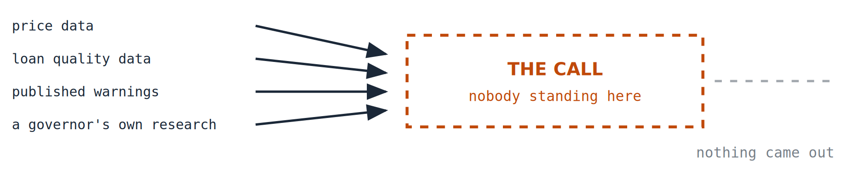
PART TWO · WHAT IT LOOKS LIKE WHEN IT FAILS
Nobody made the call
Not because the Fed lacked the data. Not because the system was broken. Not because anyone was stupid or corrupt. The last step belongs to a person, and in that room, at that time, no one took it.
15
Notes:
The box was not missing from the design. It was there, and it was empty.

Slide 18
PART THREE · LIMITS, AND WHAT TO DO WITH IT
What this does not claim
Short versions tend to overstate. Here is what this one is not saying.
✕
The Federal Reserve caused the financial crisis.
It did not. The case here is narrower: a question was in front of an institution built to answer it, and the answer was never given.
✕
Good structure produces good judgement.
The opposite, and that is the entire point. The Fed in 2006 had the structure and did not make the judgement.
✕
AI output cannot be trusted or checked.
It can be checked, but not by reading it. You have to go behind it to the sources, which is expensive and often impossible.
16
Notes:
Almost nothing in this genre says what it does not claim.

Slide 19
PART THREE · LIMITS, AND WHAT TO DO WITH IT
Three things to ask about anything you are handed
1. HOW FAR HAS IT TRAVELLED?
2. WHO TRIED TO BREAK IT?
3. WHO PAYS IF IT IS WRONG?
Count the hands it passed through on the way to you. If you cannot count them, that is the answer.
Not whether criticism was allowed. Whether it happened, and whether anything was retested afterwards.
A claim nobody pays for when it fails is a different kind of object from one somebody does.
None of these asks whether the person sounds confident, which is the signal most of us actually use.
17
Notes:
These three are the practical payoff.

Slide 20
PART THREE · LIMITS, AND WHAT TO DO WITH IT
Where this comes from
This is a short version of a working paper called The Architecture of Truth, which runs to about fifty pages and carries the evidence, the sources and the objections, including the ones that have not been answered.
It is part of a series on what judgement is, why it has to be carried by people who bear the consequences of being wrong, and what that means for building with machines that bear none.
Working papers are revised when they are shown to be wrong, and what changed is kept on the record.
James Maconochie | Architecture & Attention
HUMILITAS, HUMANITAS, ET CURIOSITAS · SEMPER
Humility, humanity, and curiosity. Always.
18
Notes:
End.

