Slide 1

ARCHITECTURE & ATTENTION
Who Pays If It’s Wrong?
Hundreds of billions of dollars are riding on a particular bet about how AI gets better. The bet may well come off. This is about what happens to everybody else if it does not.
The argument of the working paper When the Music Stops | James Maconochie
Notes:
Seventeen sheets. The bet, where it is thin, who carries the cost, and the limits. Every figure in this deck prints its own caveat.

Slide 2
WHERE THIS SITS
There is more language in the world than anyone can attend to. The obvious fix, an AI that reads it all for you and tells you what is true, does not work: the judgement that would take requires having been wrong at your own expense, and nothing a model does costs it anything. So the judging stays with people, and almost nothing we currently inspect can tell whether a person actually judged or simply agreed.
01
Why Does It All Feel Like Too Much?
02
Why Can’t You Just Be Told?
03
What Holds a Claim Up?
04
How Would You Know?
05
Who Pays If It’s Wrong?
06
What Would You Build Instead?
Six short pieces, each drawn from a working paper. Each one stands on its own; this is the fifth. They are ordered so that every piece ends by raising the question the next one is called.
Notes:
Apparatus, not argument. The same slide is in all six decks.

Slide 3
PART ONE · THE BET
You are probably in it already
If you have a pension, a workplace retirement plan, or money in an index fund, you own a piece of this. Not because you decided to back artificial intelligence, but because the funds most people’s savings sit in hold the whole market, and a handful of AI-exposed companies have become a very large part of what the whole market is.
Nobody asked you. There was no form. The exposure arrived through the ordinary machinery of saving sensibly.
This is not about whether the bet is a good one. That is genuinely arguable, and the paper says so repeatedly. The question is who is holding it.
1
Notes:
The recognition line. Most people in the room own this exposure and did not choose it.

Slide 4
PART ONE · THE BET
What the bet actually says
Underneath the spending is an argument with four steps. It is rarely written down in one place, because each step is usually used to justify the next rather than stated on its own.
01 SCALING WORKS
02 SO AGI FOLLOWS
03 SO THE SPENDING IS JUSTIFIED
04 SO THE WINNER TAKES MOST
Bigger models keep getting better as they get bigger.
Or at the very least, a huge jump in what can be produced.
Hundreds of billions of dollars, committed up front.
Which rewards spending early, and spending hard.
The paper calls this a reasonable bet in the same breath as calling it a bet, and both halves of that sentence are doing work. Every one of the four steps holds only while the first one does.
2
Notes:
What it instantiates: valuations presuming capture of a large share of future knowledge work, and infrastructure spend that only makes sense on economy-wide transformation. Training costs front-loaded, inference revenue to follow.

Slide 5
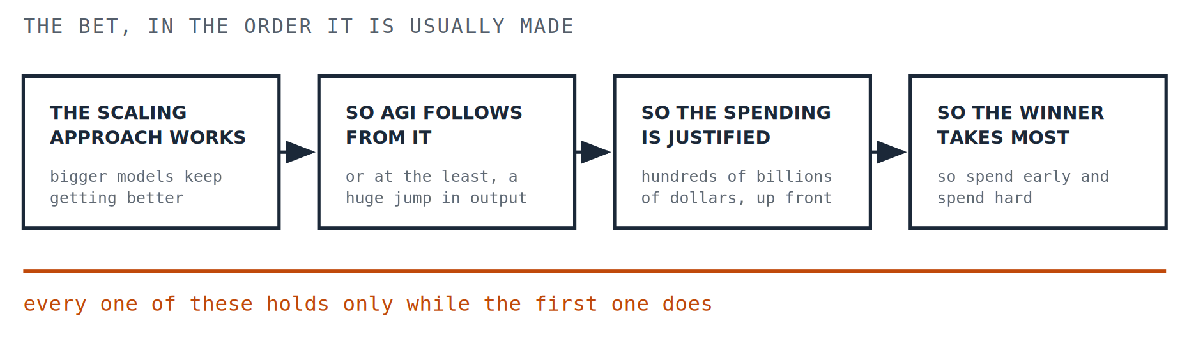
PART ONE · THE BET · CONTINUED
Four steps, one dependency
The rule underneath is the diagram. The boxes are only its evidence.
2 / 2
Notes:
Four separate-looking risks that are one risk at four sizes.

Slide 6
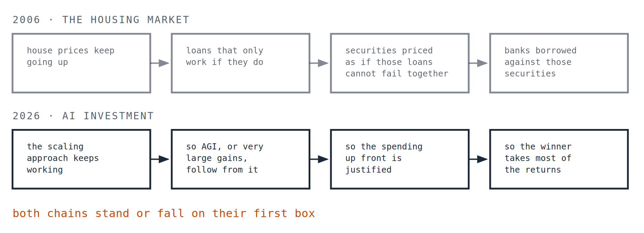
PART ONE · THE BET
You have seen this shape before
What Holds a Claim Up? finds the housing market of 2006 stacked exactly this way.
3
Notes:
The caveat is the point: 2006 was corrupted incentives, no-doc loans, and ratings that did not describe what they rated. None of that is alleged here. What is shared is the structure, and only the structure. That caveat is the first thing that would fall off a short version and the thing that keeps the comparison worth making.

Slide 7
PART ONE · THE BET
Four people who think the first step is wrong
The whole chain rests on step one. So it matters that four well-credentialled researchers, from four different directions, think step one does not hold.
YANN LECUN
GARY MARCUS
RODNEY BROOKS
FRANÇOIS CHOLLET
A Turing Award winner and for a decade Meta’s chief AI scientist. Language models are useful, but are a turning off the road to human-level intelligence.
The reasoning gap is not closing at the rate the scaling story requires, and what looks like reasoning is often retrieval wearing its clothes.
When people watch a system do one thing well they assume it can do the neighbouring things, and are usually far too optimistic about that.
Memorisation is useful and is not intelligence. On his benchmark, built to test that, one leading model scored about 5 per cent where people score 84.
And the honest part: these four are not the consensus. Plenty of serious researchers still expect scaling plus refinement to keep delivering, and the paper’s own limitations concede that surveying four critics risks making the field sound more settled against scaling than it is.
4
Notes:
The concession belongs on the slide, not in a note. Without it this is a stacked panel.

Slide 8
PART ONE · THE BET
Useful and overhyped are not mutually exclusive
There is a strong pull, in any argument about this, to pick a side: either the technology is real and the money is fine, or the money is mad and the technology is a trick. Both are more comfortable than the position the paper actually takes.
Useful and overhyped are not mutually exclusive.
The sentence the paper flags as the most important one in its section on historical parallels
A technology can be genuinely important and the financial structure built around it can still have run ahead of what it has been shown to return. Those are two claims about two different things, and holding both is not fence-sitting.
5
Notes:
Identifying bubble-like structure is not calling AI fraudulent, and not predicting an imminent crash.

Slide 9
PART TWO · WHERE IT IS THIN
Three cracks
None of these says the bet fails. Each is a place where the structure is thinner than the spending assumes.
THE ADOPTION GAP
WHO IS MAKING MONEY
DEMO TO DEPLOYMENT
The distance between organisations trying AI and organisations running something important on it. Pilots are plentiful. Production is not.
Most revenue so far belongs to the companies selling the equipment rather than the companies using it. One leading AI firm is reported to have lost around five billion dollars in 2024.
A system that is ninety per cent right is a remarkable demonstration. For work where being wrong carries a cost, the remaining ten per cent is the entire problem.
The loss figure comes from business journalism rather than audited accounts: an informed estimate, not a verified fact.
6
Notes:
The shovel-seller framing. Nvidia’s revenue is real; the question is whose returns justify it.

Slide 10
PART TWO · WHERE IT IS THIN
How much of the market this now is
The reason a wrong bet would not stay with the people who made it is arithmetic rather than conspiracy.
about 30%
roughly ¾
about 60%
of the total value of the S&P 500 sat in seven large technology companies, as of late 2025.
of the index’s returns since ChatGPT are attributable to a small set of AI-exposed companies.
of American workers are in an employer-sponsored retirement plan, most holding broad market funds.
S&P Global, 2025. A point-in-time figure that moves with the market; quoted for order of magnitude, not as today’s number.
S&P Global, 2025. The paper calls this directional rather than measured: published figures run from about 60 per cent to over 80, depending on window, index method, and what counts as AI-related.
Investment Company Institute, 2024.
Put those together and a decline concentrated in those companies does not stay in those companies.
7
Notes:
Every figure on this slide prints its own caveat. That is the deliberate difference between this deck and the others.

Slide 11
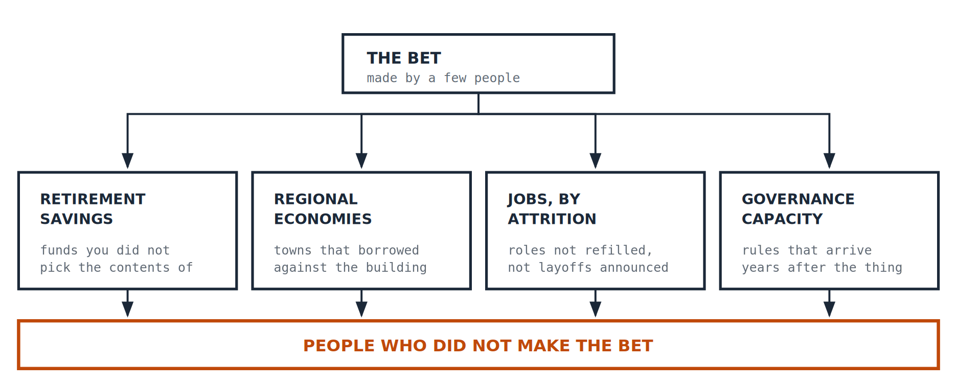
PART THREE · WHO PAYS
Four ways the cost travels
Corrections are painful. The claim is that the pain lands somewhere specific, and not where the decisions were made.
8
Notes:
The asymmetry is the argument; the four channels are only how it travels.

Slide 12
PART THREE · WHO PAYS
The one in your account
A target-date fund is the most sensible, least adventurous thing a person can do with retirement money. It is also, right now, a concentrated position in a handful of companies, arrived at by following advice that was good advice.
The people who made this bet deliberately have options an ordinary saver does not: they can spread the risk, insure against it, and get out at a time of their choosing.
So the group that made the decision and the group carrying the consequence are largely different groups of people. That is the paper’s central distributional claim, and it does not require anybody to have behaved badly.
9
Notes:
No villain is needed for this argument to work, which is what makes it hard to dismiss.

Slide 13
PART THREE · WHO PAYS
The towns that built for it
Data centres land in particular places: northern Virginia, central Oregon, west Texas, parts of the Midwest. The construction work is real and it is temporary. The permanent staffing of a finished facility is small relative to how much ground it covers. Meanwhile local governments issue bonds and plan budgets against the tax revenue those facilities are expected to produce.
Around 2000 the same thing happened with fibre-optic cable: towns built for traffic that did not come, and were left with unused capacity in the ground and budgets planned around growth that never arrived.
The current build is larger, and it is more concentrated in fewer places.
10
Notes:
Dark fibre, unfinished developments, municipal budgets planned around growth that never arrived.

Slide 14
PART THREE · WHO PAYS
Nobody announces this one
The way work actually disappears is not a press release about artificial intelligence. It is a role that does not get refilled when somebody leaves, a team restructured into a smaller one, a set of tasks that quietly moves.
WHAT IS UNSETTLED
WHAT IS NOT
Whether AI ends up destroying more work than it creates is genuinely open among economists. The paper cites both sides and resolves neither. The data is too young.
That the transition costs something, that it costs it to particular people in a particular decade of their lives, and that aggregate figures hide exactly that.
The author writes himself into this section rather than observing it from outside: after twenty-five years in technology consulting, made redundant in September 2023, then roughly a year looking for the same kind of job before deciding to do something else. He notes he had savings, a family, and a background that made the pivot possible, and that most people in that position have none of those.
11
Notes:
That cost does not appear in any aggregate statistic. Deliberately placed where the claim is weakest, not where it is strongest.

Slide 15
PART THREE · WHO PAYS
The slowest channel
The fourth route is the one with no obvious victim, which is why it tends to go unmentioned.
COMPLEXITY
SPEED
WHICH LEVEL DECIDES
ATTENTION
When the only people who understand a system work for the companies building it, those meant to govern it become dependent on them.
Capability moves in months. Legislation moves in years. The result is not deliberate deregulation; it is deregulation by default.
Where national rules override state and local ones, the places carrying the local consequences have the least say over them.
The public has a limited amount of it and this subject is tiring. That is a problem with how the information reaches people, not with the people.
None of this is corruption, which is exactly what makes it hard. Each one makes the next harder to fix, and between them they leave a gap filled by the organisations that most needed governing.
12
Notes:
Regulatory capture through complexity, the speed mismatch, preemption, and the democratic attention deficit.

Slide 16
PART FOUR · LIMITS, AND WHAT TO DO WITH IT
If not this, then what
The paper does not stop at the diagnosis, but it is modest about the alternative, and so is this slide.
Shift the aim from building something that replaces the person to building something that makes a person’s judgement go further. That is also a cheaper thing to build, because it does not require solving general intelligence first.
A companion piece, What Would You Build Instead?, sets out what such a system looks like and what it would commit to. The paper itself is careful to call this a direction rather than a specification, and says plainly that its author would need collaborators to turn it into one.
13
Notes:
Shifting capital intensity from hyperscale GPU clusters toward interface design and domain tooling also reduces the concentration risk.

Slide 17
PART FOUR · LIMITS, AND WHAT TO DO WITH IT
What this does not claim
Compression is where a careful argument turns into a loud one. So, explicitly.
✕
A crash is coming.
Not the claim, and not a prediction. The stated purpose is to identify where the structure is fragile and who is hurt if it gives.
✕
AI is a fraud, or useless.
The technology is treated throughout as real and important. Fragility is a claim about the financial structure on top of it.
✕
The experts agree scaling has stalled.
They do not. Four critics are surveyed, and the paper concedes four critics are not a consensus.
✕
AI is destroying jobs.
The economics is unsettled and the paper leaves it unsettled. The narrower claim is that the transition has costs that fall on identifiable people.
✕
The author has no stake in this.
He states the opposite: displaced from the industry himself, and flags that this may incline him to read the signals as more threatening than they are.
14
Notes:
The last one is the author’s own declared bias, promoted rather than buried.

Slide 18
PART FOUR · LIMITS, AND WHAT TO DO WITH IT
Where these numbers come from
No other piece in this series has this slide, and this one needs it. The figures are not all the same quality, and the paper says which are which rather than letting the strongest-sounding ones carry the argument.
ADOPTION
CONCENTRATION
COMPANY LOSSES
Official statistics put business use of AI under about 10 per cent on a narrow definition. Private surveys using broader ones reach upward of 50. The paper uses the low figure deliberately.
The three-quarters-of-returns figure is directional. Published estimates run from about 60 per cent to over 80 depending on method.
Revenue and loss figures for private AI companies come from business journalism, not audited accounts. Informed estimates, not verified facts.
Three more in the paper: the 1.5 trillion dollar bond projection is a forecast rather than an observation, the labour question is genuinely open in the literature, and the energy figure comes from equity research rather than disclosures.
15
Notes:
This is the sheet that makes the rest publishable.

Slide 19
PART FOUR · LIMITS, AND WHAT TO DO WITH IT
Three questions worth asking out loud
1. WHO DECIDED, AND WHO IS HOLDING IT?
2. WHAT WOULD HAVE TO BE TRUE FOR THIS TO WORK?
3. WHERE IS THE NUMBER FROM?
If those are the same people, this is just investing. If they are different people, it is something else, and the difference is the whole subject.
Ask it of the four steps. A chain where everything rests on one claim is not four risks. It is one risk, four times.
Survey or census. Audited or reported. Measured or projected. The difference between a figure that can bear weight and one that cannot.
16
Notes:
The third works on this deck too, which is the point of slide 15.

Slide 20
PART FOUR · LIMITS, AND WHAT TO DO WITH IT
Where this comes from
This is a short version of a working paper called When the Music Stops, which carries the full argument, the sources, the limitations and the open questions, including the ones the author cannot answer.
Part of a series on what judgement is, and why it has to be carried by people who bear the consequences of being wrong.
If we do not choose the architecture, the architecture will choose us.
Working papers are revised when they are shown to be wrong, and what changed is kept on the record.
James Maconochie | Architecture & Attention
HUMILITAS, HUMANITAS, ET CURIOSITAS · SEMPER
Humility, humanity, and curiosity. Always.
17
Notes:
End.

