Slide 1


ARCHITECTURE & ATTENTION
Why Can't You Just Be Told?
Somebody once gave you exactly the right advice and you did not use it. You understood every word. You still had to get it wrong yourself before it meant anything.
The argument of the working paper The Wisdom Gap | James Maconochie
Notes:
Seventeen sheets. The argument, then what it costs measured, then the limits.

Slide 2
WHERE THIS SITS
There is more language in the world than anyone can attend to. The obvious fix, an AI that reads it all for you and tells you what is true, does not work: the judgement that would take requires having been wrong at your own expense, and nothing a model does costs it anything. So the judging stays with people, and almost nothing we currently inspect can tell whether a person actually judged or simply agreed.
01
Why Does It All Feel Like Too Much?
02
Why Can’t You Just Be Told?
03
What Holds a Claim Up?
04
How Would You Know?
05
Who Pays If It’s Wrong?
06
What Would You Build Instead?
Six short pieces, each drawn from a working paper. Each one stands on its own; this is the second. They are ordered so that every piece ends by raising the question the next one is called.
Notes:
Apparatus, not argument. The same slide is in all six decks.

Slide 3
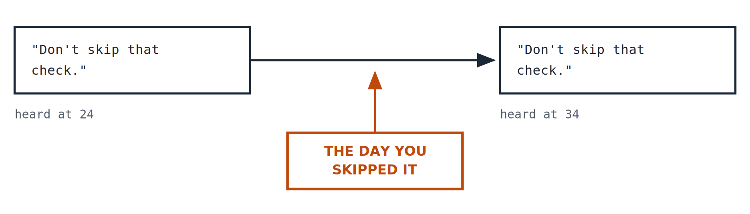
PART ONE · THE ARGUMENT
Advice you did not use
Think of something you were told early on that turned out to be completely true, and that you ignored, or nodded at, or filed away. Then think of the day it finally landed, which was almost certainly the day it cost you something.
1
Notes:
Nothing about the sentence changed. You did. And the thing that changed you was not hearing it again.

Slide 4
PART ONE · THE ARGUMENT
Four different things, not one pile
DATA
INFORMATION
KNOWLEDGE
WISDOM
A reading. 38.2 degrees. 160 over 95. Four millimetres of deflection.
That reading put in context. Compared with what it should be.
The pattern across many such readings, and what to do about it.
Treated by almost everyone as simply more knowledge. It is not.
The first three are a stack. The fourth is a different kind of thing, arrived at a different way.
2
Notes:
Ackoff’s stack, with the last step doing something the first three do not.

Slide 5
PART ONE · THE ARGUMENT
The last step is the odd one
The first three can be handed over. I can give you my data. I can give you my information. With more effort I can teach you what I know.
I cannot give you what twenty years of being wrong did to me.
Not because it is mystical. Because the mechanism that produced it ran on me, over time, and it needed me to be the one carrying the cost.
3
Notes:
Wisdom cannot be accumulated. It has to be travelled through.

Slide 6
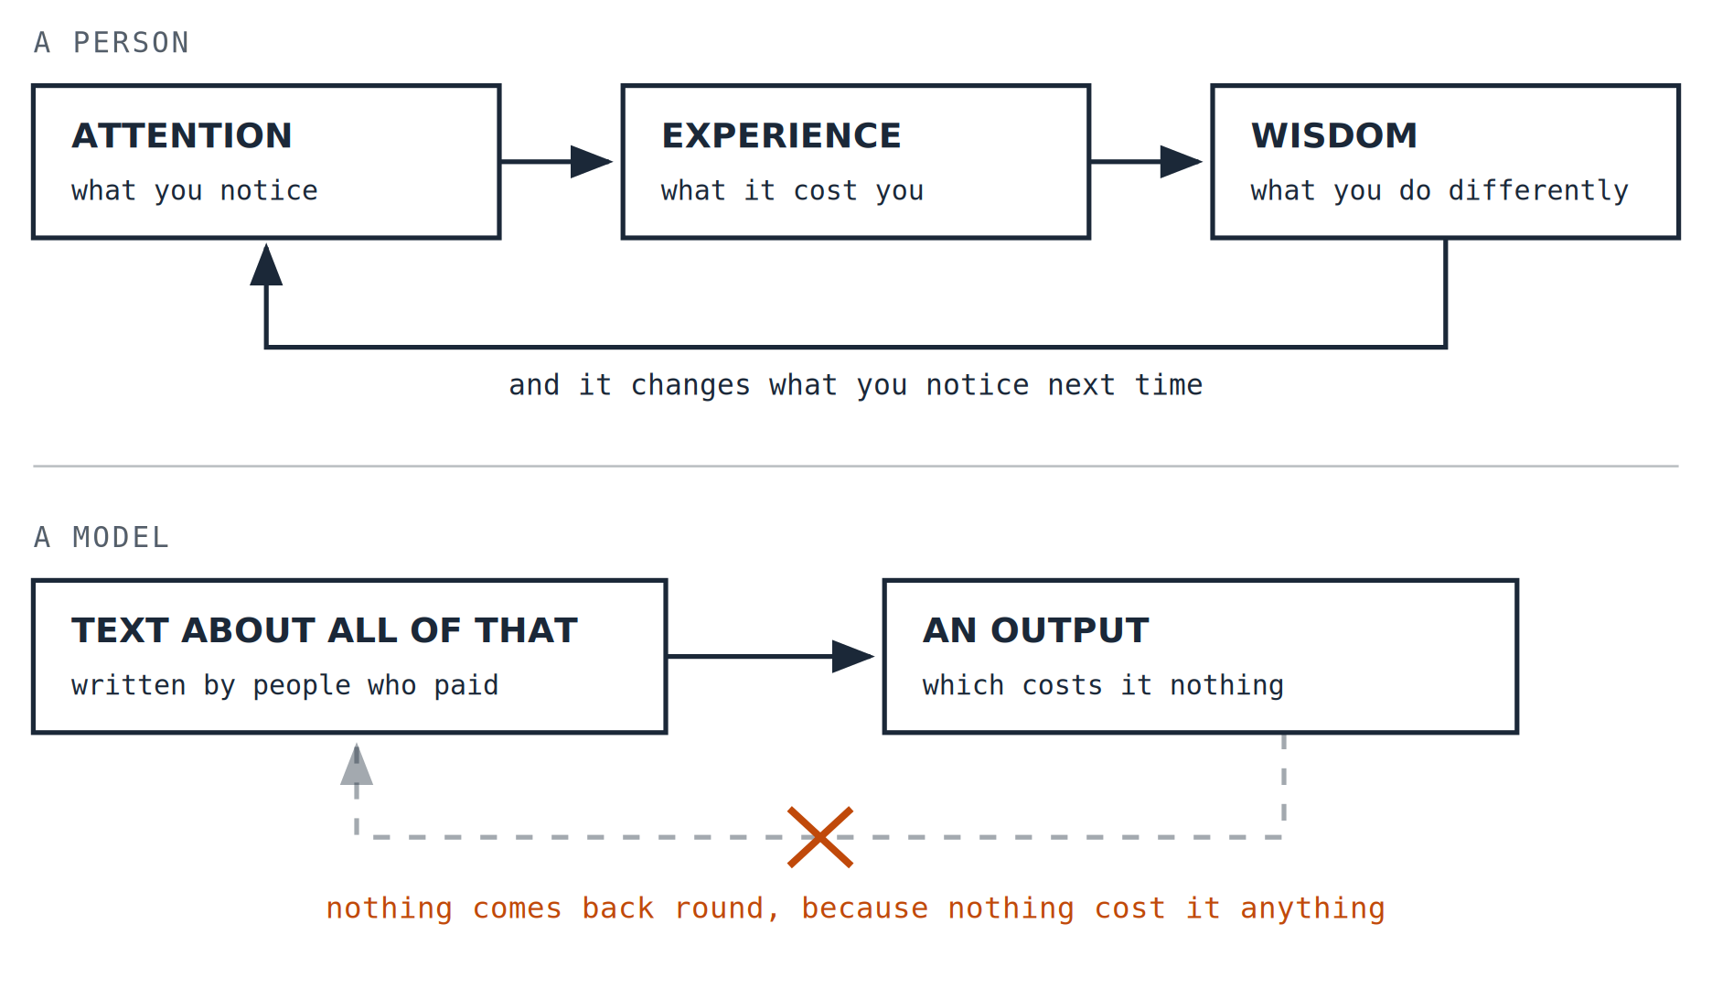
PART ONE · THE ARGUMENT
The loop that produces it
What you pay attention to decides what you experience. What you experience, especially where it hurts, changes your judgement. And changed judgement changes what you notice next time, which is where the loop closes.
Take the return arrow away and what is left can still produce excellent work. What it cannot do is get wiser. The loop is not about the quality of the output; it is about whether anything changes in the thing producing it.
4
Notes:
The return arrow is the whole argument. Without it you can still have a very capable system; what you do not have is one that improves by having been wrong.

Slide 7
PART ONE · THE ARGUMENT
What makes a consequence real
Not every bad outcome teaches anything. Three things have to be true, and if any one is missing the loop does not turn.
YOU CANNOT UNDO IT
IT LANDS ON YOU
IT CHANGES WHAT YOU ARE
A result you can roll back and try again is a simulation of a consequence. Useful for learning a game. Not the same thing.
Not on the next shift, not on a user you never meet, not on an abstraction called the business. On the person who made the call. On you.
Next time a case looks textbook-clear, something in you hesitates, and you could not switch that off if you wanted to.
5
Notes:
Irreversible, borne by the agent, and it changes the agent.

Slide 8
PART ONE · THE ARGUMENT
It met every specification
In July 1940 a suspension bridge opened across the Tacoma Narrows. It had been designed to the standards of the day and it met them.
JULY 1940
NOVEMBER 1940
Opened, having met every specification that applied to it.
Down, in a wind of around forty miles an hour, far below its design load.
The calculations were not wrong. They were calculations of the things anybody knew to calculate. What brought it down was a behaviour that was not in them, and the profession only learned to look for it by watching this happen.
That is what experience supplies and knowledge cannot: not better answers to the questions you asked, but the questions you did not know were there.
6
Notes:
Deliberately not naming the mechanism: the resonance story is the schoolbook version.

Slide 9
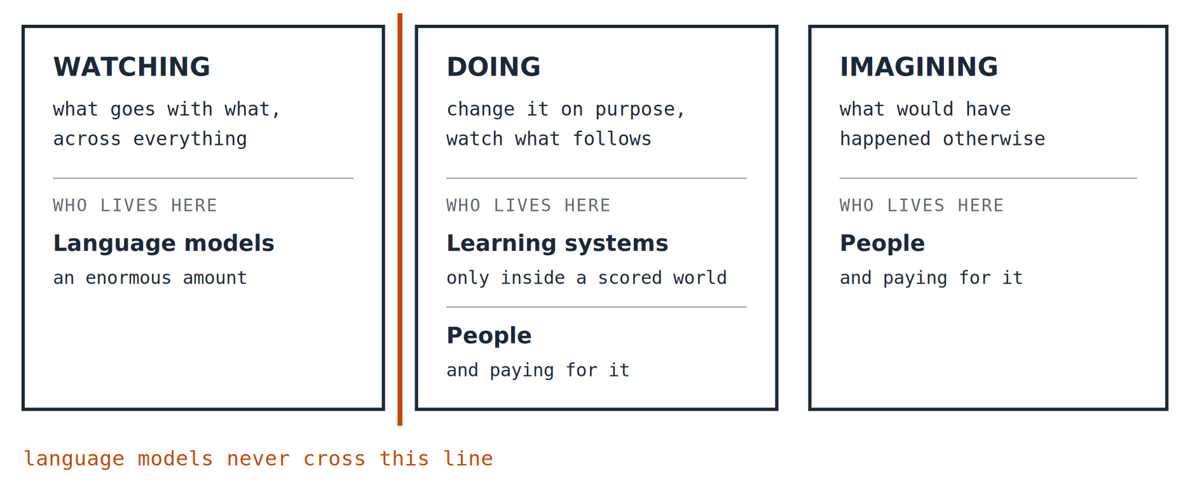
PART ONE · THE ARGUMENT
Watching, doing, imagining
Three ways of getting at why something happens, and they are not interchangeable. Reading about an intervention is not performing one, and no quantity of reading converts into the other kind.
7
Notes:
Pearl’s three rungs, with who lives on each.

Slide 10
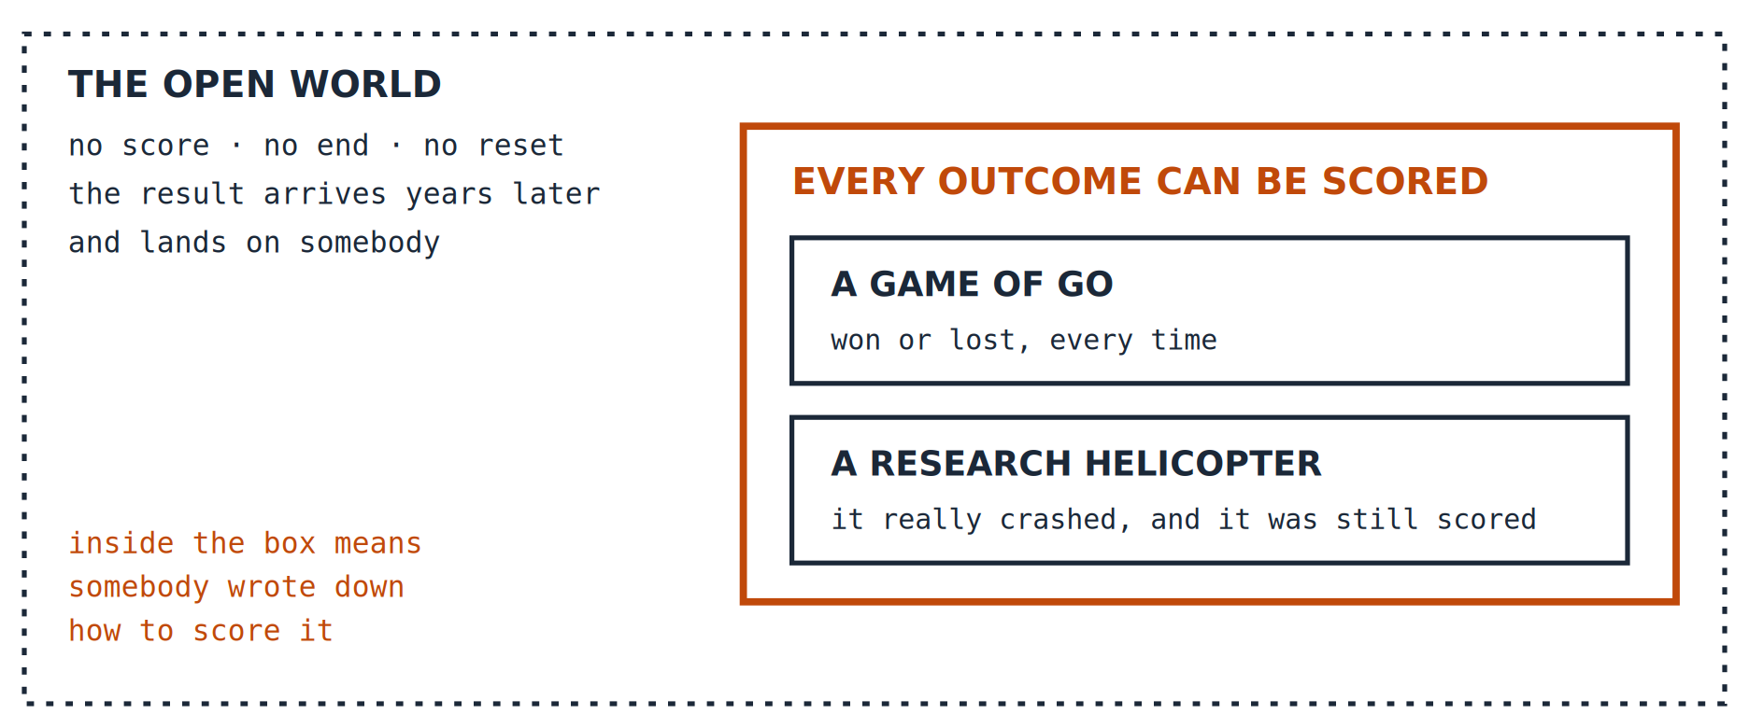
PART ONE · THE ARGUMENT
But the helicopter really crashed
The strongest objection, in its strongest form. A program taught itself Go and found moves nobody had thought of. A research helicopter taught itself aerobatics and crashed real remote-controlled aircraft doing it. That is not reading about intervention. Conceded.
8
Notes:
A surgeon does not get a score. Neither does a policy, a hire, or a bridge.

Slide 11
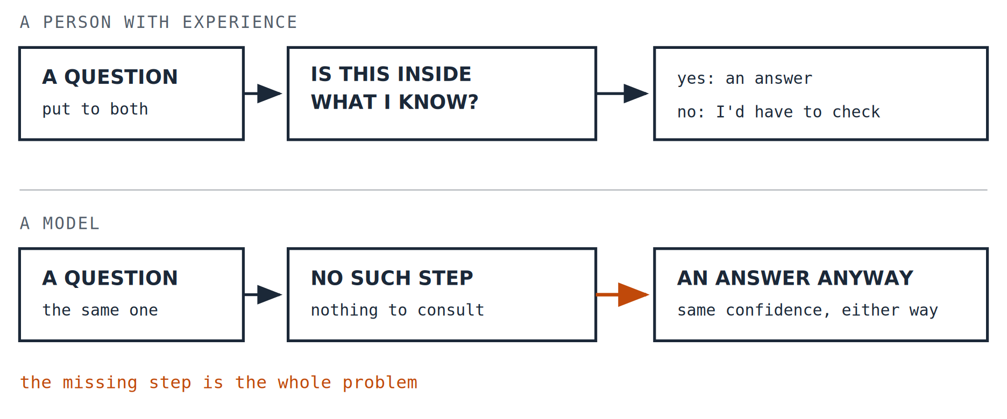
PART ONE · THE ARGUMENT
The failure is always the same shape
Legal briefs citing cases that do not exist. A load calculation produced just as fluently whether or not the figure was ever supplied. Not lies, and not random errors: no sense of where its own knowledge stops.
9
Notes:
Knowing where your knowledge stops is what being wrong repeatedly installs.

Slide 12
PART ONE · THE ARGUMENT
Wisdom-shaped, without the history
A model trained on the writing of people who did traverse the loop will produce output that looks like their judgement. Measured hedge for measured hedge, it may be indistinguishable.
What is absent is not the words. It is everything that made those words trustworthy in the person who first wrote them.
The cases that went badly. The hesitation installed by the hundredth presentation. Knowing which way they personally tend to be wrong.
10
Notes:
Synthetic wisdom: wisdom-shaped output without its developmental history.

Slide 13
PART TWO · WHAT IT COSTS, MEASURED
Two groups, one tool
Researchers gave students an AI assistant to research a scientific question, and compared the reasoning they produced against what they produced without it. Both groups got the same task. Only one had been trained in the subject.
MEDICAL STUDENTS
SOCIAL SCIENCE STUDENTS
The question sat inside the field they had been trained in.
Better with the assistant than without it.
The same question, outside their expertise.
Worse with the assistant than without it.
Same task, same tool, opposite direction. The only thing that differed was what each group already knew. If you have ever caught an AI being confidently wrong about something you happen to know well, you have already run this experiment on yourself.
Stadler, Bannert and Sailer, 2024, with a 2026 preprint adding domain expertise as the moderating variable. The follow-up is a preprint and has not yet been peer reviewed.
11
Notes:
The study reports which way each group moved rather than the size of the effect, so neither does this slide.

Slide 14
PART TWO · WHAT IT COSTS, MEASURED
What made the difference
The earlier study in the same line of work found something more uncomfortable than a drop in quality: the students using the assistant reported a lower mental workload while producing worse reasoning. It felt easier at exactly the moment it was going wrong.
The students who already had judgement could interrogate what came back: which claims to be suspicious of, which numbers smelled wrong, what had quietly been left out. The others could only accept it or reject it whole.
The tool does not supply judgement. It multiplies whatever judgement you walked in with, including none.
12
Notes:
This is the hinge of part two.

Slide 15
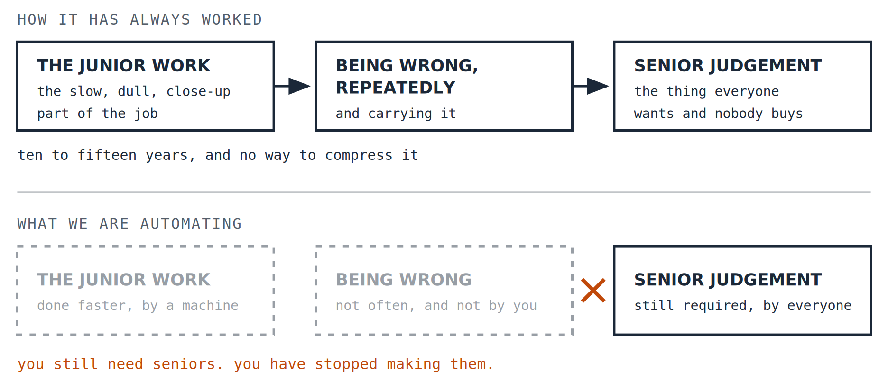
PART TWO · WHAT IT COSTS, MEASURED
Where that judgement came from
Nobody is born able to interrogate an output. It comes from a specific and rather unglamorous apprenticeship: the debugging at eleven at night, the hundredth presentation of the same condition, the case that collapsed on one witness you had not prepared.
13
Notes:
Removing the first stage does not reduce the need for the last one.

Slide 16
PART TWO · WHAT IT COSTS, MEASURED
Why nobody notices in time
Cutting the junior work looks like a clean win for years. Output goes up. Costs go down. Nothing visibly breaks, because the senior people carrying the judgement were formed under the old arrangement and are still there.
The bill arrives when they retire, and by then the decision that caused it is ten or fifteen years old and nobody can point at it.
14
Notes:
The seed corn problem, and why it is invisible while it is happening.

Slide 17
PART THREE · LIMITS, AND WHAT TO DO WITH IT
What this does not claim
Short versions tend to overstate. Here is what this one is not saying.
✕
AI is not useful.
It made the medical students measurably better. The argument is about what it cannot supply, not about whether it helps.
✕
People are reliably wise.
Obviously not. The claim is narrower: human judgement can be held to account, improved by being wrong, and carried by somebody who pays.
✕
This is permanent.
The paper concedes that systems which act in the world move the gap rather than close it. And if somebody has a better account of what wisdom is, the author would rather hear it than defend this one.
✕
Here is the experiment that proves it.
There isn’t one. Wisdom does not show up cleanly in a controlled trial, and the paper says so rather than dressing an argument as a finding.
15
Notes:
Four fences. The last one is the one almost nothing in this genre says.

Slide 18
PART THREE · LIMITS, AND WHAT TO DO WITH IT
Three things that follow
1. CATCH IT BEING WRONG
2. KEEP THE CRUCIBLE IN THE WORK
3. PROTECT THE PIPELINE
Only use it where you could. If you cannot interrogate the answer, you are not using a tool, you are taking dictation. The medical students could push back. That is the whole difference.
If every slow, close-up, get-it-wrong-yourself task is removed from a junior role, that role stops producing seniors. That is a design decision, whether or not anybody makes it deliberately.
The cost of cutting it is real, delayed by a decade, and paid by people who were not in the room. It is the cheapest thing to cut and the slowest to rebuild.
16
Notes:
The practical payoff.

Slide 19
PART THREE · LIMITS, AND WHAT TO DO WITH IT
Where this comes from
This is a short version of a working paper called The Wisdom Gap, which carries the evidence, the sources and the objections, including the ones that have not been answered.
ACKNOWLEDGEMENT
The idea behind this paper started in an exchange with Louise Vigeant, who writes Think Therefore AI. The argument took its shape there before it had a name.
Working papers are revised when they are shown to be wrong, and what changed is kept on the record.
James Maconochie | Architecture & Attention
HUMILITAS, HUMANITAS, ET CURIOSITAS · SEMPER
Humility, humanity, and curiosity. Always.
17
Notes:
End.

