Slide 1
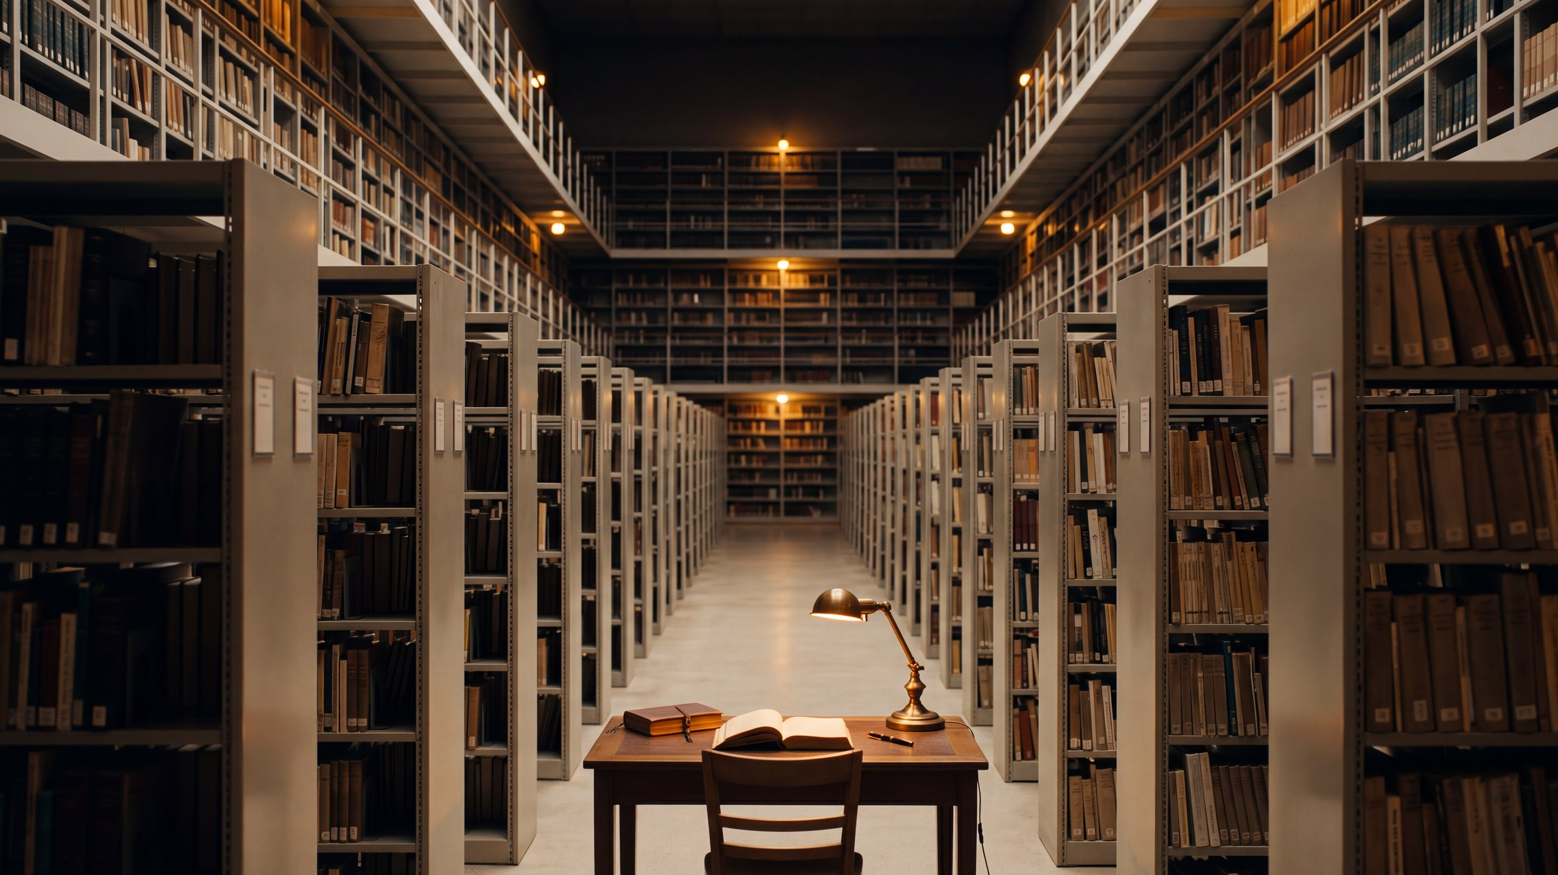

ARCHITECTURE & ATTENTION
Why Does It All Feel Like Too Much?
Something changed about how much language there is, and nothing changed about how much of it a person can take in. That gap has opened twice before, and both times it ended badly.
The argument of the working paper The Attention Crisis | James Maconochie
Notes:
Sixteen sheets. What got cheap, what did not change, the two historical cases, and why a better filter is not the answer.

Slide 2
WHERE THIS SITS
There is more language in the world than anyone can attend to. The obvious fix, an AI that reads it all for you and tells you what is true, does not work: the judgement that would take requires having been wrong at your own expense, and nothing a model does costs it anything. So the judging stays with people, and almost nothing we currently inspect can tell whether a person actually judged or simply agreed.
01
Why Does It All Feel Like Too Much?
02
Why Can’t You Just Be Told?
03
What Holds a Claim Up?
04
How Would You Know?
05
Who Pays If It’s Wrong?
06
What Would You Build Instead?
Six short pieces, each drawn from a working paper. Each one stands on its own; this is the first. They are ordered so that every piece ends by raising the question the next one is called.
Notes:
Apparatus, not argument. The same slide is in all six decks.

Slide 3
PART ONE · WHAT CHANGED, AND WHAT DIDN’T
It is not that you are bad at this
You open your phone and there is more worth reading than you can read, more worth checking than you can check, and more arriving while you decide. Most people experience that as a shortcoming of their own: they should be more disciplined, better at filtering, less distractible.
It is not a shortcoming. It is arithmetic, and the arithmetic changed recently and sharply.
What follows is what changed, why the thing that did not change was never going to, and what happened the last two times a language technology outran the societies using it.
1
Notes:
The recognition line. The reader has lived this and should be told so in the first thirty seconds.

Slide 4
PART ONE · WHAT CHANGED, AND WHAT DIDN’T
Three things got cheap
For almost all of human history, putting words in front of people was expensive: time, labour, skill, materials. Three times something made it much cheaper, and each time it was a different thing that got cheaper.
PRINTING
THE INTERNET
GENERATIVE MODELS
Copying got cheap. Somebody still had to write it.
Sending got cheap. Somebody still had to write it.
Making it got cheap. This one is new in kind, not only in degree.
The first two made it cheaper to move words somebody had written. The third makes the writing itself nearly free.
2
Notes:
The third collapse is the one with no precedent, which is why the historical cases are a guide and not a template.

Slide 5
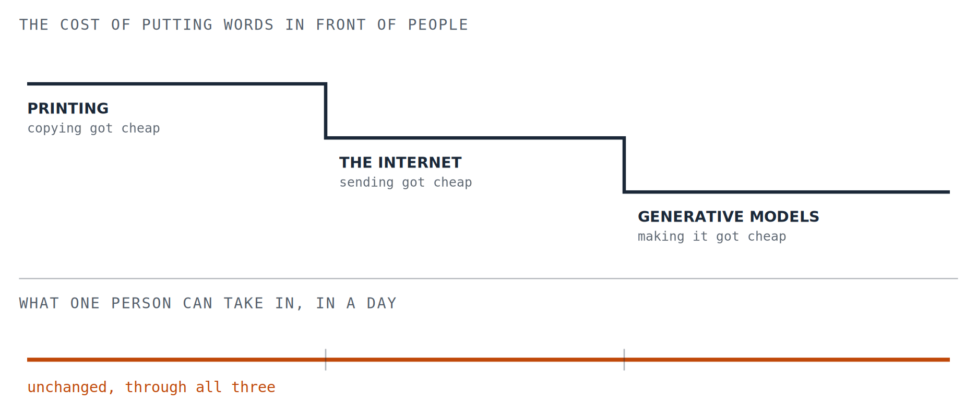
PART ONE · WHAT CHANGED, AND WHAT DIDN’T · CONTINUED
Two measures, one stretch of time
Two different kinds of quantity, drawn on separate axes on purpose.
2 / 2
Notes:
The tick marks line the two panels up. The lower line is the whole argument.

Slide 6
PART ONE · WHAT CHANGED, AND WHAT DIDN’T
The part that did not change
Attention runs on equipment shaped for a slower world. These are not character flaws.
01
Emotionally charged things jump the queue.
The fast, alarm-driven part responds before the slow, reflective part has been consulted.
02
Quick payoffs get reinforced.
Systems built to hold attention are built on exactly the loop that rewards reflex over reflection.
03
Careful thinking gets tired.
The reflective part is slow and expensive to run. Worn out, people fall back on rules of thumb.
04
Switching costs more than it looks.
Constant interruption erodes the working memory that sustained reasoning depends on.
05
A narrow view feels like a clear one.
When what reaches you has been selected for you, the result only resembles clarity.
3
Notes:
The paper is explicit: biological constraints, not moral failings. The architecture worked well in the environment it evolved for.

Slide 7
PART ONE · WHAT CHANGED, AND WHAT DIDN’T
The bottleneck moved
For most of history the hard part was producing language, and that effort was a kind of filter. Not a good one, but a real one: it limited how fast anything could spread, including the things that should not have.
That filter is gone. The hard part is now on the other side.
Which matters, because when attention is the scarce thing, a predictable sort of material wins. Not the best material: the material best adapted to a shortage of attention.
PROVOCATIVE BEATS TRUE
SIMPLE BEATS NUANCED
TRIBAL BEATS THOUGHTFUL
CONFIDENT BEATS CAREFUL
Reacting is cheaper than checking.
Nuance costs the reader something.
Recognising your side is instant.
Certainty reads as competence.
4
Notes:
On volume the paper is deliberately coarse: tens of trillions of tokens a day, order of magnitude, not a measurement. Quoted that way here on purpose.

Slide 8
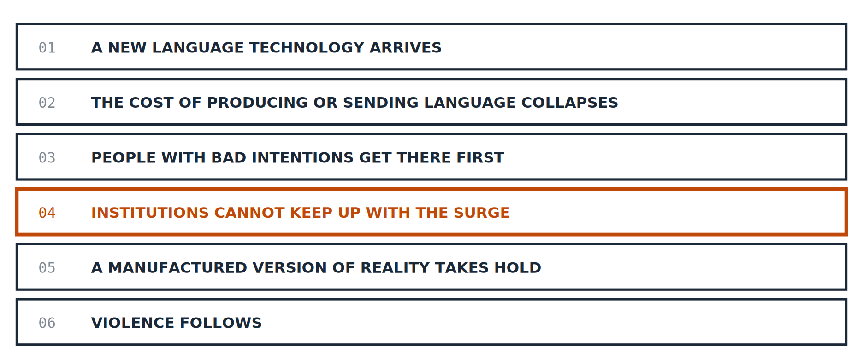
PART TWO · IT HAS HAPPENED BEFORE
A pattern with six steps
The same sequence has run all the way through twice: in Europe after the printing press, and in Myanmar after the smartphone. Both follow.
5
Notes:
The accent sits on step four, not step six: the paper locates its own lesson there. Not that texts are dangerous, but that a technology which outruns a society’s safeguards can manufacture reality faster than that society can contest it.

Slide 9
PART TWO · IT HAS HAPPENED BEFORE
1486, and a book
An inquisitor named Heinrich Kramer published a manual for identifying and prosecuting witches. Before the press, a text like that would have circulated among a small circle of clergy and stayed there. Between 1487 and 1520 it went through 28 editions and probably put fifteen to thirty thousand copies into circulation, becoming an authority in Catholic and Protestant regions alike.
What had been local superstition became something closer to a shared European account of what was real, and that account was used to justify around 110,000 trials and, by the paper’s figures, forty to sixty thousand executions, mostly of women, over the two centuries that followed.
WHAT THE PAPER SAYS THE BOOK DID NOT DO
It did not create misogyny, and it did not create fear of the occult. Both were already there. What the press did was amplify them to a degree that earlier societies had no way to sustain.
6
Notes:
The paper cites Kramer directly but attaches no source to the trial and execution counts. They are in line with the general historical literature and are the figures here most likely to be challenged first.

Slide 10
PART TWO · IT HAS HAPPENED BEFORE
2014, and a phone
Myanmar in 2014 had almost no internet. Within a few years the price of a SIM card collapsed and tens of millions came online at once. For a great many of them one platform was not part of the internet; it was the internet: news, identity, community.
Into that arrived a coordinated campaign casting the Rohingya, a Muslim minority, as an invading and existential threat. Feeds ranked by engagement carried the most inflammatory version of any claim furthest. A new shared account of reality formed, in which a minority moved from being other people to being enemies. What followed was a campaign of ethnic cleansing; the UN fact-finding mission reported in 2018 that nearly 725,000 Rohingya had fled to Bangladesh, and cited an estimate of up to ten thousand deaths, which it judged a conservative one.
WHAT THE PAPER SAYS THE TECHNOLOGY DID NOT DO
It did not create the prejudice. It amplified it, speeding up how fast a story formed and how fast feeling spread beyond what Myanmar’s institutions, or its citizens, could resist.
7
Notes:
The UN mission is cautious in the same direction: A/HRC/39/64 para. 74 calls Facebook an instrument useful to those seeking to spread hate, and says the extent to which posts led to real-world violence must still be independently examined. This block is the reason the slide exists: in a short version it is the first thing that would fall off.

Slide 11
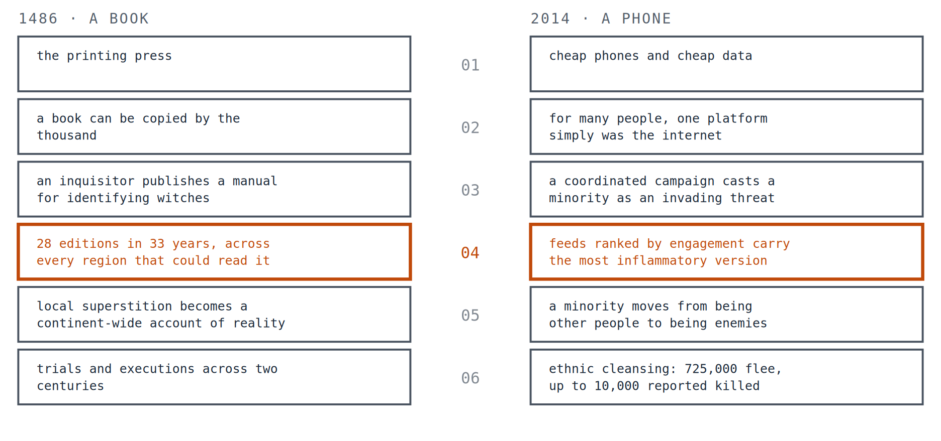
PART TWO · IT HAS HAPPENED BEFORE
The same six steps, twice
Five centuries apart, with nothing in common technologically, the two run the same way.
8
Notes:
Identical geometry on purpose. The point of drawing it twice is that the second case is not a new kind of event; it is the same sequence at a different speed.

Slide 12
PART TWO · IT HAS HAPPENED BEFORE
What is different about now
Both previous cases involved language that a person still had to write. A book took an author. A disinformation campaign took operators.
The step that has now collapsed is the writing itself. One person with a generative model can produce more text in a day than a medieval monastery produced in a year.
Nothing on the receiving side has moved at all. Which means the gap at step four (where institutions and people cannot keep up with the surge) is wider now than in either historical case, and widening.
9
Notes:
And it can be tailored to the reader, tuned for feeling, and delivered as fluent credible prose.

Slide 13
PART THREE · WHY A BETTER ANSWER MACHINE IS NOT THE ANSWER
The trouble with an oracle
The obvious fix is a machine that tells you what is true. The paper argues this makes the problem worse, and is careful that the argument depends on a particular idea of such a system, one that decides on your behalf. The author notes that not everyone defines it that way.
THERE IS NO NEUTRAL FILTER
WHOEVER CONTROLS IT CONTROLS A GREAT DEAL
WHAT IS NOT USED, WEAKENS
Any system that decides what deserves your attention has a view about what matters. Its errors become everybody’s errors at once.
A single authoritative filter is an unusually valuable thing to capture, and the failure mode is not chaos. It is something more ordered and more brittle than that.
If the machine does the judging, the capacity to judge gets less practice. The paper’s own example is small and it says so: a generation ago people knew phone numbers.
10
Notes:
Underneath all three: the shortage is not of intelligence. People reason well given time, clarity and context. The shortage is of the attention needed to use the intelligence they already have.

Slide 14
PART THREE · WHY A BETTER ANSWER MACHINE IS NOT THE ANSWER
A personal note, and why it is in the paper
The paper stops in the middle and the author writes about himself: a period in which his own responses had become reflex rather than choice, and the slow recognition (not a sudden one, he is specific about that) that what needed changing was not his information or his strategy but where his attention was going.
People drift into lives shaped by habit rather than intention. Societies drift into information environments shaped by reflex rather than reflection. In neither case is more data the thing that gets you out.
That is also the step connecting the two halves of the paper. If attention is how a person decides what matters, then losing control of it costs more than knowledge. It costs agency.
11
Notes:
Drop this section and the argument loses the step from information to agency.

Slide 15
PART FOUR · LIMITS, AND WHAT TO DO WITH IT
What would help instead
Not a better filter but a different relationship: tools that help a person navigate an infinite amount of language, rather than tools that generate more of it or decide on their behalf.
SHOW THE DISAGREEMENT
FLAG THE NARROWING
NOTICE THE TEMPERATURE
Where sources actually diverge, rather than resolving it quietly on your behalf.
When the range of what is reaching you has quietly contracted.
When the emotional charge is high and the analysis is thin.
None of these tells you what is true. The companion piece, What Would You Build Instead?, carries the design principles; they are not restated here, because saying them twice in slightly different words would make them sound less settled than they are.
12
Notes:
The paper presents its principles as a floor rather than a closed set: at least these, not only these.

Slide 16
PART FOUR · LIMITS, AND WHAT TO DO WITH IT
What this does not claim
Where a short version could most easily become louder than the paper. So, explicitly.
✕
Technology caused these atrocities.
The paper says the opposite twice, in its own words, and both statements are on the slides above.
✕
People are irrational.
The reverse: humans are unusually responsive to narrative, especially when it is charged and framed as survival.
✕
Books, or platforms, are dangerous.
Stated and rejected. The claim is about what happens when a language technology outruns the safeguards around it.
✕
Media literacy will fix this.
Called necessary but not sufficient. Literacy is a skill held by individuals; it does not scale against the volume.
✕
AI is the problem.
The closing position is that the same technologies contain the means to address it: a conditional optimism, not a comfortable one.
13
Notes:
Five, and the first one is the one that matters most.

Slide 17
PART FOUR · LIMITS, AND WHAT TO DO WITH IT
Three questions worth asking
1. WHICH OF THE SIX STEPS ARE WE ON?
2. WIDENING WHAT REACHES ME, OR NARROWING IT?
3. WHAT DID I ATTEND TO TODAY, AND DID I CHOOSE IT?
The first three have clearly run. The argument is about the fourth, which is the last one where anything can still be done cheaply.
Fewer conflicting things reach you, so you feel more certain rather than less informed. It never announces itself, so it has to be asked about.
Not a productivity question. If attention is how a person decides what matters, this is the whole argument applied to one day.
The third one is the only question in this series a reader can act on before lunch.
14
Notes:
Step four is the actionable one. Steps five and six are not places you intervene.

Slide 18
PART FOUR · LIMITS, AND WHAT TO DO WITH IT
Where the title comes from
The breakthrough that produced modern language models came from a paper whose title said attention was all you needed, attention there being a mechanism inside the model, not the human kind.
Attention is all we have.
The claim underneath it is that attention is not one cognitive faculty among several. It is the thing by which a person builds an inner life and by which a society builds a shared one: how individuals form an identity, how groups reach agreement, how a civilisation holds together at all.
Which is why the paper’s sharpest line about the present is not about danger. It is that all of this accelerates everything except understanding.
15
Notes:
The inversion is the paper’s, and it names the earlier essay this one grows out of.

Slide 19
PART FOUR · LIMITS, AND WHAT TO DO WITH IT
Where this comes from
This is a short version of a working paper called The Attention Crisis, which carries the full argument, the sources, the objections and the estimates with their workings shown.
It is part of a series on what judgement is, why it has to be carried by people who bear the consequences of being wrong, and what that means for building with machines that bear none.
Working papers are revised when they are shown to be wrong, and what changed is kept on the record.
James Maconochie | Architecture & Attention
HUMILITAS, HUMANITAS, ET CURIOSITAS · SEMPER
Humility, humanity, and curiosity. Always.
16
Notes:
End.

