Slide 1
Data and Algorithms

Slide 2
Ideas for Coursework
Custom pathfinding/City builder using c#/unity/threads??
Chess min/max game
Cryptography
Madelbrot set with
RTS style game with various agents

Slide 3
RTS Style Game
Basic block graphics
Simple base/unit generation (amp c++)
Basic Image Processing ???
2d SFML visualisation (CPU for handling core gameplay)
Barracks – Soldiers/Bazooka
Harvester - Collectors
War Factory – Tanks/APC

Slide 4
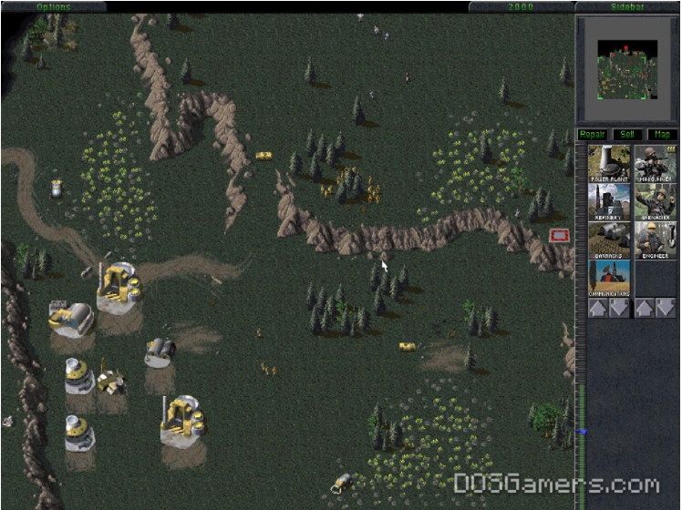
Rough Idea of Game Layout - Initial
Path Finding – No unit collision/Grid Based Movement
Automated Resource Collectors
Automated Units for combat
Enemy AI Building/Combat
Fixed Building Locations/Maps
4 AIs Battling against each other?
Grey box art acceptable??

Slide 5
Bugs and Todo
Add in Timing information and thread numbers
Add a class to write this data out
Bugs
AI firing at empty squares
Ais blocked by themselves
Optimisation through profiling

Slide 6
- this 0x0bb9aa58 {...} SearchAndDestoy *

