Slide 1

STV-Project Presentation
Team Member :
107598010陳郁欣
107598013鄭鴻仁
107598020林冠璋
107598025陳巧宜
107598042洪子軒

Slide 2
Outline
1. Test Criteria
2. Approach
3. All Test Cases
4. Testing Tools : AKB
5. Demo Sample Test Case and AKB
6. Live demo
7. Test Results Analyze
8. Pass/Fail
9. Team member contributions and feedbacks
Notes:
1.滑動問題
2.系統通知
3.等待問題
4.權限
5.設定
6.時間問題 (跨日 )
7.螢幕比例
1.TestData
2框架 & 框架說明
3.腳本
4.StateGraph
5.文件
6.影片
7.UseCase Diagram
8.CI

Slide 3
Test Criteria
Code Statement Coverage:
Suspension criteria:
當達到40% 的test cases不通過時，所有測試人員暫停測試，並且集中處理所有沒通過的test cases，確認是App的問題(確認是App錯誤的話就回報 Bug)還是test case 撰寫問題。
Resumption criteria:
在解決不通過的test cases後，所有測試人員繼續進行接下來的測試。
Approval criteria:
所有test cases 必須通過(確認行為無誤)，並且達到程式覆蓋率(Code coverage) 70%。

Slide 4
In order to design a test case, we used the following:
1.State Graph(Reference by GitHub Open Source : ACE(Android CrawlEr )
2.Test Data
3.UseCase Diagram
Notes:
改名為 Test case design artifacts

Slide 5
Approach
1.UseCase Diagram
1.1.EditTask EachChoice Coverage
1.2.Category – EachChoice Coverage
2.EdgeCoverage
3.ISP
Notes:
這邊用手機Demo

Slide 6
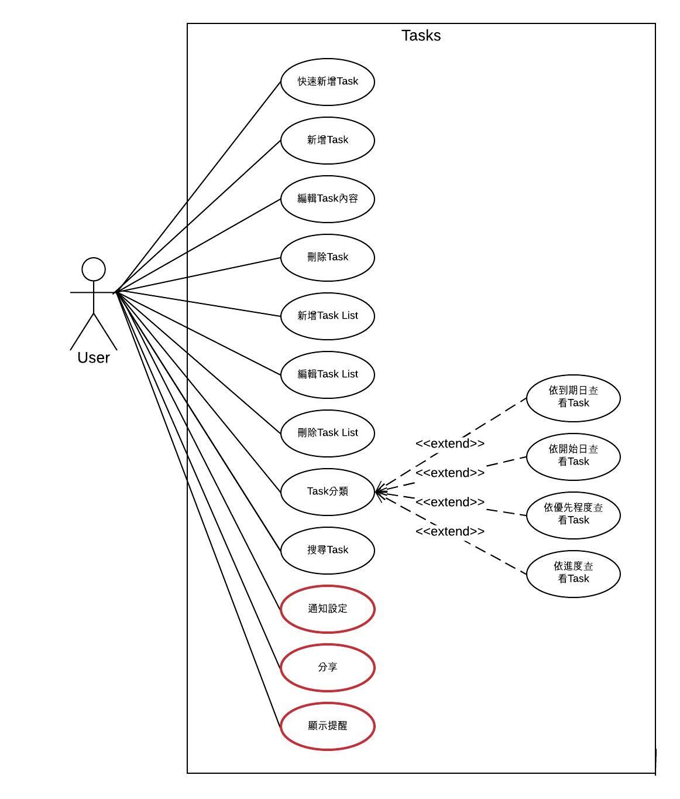
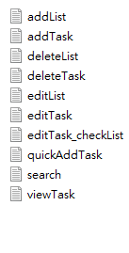

Slide 7
2.EdgeCoverage
EdgeCoverage –Use StateTransitionGraph
TestCaseName | TestPath
endWithNode 2-1 | {1,2,24,2}
endWithNode 2-2 | {1,2,20,21,22,20,30,2}
endWithNode10 | {1,2,8,2,8,9,10}
endWithNode12 | {1,2,8,9,11,9,11,12}
endWithNode14 | {1,2,8,9,11,13,14}
endWithNode15_1 | {1,2,8,9,15,16,15}
endWithNode15_2 | {1,2,8,9,15,17,17,15}
‧‧‧ | ‧‧‧
Total: 20

Slide 8
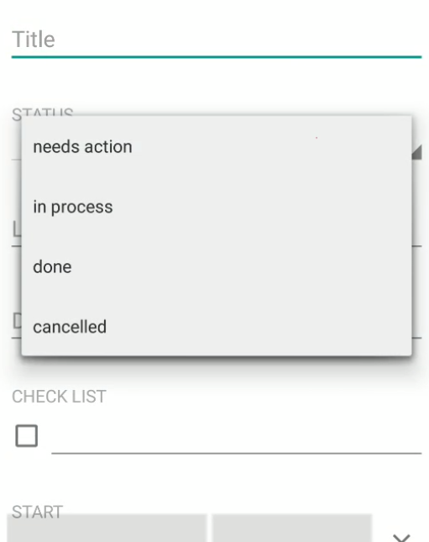
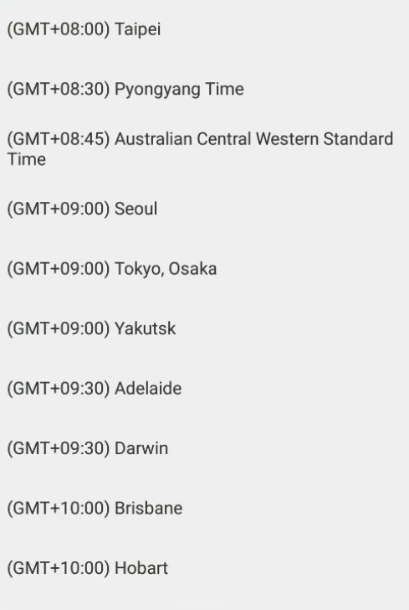
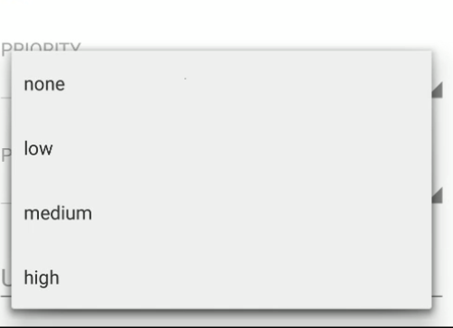
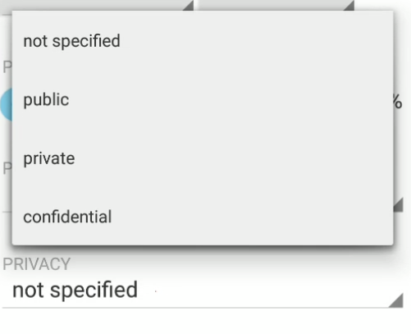
Approach- Each Choice for Tasks
Test Scenario : EditTasks

Slide 9

EditTaskEachChoiceCoverage
 | b1 | b2 | b3 | b4
Folder | My tasks | New List
Status | needs action | In process | done | cancelled
Time Zone | GMT-11:00 | GMT+00:00 | GMT+14:00
Priority | none | low | medium | high
Privacy | not specified | public | private | confidential

Slide 10
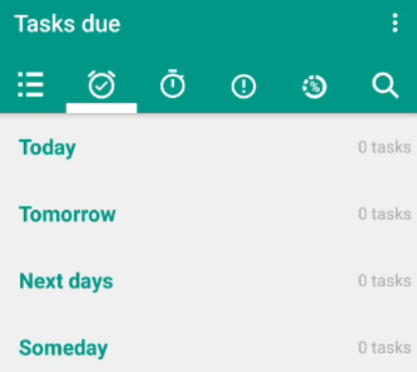
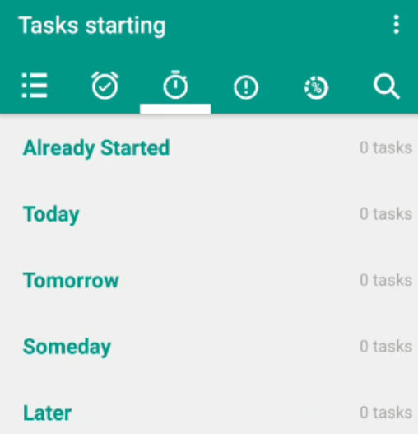
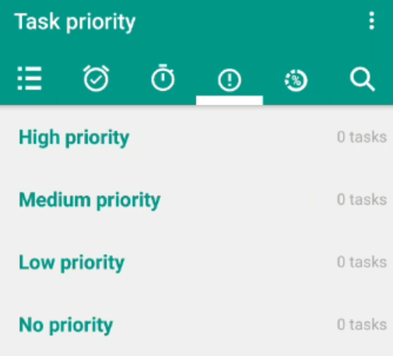
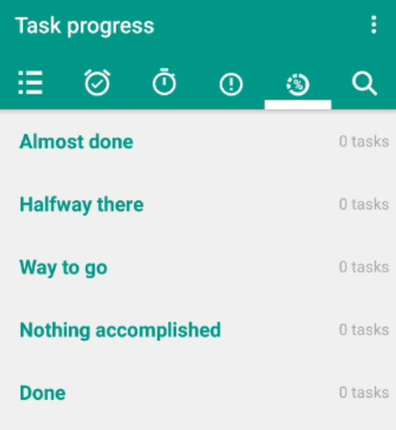
Approach-
Test Scenario : Classification
 | b1 | b2 | b3 | b4 | b5 | b6
Task due | Today | Tomorrow | Next day | Some day | none
Starting | Already Start | Today | Tomorrow | Someday | Later | none
Priority | High | Medium | Low | No | none
Progress | Almost done | Halfway there | Way to go | Nothing accomplished | Done | none

Slide 11
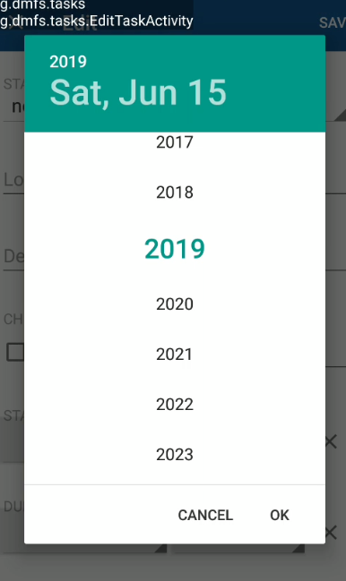


Input Space Partition
For EditText
C1: Null string
C2: Special character: @#$%^& by Random Pick unicode
C3: Valid string
For Numerical Partition
C1: Select 1900 year
C2: Select 2019 year
C3: Select 2100 year
Notes:
C1: have null string
C2: special character(空白) 說明 那些字元 為什麼是這些字元
C3: valid string (要分詳細一點) 例如STRING 上限

Slide 12
All Test Cases
Criteria | ScriptName
addTask | addList
 | addTask
 | deleteList
 | deleteTask
 | editList
 | editTask
 | editTask_checkList
 | quickAddTask
 | search
 | viewTask
 | viewTask1
Total | 11

Slide 13
All Test Cases
Criteria | ScriptName
CategoryEachChoiceCoverage | block1
 | block2
 | block3
 | block4
 | block6
 | somedayStartCategory
 | tomorrowStartCategory
Total | 7

Slide 14
All Test Cases
Criteria | ScriptName
EdgeCoverage | endWithNode10
 | endWithNode12
 | endWithNode14
 | endWithNode15_1
 | endWithNode15_2
 | endWithNode15_3
 | endWithNode2-1
 | endWithNode2-2
 | endWithNode20
 | endWithNode21
 | endWithNode24_1
 | endWithNode24_2
 | endWithNode24_3
 | endWithNode24_5
 | endWithNode30_1
 | endWithNode30_2
 | endWithNode34
 | endWithNode35
 | goThroughNode3to7
Total | 19

Slide 15
All Test Cases
Criteria | ScriptName | ScriptName
InputSpacePartition | saveWithEarlyCompleteDate | saveWithNumbericLocation
 | saveWithFutureCompleteDate | saveWithEarlyStartDate
 | saveWithSettingCompleteTime | saveWithFutureStartDate
 | saveWithRandomTextDescription | saveWithThisYearStartDate
 | saveWithEarlyDueDateAndCheckTaskListView | saveWithSettingStartTime
 | saveWithFutureDueDate | saveWithNoTaskName
 | saveWithSettingDueTime | saveWithNoTaskNameAfterSaveTask
 | editList_forNullName | saveWithTaskName
 | editList_forRandomly | saveWithBottomCountryInTimeZone
 | editList_forSpace | saveWithTopCountryInTimeZone
 | saveWithRandomTextURL
Total | 21

Slide 16
All Test Cases
Criteria | ScriptName
EditTaskEachChoiceCoverage | editTaskEachChoiceSelection1
 | editTaskEachChoiceSelection2
 | editTaskEachChoiceSelection3
 | editTaskEachChoiceSelection4
Total | 21

Slide 17
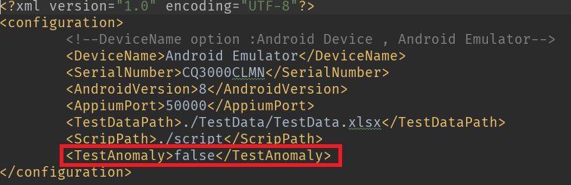
Anomaly
1.螢幕翻轉
2.On Pause
3.Context:Wifi Bluetooth PhoneCall…(不測) :時間不夠再加上此App 沒有用到太多
4.Random Input
Notes:
這頁順序往後 內容改在 test case 設計+方法

Slide 18
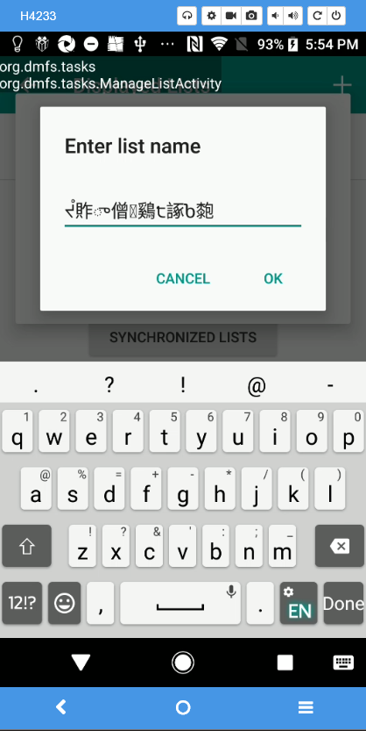
Anomaly
4.Random Input(by Unicode)
Midterm: 符號 -> Final: Random Unicode
Notes:
這頁順序往後 內容改在 test case 設計+方法

Slide 19
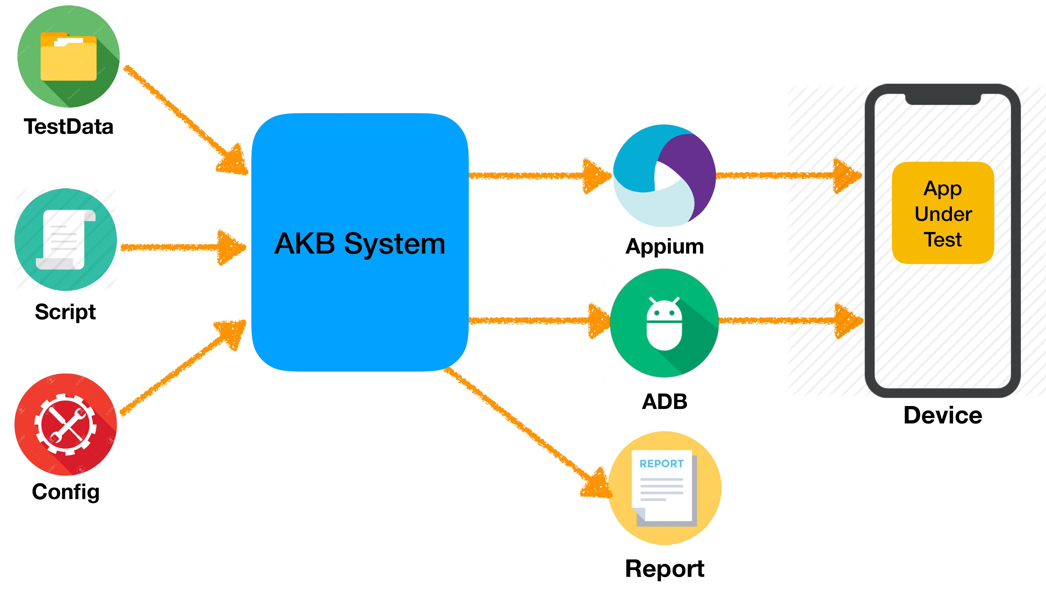
Testing Tools : AKB-Conceptual Diagram

Slide 20
Testing Tools : AKB-How to write and run a script

Slide 21
Test Results Analyze

Slide 22
Pass/Fail

Slide 23
Pass/Fail – Crash and Anomaly

Slide 24
https://sgit.csie.ntut.edu.tw/jenkins3/

Slide 25
Difficulties
1.滑動問題 : 某些元件滑動需要速度感才能觸發，但是在appium很難達成
2.系統通知 : 在Appium無法製造觸發app的
3.等待問題 : 在切換app畫面時，Xml 已改變，但是畫面卻還在正在動畫中，導致元件無法觸發。
4.權限 :在android 6 版本中有看到要求permission的dialog，但是在android 8 之後就沒有看見。
5.設定:同上
6.時間問題 (跨日 ):在app中 某些時段(快要跨日)設定完， 就會容易出現腳本跑不過，或是在assert 時難以確認當下時間。
7.螢幕比例:每個螢幕手機大小不同，導致畫面上出現的東西不一樣，有些需要滑動之後才看的到(ex:EditTasksActivity)

Slide 26
Team member contributions and feedbacks - Artifacts
1.TestData
2.框架Source Code & 框架使用說明
3.腳本
5.文件:TCS、STP、SDT、PPT
6.影片 : How to wirte and Run a Script , RunTotalScript ,RunTotalScriptWhitAnomalyOperation
7. Diagram: UseCase 、StateGraph、ClassDiagram
8. CI

