Slide 1

STV-Project Presentation
Team Member :
107598010陳郁欣
107598013鄭鴻仁
107598020林冠璋
107598025陳巧宜
107598042洪子軒

Slide 2
Outline
1. Apps: Tasks Introduction
2. Approach
3. Project activities and Plan schedule
4. Test tools to be used
5. Responsibility of team members

Slide 3
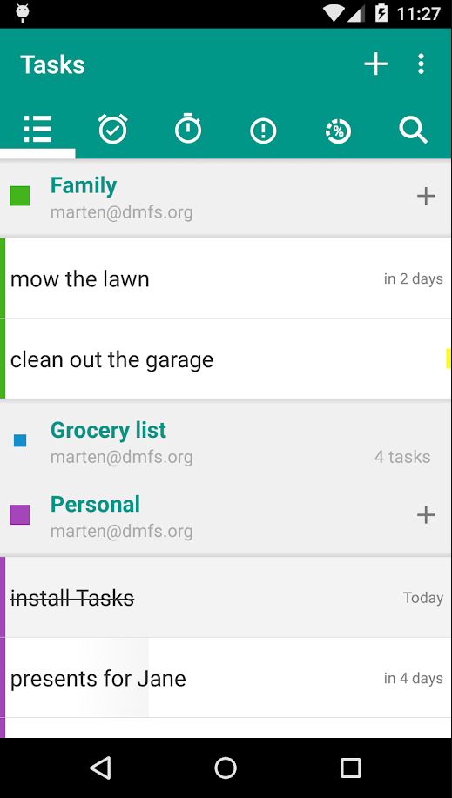


Tasks
點我! 觀看更多有關Tasks

Slide 4
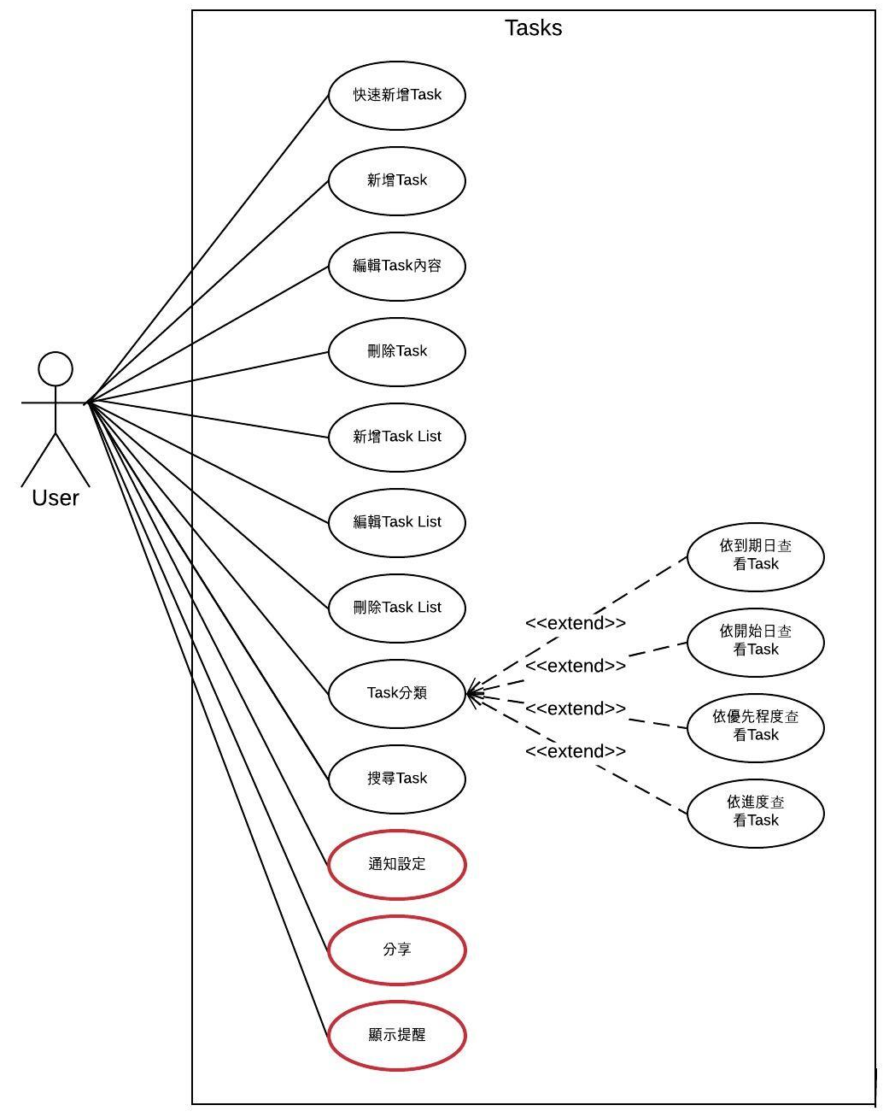
Tasks
Features Not To Be Tested
Notes:
這邊用手機Demo

Slide 5
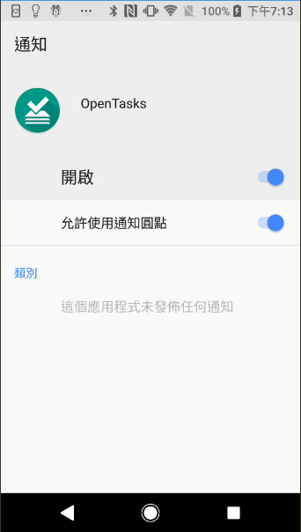
Tasks-Features Not To Be Tested

Slide 6
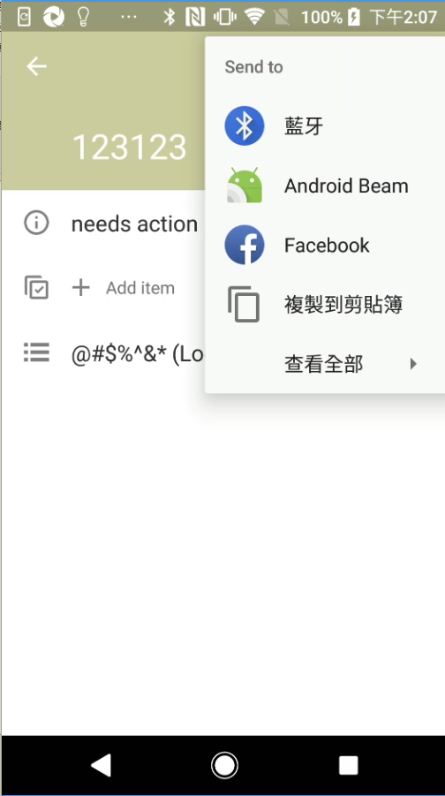
Tasks-Features Not To Be Tested

Slide 7
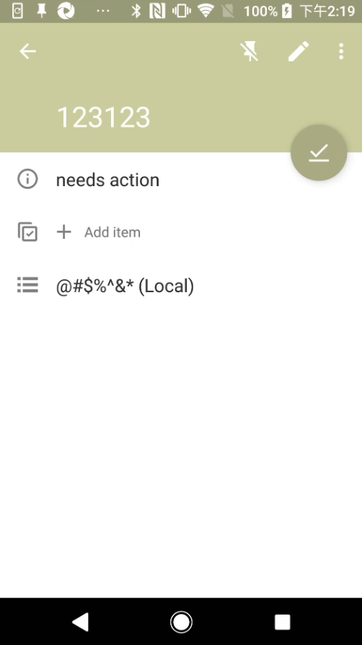
Tasks-Features Not To Be Tested
Notes:
通知功能 要不要測 不測的話要想好理由

Slide 8
Test Criteria
Code Coverage:
Suspension criteria:
當達到40% 的test cases不通過時，所有測試人員暫停測試，並且集中處理所有沒通過的test cases，確認是App的問題(確認是App錯誤的話就回報 Bug)還是test case 撰寫問題。
Resumption criteria:
在解決不通過的test cases後，所有測試人員繼續進行接下來的測試。
Approval criteria:
所有test cases 必須通過(確認行為無誤)，並且達到程式覆蓋率(Code coverage) 70%。
Notes:
順序往後 要說明甚麼 code coverage 例如 statement code coverage

Slide 9
Test Criteria
Abnormal Criteria:
Suspension criteria:
當偵測到異常狀態，將bug送進Bug tracking 系統，並且定期回報給開發團隊。
Approval criteria:
所有test cases 必須通過(確認App行為無誤) ，並且錯誤數量 低於3

Slide 10
Abnormal detection(precondition: Code Coverage 達到70%)
1.快速點擊
2.螢幕翻轉
3.On Pause
4.輸入特殊字元
5.輸入上下限值 or 輸入空值
6.手機環境改變
Notes:
這頁順序往後 內容改在 test case 設計+方法

Slide 11
Approach
In order to design a test case, we used the following:
1.State Graph(Reference by GitHub Open Source : ACE(Android CrawlEr )
2.Test Data
3.Source Code
4.Developer Issues List
5.UseCase Diagram
Notes:
改名為 Test case design artifacts

Slide 12
Approach
We use independent path for code coverage Criteria
To detect App’s abnormal behavior :
1.Each Choice
2.Equivalence partition
3.Sequencing Constraints
Notes:
independent path 要用在白箱測試 改 edges coverage criteria 並且說明 那些TR 用到哪種Criteria
要分清楚 哪些是壓力測試 哪些是系統測試

Slide 13
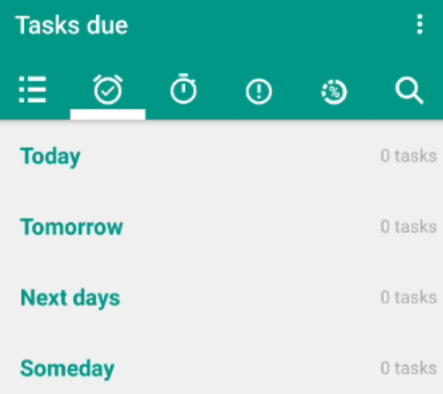
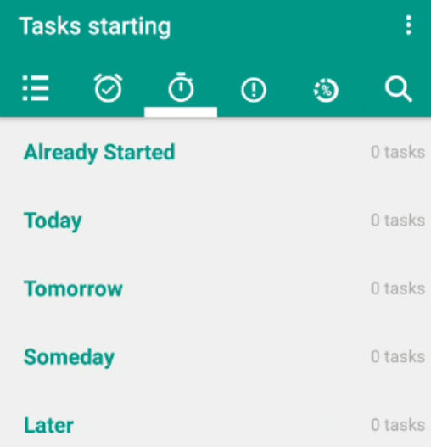
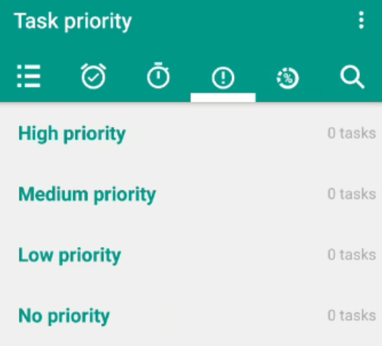
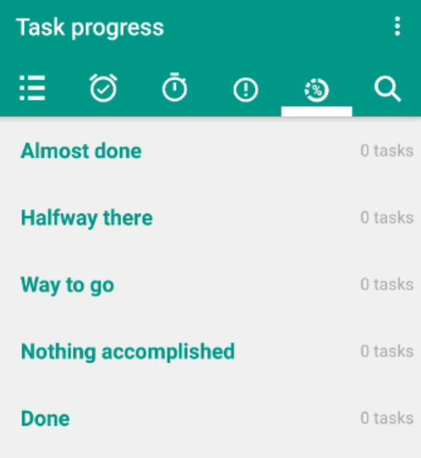
Approach- Each Choice for Tasks
Test Scenario : Classification
 | b1 | b2 | b3 | b4 | b5 | b6
Task due | Today | Tomorrow | Next day | Some day | none
Starting | Already Start | Today | Tomorrow | Someday | Later | none
Priority | High | Medium | Low | No | none
Progress | Almost done | Halfway there | Way to go | Nothing accomplished | Done | none

Slide 14
Approach- Each Choice for Tasks
 | b1 | b2 | b3 | b4 | b5 | b6
Task due | Today | Tomorrow | Next day | Some day | None
Starting | Already Start | Today | Tomorrow | Someday | Later | None
Priority | High | Medium | Low | No | None
Progress | Almost done | Halfway there | Way to go | Nothing accomplished | Done | None
TR1: { Today ,Already Start, High, Already Start, Almost done}
TR2: { Tomorrow ,Today ,Medium ,Halfway there}
TR3: { Next day ,Tomorrow ,Low ,Way to go }
TR4: { Some day ,Someday ,No ,Nothing accomplished}
TR5: { None, Later, None, Done}
TR6: { Today, None, High, None}

Slide 15
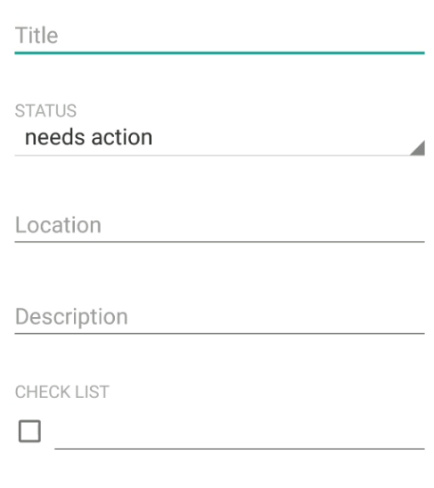

Approach - Choosing Partitioning +Each Choice
Test Scenario : Edit Task
Title:
C1: have null string
C2: special character
C3: valid string
Check List C1: The CheckBox is Check
Time Zone C1: > GMT+00:00
C2: = GMT+00:00
……
Notes:
C1: have null string
C2: special character(空白) 說明 那些字元 為什麼是這些字元
C3: valid string (要分詳細一點) 例如STRING 上限

Slide 16
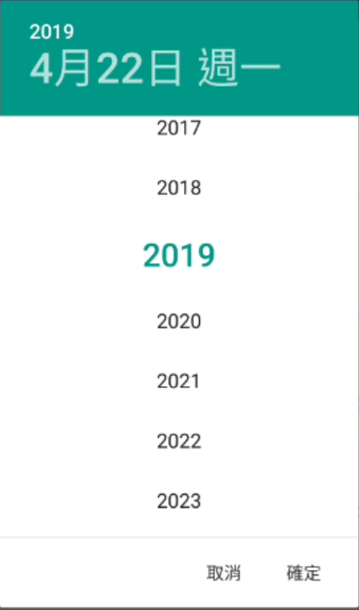
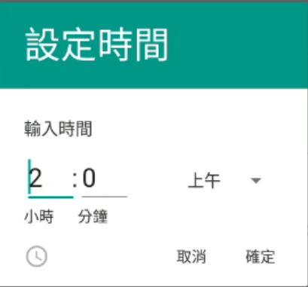

Approach - Equivalence Partitioning
Test Scenario : Edit Task
Ex: the “calendar_year_picker” : 1900~2100
No. | Value | Expected Output
1 | 1900 | 1900
2 | 1901 | 1901
3 | 1999 | 1999
4 | 2000 | 2000
5 | 2001 | 2001
6 | 2099 | 2099
7 | 2100 | 2100

Slide 17
Approach - Sequencing Constraints
Common Steps :Add List
Add List1
Add Task1 in List1
find faults???
Delete List1

Slide 18
Project activities
No. | Task | Predecessor Tasks | Special Skill | Responsibility
1 | 討論Testing Tools、Apps | None | 了解各個App測試工具 | All Teams
2. | 開發Testing Tools | None | 會撰寫 java | All Teams
3 | 準備測試計畫 | None |  | All Teams
4. | 準備測試設計規格 | Task1 | None | All Teams
5. | 準備測試案例規格 | Task2 | None | All Teams
6 | 準備測試流程規格 | Task3 | Maven Dependency Rule | All Teams
7 | 建立測試環境 | Task4 | 了解Junit、Maven、IntellJ、Android Simulator、Appium | All Teams
8 | 驗證測試環境 | Task5 | 了解Junit、Maven、IntellJ、Android Simulator、Appium | All Teams
9 | 撰寫測試項目並且上傳版本控制且在Ci執行測試 |  | 了解測試案例需求 | All Teams
10 | 檢查測試流程 | Task7 | None | All Teams
11 | 執行批次測試流程 | Task8 | None
12 | 檢查批次測試流程結果 | Task9 | None | All Teams
13 | 產生測試報表 | Task10 | None | All Teams
14 | 分析測試報表 | Task11 | None | All Teams
15 | 重複步驟9~14直到所有測試案例通過 |  | None | All Teams
16 | .封裝測試文件及資料 | Task15 | None | All Teams
Notes:
測試案例分析 實作 review 要詳細說明

Slide 19
Plan schedule
https://www.lucidchart.com/documents/edit/374673c4-d53d-4d0c-ad7a-de5cd8ff10b0/4

Slide 20
Test tools to be used-AKB
AKB(Appium Keyword driven Based):
1.Easy to write test script
2.Can use for any Apps (But need to be defined TestData for App)
3.Easy to execute Script
4.Easy to manage Test Case
5.Provide Log for Test Case (ex: execute time, pass/fail , execute event or path)
6.Easy to pull coverage file from Android device

Slide 21

Test tools to be used-AKB
Write Script
AKB
TastCase1.txt
Tester
AKB
Run Script
TaseCaseLog.txt

Slide 22
Test tools to be used-AKB Script
AKB-Script Add Tasks
Event Value
TaskList Click menu_btn
TaskList Click displayed_lists
DisplayedLists Click add_list_btn
DisplayedLists TypeText{test list} list_editText
DisplayedLists Click color_set_1
DisplayedLists Click pick_color{15}
DisplayedLists Click save_btn
DisplayedLists Click return_btn
Element Index
Event
Element
Activity Name

Slide 23
Test tools to be used-CI
https://sgit.csie.ntut.edu.tw/jenkins3/job/QuickAddTask/

Slide 24
Responsibility of team members
Developer 陳郁欣, 鄭鴻仁,林冠璋,陳巧宜,洪子軒
責任:設計測試案例，完成測試需求。
Role | Candidate | Description
Test Engineers | 陳郁欣, 鄭鴻仁,林冠璋,陳巧宜,洪子軒 | 將測試案例撰寫成腳本
Tool Specialist | 陳郁欣 | 架設appium環境 與CI

