Slide 1

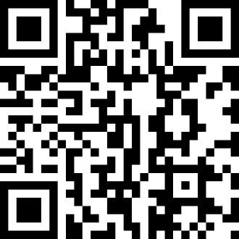

Help us evaluate our new survey system!
1. Connect to the Wi-Fi hotspot: front_desk_test
2. Scan the QR Code!

