Slide 1
Mark Renzo
More ways to
make your mark
One signature remix. Five new directions.
Round two
Notes:
Source: user brief, supplied portfolio screenshot and subsequent request for more brand variations plus concept 05 in concept 01’s palette. This is a new concept deck, preserving the first-round deck. All logos and website visuals are design explorations. No website implementation is claimed.

Slide 2
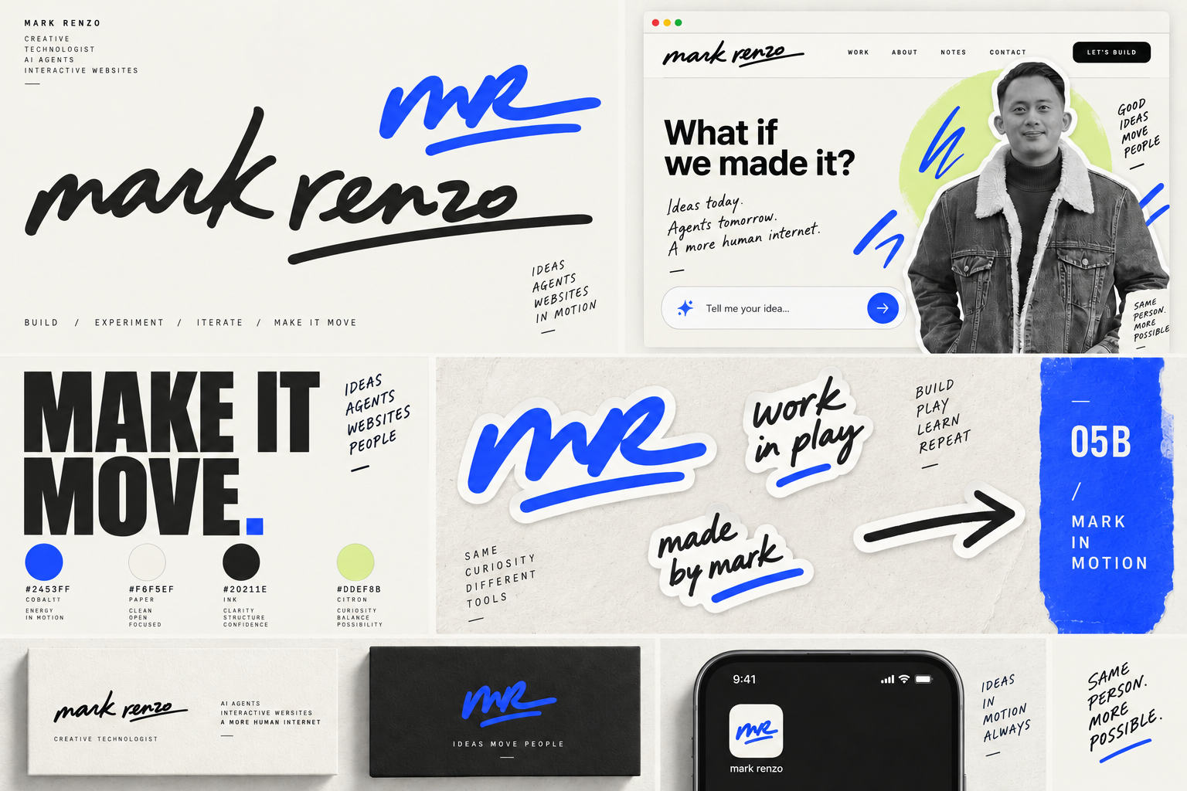
05B Mark in Motion, in cobalt
Identity concept
Notes:
05B Mark in Motion, in cobalt. Artwork generated for Mark Renzo’s personal brand exploration from the user brief. Source image: /Users/markrenzo/Documents/ChatGPT/markrenzodotcom/branding/concepts/05b-mark-in-motion-cobalt.png. Generated artwork is raster concept material, not production vector logo artwork. Typography suggestions describe a proposed production type system, not an exact identification of generated lettering. Website views are visual concepts, not an implemented or live site. Hybrid direction combines concept 05’s handwritten signature with concept 01’s palette: cobalt #2453FF, paper #F6F5EF, ink #20211E, citron #DDEF8B. Existing portrait references originate at https://markrenzo.com/ with user authorization.

Slide 3
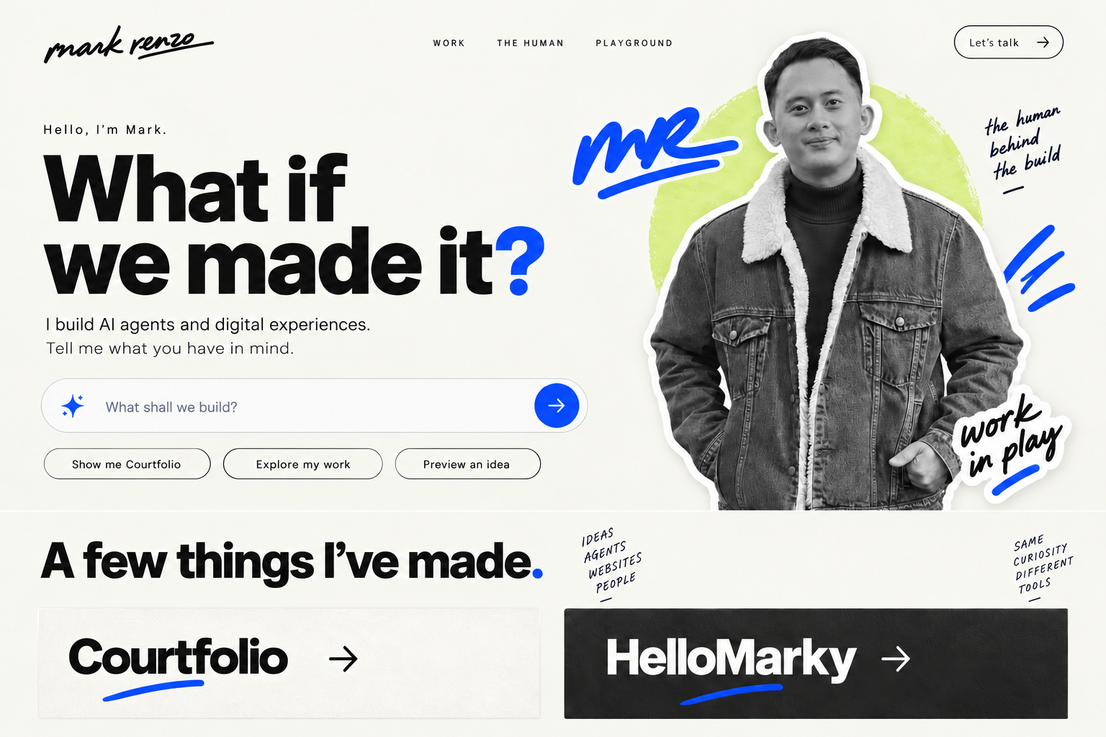
05B A homepage for the hybrid
Website concept
Notes:
05B A homepage for the hybrid. Artwork generated for Mark Renzo’s personal brand exploration from the user brief. Source image: /Users/markrenzo/Documents/ChatGPT/markrenzodotcom/branding/concepts/05b-homepage-preview.png. Generated artwork is raster concept material, not production vector logo artwork. Typography suggestions describe a proposed production type system, not an exact identification of generated lettering. Website views are visual concepts, not an implemented or live site. Hybrid direction combines concept 05’s handwritten signature with concept 01’s palette: cobalt #2453FF, paper #F6F5EF, ink #20211E, citron #DDEF8B. Existing portrait references originate at https://markrenzo.com/ with user authorization.

Slide 4
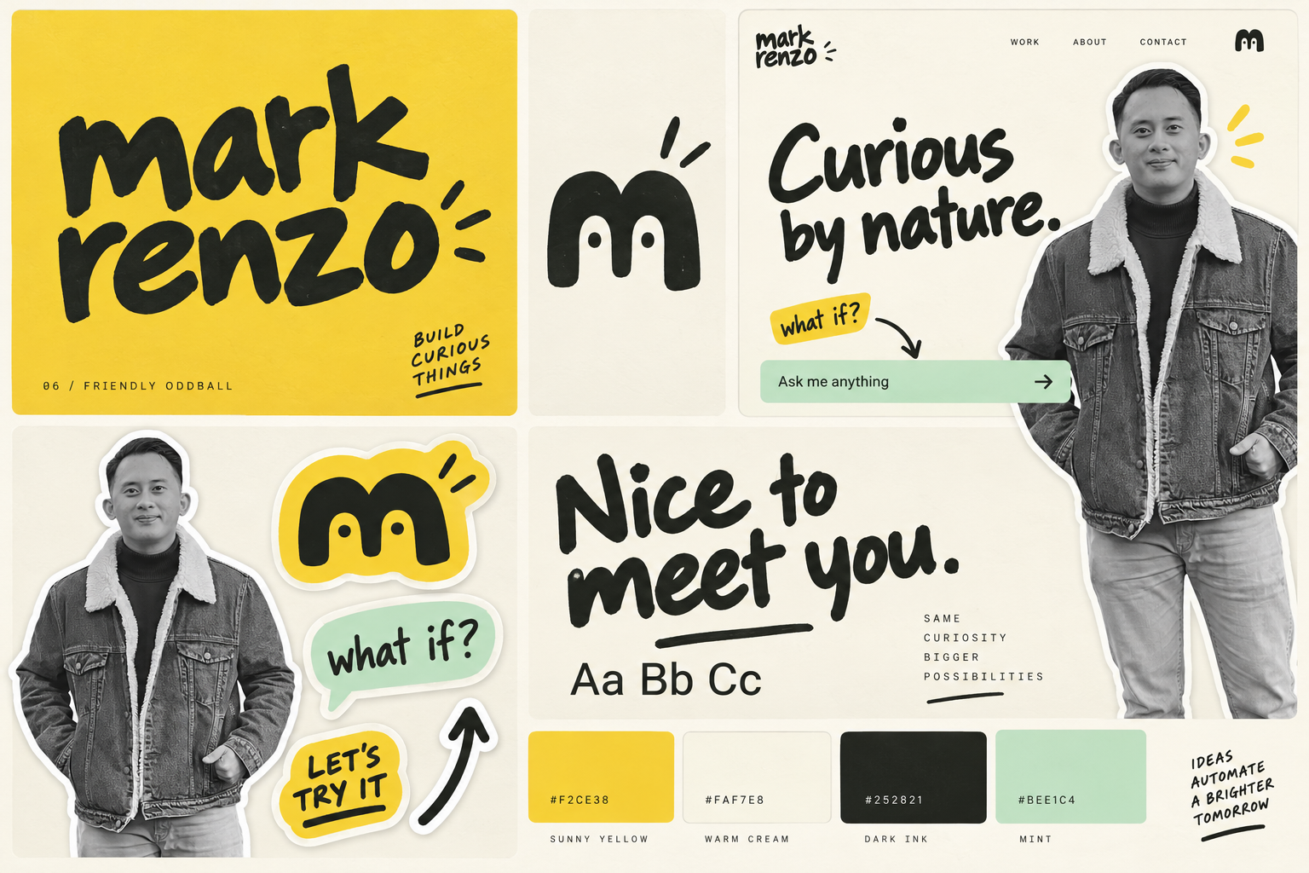
06 Friendly Oddball
Identity concept
Notes:
06 Friendly Oddball. Artwork generated for Mark Renzo’s personal brand exploration from the user brief. Source image: /Users/markrenzo/Documents/ChatGPT/markrenzodotcom/branding/concepts/06-friendly-oddball.png. Generated artwork is raster concept material, not production vector logo artwork. Typography suggestions describe a proposed production type system, not an exact identification of generated lettering. Website views are visual concepts, not an implemented or live site. Existing portrait references originate at https://markrenzo.com/ with user authorization.

Slide 5
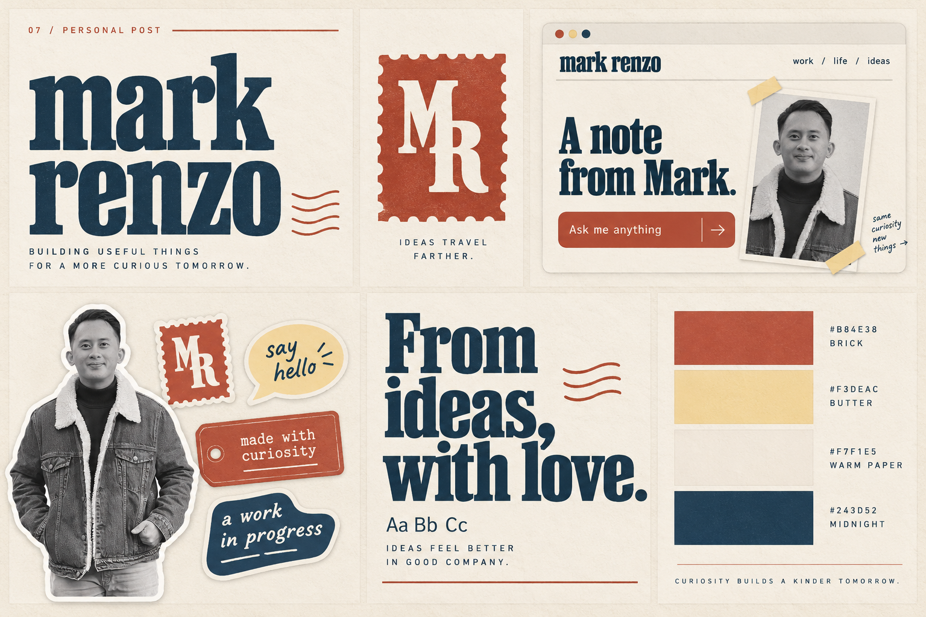
07 Personal Post
Identity concept
Notes:
07 Personal Post. Artwork generated for Mark Renzo’s personal brand exploration from the user brief. Source image: /Users/markrenzo/Documents/ChatGPT/markrenzodotcom/branding/concepts/07-personal-post.png. Generated artwork is raster concept material, not production vector logo artwork. Typography suggestions describe a proposed production type system, not an exact identification of generated lettering. Website views are visual concepts, not an implemented or live site. Existing portrait references originate at https://markrenzo.com/ with user authorization.

Slide 6
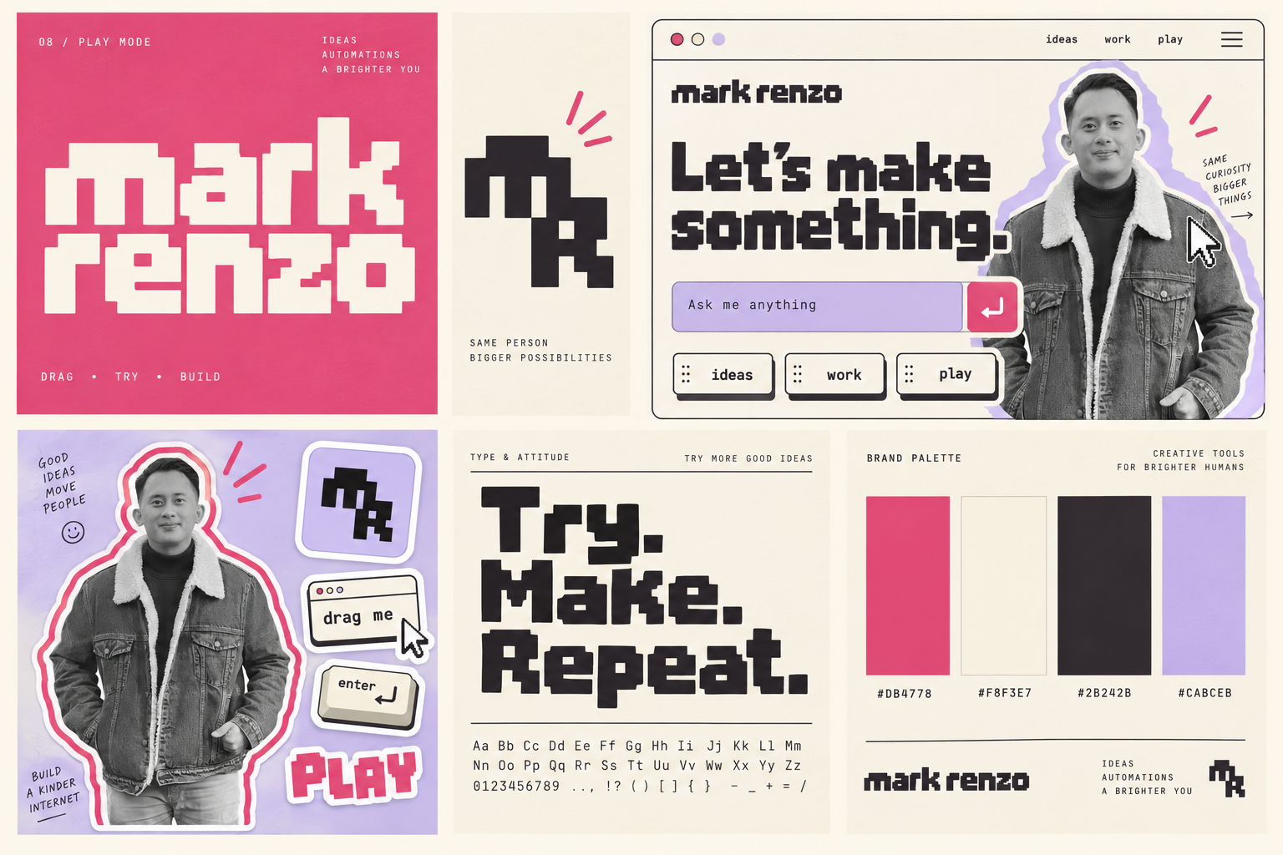
08 Play Mode
Identity concept
Notes:
08 Play Mode. Artwork generated for Mark Renzo’s personal brand exploration from the user brief. Source image: /Users/markrenzo/Documents/ChatGPT/markrenzodotcom/branding/concepts/08-play-mode.png. Generated artwork is raster concept material, not production vector logo artwork. Typography suggestions describe a proposed production type system, not an exact identification of generated lettering. Website views are visual concepts, not an implemented or live site. Existing portrait references originate at https://markrenzo.com/ with user authorization.

Slide 7
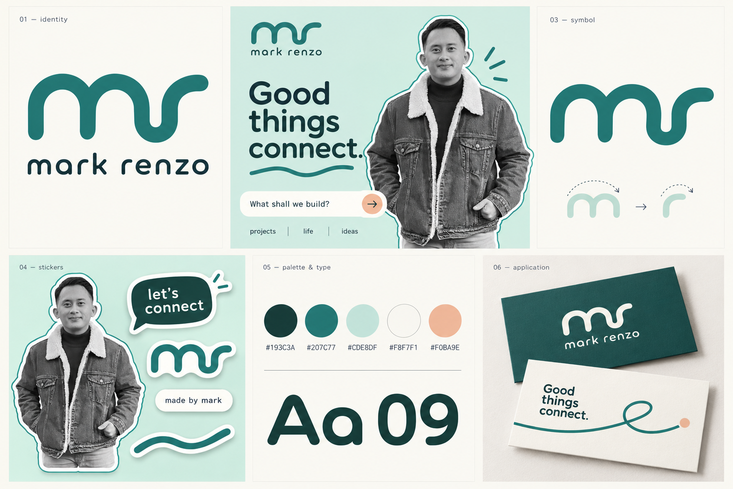
09 Soft Signal
Identity concept
Notes:
09 Soft Signal. Artwork generated for Mark Renzo’s personal brand exploration from the user brief. Source image: /Users/markrenzo/Documents/ChatGPT/markrenzodotcom/branding/concepts/09-soft-signal.png. Generated artwork is raster concept material, not production vector logo artwork. Typography suggestions describe a proposed production type system, not an exact identification of generated lettering. Website views are visual concepts, not an implemented or live site. Existing portrait references originate at https://markrenzo.com/ with user authorization.

Slide 8
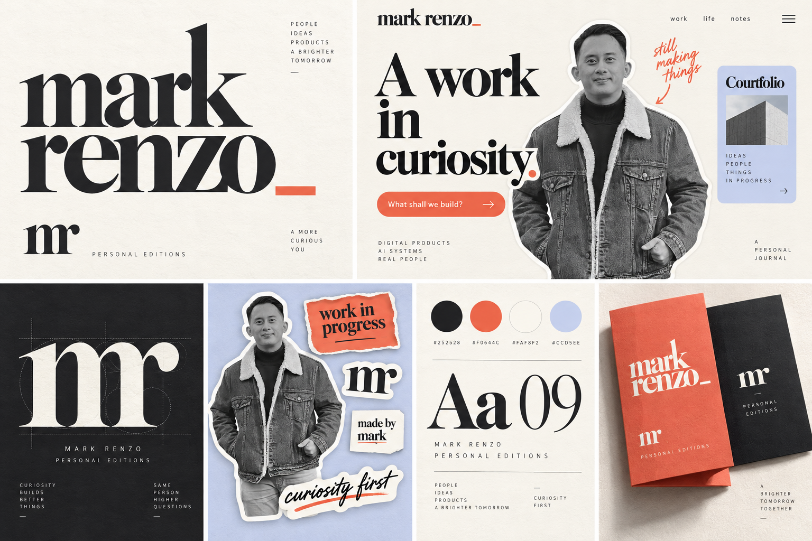
10 Renzo Editions
Identity concept
Notes:
10 Renzo Editions. Artwork generated for Mark Renzo’s personal brand exploration from the user brief. Source image: /Users/markrenzo/Documents/ChatGPT/markrenzodotcom/branding/concepts/10-renzo-editions.png. Generated artwork is raster concept material, not production vector logo artwork. Typography suggestions describe a proposed production type system, not an exact identification of generated lettering. Website views are visual concepts, not an implemented or live site. Existing portrait references originate at https://markrenzo.com/ with user authorization.

Slide 9
Six different ways to feel like you
05B remixes your favourites. 06–10 explore new personalities.
DIRECTION | PERSONALITY | STRONGEST FIT
05B Mark in Motion | Expressive + considered | Your preferred signature logo with Curious Human’s cobalt palette.
06 Friendly Oddball | Playful + sunny | Sticker play and a little character with room for mischievous motion.
07 Personal Post | Personal + well travelled | Life stories and project souvenirs in a personal postal world.
08 Play Mode | Digital + nostalgic | An interactive playground with pixel details and playful prompts.
09 Soft Signal | Calm + approachable | A quieter AI guide with a soft visual rhythm.
10 Renzo Editions | Editorial + expressive | Bold project stories with the character of a publication.
Mark Renzo / Round two
09
Notes:
This comparison is qualitative design judgment based on the user’s request and the artwork concepts. 05B is an explicit remix of concepts 05 and 01. Friendly Oddball uses a sunny marker style and a small m character. Personal Post uses a postal/slab direction. Play Mode uses a pixel monogram and raspberry tone. Soft Signal uses teal and monoline forms. Renzo Editions uses a high-contrast serif and coral. These are conceptual personalities rather than claims of measured performance.

Slide 10
My recommendation
05B
Your signature,
in Curious Human colours.
The clearest interpretation of your latest preference: the personal
energy of 05 with the cream, ink and cobalt world of 01.
06 for more play. 09 for calm. 10 for an editorial voice.
Which one feels most like you now?
Notes:
Recommendation reflects the user’s explicit request to see concept 05 in concept 01’s palette. It is a design judgment, not a final selection by the user. Suggested alternatives: 06 Friendly Oddball for stronger playful character, 09 Soft Signal for calm, 10 Renzo Editions for editorial expression. Final logo vector construction, proposed typeface confirmation, motion design and site implementation follow direction selection.

